Slide 1







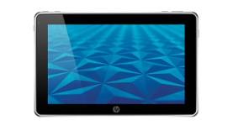







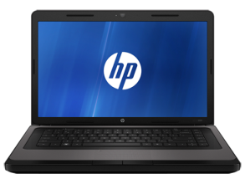

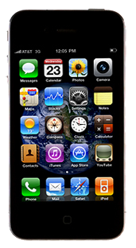
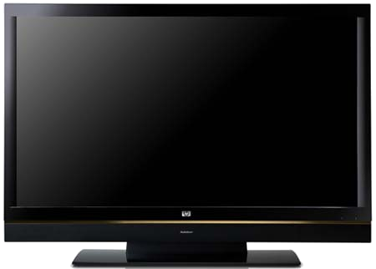

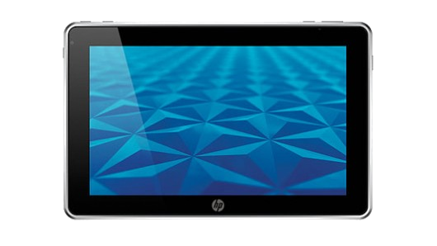
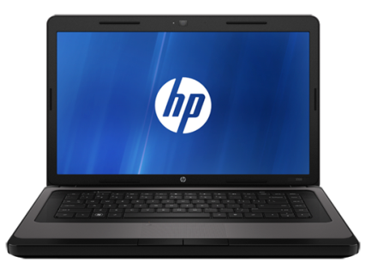

HP Better Together
Poster Session ‘12
Better Together
street
street
street
HOME
Office
Identified Opportunity
Existing devices integration
Users use diverse set of devices during the course of their day. While each device works well independent of each other, they do not work well together. Opportunity for HP to fill the commercial gap with an integrated solution, creating a Halo effect with the Better Together product.
Can interact to DLNA devices without needing software installation.
Local network
Project Vision
Simplify content access from anywhere;
Diversity of use: share content, contacts and objects;
Multi-platform;
Extensibility – users may use the framework to develop their own solutions;
Provide a platform of software and services to integrate devices and their contents;
Allow the user to access their content in an agnostic way of device or location;
It also allows people to communicate via voice and video using their devices over the Internet.
Critical Success Factors
Pairing
Devices knowing each other according ownership
Presence/Location
Devices quickly finding each other
Synchronization
Content propagation among devices according owner configuration
Media Streaming (P2P)
Voice & Video Chat
Current Results
User can register her devices on HP @Cloud with secure authorization
Devices knowing all other user’s devices
New photos propagation can be automatic or by user selection
Documents can also be propagated to other devices and stored @Cloud
User can print documents and photos via ePrint PPL or local attached printer
A non-call device can ask a call capable device to dial a phone number
A video (or any) URL can be sent to another larger screen device to improve the user experience
Key Technologies
 | LOCAL | REMOTE (over SSL)
Pairing | OAuth, DevID, ... | OAuth, DevID,...
Presence/Location | SSDP, mDNS, ... | BTCloud polling, Push Notifications, ...
Synchronization | Sockets, UPnP/DLNA, BTCloud, ... | BTCloud sync, Push Notifications, ...
Media Streaming | UPnP/DLNA | WebRTC, libjingle, ...
About the program
Sponsors
Carlos Montalvo, PCBU VP
Soma Santhiveeran, PCBU Program Manager/Sponsor/Technical Contact
Research and Development Team
Leonardo Pilatti, Portfolio Manager
Ricardo Moreira, Project Manager
Roque Scheer, Technical Arquitect
10 developers
No testers

