Slide 1
SQL for Data Analysis
Mauricio Montero Marin

Slide 2
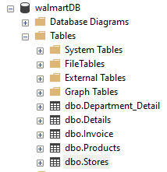
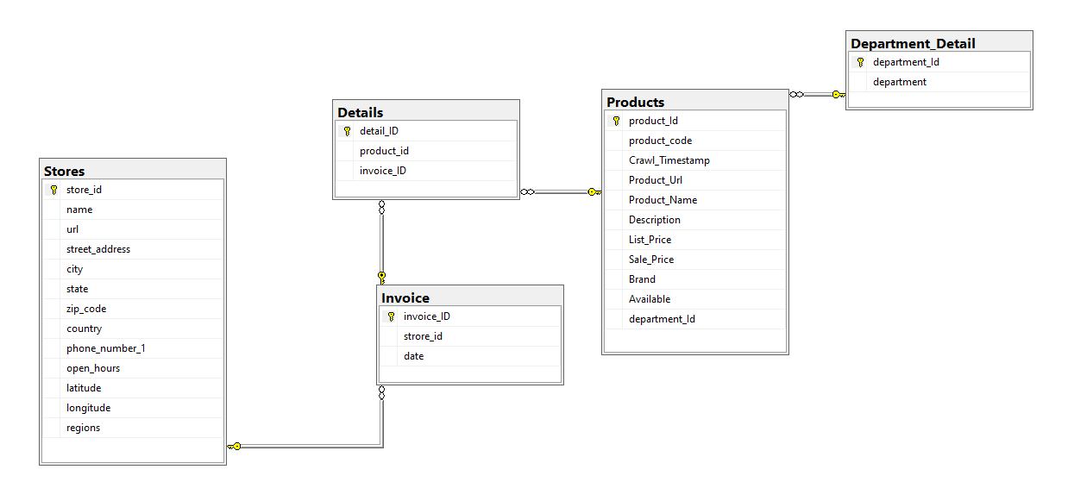
WALMART db

Slide 3
Practice #1: Part 1
Run a query query that extracts the information from the first 20 rows, from each of the loaded bases, take a screenshot of each result and its respective query and save it as you will need it as evidence to validate the course deliverables.

Slide 4
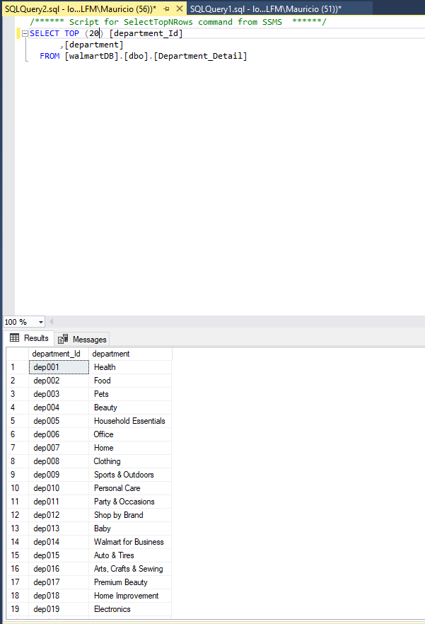

Slide 5
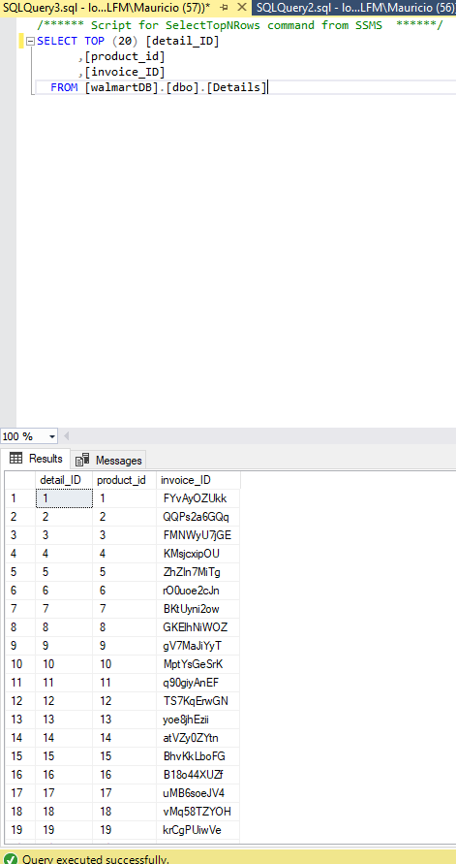

Slide 6
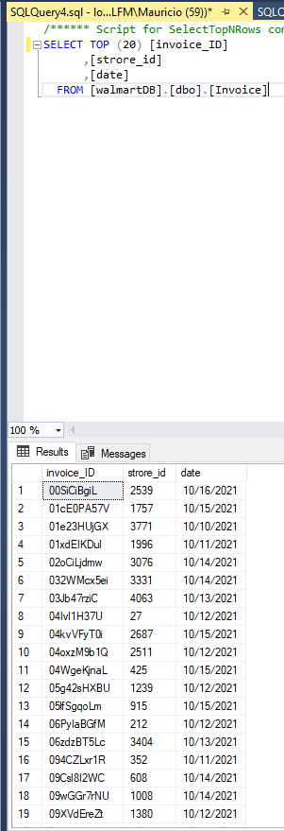

Slide 7
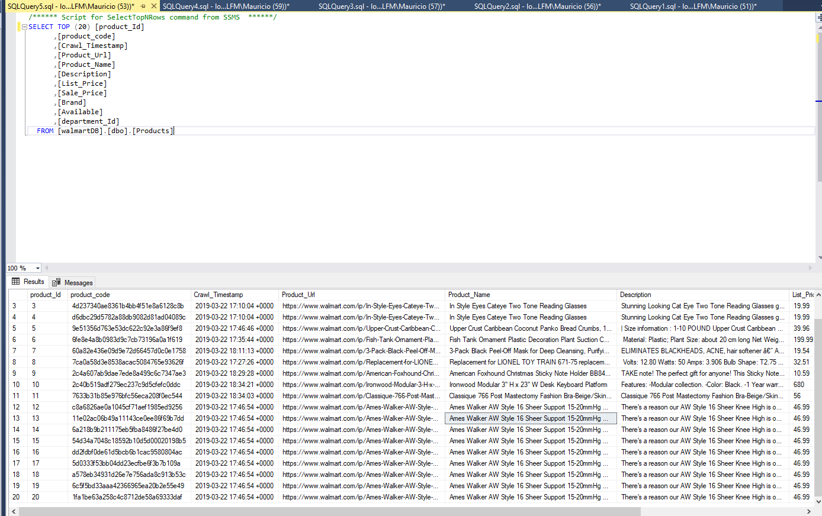

Slide 8
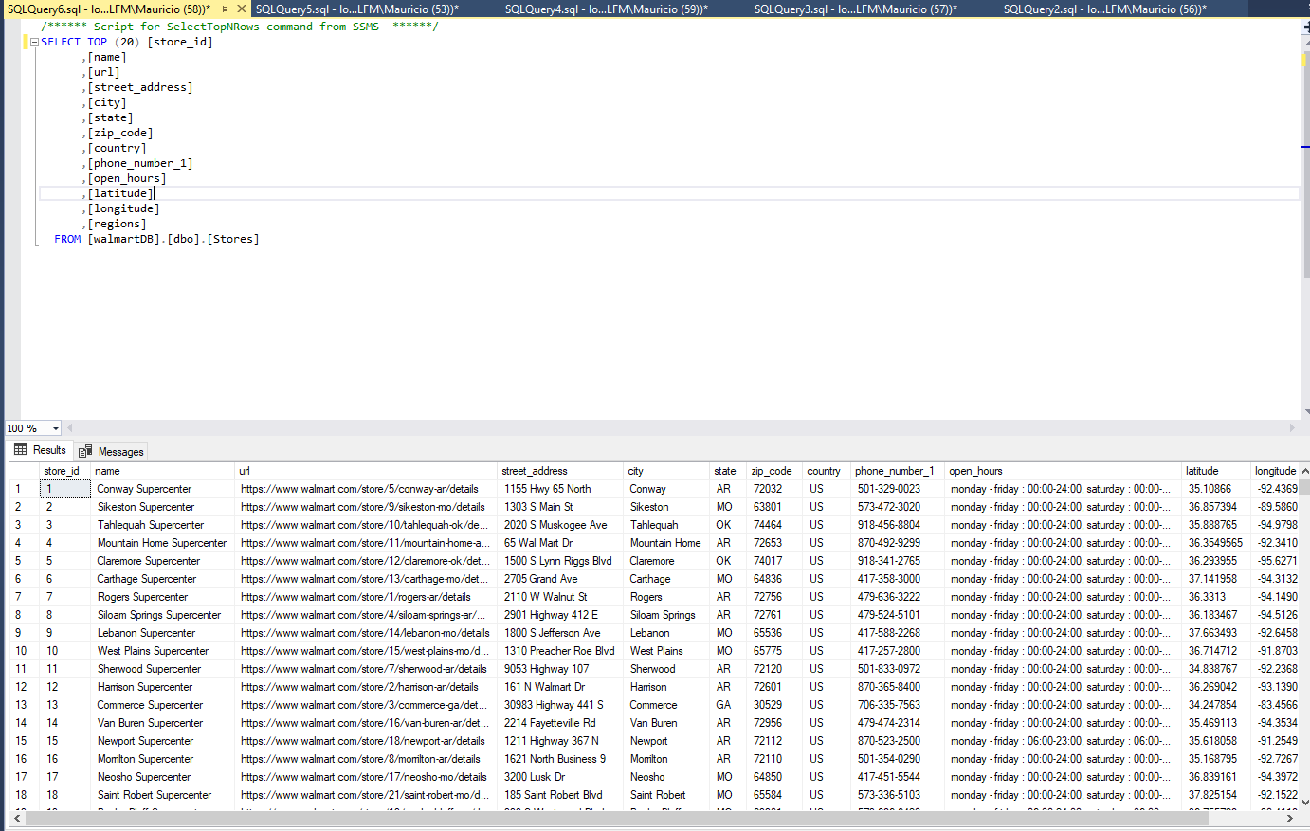

Slide 9
Practice #1: Part 2
For any Data Analysis you will always have to perform an exploration with the information you are working on, so make your first querys.Selecciona de la Tabla Date las primeras 100 Filas.
Make a Distinctive query of the Year column and sort from most recent to oldest year. This will allow us to understand the scope of our Database.Extrae los fines de semana (sábado y domingo) en tu base de datos, del año 2018.
Make a query that brings the grouped months and order them from January to December
From the Electoral Roll Table, search for people who have the initial of the first name equal to the initial of your own name and that their first surname is also equal to your own first surname. For example, if your name is Esteban Madrigal, the query should bring all people with the surname Madrigal and that their name begins with "E".

Slide 10
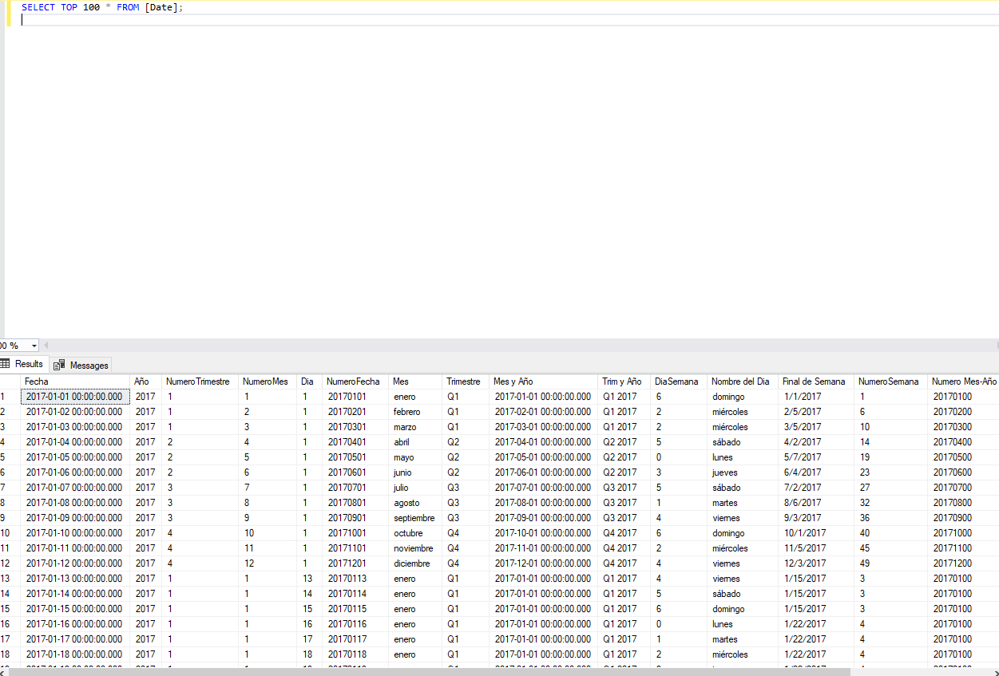

Slide 11
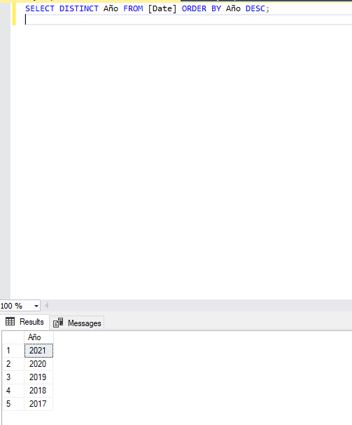

Slide 12
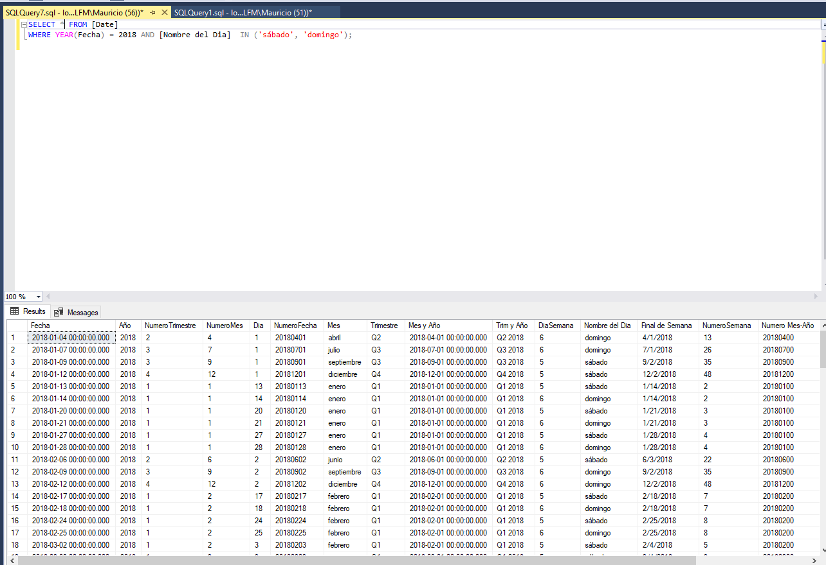

Slide 13
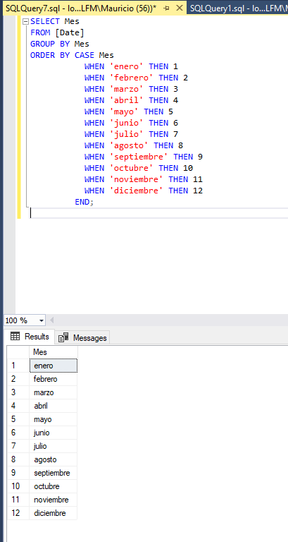

Slide 14
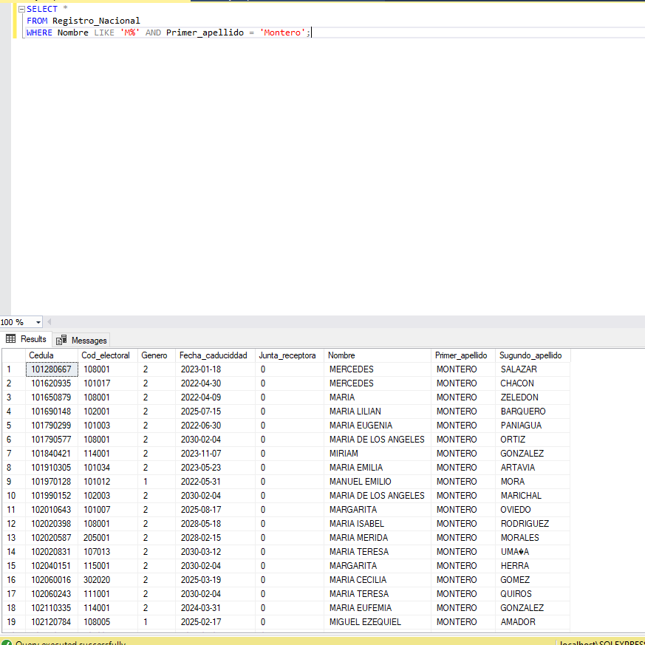

Slide 15
PrActicE #2
In this second practice you will use logic in the language of databases, and thus be able to extract our information ready to be analyzed. Perform the following querys:Para ello es importante empezar a explorar nuestros datos y verifique las tablas que te permita extraer la información.
Make a query where you extract the 16 different colors that exist.Extrae la Venta por Color y agrupa su resultado obteniendo únicamente los primeros 10 ID del color, asimismo confecciona una columna condicional nueva con los diferentes colores (en español). Para ello puedes tomar de referencia los nombres en inglés del resultado de la consulta anterior y ordena sus datos por ID de Color.
Extract the Sale by Name of the Day (Saturday, Sunday, Monday, ect) for the Asia and Europe Region, for the year 2018 and create a conditional column: if it is Saturday or Sunday indicating Weekend, otherwise Work Week.Realiza una consulta que extraiga la venta por Mes y Año. Sin embargo, el mes debe de traer únicamente las primeras 3 iniciales del mes en formato mayúscula para ello utilice las funciones de texto.
Make a query that contains in the Select statement:
Month name
Channel name
Store type
Continent name
Monetary sale iin units
Sort it from Highest to Lowest according to units
This information will only be for the year 2018 and 2019 and from Monday to Friday

Slide 16
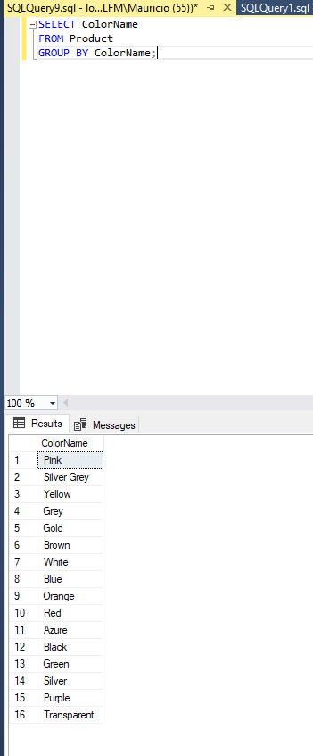

Slide 17
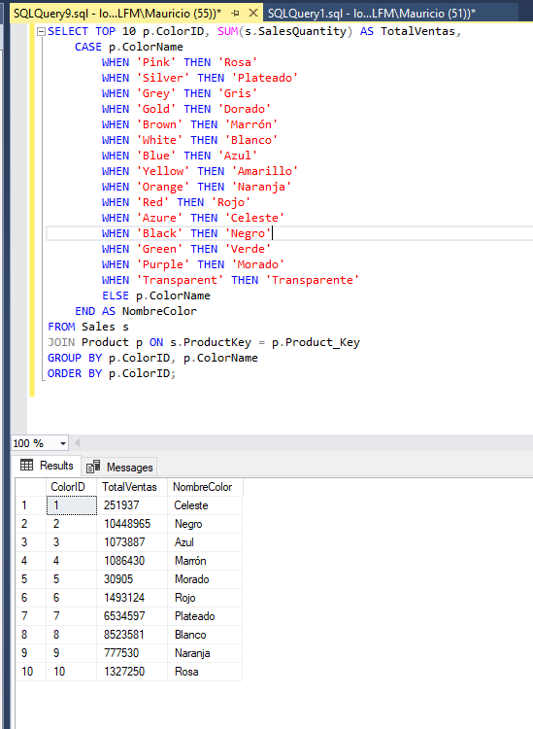

Slide 18
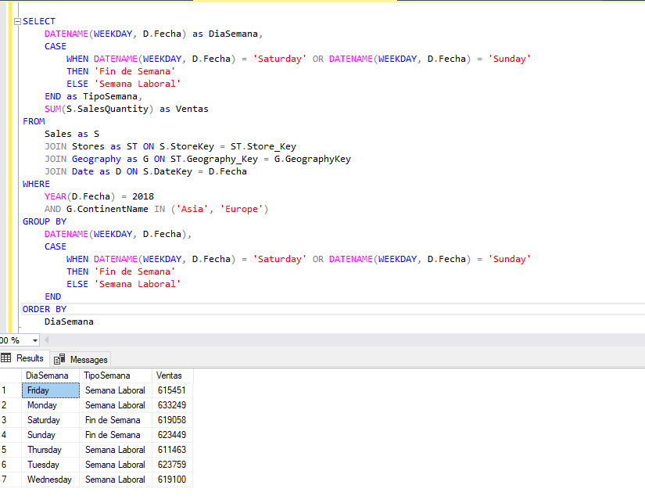

Slide 19
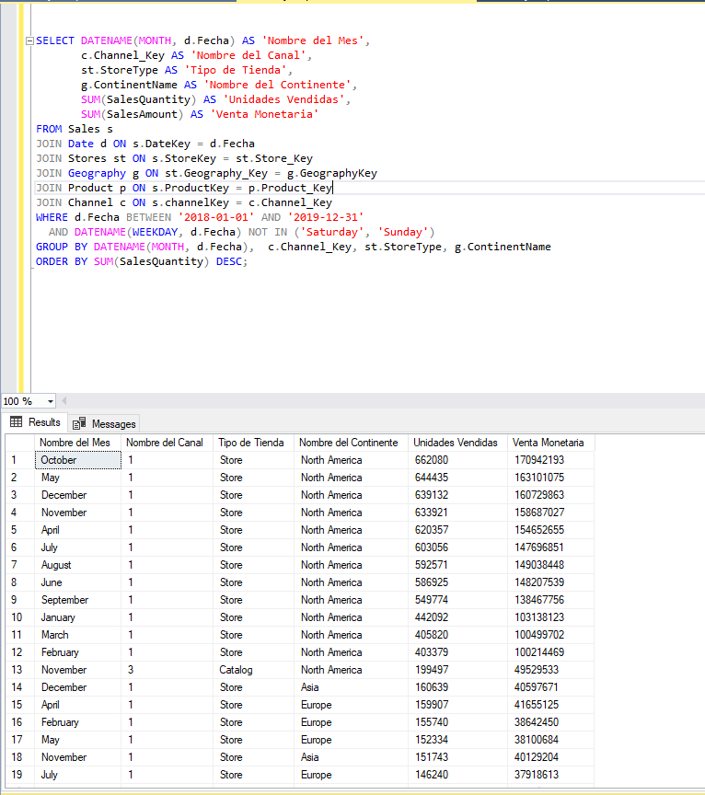

Slide 20
Final Project Instructions
SQL final project
For this project you will need to have uploaded the data tables that were requested in practice #1. In this project you will need to develop two Querys that extract important information to perform your analysis.

Slide 21
First Query:
This query must contain in its structure:
Text Functions (at least 2)
At least one Join Date Functions (at least 2)
Basic Math Operations (at least 1)
Command Where, Group By, Order By
Click to explore data→

Slide 22
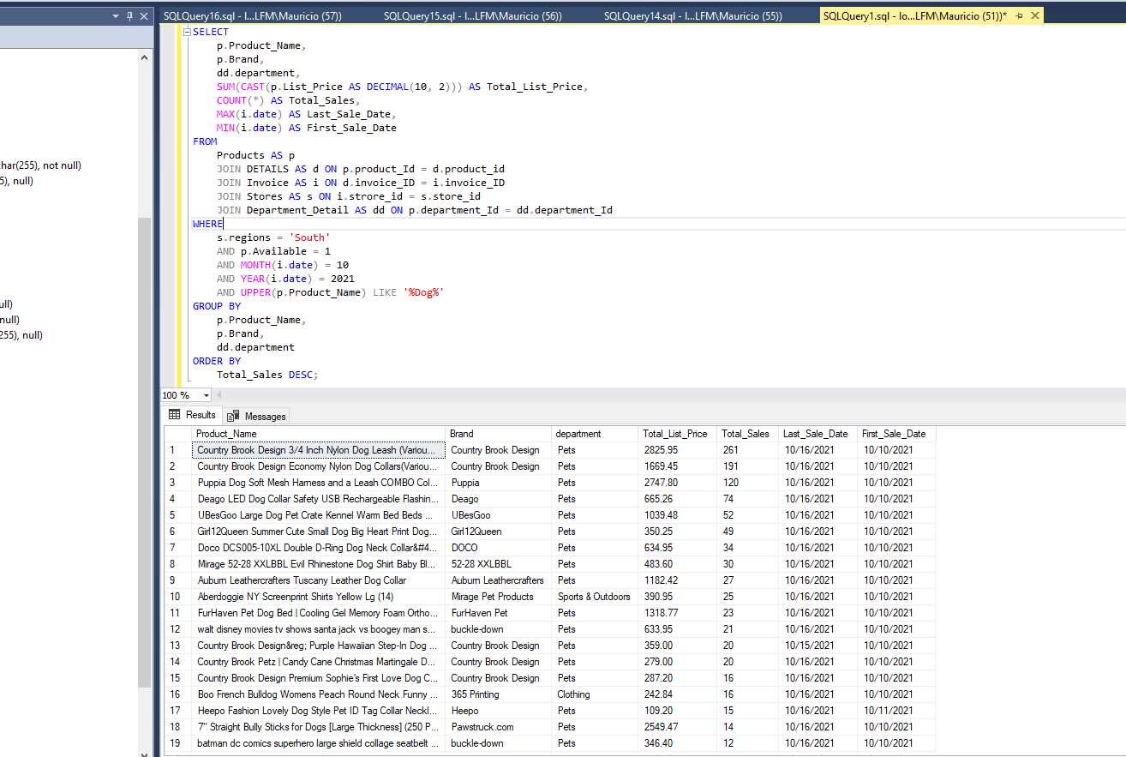

Slide 23
Second Query:
This query must contain in its structure:
Aggregation Functions (at least 2)
At least one Join Logical Functions (at least 1)
Commando Where (Logical Operations), Group By, Order By, Having
Select Nested (at least 1)
Click to explore data→

Slide 24
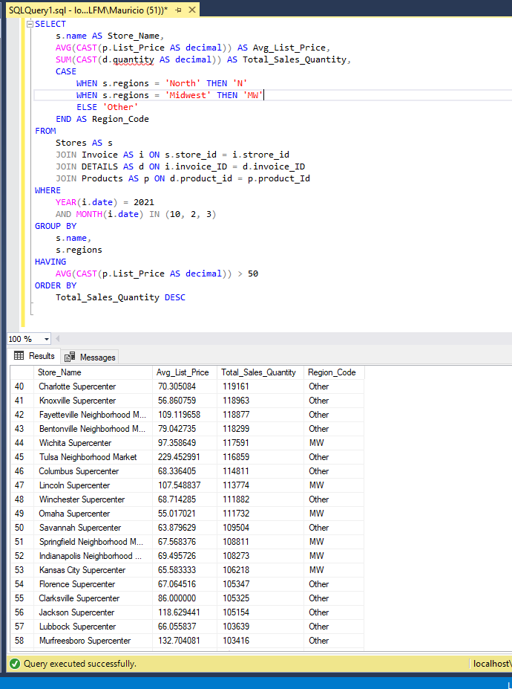

Slide 25
CONCLUsions
San Antonio Super Center is the store with the highest sales volume.
Shreveport Supercenter is the store with less sales
In the month of October the dog item that sold the most in the southern region was Country Brook Design 3/4 Inch Nylon Dog Leash (Various Colors & Lengths)
In the month of October the articles for dog with less rotation in the southern region were:
Rat Terrier Makes Me Happy *I590* 6 inch Sticker dog decal
mirage 614-02 bk-18 two row ab crystal black ice cream dog collar - size 18
Mirage 625-SV LV12 Crystal and Silver Spikes Dog Collar Lavender - Size 12
POLKA DOT-PURPLE-MULTI2-L 4 ft. Dot Dog Leash&#44; Purple & Multi - Small
PetAlive Energy Tonic - All Natural Herbal Supplement Promotes Energy and Vitality in Cats and Dogs Including Older Pets - 60 Veggie Caps

