Slide 1
Exploring Polymorphism and Metamorphism through a Python Virus
Mauricio Ambrosio
ECE 56401: Computer Security

Slide 2
Definitions
Antiviruses keep vast databases of virus signatures (code patterns) which are useful to detect them
Polymorphism and metamorphism are 2 different techniques that make viruses harder to detect
Polymorphic viruses infect files with different versions of themselves while metamorphic viruses change their own code upon each execution
This avoids common code patterns across virus and infected files

Slide 3
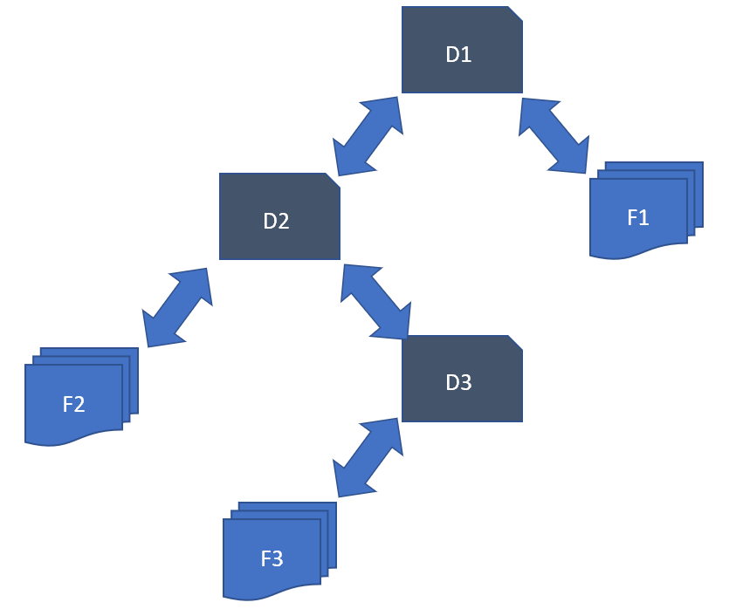
Finding Files to Infect
Breath First Search with virus directory as root
Include parent directory (i.e., “..”) to queue at end of each iteration
collect python files (i.e., .py and .pyw) from visited directories
Ex: If F2 is infected, D2 will be the root directory
D3 and D1 are visited in this order
D1 is visited last because it is the original parent of the root directory
Both F3 and F1 are marked to be infected

Slide 4
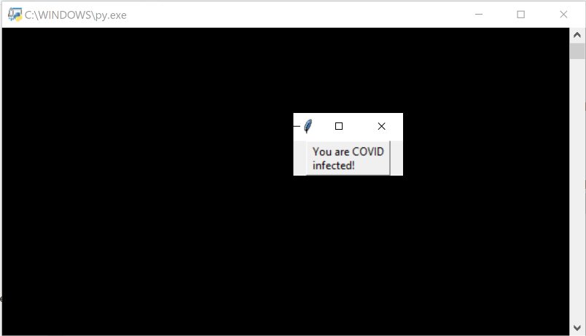
Payload
Payload shows a simple message before running original infected script code.
Python is high-level language, harder to control/damage system
Focus on polymorphism and metamorphism

Slide 5
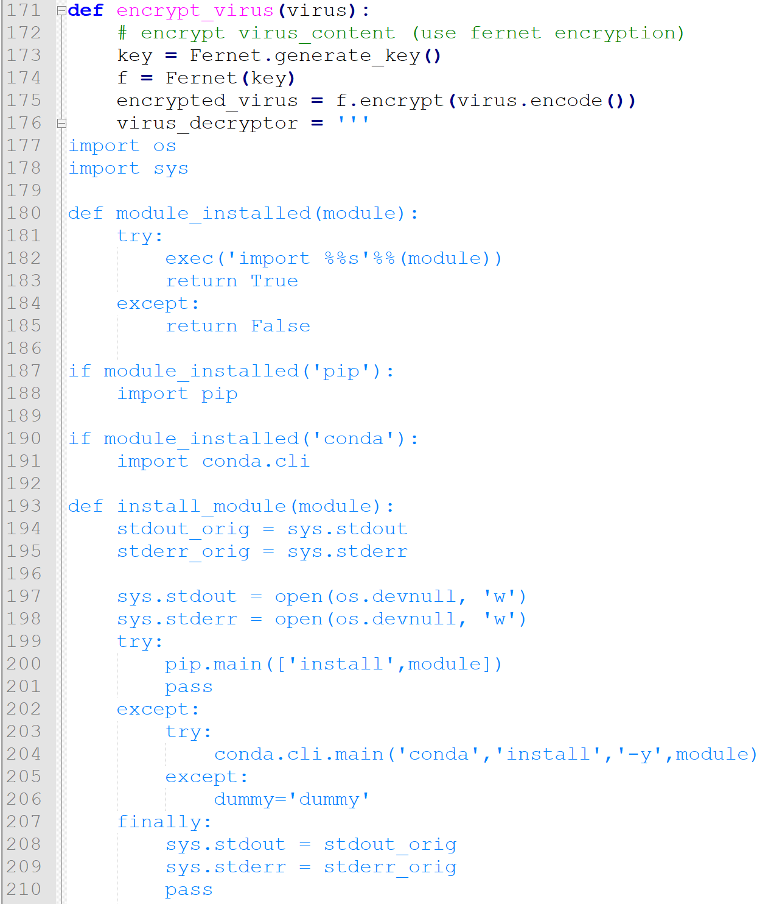
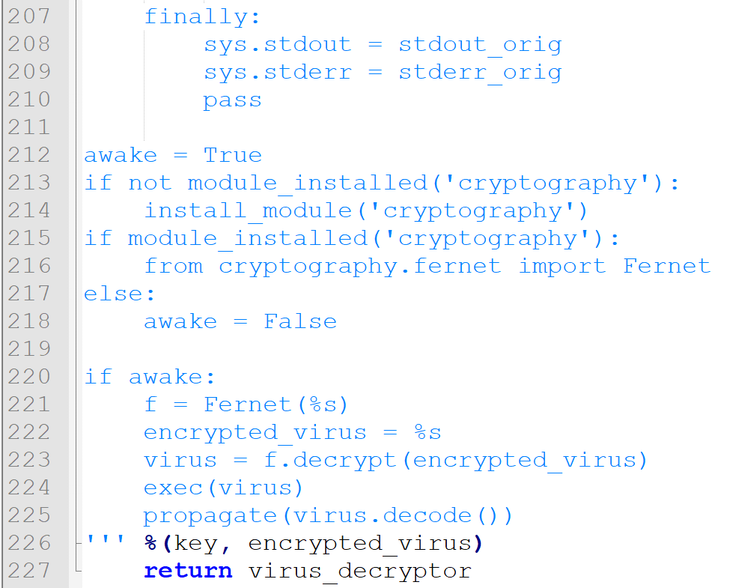
Polymorphism
Polymorphic viruses, infect other files with a differently encrypted version of the virus for each file
This results in different infected files having different encrypted virus codes
Read virus content within marker
Encrypt it (fernet) and prepend cypher text to files along with decryption code
Infected files will first run virus code (payload & infect other files)

Slide 6
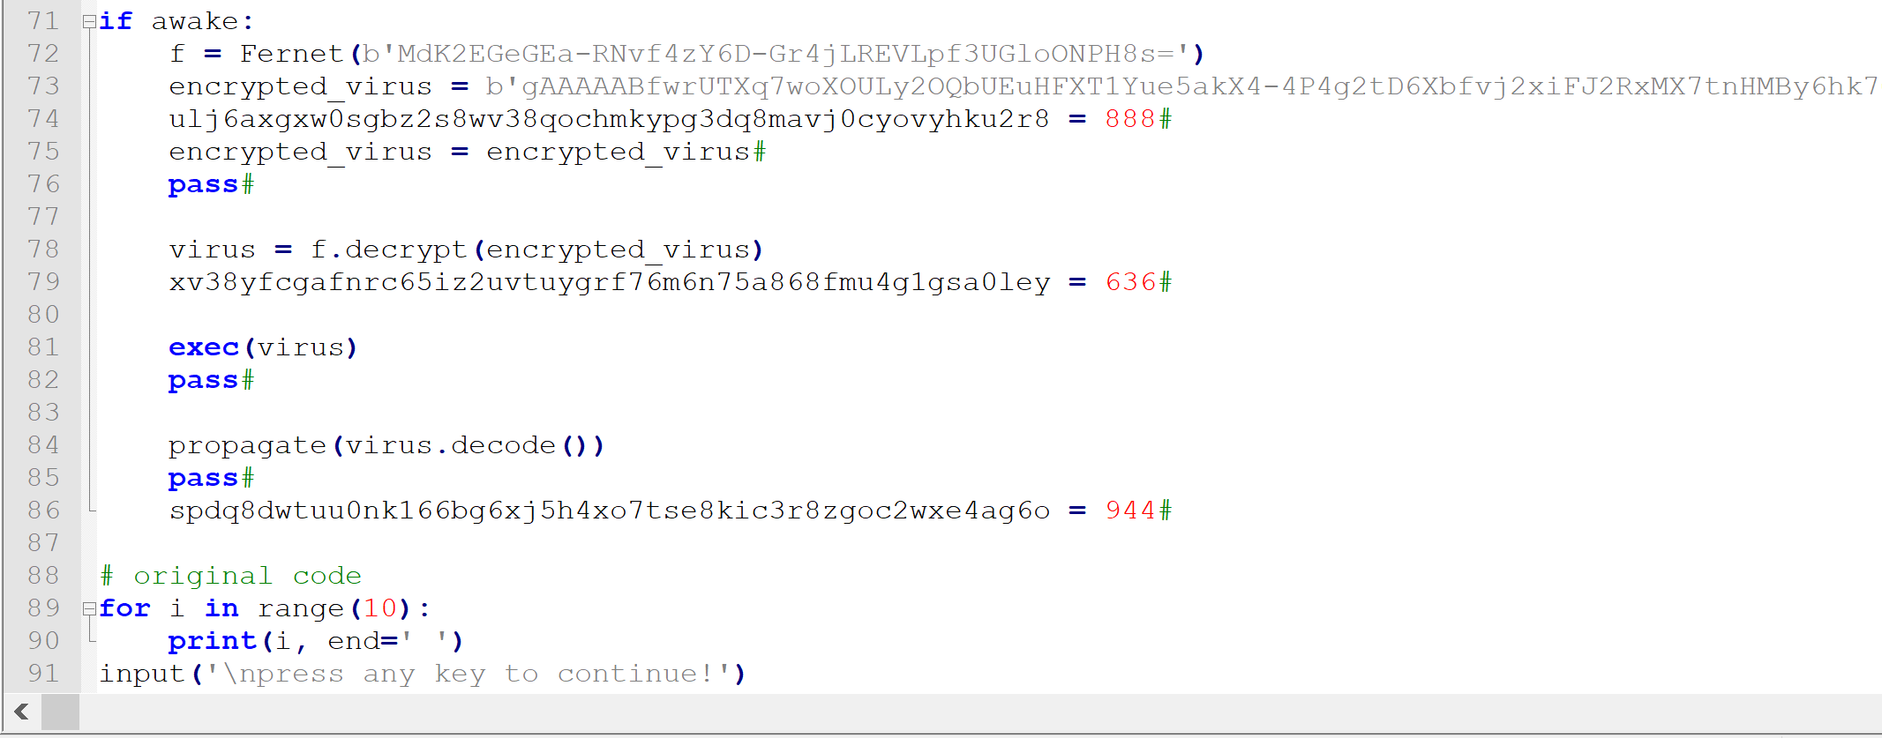
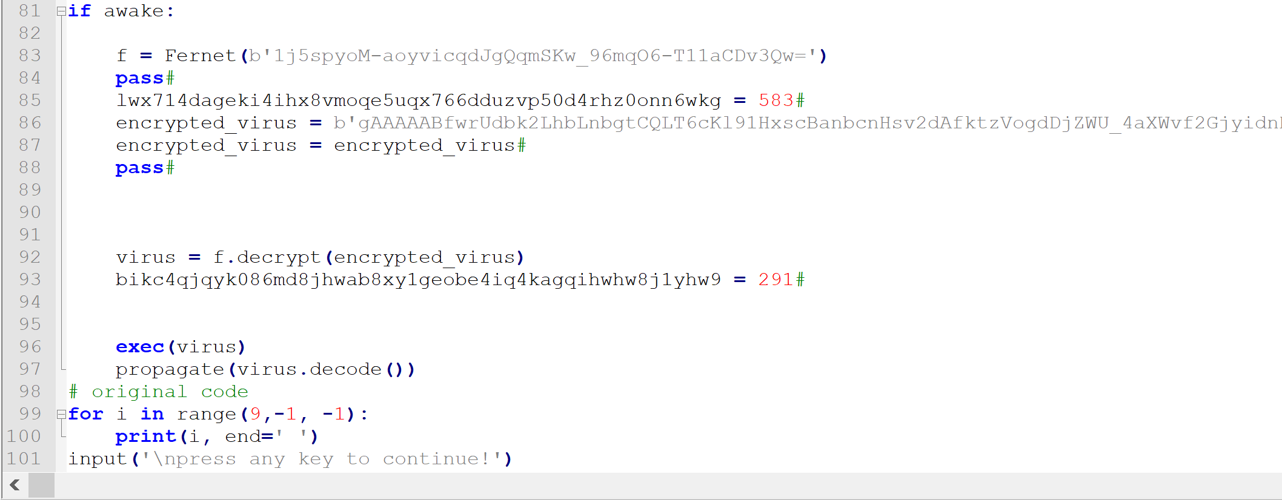
Different virus encryptions
To indicate file already infected:
Prepend hash of file name (md5)
Original virus prepended with #covidpatientzero

Slide 7
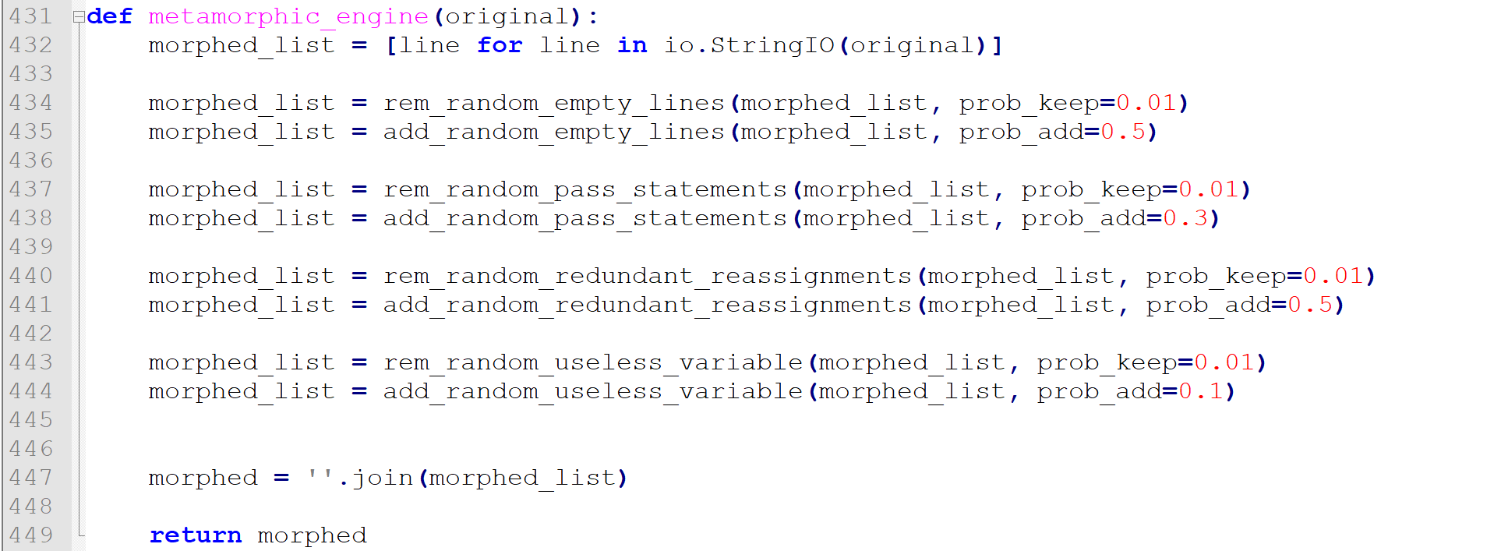
Metamorphism
Metamorphic viruses change their code while maintaining code semantic
New files are infected with mutated versions
4 techniques are used in this project
Other techniques (more advanced):
Reordering code and using jump instructions to maintain flow
Inserting control statements that are always true/false:
Ex: if(2<3):

Slide 8
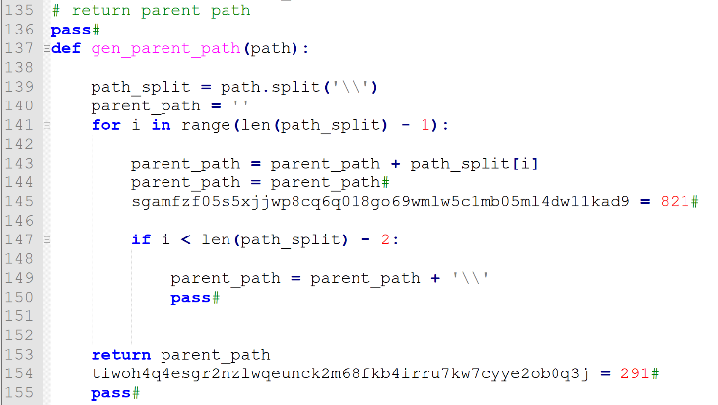
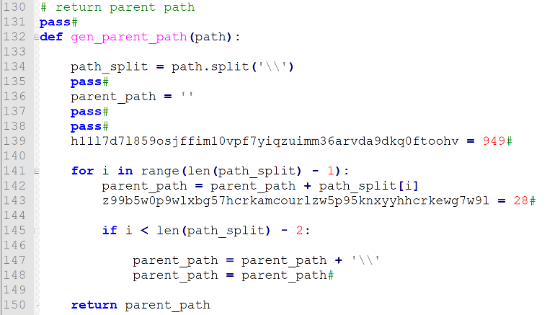
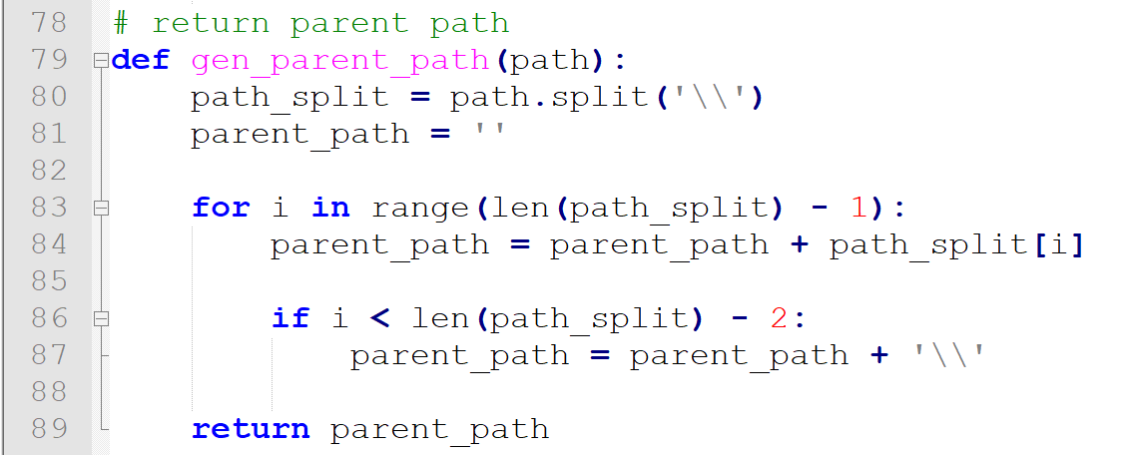
Metamorphism

Slide 9
Demonstration / Questions?

Slide 10
References
1. P. Beaucamps, “Advanced Metamorphic Techniques in Computer Viruses,” citeseerx.ist.psu.edu, Nov. 2008.
2. V. Nguyen, “A study of polymorphic virus detection,” ResearchGate, Nov. 2018.
3. A. Sharma and S. K. Sahay, “Evolution and Detection of Polymorphic and Metamorphic Malwares: A Survey,” International Journal of Computer Applications, vol. 90, no. 2, pp. 7–11, Mar. 2014.
4. L. Wang, D. Xu, J. Ming, Y. Fu, and D. Wu, “MetaHunt: Towards Taming Malware Mutation via Studying the Evolution of Metamorphic Virus,” Proceedings of the 3rd ACM Workshop on Software Protection - SPRO'19, 2019.

