Slide 1

What Do the Asserts in a Unit Test Tell us About Code Quality?
IME-USP
Mauricio Aniche
Gustavo Oliva
Marco Gerosa University of São Paulo (USP)

Slide 2
Unit Tests and Code Quality
Great synergy between a testable class and a well-designed class (Feathers, 2012)
The write of unit tests can become complex as the interactions between software components grow out of control (McGregor, 2001)
Agile practitioners state that unit tests are a way to validate and improve class design (Beck et al, 2001)

Slide 3
Unit Tests and Asserts
Every unit test contains three parts
Set up the scenario
Invoke the behavior under test
Validates the expected output
Assert instructions
assertEquals (expected, calculated);
assertTrue(), assertFalse(), and so on
No limits for the number of asserts per test

Slide 4
A little piece of code
class InvoiceTest {
@Test
public void shouldCalculateTaxes() { // (i) setting up the scenario Invoice inv = new Invoice(5000.0);
// (ii) invoking the behavior
double tax = inv.calculateTaxes();
// (iii) validating the output assertEquals (5000 ∗ 0.06 , tax );
}
}

Slide 5
Why would…
… a test contain more than one assert?
Is it a smell of bad code/design?

Slide 6
Research Design
We selected 22 projects
19 from ASF
3 from a Brazilian consultancy
Data extraction from all projects
Code metrics
Statistical Test
Qualitative Analysis

Slide 7
Hypotheses
H1: Code tested by only one assert does not present lower cyclomatic complexity than code tested by more than one assert
H2: Code tested by only one assert does not present fewer lines of code than code tested by more than one assert
H3: Code tested by only one assert does not present lower quantity of method invocations than code tested by more than one assert

Slide 8
Data Extraction
Test code
Number of asserts per test
Production method being tested
Production code
Cyclomatic Complexity (McCabe, 1976)
Number of method invocations (Li and Henry, 1993)
Lines of Code

Slide 9
Heuristic to Extract the Production Method
class InvoiceTest {
@Test
public void shouldCalculateTaxes() { // (i) setting up the scenario Invoice inv = new Invoice(5000.0);
// (ii) invoking the behavior
double tax = inv.calculateTaxes();
// (iii) validating the output assertEquals (5000 ∗ 0.06 , tax );
} }
class Invoice {
public double calculateTaxes()
{
// something…
}
}

Slide 10
Selected Projects
Pre-selected all 213 projects from Apache
Eliminated those because of:
Minimum test ratio (unit tests / production methods >= 0.2)
Success in production method detection algorithm (higher than 50% in all unit tests that contain more than 1 assert)

Slide 11
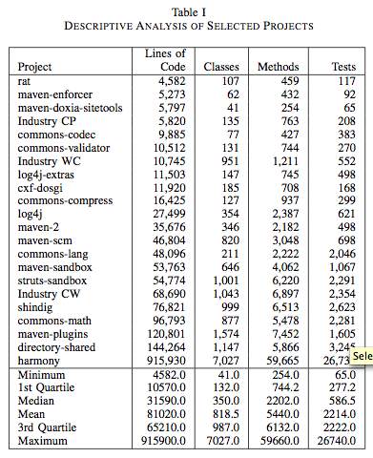
Selected Projects

Slide 12
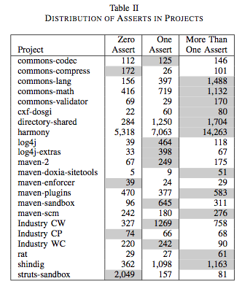
Asserts Distribution in Selected Projects

Slide 13
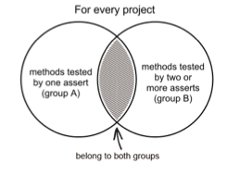
Statistical Test
Separation in two different groups
The same method can appear in both groups
No duplicates
Wilcoxon Signed-Rank Test
Notes:
É importante dizer o porquê da escolha desse teste estatístico

Slide 14
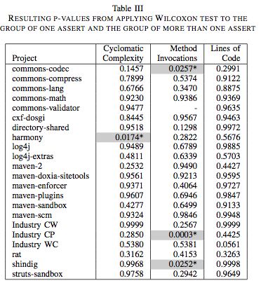
Results of the Test

Slide 15
Why more than 1 assert?
130 tests randomly selected
Qualitative analysis:
More than one assert for the same object (40.4%)
Different inputs to the same method (38.9%)
List/Array (9.9%)
Others (6.8%)
Extra assert to check if object is not null (3.8%)

Slide 16
“Asserted Objects”
We coined the term “asserted objects”
It counts not the number of asserts in a unit test, but the number of different instances of objects that are being asserted
assertEquals(10, obj.getA());
assertEquals(20, obj.getB());
Counts as 1 “asserted object”

Slide 17
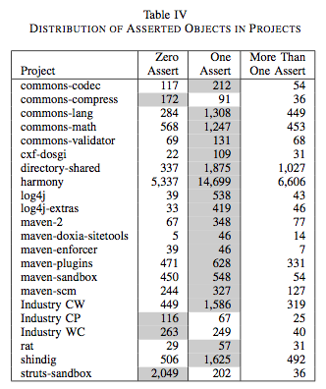
Distribution of Asserted Objects

Slide 18
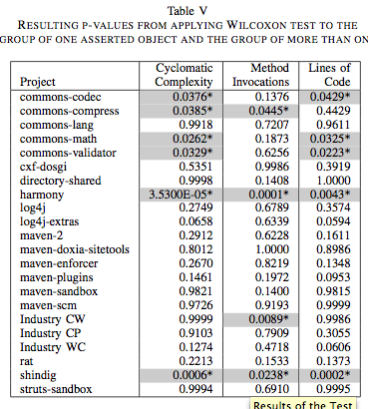
Results of the Test

Slide 19
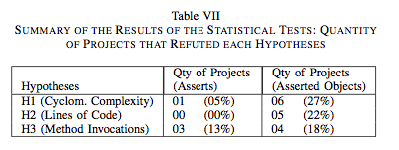
Summary of the Tests

Slide 20
Findings
Counting the number of asserts in a unit test does not give valuable feedback about code quality
But counting the number of asserted objects may provide useful information
However, the difference between both groups was not “big”
A possible explanation:
Methods that contain higher CC, lines of code, and method invocations contains many different paths, and developers prefer to write all of it in a single unit test, rather than splitting in many of them

Slide 21
Threats to Validity
Many unit tests variations that are not supported by our tool
The production method detection algorithm
Before/After methods
The projects’ filtering process
Integration and system tests

Slide 22
Related Work
Most similar to our work: Bruntink and van Deursen (2006).
Significant correlation between class metrics (fan out, size of a class, response for a class) and test metrics (size of the class, number of asserts).

Slide 23
Conclusions
The number of asserts does not tell us anything about the production code quality
But the number of asserted objects does.
“More than one asserted object per test” smell
The need of replicating the study with a larger amount of industry projects

Slide 24
Contact Information
Mauricio Aniche aniche@ime.usp.br / @mauricioaniche
Gustavo Oliva goliva@ime.usp.br / @golivax
Marco Gerosa gerosa@ime.usp.br
Software Engineering & Collaborative Systems Research Lab (LAPESSC) http://lapessc.ime.usp.br/

