Slide 1
BCI433
IBMi Business Computing

Slide 2
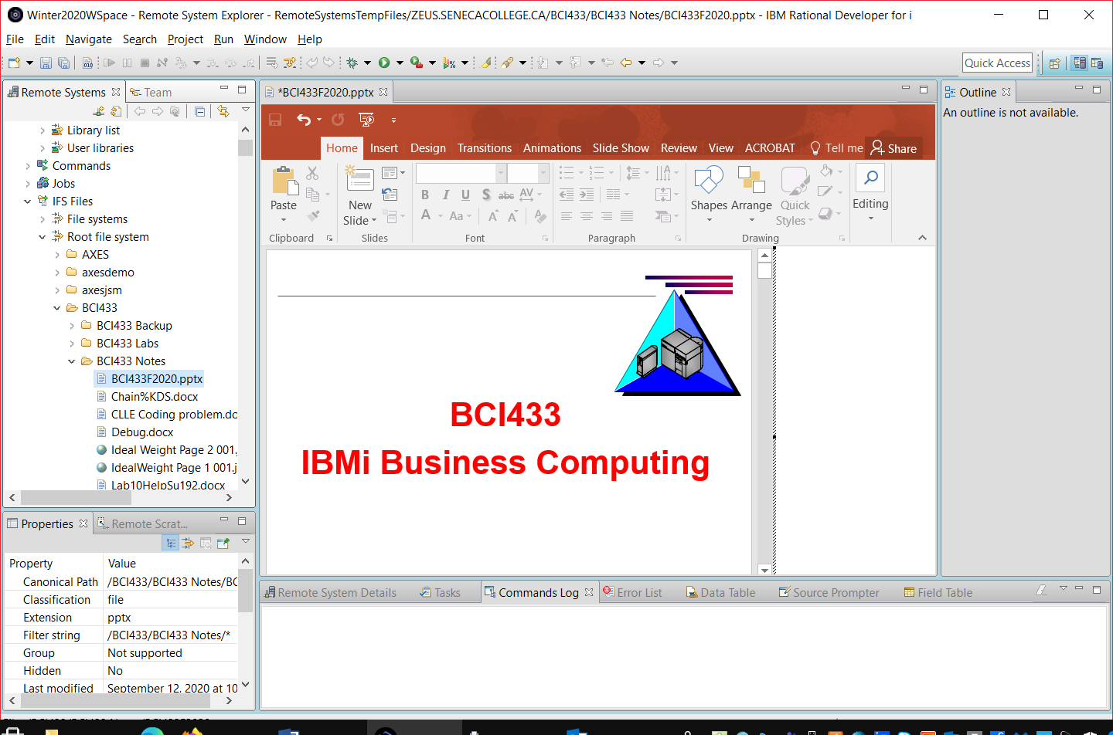
Accessing This Powerpoint Presentation in the IFS Using RDi

Slide 3
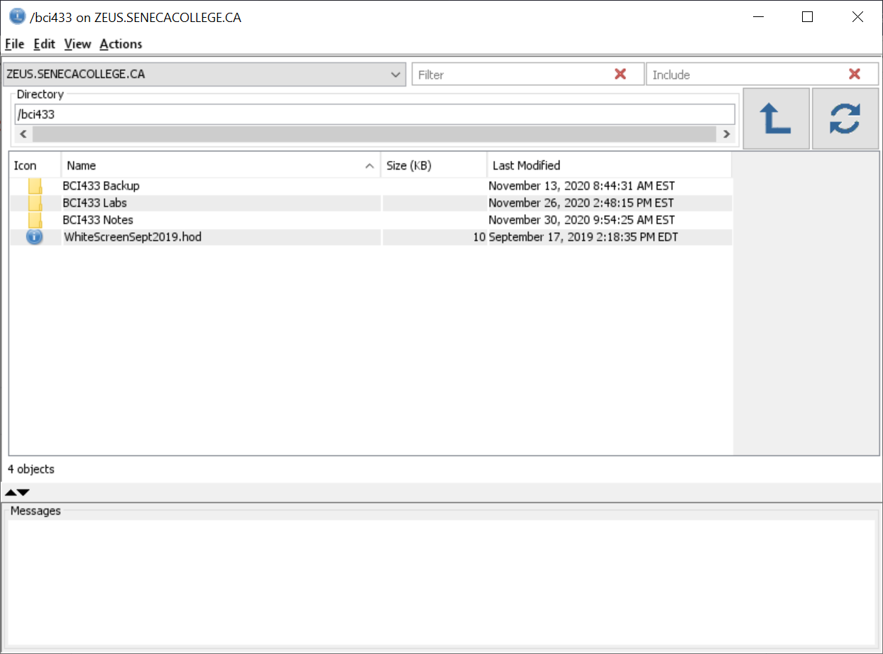
Accessing This Powerpoint Presentation in the IFS Using ACS

Slide 4
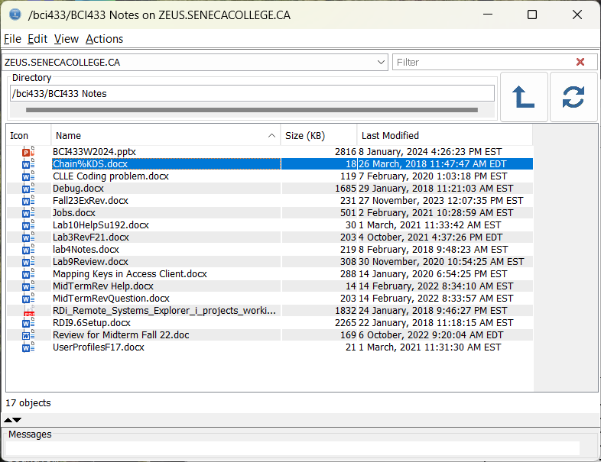
Accessing This Powerpoint Presentation in the IFS Using ACS

Slide 5
BCI433 Formula for Success
Complete the Labs
Show up for lectures
Take notes
Utilize the Information on Blackboard
Bring required USB flash drive to labs
Ask Lots of Questions
Don’t electronically copy labs from other students or the web

Slide 6
BCI433 is
IBMi system
Procedural Programming
  CLLE, RPGLE
Business Applications
Embedding SQL in a program

Slide 7
BCI433 Resources
Blackboard (Lab 1 only)
Labs 2 - 9 available on IBMi in IFS
Handouts in BCI433LIB on IBMi
IBM’s i 7.4 Documentation
https://www.ibm.com/support/knowledgecenter/ssw_ibm_i_74/rzahg/welcome.htm
Instructor
  Labs
  Office Hours
  Email

Slide 8
BCI433 Office Hours Winter 2024
Monday 3:20 – 4:10 zoom
Wednesday 9:50 – 10:40 zoom
Friday 9:50 – 10:40 zoom
Set up an appointment by email during the office hour (I will respond with a zoom link during the office hour)
Some issues may also be resolved with only email any day

Slide 9
IBM i User Interface
5250 emulation with Access Client Solutions, RDi or Mocha
GUI with Navigator for i
Program Development with Websphere Devbelopment Studio Client (WDSC) (large install)
IBM Rational Developer for Power Systems (RDp) (smaller footprint)
Rdi Rational Developer for IBMi

Slide 10
This week’s lab
Install Access Client Solutions
Read the BCI433 Standards in Blackboard
Send an email to Russell.Pangborn@senecapolytechnic.ca with a copy and paste of the agreement to the standards and with an optional disagreement to any one of the pasted items
Lab 1 is due Friday of the 2nd week
Get ahead and stay ahead, show me lab 1 this Friday

Slide 11
Warning for Software Install
Before installing and running Client Access Solutions you need to:
Install Java JDK
Set up and run the Seneca VPN
Student VPN | IT Services | Seneca Students (senecacollege.ca)

Slide 12
BCI433 Software
You can use Myapps to run Access Client Solutions (ACS) or Rational Developer for i (RDi)
https://myapps.senecapolytechnic.ca/login
It is recommended that you install this software on your PC.

Slide 13
BC433 Software
To obtain and install the BCI433 IBMi software:
1. Log into VPN. To log on, refer to VPN.
2.
From Windows file explorer:
\\mydrive.senecacollege.ca\courses\AS400\
From web browser:
file://///mydrive.senecacollege.ca/courses/AS400/
3. If you are prompted to log in use your Seneca Email and password
4. Download the IBMi software

Slide 14
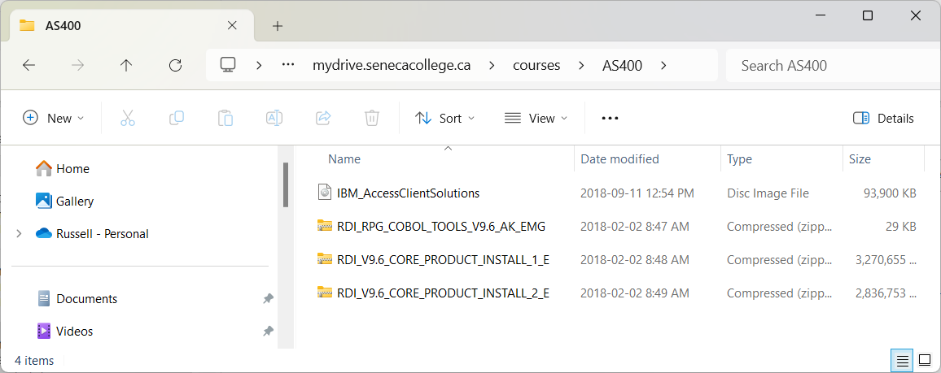
Windows Explorer Link Shows

Slide 15
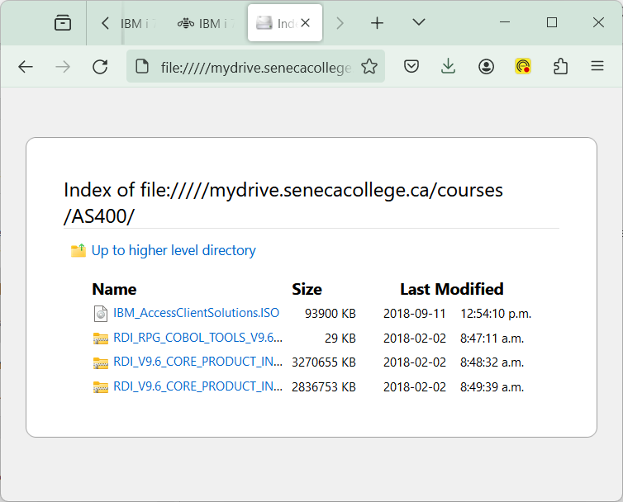
File Browser Link Shows

Slide 16
Software for BCI433
In Blackboard, click on Content
Click on BCI433 Software
You just need ACS for Lab 1
You can download RDi in week 2

Slide 17
iSeries Business Application Developer
Specialist Designations discontinued
Still retain the SENECA/TUG award
Take an IBM i Subject in later semesters

Slide 18
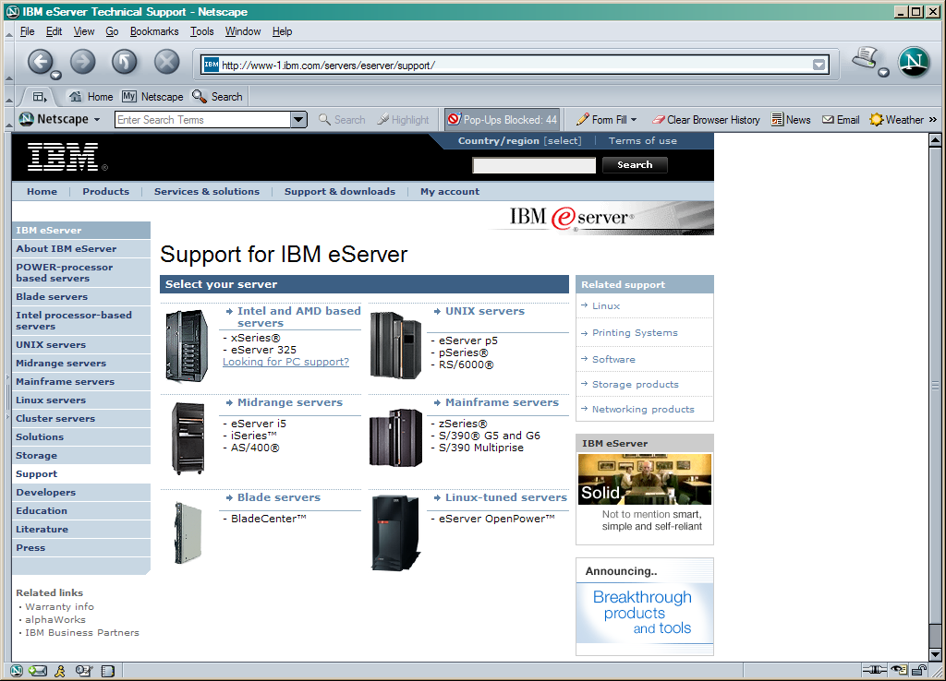
A Midrange System

Slide 19
A Business System
Used by Banks
Used by Retailers
Used by Hockey Hall of Fame
Used by Casinos in Vegas

Slide 20
IBM Systems
zSeries - Mainframe servers – System 390
pSeries - Unix servers – RS6000
xSeries - Intel Based servers – PC’s
iSeries - Midrange servers – AS/400
pSeries and iSeries are united on one hardware platform called Power Systems

Slide 21
A Naming Nightmare
AS/400 using OS/400 operating system
iSeries using OS/400 operating system
System i using i5/OS operating system
Power System using i operating system
Power Systems is the platform
IBM i is the operating system
User Magazine Article on Name Changes

Slide 22
Our Machine
System Value Qmodel – 41A
Uses a Power 9 microprocessor developed by IBM
At York location we had a 9408-M25 - IBM Power 520 Express
Used a Power 6 microprocessor
Increased memory by 16 times with newer microprocessor
used by multi-environment large data centers

Slide 23
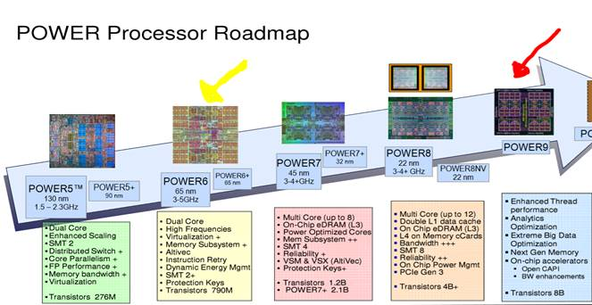
Our Machine

Slide 24
News Item 2007
IBM Unleashes World's Fastest Chip in Powerful New Computer
This processor doubles speed without adding to energy 'footprint,' enabling customers to reduce electricity consumption by almost half; Enough bandwidth to download entire iTunes catalog in 60 seconds
Power Systems based on Power 6 Processors

Slide 25
POWER7
The Power7 is IBM's first eight-core processor, with each core capable of four-way simultaneous-multithreading operation. Its key architectural features include an advanced memory hierarchy with three levels of on-chip cache; embedded-DRAM devices used in the highest level of the cache; and a new memory interface. This balanced multicore design scales from 1 to 32 sockets in commercial and scientific environments.

Slide 26
Open Power Consortium Aug 2013
The Consortium intends to build advanced server, networking, storage and GPU-acceleration technology aimed at delivering more choice, control and flexibility to developers of next-generation, hyperscale and cloud data centers.
http://www-03.ibm.com/press/us/en/pressrelease/41684.wss

Slide 27
Our Machine - POWER9
POWER9 is a family of superscalar, multithreading, symmetric multiprocessors based on the Power ISA announced in August 2016 at the Hot Chips conference.
The current fastest supercomputer in the world, Summit, is based on POWER9, while also using Nvidia's Volta GPUs as accelerators.
Summit or OLCF-4 is a supercomputer developed by IBM for use at Oak Ridge National Laboratory, which as of November 2018 is the fastest supercomputer in the world, capable of 200 petaflops

Slide 28
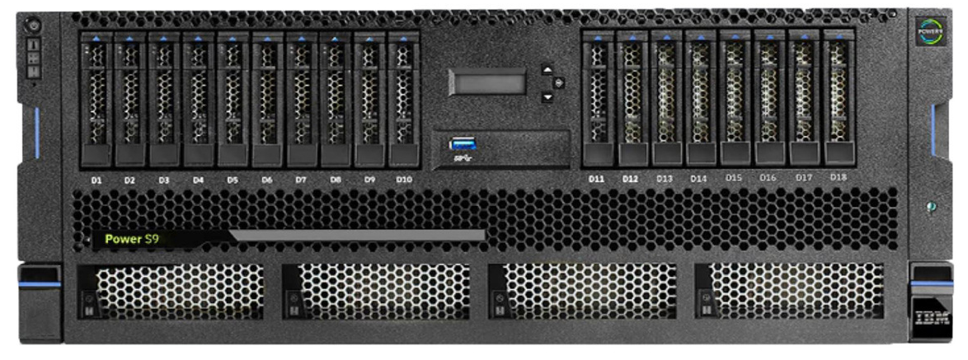
Architecture
We have Power 9 - Power 10 now out

Slide 29
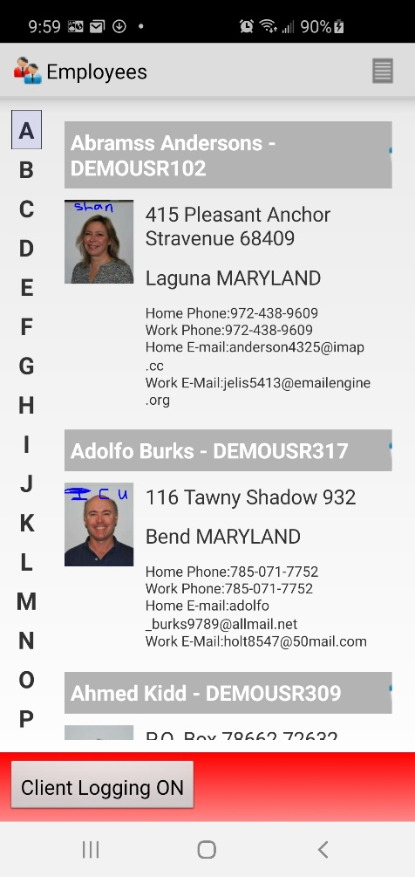
MAP525 and IBMi program and data

Slide 30
RELIABLE
“Platform Availability: Can You Spare a Minute”
Gartner Group study
Platform | Outages/Server/Year | Availability (24x365 basis)
iSeries | 5.2 hours | 99.94%
S/390 | 8.9 hours | 99.90%
VAX | 18.9 hours | 99.78%
UNIX (all) | 23.64 hours | 99.73%
NT server | 224.5 hours | 97.44%

Slide 31
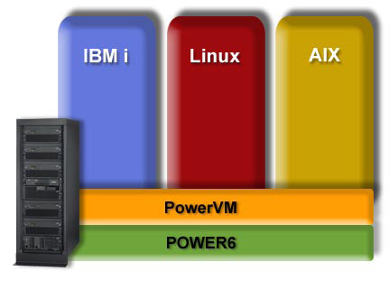
PowerVM Partitioning IBM AIX , IBM i, and Linux on a Single POWER6 System

Slide 32
A Database System
Database is built in...not added on
All data accessed through integrated data base
DB2 UDB for iSeries does not have a data base package
iSeries is a data base machine
iSeries designed with a relational database

Slide 33
ComputerWorld DBMS Survey

Slide 34
NT Server Weaknesses
64-Bits. No Buts.
64 Bit Support
DB2/400
AS/400
Today
SQL Server
NT Server
Today
Oracle
on Alpha
Today
Oracle on others Today
Hardware
Yes
Intel No
Alpha Yes
Others No
Alpha Yes
No
Operating System
Addressing
Data path
Instructions
Registers
Functional Units
Yes
Yes
Yes
Yes
Yes
No
No
No
No
No
Yes
Yes
Yes
Yes
Yes
No
No
No
No
No
Middleware
Database
All other
Yes
Yes
No
No
Yes
No
No
No
Applications
Automatic Migration
Yes
Yes
No
No
No
No
No
No

Slide 35
A Popular Platform
Over a million units sold
Capable of running a variety of operating systems and applications
Linux, Java, Domino, HTML, Apache Web server, Windows NT and 200, and Unix
Flexible, Durable, Dependable, Easy to run

Slide 36
User Groups
Toronto User Group for Power Systems
(TUG) http://www.tug.on.ca/
Common http://www.common.org/
European User Groups

Slide 37
i Blogs
You and i
i Can
Modern i zation
DB2 for i

Slide 38

30th Anniversary
IBM Champions
IBM Power Systems: Your Unfair Advantage (video ad)

Slide 39
Consultant & Press Comments
"IBM's AS/400 scored exceptionally high satisfaction ratings in nearly every category....it's superior ratings in areas such as service and support, product quality and database management put the AS/400 in a league of it's own." -- Computerworld
"OS/400 is, in our view, the database in the DB2 family which has the most sophistication in its parallel implementation, and the AS/400 Development Plans are sound." -- The Bloor Research Group
"DB2/400's cost-to-use is less than that for Oracle or any other database." -- ETG Consulting
“Sutdy shows Intel servers cost 95 percent more than IBM eserver iSeries over a five-year period” IDC
"There will be more Data Warehousing done on AS/400s than any other platform for the next several years." -- Gartner Group
IBM iSeries named “Best of Show at LinuxWorld Conference and Expo – San Francisco, Aug 30, 2001

Slide 40
Lab 1
Introduction to system environment
Library Lists
System Values
Writing Cl Programs
Printing / Viewing Spooled files

Slide 41
Definitions - Object
On the Power System everything is an object
When storage is allocated for an object, the object type determines what programs are allowed to act upon that object
Lab 1 objects used were *USRPRF, *LIB, *CMD, *MSGQ, *OUTQ, *FILE and *PGM

Slide 42
Definitions - Library
Object that is used as a system directory to keep track of other objects
Object Type is *LIB
QSYS is the only library that can contain other libraries
Allowing access to an object additionally requires allowing access to the library that contains the object

Slide 43
Definitions – Source Physical File
Object that is used to store program code
Each separate program is a member of the source physical file
When this member is successfully compiled a new program object (*PGM) is placed in a library (usually your current library)
All members have three fields. Data stored in these fields are: a line number; actual program code; and the date the line was entered or changed.

Slide 44
Definitions – Library List
Used when an object is referred to without including the library name where it is stored
A system administrator decides what libraries are included
System portion of library list is QSYSLIBL and usually is a list of IBM libraries with IBM objects
User Portion of library list is QUSRLIBL and usually contains libraries with commonly shared user objects
Current library is your student library

Slide 45
Definitions – Library List
The library list is searched for a library containing the name of the object referenced
Call INTROLAB ---- What Happens
If INTROLAB is in none of the libraries in the library list?
If INTROLAB is in all of the libraries in the library list?

