Slide 1
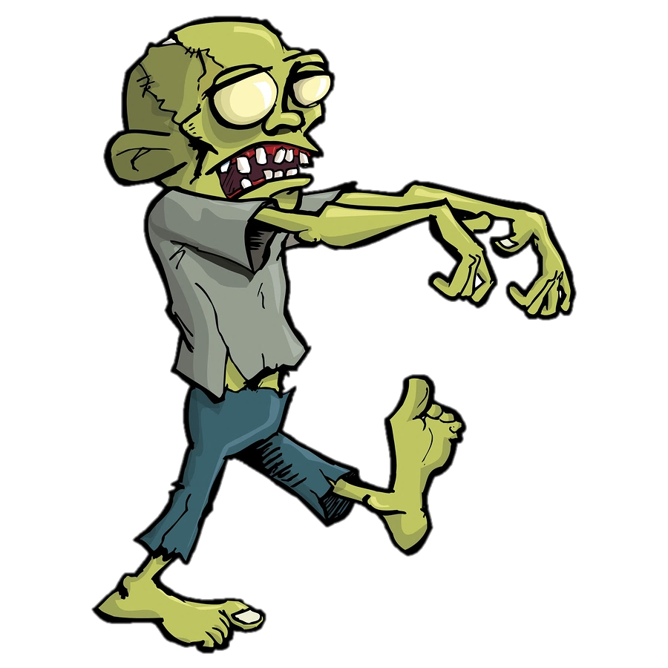
LC Battle
Notes:
https://es.pinterest.com/pin/447123069230590134/

Slide 2

You loose!
Notes:
https://es.pinterest.com/pin/447123069230590134/

Slide 3
You won!
Notes:
https://es.pinterest.com/pin/447123069230590134/

Slide 4
Botones
PLAY
HOW TO PLAY
LEADERBOARD
EXIT
PLAY
HOW TO PLAY
LEADERBOARD
EXIT

Slide 5

Select Level

Slide 6
Play Again
Back to main menu
Play Again
1
1
Play
2
2
Back to main menu
3
3
Play
4
4
5
5

Slide 7



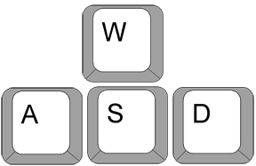
Move around with arrows
Shoot with mouse´s left click
Point shooter with cursor

Slide 8
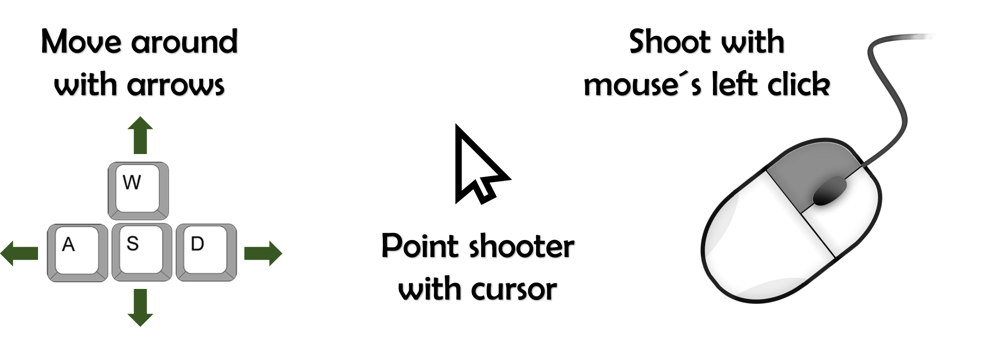
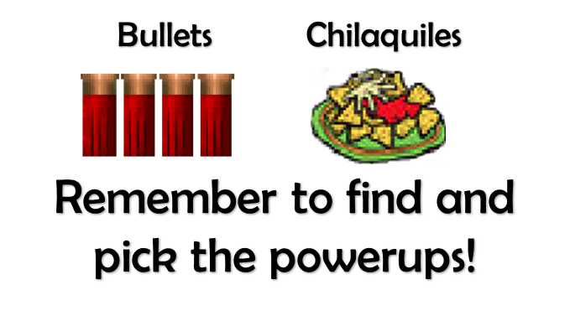

Remember to find the key before looking for the exit
Press P key to pause

Slide 9
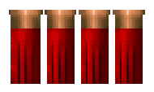

Bullets Chilaquiles
Remember to find and pick the powerups!

Slide 10

GEEK 4S

Slide 11



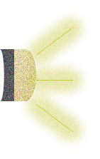

Slide 13


EXIT
Loading…

