Slide 1
ChordExecutor
Peer to Peer
Ubinet Master
Polytech’Nice Sophia Antipolis
Professor Luigi Liquori
Students Somnath Mazumdar, Mauricio Jost

Slide 2
ChordExecutor
Java language
Based in OpenChord* implementation
Distributes parallelizable jobs among nodes in the ChordExecutor.
Alleviates processing load on one requestor node.

Slide 3


A
A
B
C
D
E
A
F
B
Workflow
B
E
F
C
D
E
F
Workflow
ChordExecutor
C
D

Slide 4
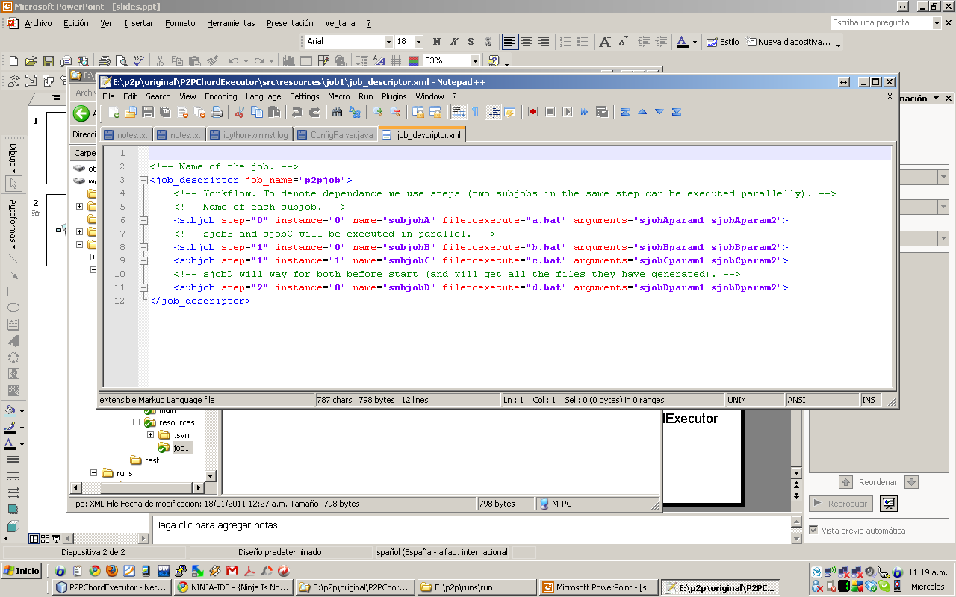
Job Descriptor
XML file
Defines
  Subjobs
  Their workflow

Slide 5
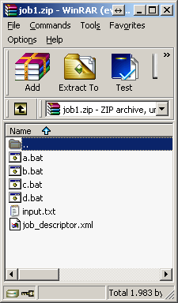
Job compressed file
Zip file that contains in the root directory
  Job descriptor
  Execution files (if needed)
  Input files

Slide 6
Thanks!

