Slide 1

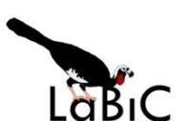
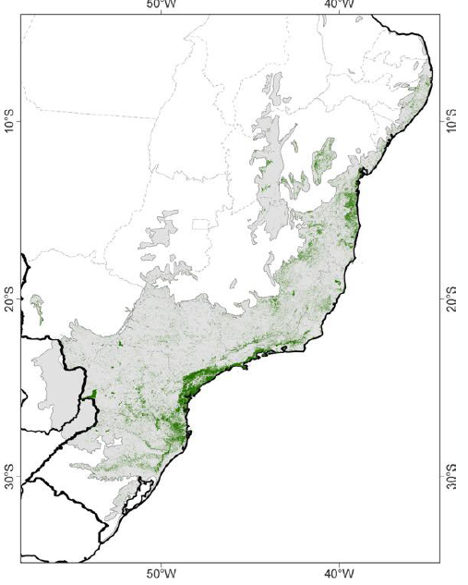









Biota Atlantic: beyond distribution maps
Integrating community information in the Atlantic forest

Slide 2


