Slide 1
Interventions from Clinical Trial Reports

Slide 2
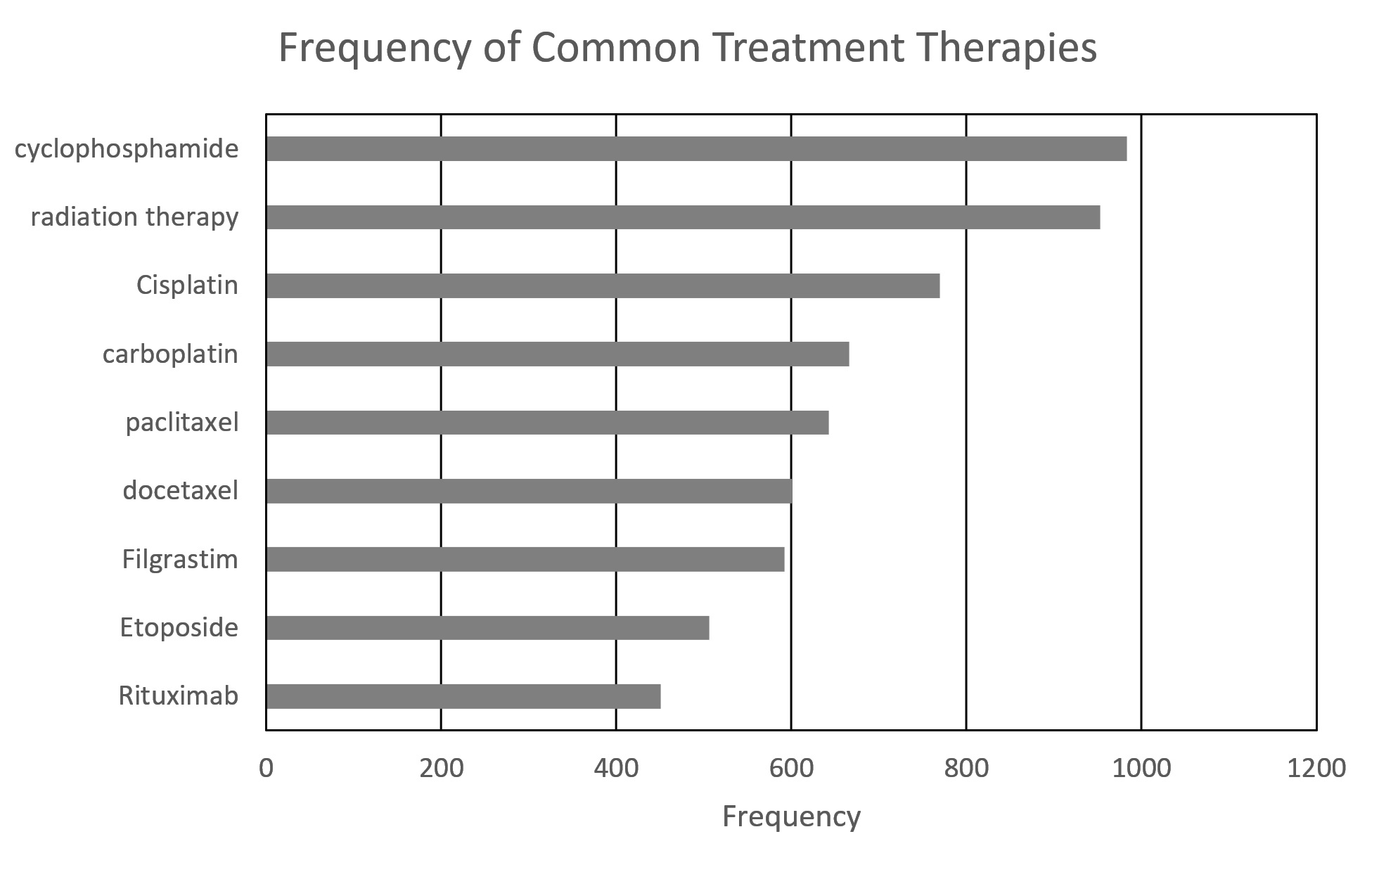
Landscape of Interventions

Slide 3
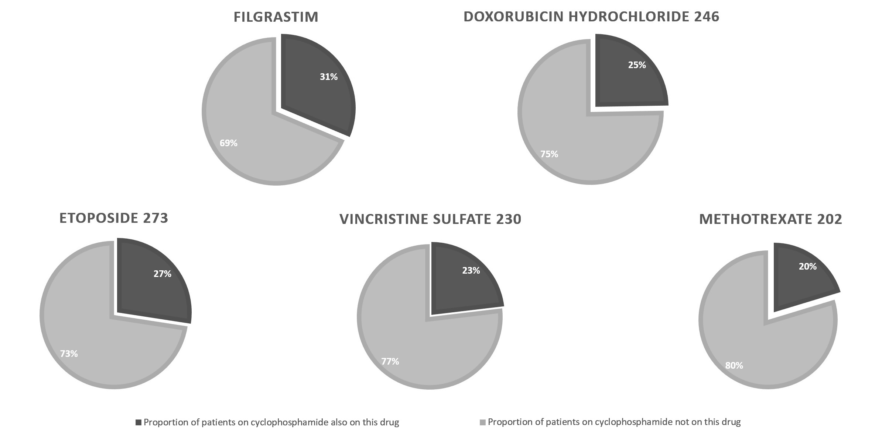
Combinations involving cyclophosphamide

Slide 4
Thank you

Slide 5
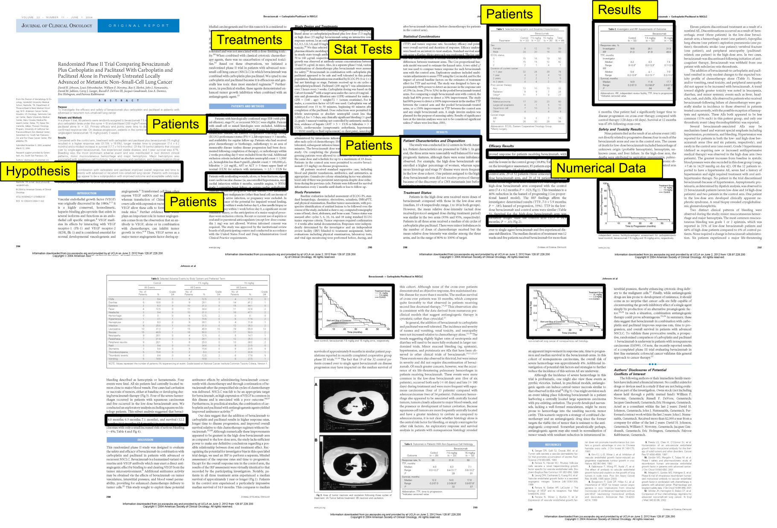
Importance of Published Literature
Notes:
Here is a clinical trial report in primary literature.
In this example, the paper is on lung cancer
The query is: To what degree did the intervention improve overall response? *SHOWN HERE
This slide shows the parts of the paper relevant to a query posed on a clinical trial report.
What were the specifics of the patients? What are the treatments? What is the numerical data? *USE POINTER (The specifics of ____ are circled.)
Understanding patient profile is in a table here. ___ is in free-text here. Results is in a graph here.

Slide 6
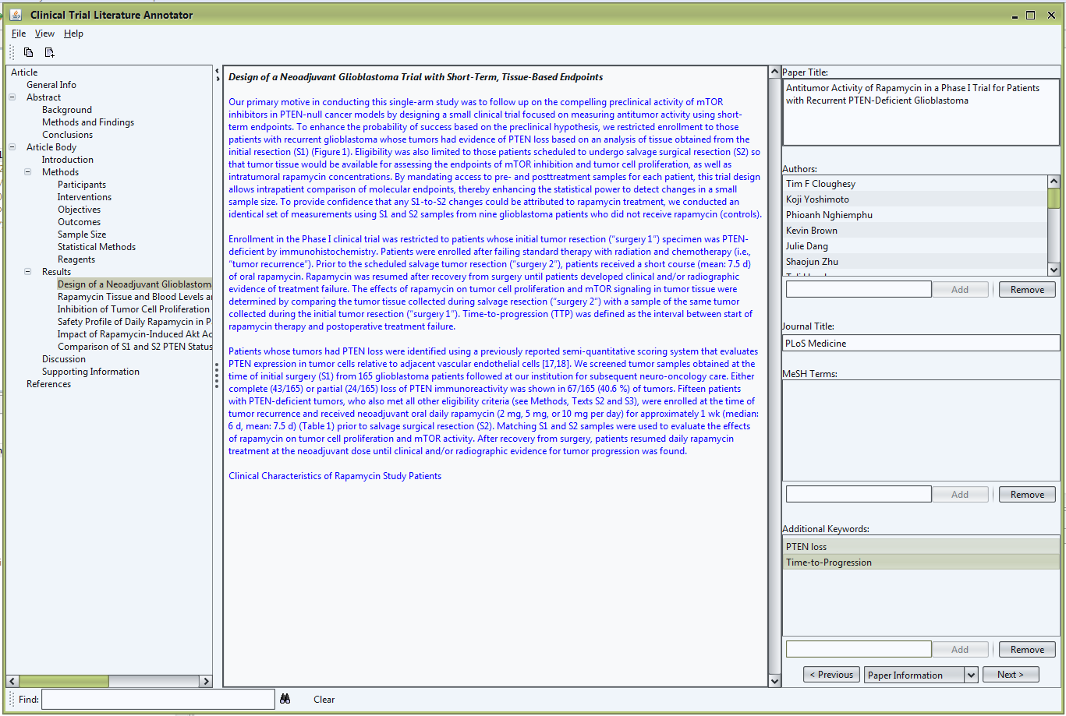
Annotation Form

