Slide 1
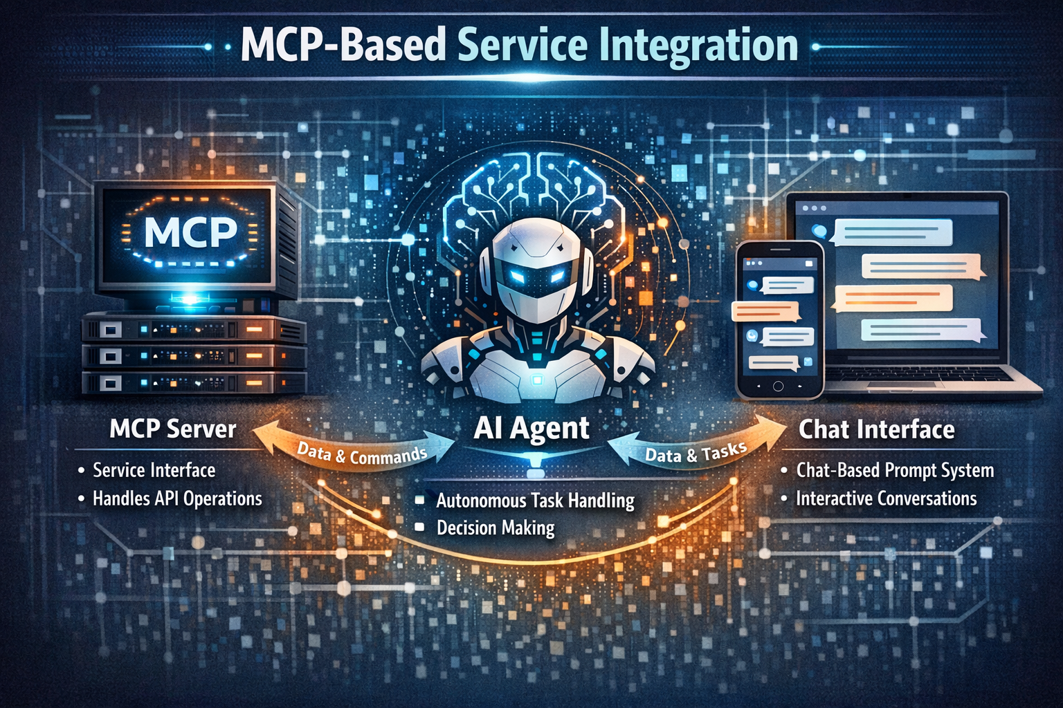
Model Context Protocol Integration with Service
Hengyu Liu, Joshua Joubert, and Maurisa Dacosta
Project Description:
Create a Model Context Protocol (MCP)–based integration for a service.
The project will include:
An MCP server to interface with the service
An AI agent capable of handling tasks autonomously without direct user interaction
A chat-based prompt interface to enable interactive use in a structured and meaningful way
Need / Significance:
This project matters because it creates a standardized, scalable way for autonomous AI agents to reliably interact with real services while still allowing humans to guide and oversee complex tasks through a simple chat interface.
Engineers, Product, DevOps, and others
Project Objectives:
Build an MCP that can integrate with a service directly and through the use of an AI Agent for autonomous interaction.
Measures:
The tools' ability to interact with the service through the MCP directly and via the agent.
Test strategy to determine whether the data returned is accurate.
Approach:
We will create an MCP to handle interactions with the service. Once that is complete, we will layer on an AI Agent for autonomous interactions and finally ad a chat interface for user interaction
Deliverables:
MCP Server
AI Agent
Chat interface
Resources:
MCP framework, LLM, AI Agent Framework, Ui Framework, Docker for running the agent locally, NLP (langchain?)
Risks and Opportunities:
The risks are around governance and safety
The opportunities are: makes complex systems accessible with natural language
Key Milestones:
Creation of MCP Server
Creation of the AI Agent
Creation of the Chat Interface

