Slide 1
Model Selection for Overparameterized Models Maurizio Filippone Statistics Program, KAUST

Slide 2

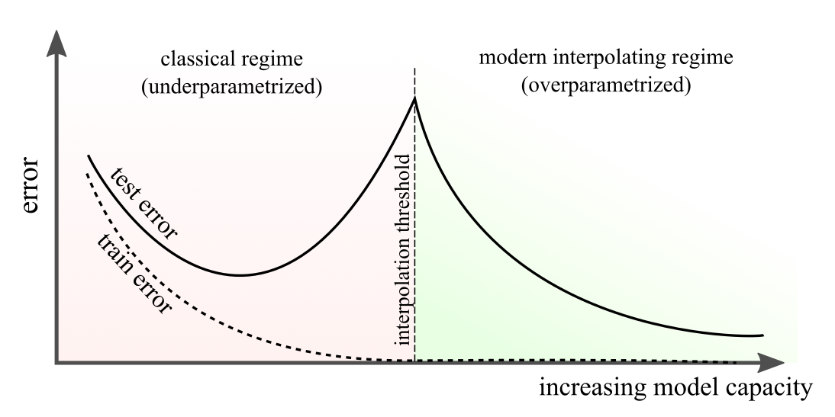
Double Descent and Neural Scaling Laws
Double descent challenged common wisdom on overfitting!
Belkin et al., PNAS 2019

Slide 3
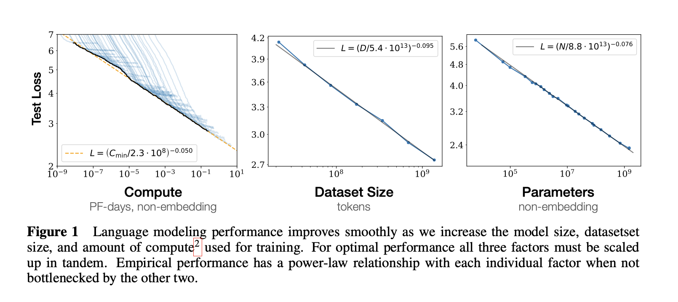
Double Descent and Neural Scaling Laws
Neural scaling laws allow one to extrapolate generalization wrt to model size, compute, and data set size.
Kaplan et al., arXiv 2020 – Bahri et al., PNAS 2024 – Rosso et al., arXiv 2025

Slide 4
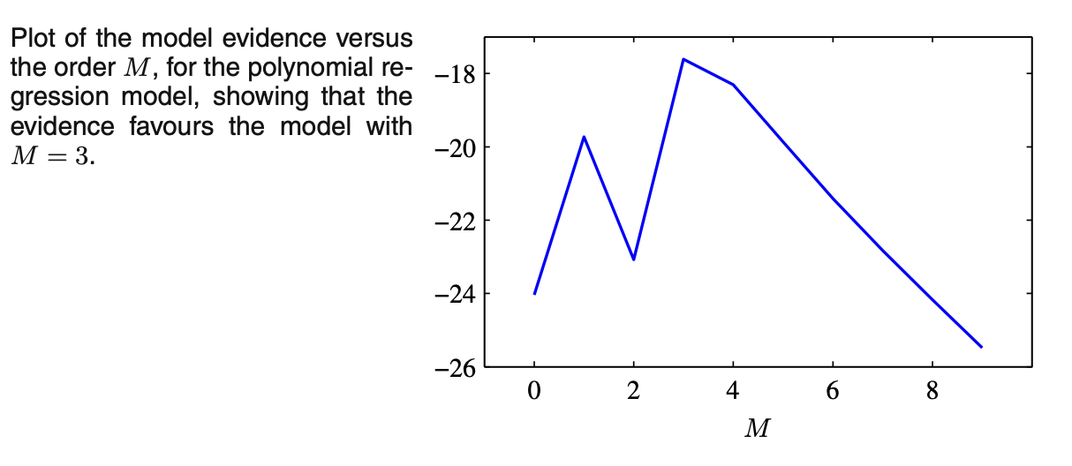
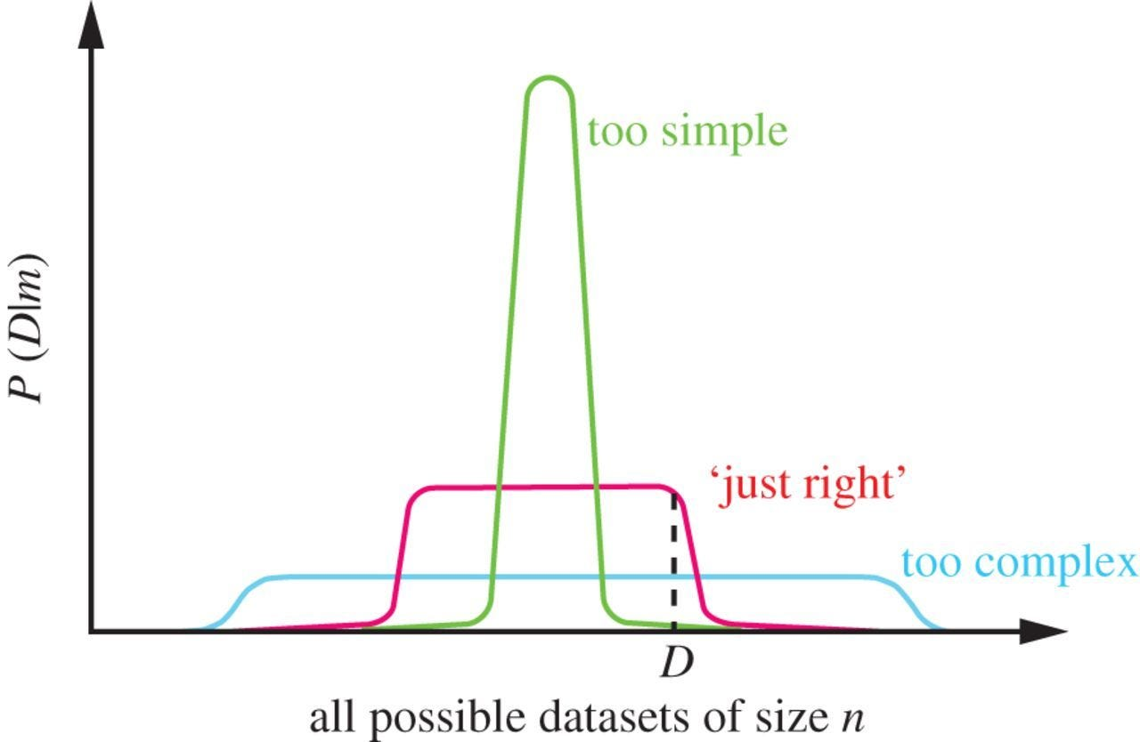
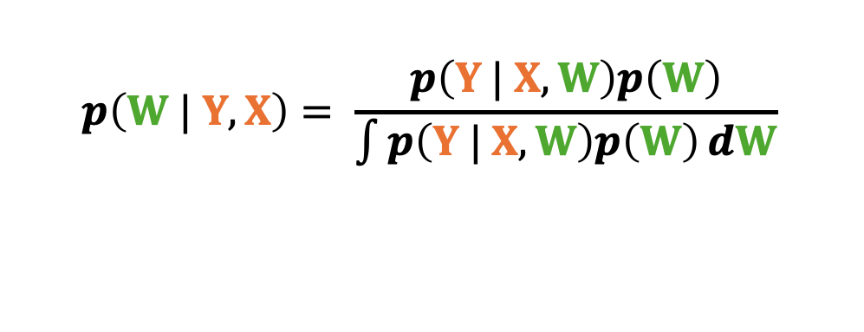
Bayesian Model Selection
Marginal Likelihood as a model selection criterion.
$$p\left(W | Y, X\right)= \frac{p\left(Y | X, W\right)p\left(W\right)}{\int{p\left(Y | X, W\right)p\left(W\right)}dW}$$
Bishop, 2006.

Slide 5
Bayesian Model Selection
Bayesian Model selection is connected with:
Occam’s Razor: simplest explanation is usually the best one
Kolmogorov complexity: length of a shortest computer program generating the weights of the network
Minimum Description Length: find the most concise representation of the data
How do we reconcile Bayesian model selection with the conclusions from research on scaling laws?
Solomonoff, Information and Control 1964 – Schmidhuber, ICML 1995 – Hinton and Van Camp, COLT 1993

Slide 6
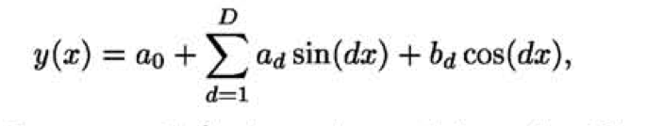
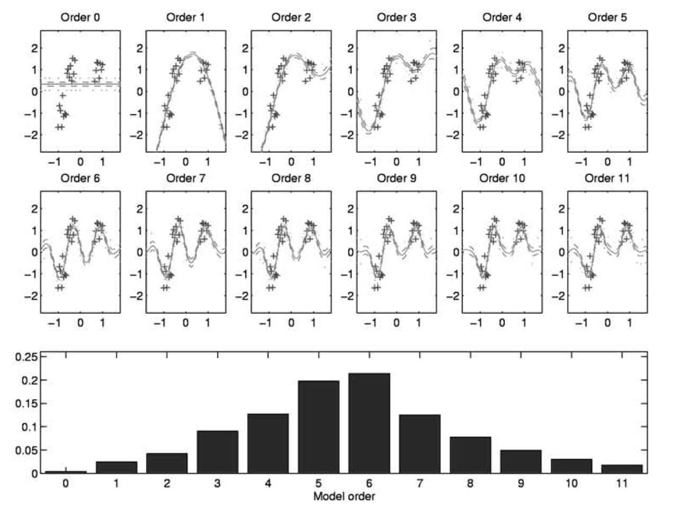
Penalizing Complexity
Consider trigonometric regression as follows:
Gaussian prior with
variance independent of d
Rasmussen and Ghahramani, NeurIPS 2000.

Slide 7
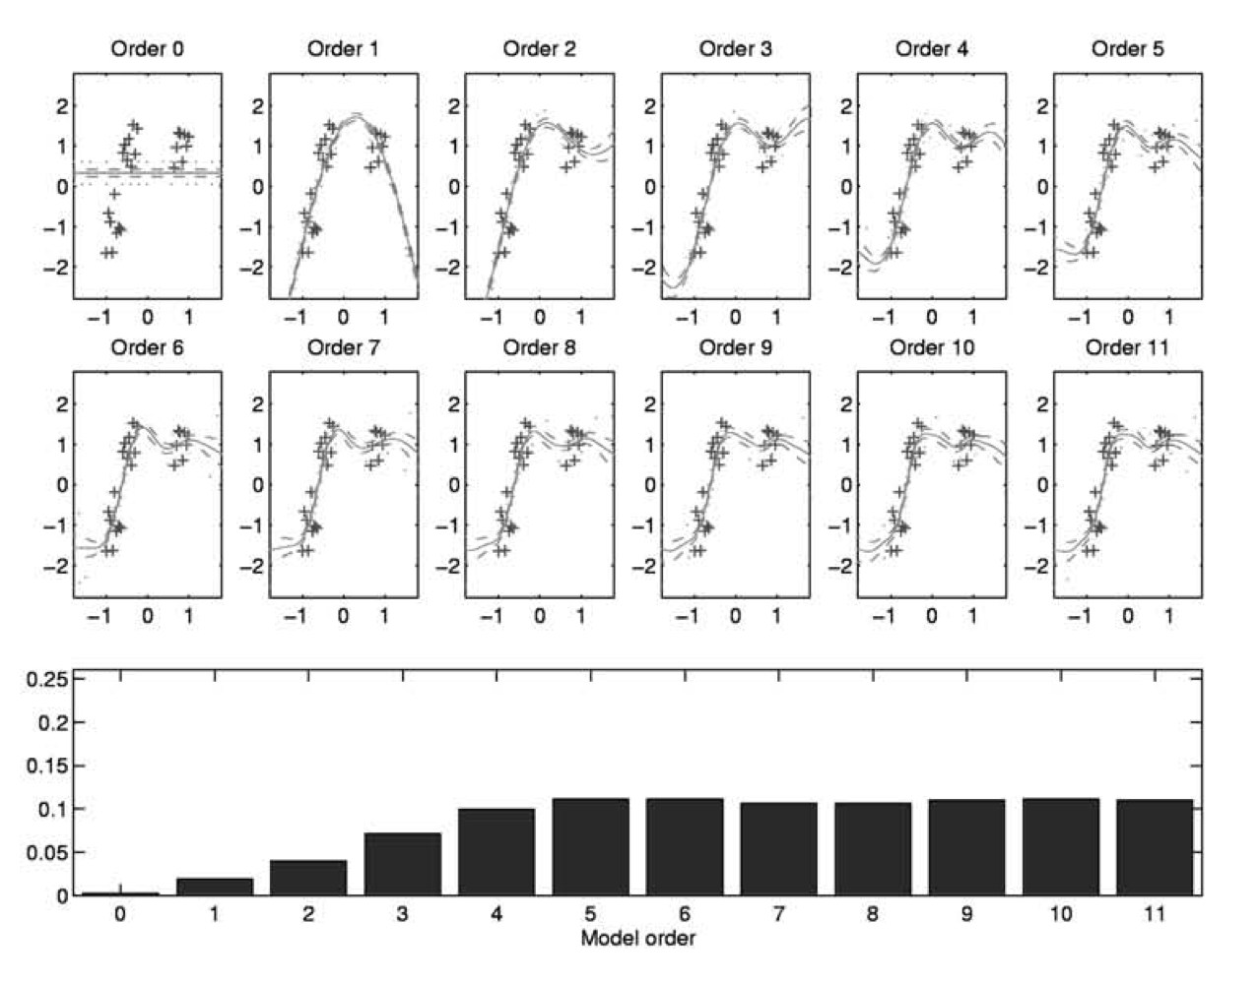
Penalizing Complexity
Consider trigonometric regression as follows:
Gaussian prior with
precision proportional to d³
Also, think about Gaussian
processes approximated with
random Fourier features (frequencies decay fast)
Rasmussen and Ghahramani, NeurIPS 2000 – Simpson et al., Stat. Sci. 2017 – Nalisnick et al., AISTATS 2021

Slide 8
Is Penalization the Answer? Or Just Over-Parameterization?
Imposing penalization on complexity makes Bayesian model selection compatible with scaling laws
However, scaling laws emerge even without this type of regularization*
Is there any more to say about priors**?
Does this imply that in overparameterized models simplicity emerges over complexity***? Simplicity bias!
* except for stochastic optimization / weight decay / dropout
** Polson and Sokolov, arXiv 2025, Riha et al., arXiv 2026
*** Mingard et al., arXiv 2019l – Wilson, arXiv, 2025

Slide 9
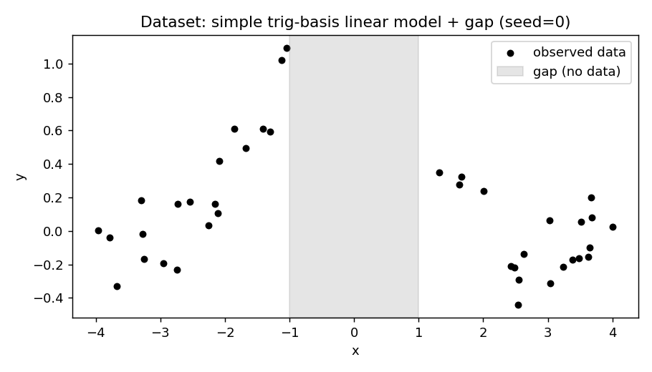
Example: Regression with Neural Networks

Slide 10
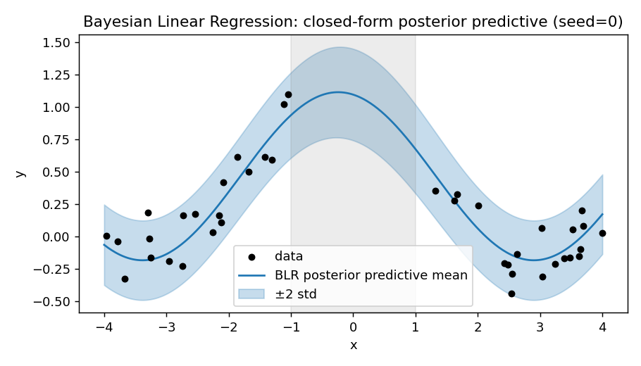
Solution with Correct Model Specification

Slide 11
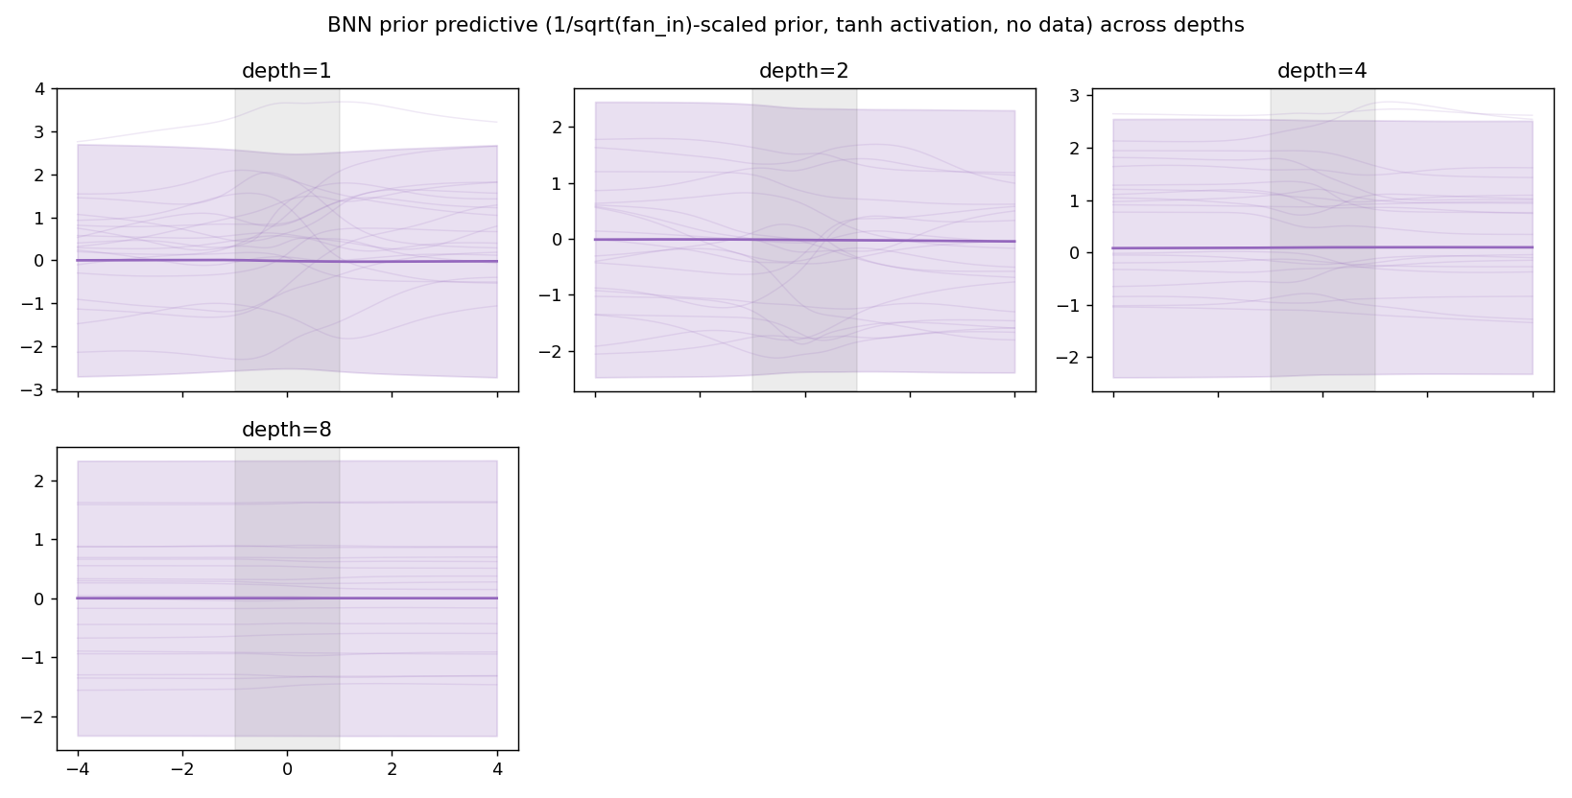
Prior Predictive Distributions

Slide 12
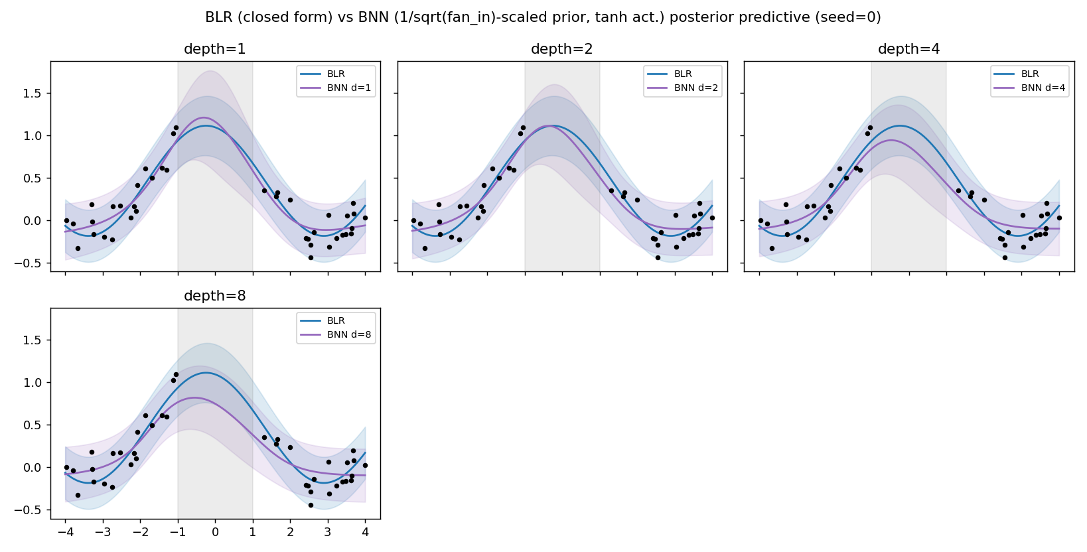
Example: Regression with Neural Networks

Slide 13
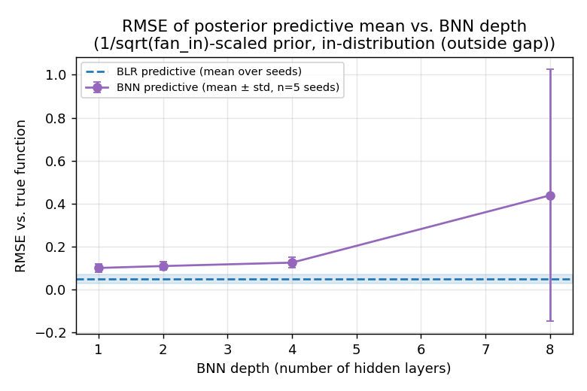
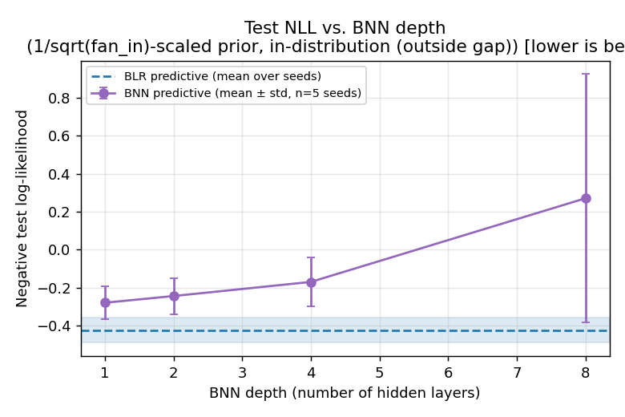
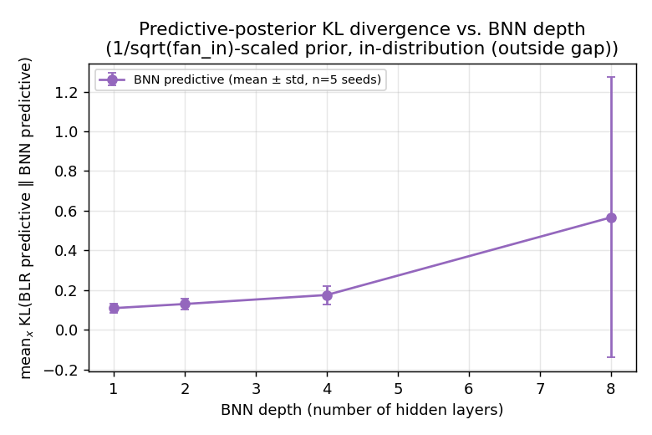
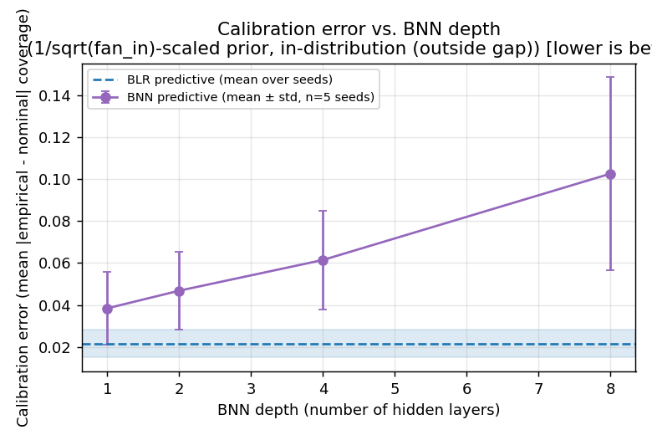
Performance In-Distribution

Slide 14
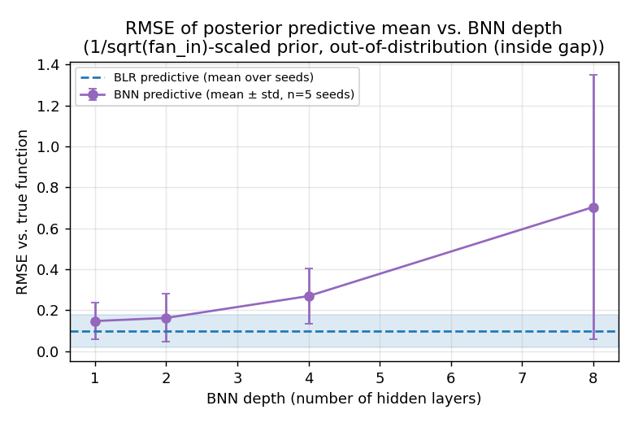
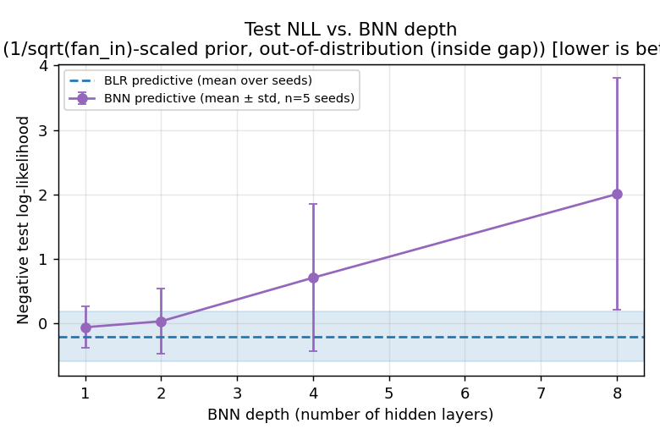
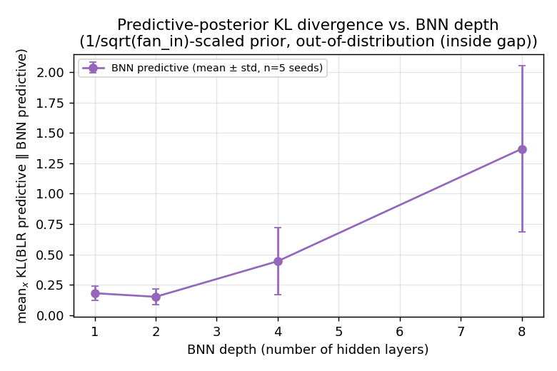
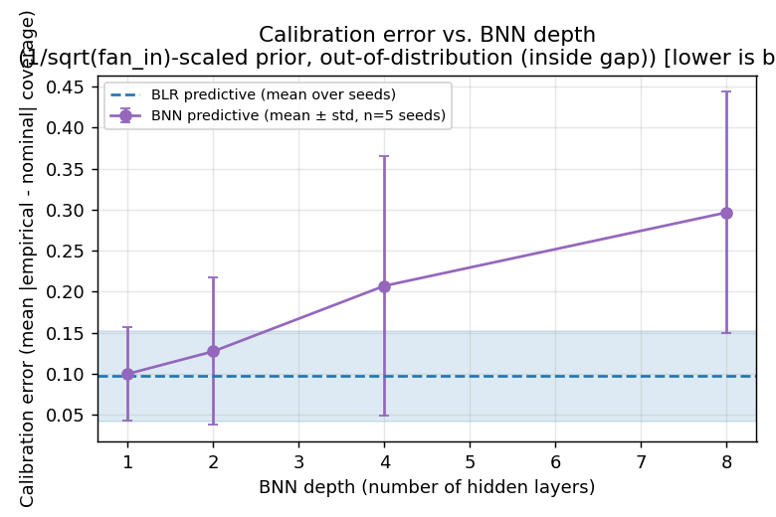
Performance Out-of-Distribution

Slide 15
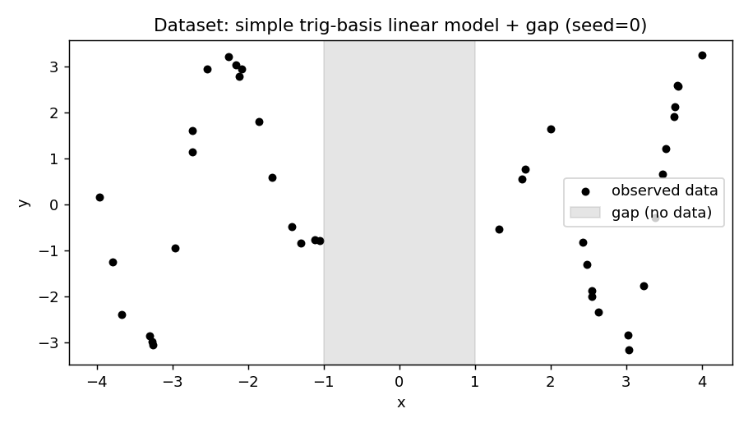
Example: Regression with Neural Networks

Slide 16
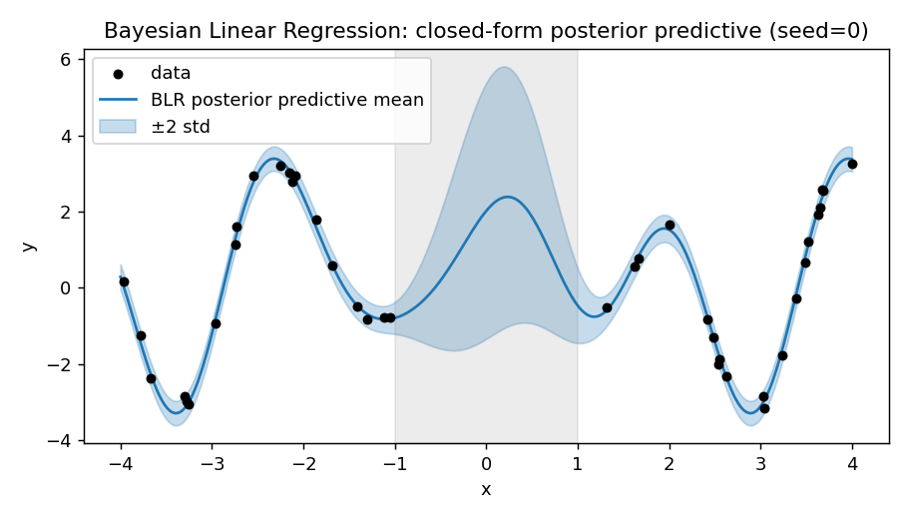
Solution with Correct Model Specification

Slide 17
Prior Predictive Distributions

Slide 18
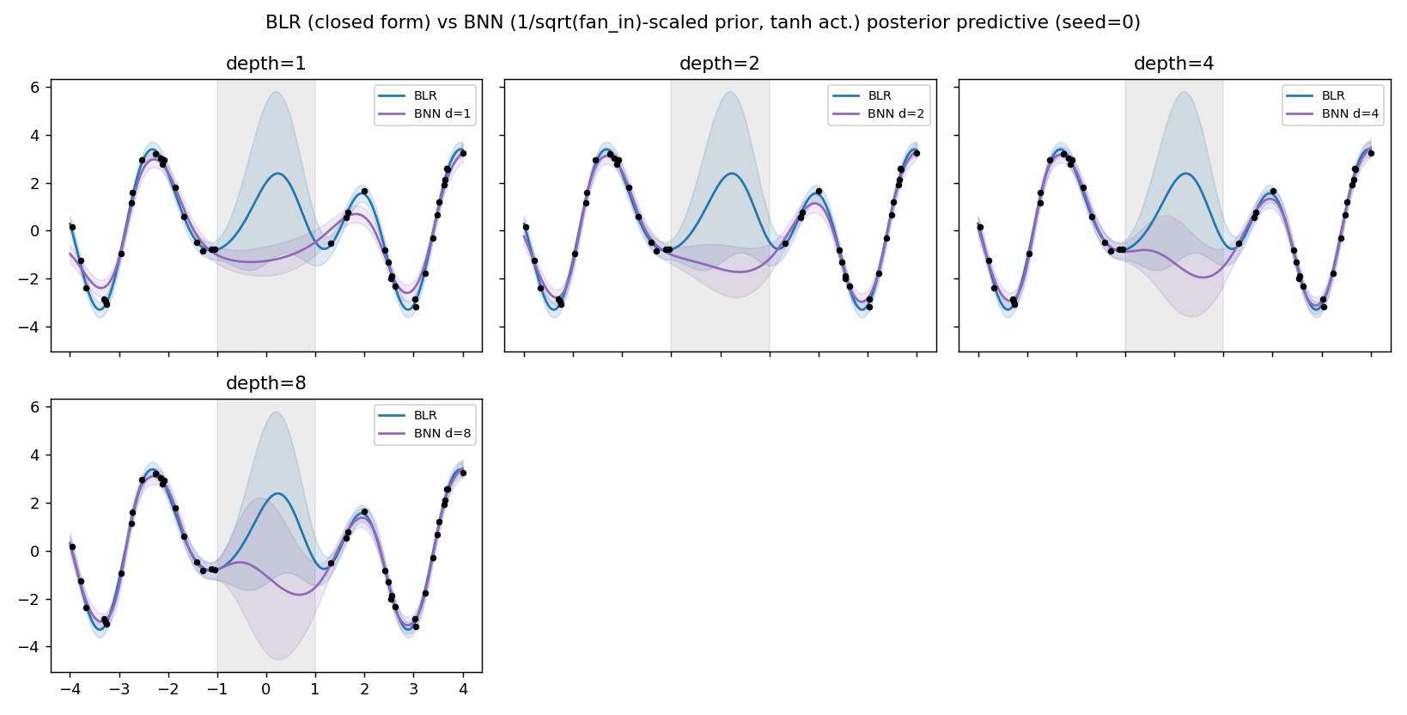
Example: Regression with Neural Networks

Slide 19
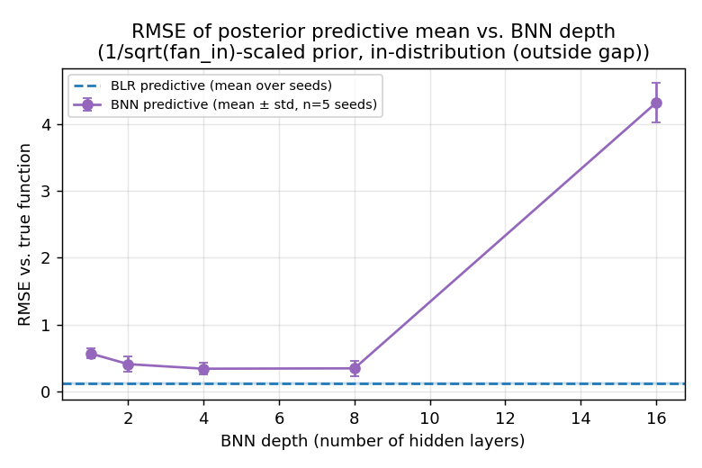
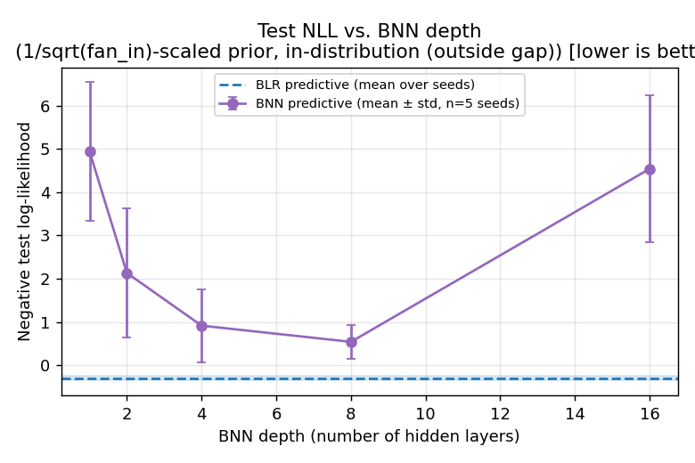
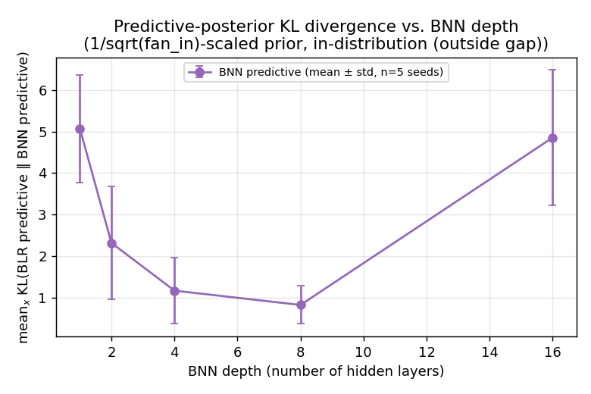
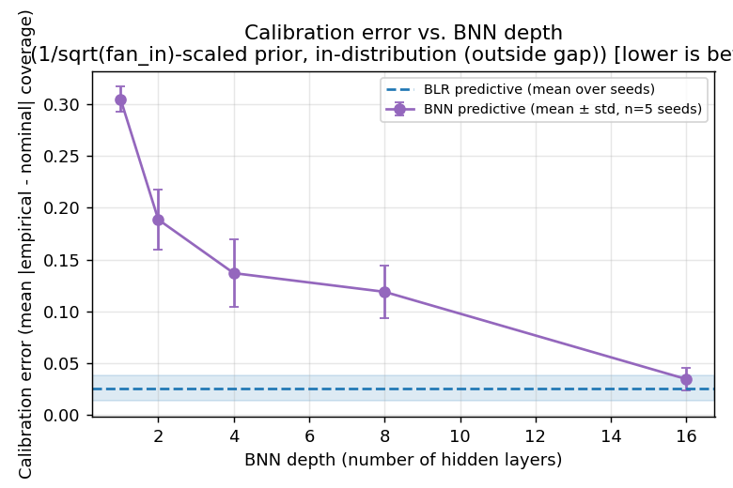
Performance In-Distribution

Slide 20
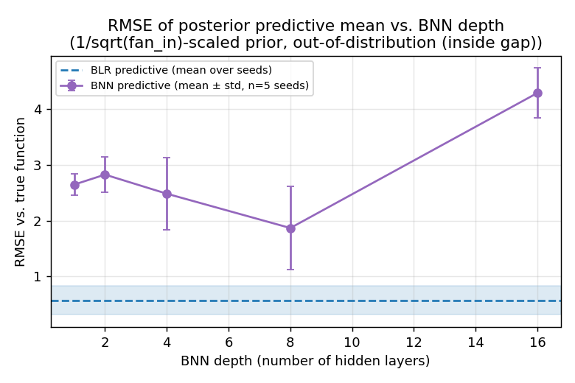
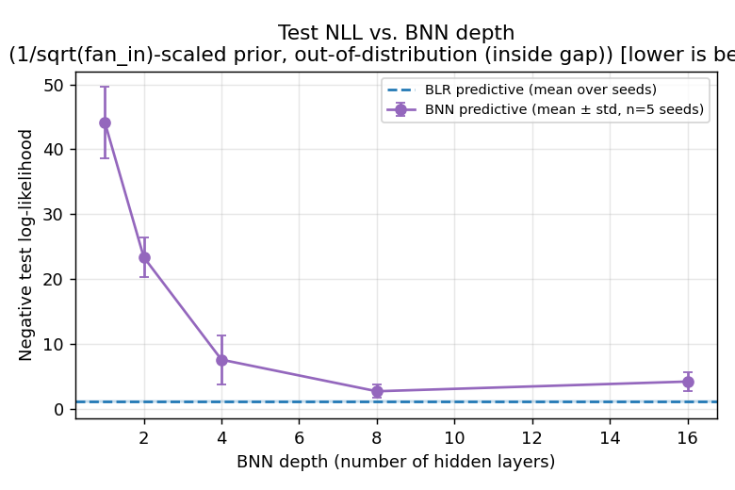
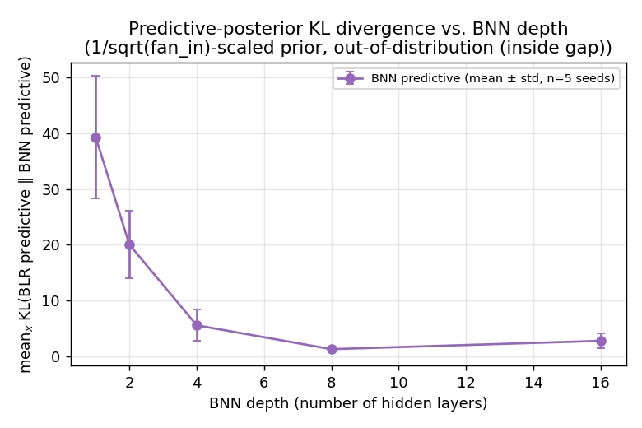
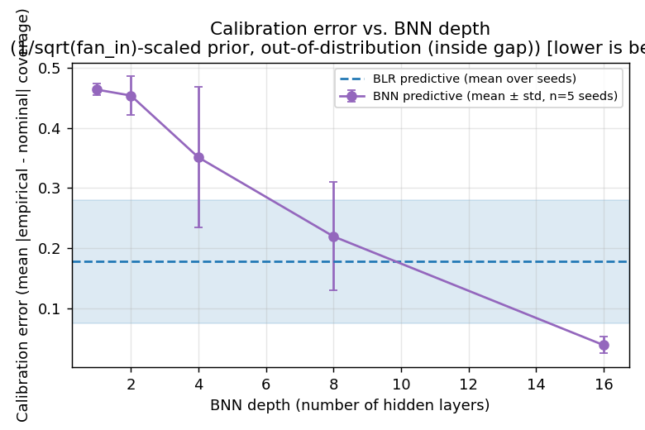
Performance Out-of-Distribution

Slide 21
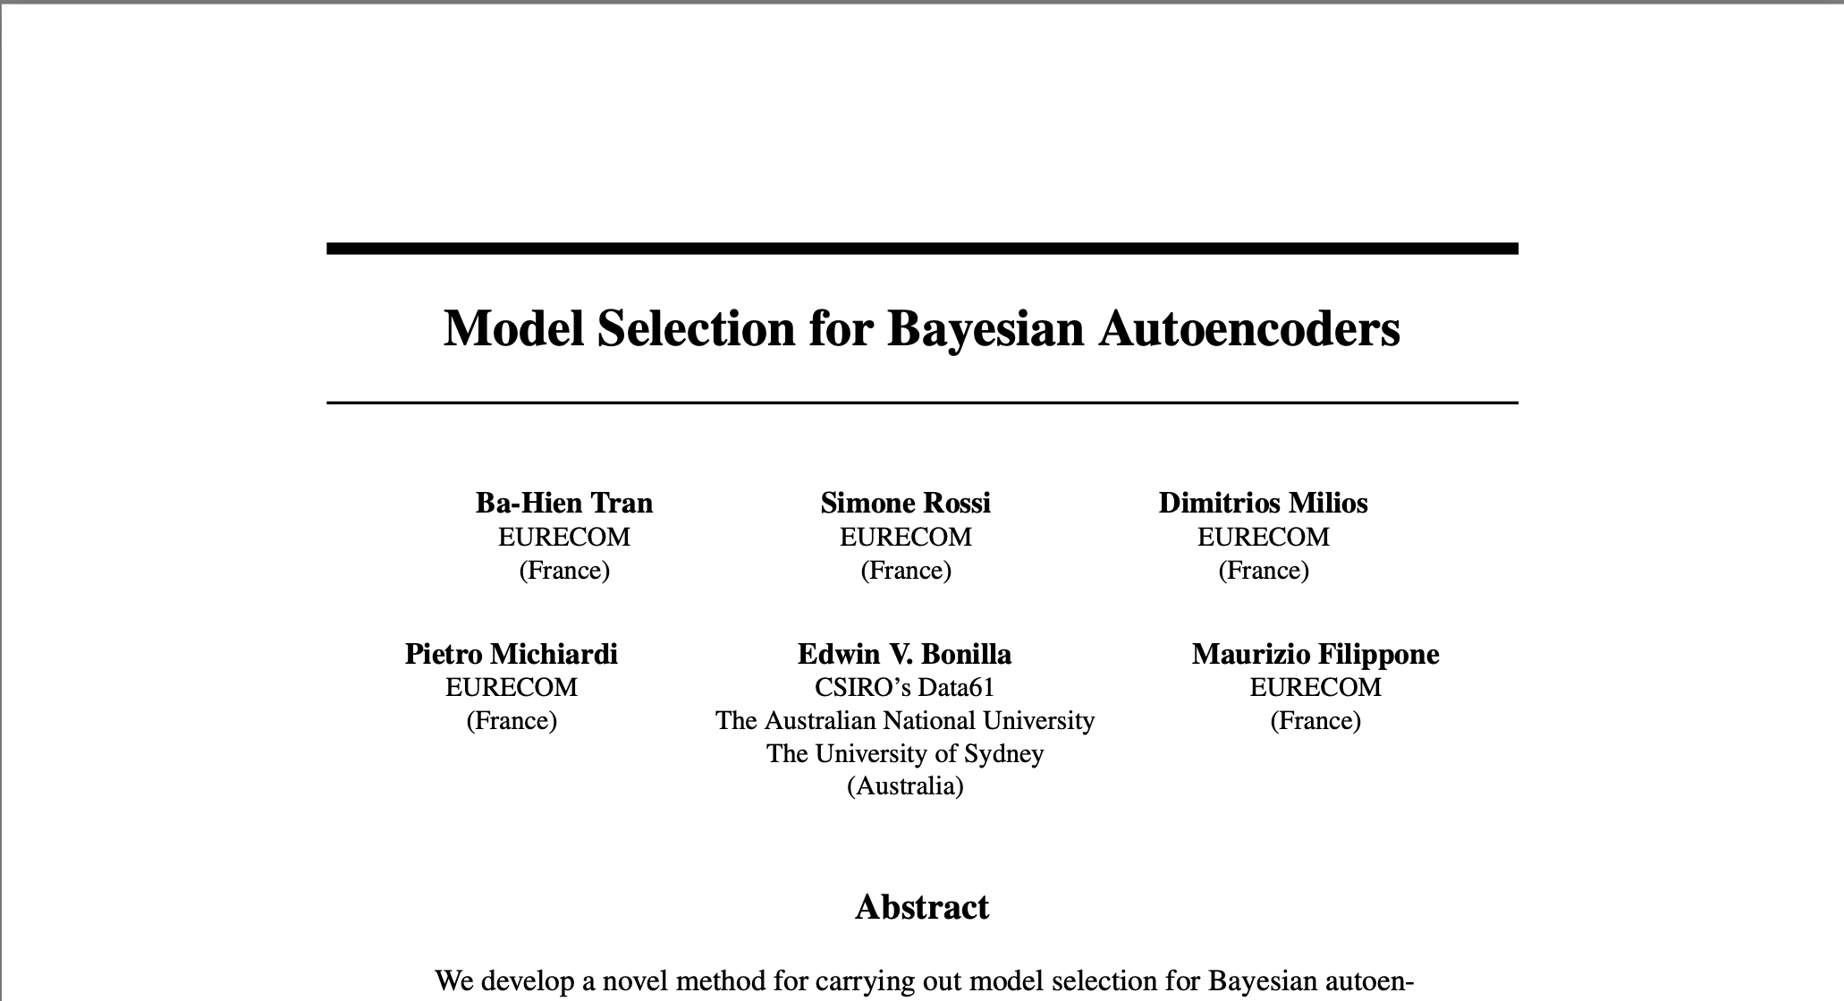
Concluding Thoughts
Scaling Laws are a fascinating phenomenon characterizing overparameterized models
Bayesian model selection is “compatible” with scaling laws if we introduce complexity penalties
But what if we don’t?
Isn’t it still relevant to look for simpler and cheaper models, as opposed to giant and expensive ones?
How to perform model selection in a practical way?

Slide 22
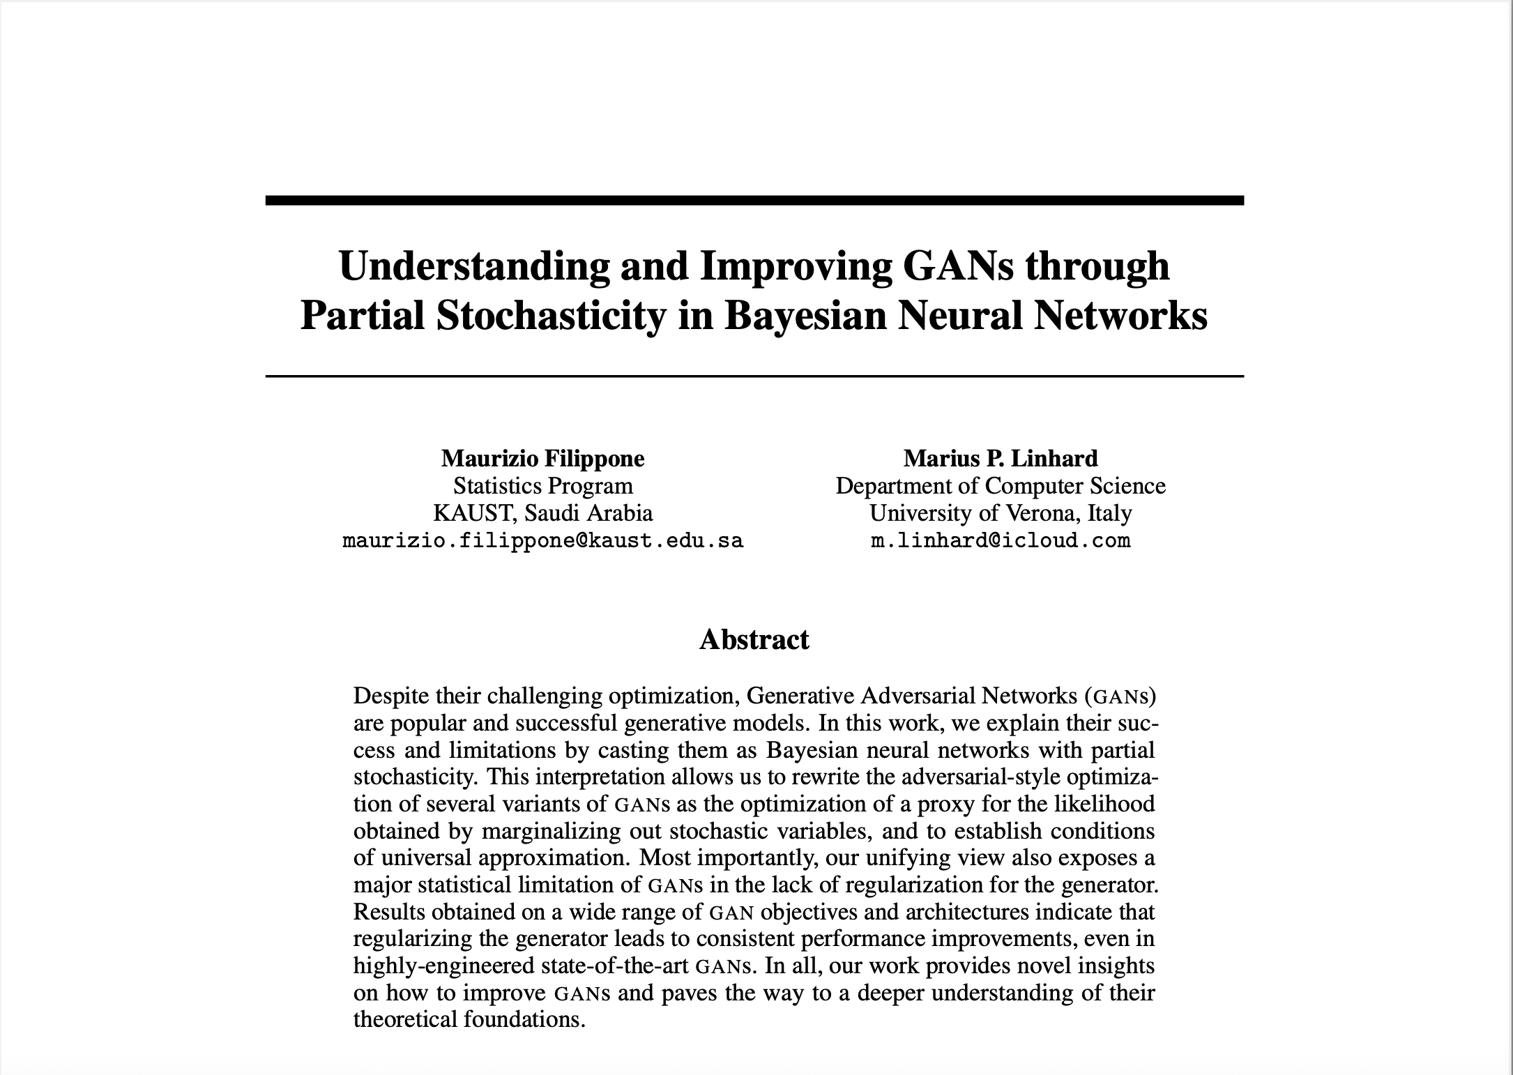
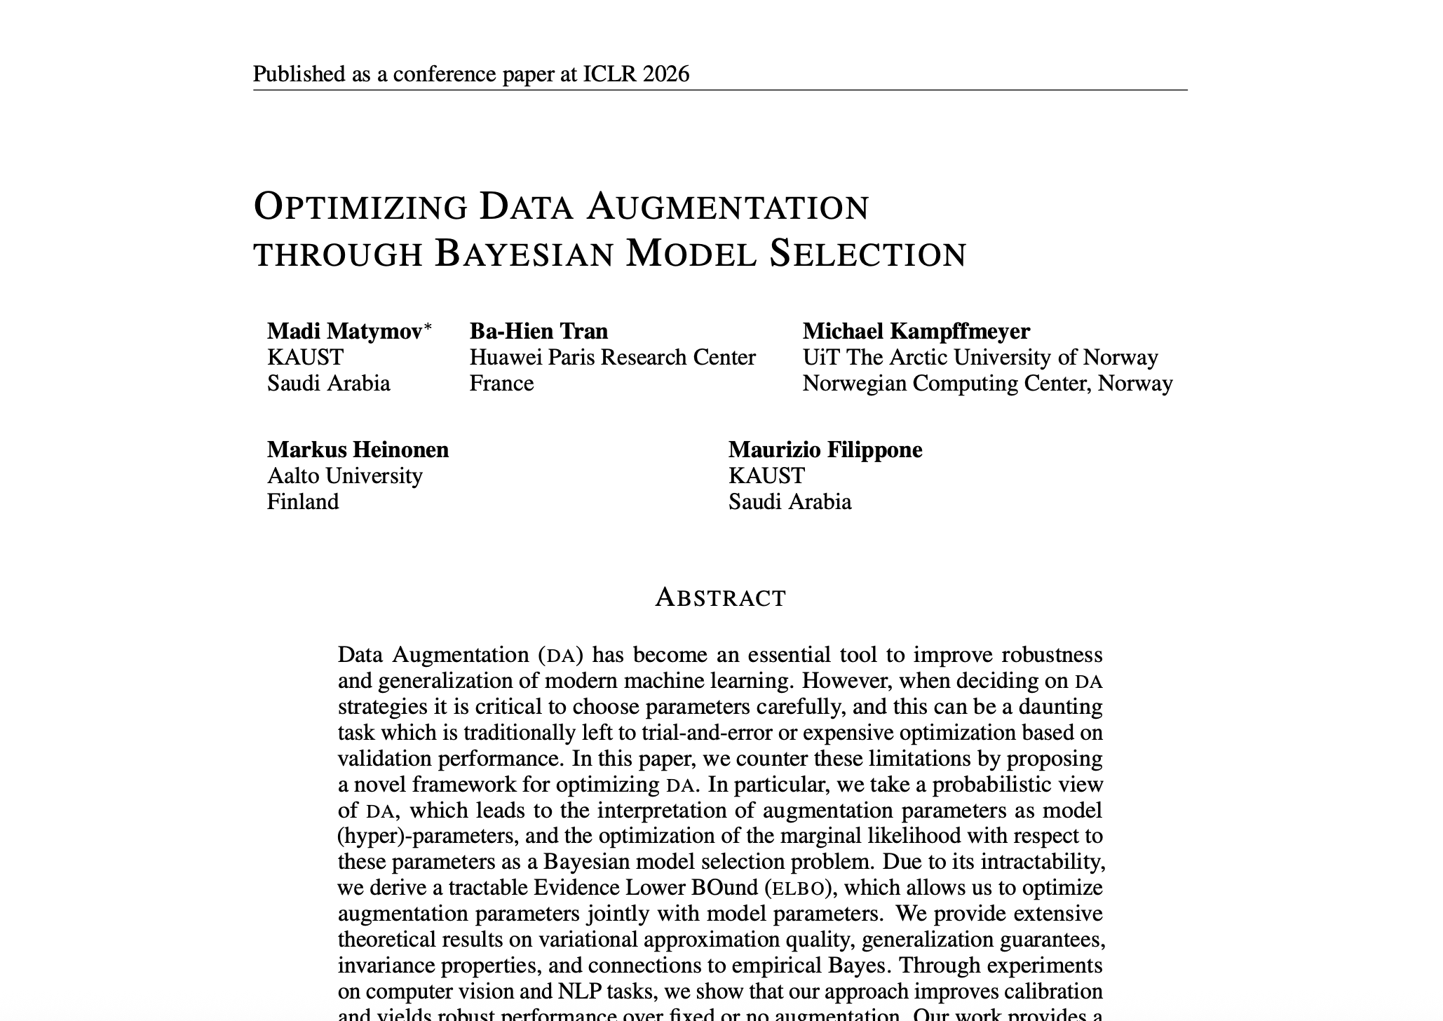
Some More References
Bayesian principles to understand and improve deep learning

