Slide 1

An Overview of the
IHO S-57 Transfer Standard for ENC Production
CARIS HOM for ENC Production
Fredericton – Canada • Heeswijk – The Netherlands • Ellicott City – United States

Slide 2

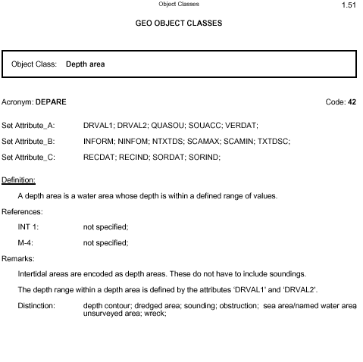
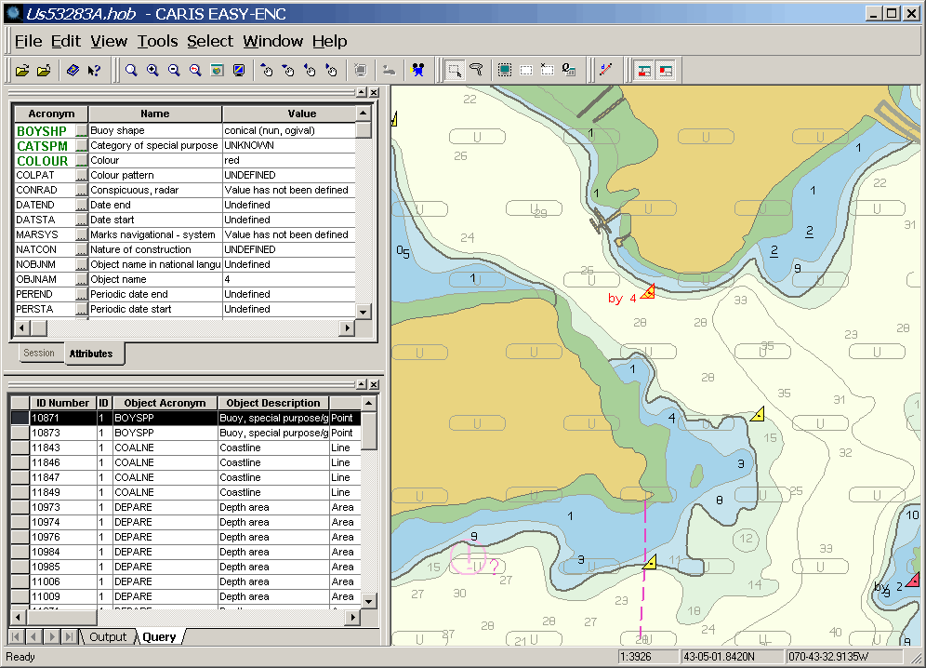
Contents
Introduction & Definitions
S-57 Transfer Standard
  1. General Information
  2. Theoretical Data Model
  3. Data Structure
S-57 Product Applications
  4. Electronic Navigational Chart (ENC)
  5. ENC Encoding
  6. ENC Data Delivery
Notes:
The contents of this presentation are given in the same order as in the S-57 Standard Document
CARIS wishes to acknowledge and thank the many individuals from different organizations who have helped contribute to the material and content used in this presentation.

Slide 3
Objectives
Overview of the IHO S-57 Standard
  Background and introduction
  S-57 Data Model
  IHO Object and Attributes Catalogues
The Electronic Navigational Chart Product
  Review the ‘ENC Product Specification’
  Understand how to use the ‘Use of the Object Catalogue’ for ENC production
  Creating ‘ENC Exchange Sets’

Slide 4
What is S-57?
What is the ‘S-57 Standard’, or ‘S-57’ for short?
  ‘International Hydrographic Organization (IHO) Transfer Standard for Digital Hydrographic Data, Ed. 3.1, Nov. 2000 - Special Publication No. S-57’
  S-57 is a Standard for the exchange of digital hydrographic data between hydrographic offices (and others) and for its distribution to users
S-57 provides a vector, file-based mechanism for
  the transfer of data from one computer system to another, independent of make as well as medium used to establish the transfer
Notes:
IHO: International Hydrographic Organization (www.iho.shom.fr)
‘An intergovernmental consultative and technical organization that was established in 1921 to support the safety in navigation and the protection of the marine environment.’
It has 70 Member States, and has its headquarters at the International Hydrographic Bureau in Monaco.

Slide 5
Why Adopt S-57?
International standard for digital hydrographic data, designed by maritime data producers
  offers a new standardized way to structure such data
  can be used for survey and chart data
S-57 is a computer and operating system independent format
Permits a very accurate and detailed method for mapping navigation data
The S-57 product, the ENC, can be used on automated vessel navigation systems
  offers increased safety and efficiency in navigation

Slide 6
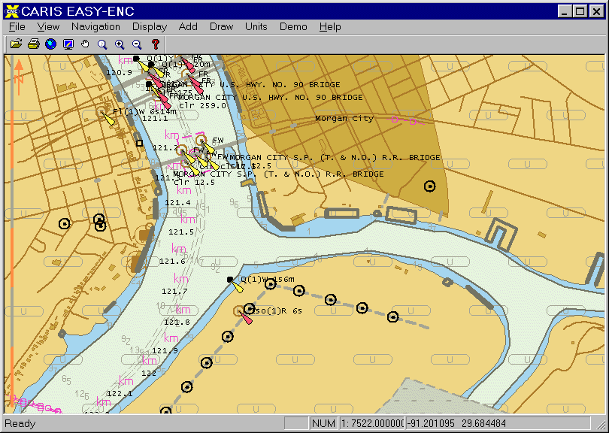
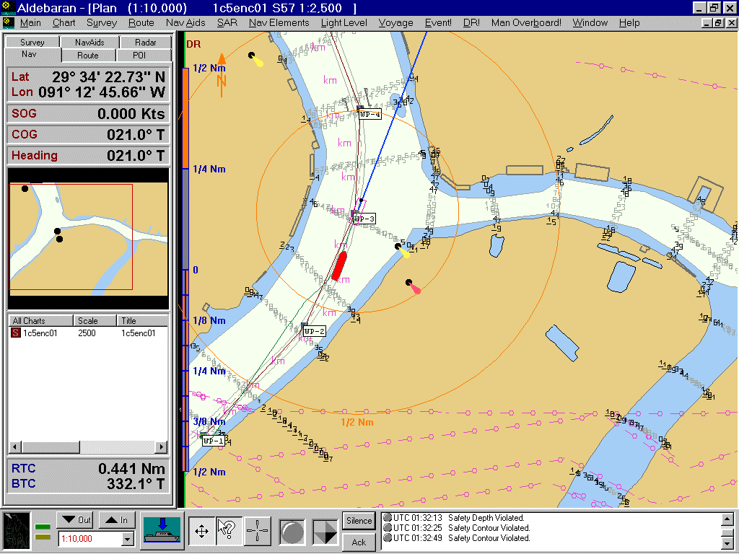
What is an ENC?
‘Electronic Navigational Chart’ (ENC)
  a file-based vector dataset based on the S-57 standard
  content is similar to the information contained in a traditional printed navigation chart, but presentation is different from printed charts (symbology, colours, etc.)
  for use with electronic charting systems on ships

Slide 7
Formal Definition of an ENC
An Electronic Navigational Chart (ENC)
  a dataset ‘standardized as to the content, structure and format as issued for use with ECDIS on the authority of government-authorized hydrographic offices. The ENC contains all the chart information necessary for safe navigation, and may contain supplementary information in addition to that contained in the paper nautical chart (e.g. sailing directions) which may be considered necessary for safe navigation’
    Performance Standards for ECDIS (International Maritime Organization, 1995)

Slide 8
Acceptance of ENCs
In November 1996, the International Maritime Organization (IMO) formally adopted the ECDIS Performance Standard, including ENC display
Use of ‘Official’ ENC data is permitted under the United Nations Law of the Sea, as long as the ENC datasets are updated and maintained using the S-57 specified mechanisms, and an adequate back-up is available
The encoding of the real-world entities is ruled by the ‘Use of the Object Catalogue’ Appendix B-1 Annex A of S-57, and ENC ‘Product Specs’.
Notes:
IMO: International Maritime Organization (www.imo.org)
‘IMO is the United Nations' specialized agency responsible for improving maritime safety and preventing pollution from ships.’
It has 162 Member States, and is based in London, United Kingdom.

Slide 9
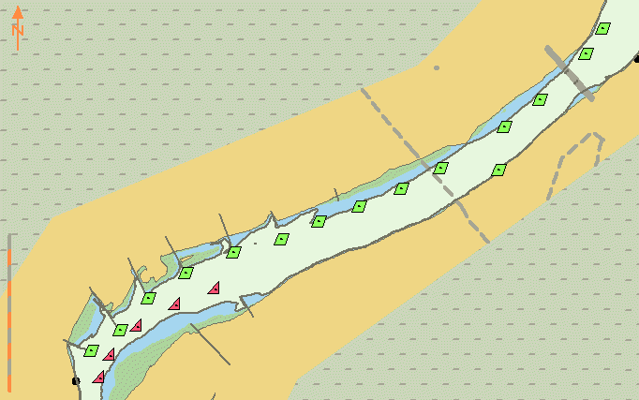
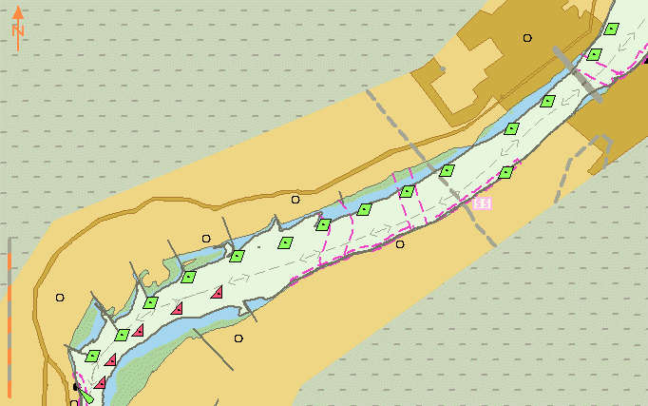
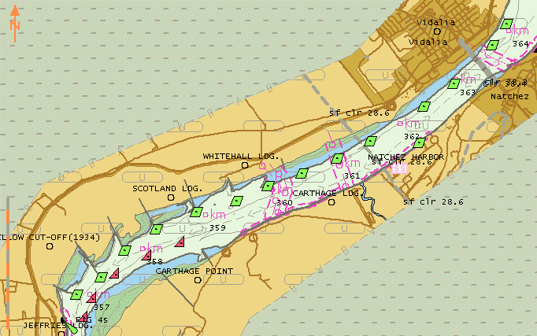
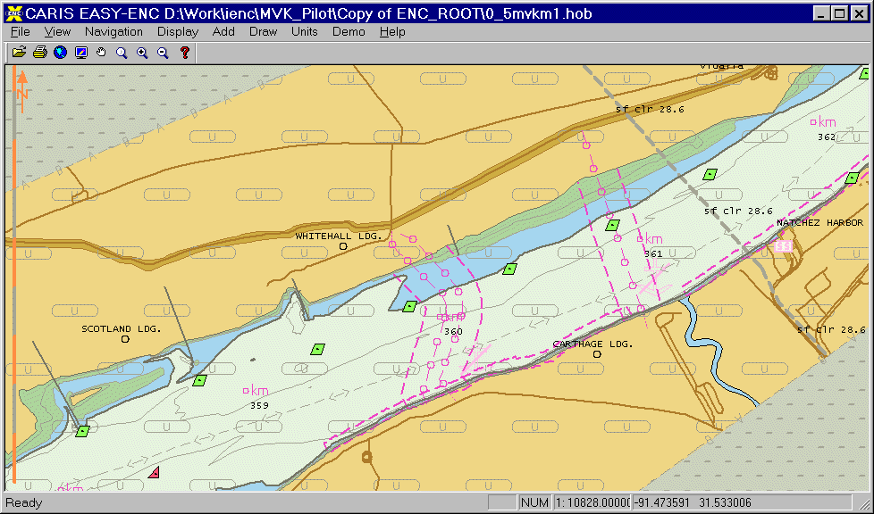
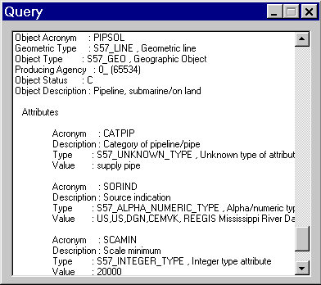
Working with ENC Data
Controlling the ENC by data display categories
ENC objects can be queried (but not edited)
Base (minimum); Standard (default); Standard & Other (all)
Notes:
Within an electronic charting system, users can work with ENC data as follows
Control what ENC objects are displayed because an ENC is a vector dataset
this is controlled by pre-defined display categories
additional controls allow text to be turned on and off, etc.
define the ‘safety contour’ to show the safe water area in the ENC
Any ENC object can also be queried within the ENC to find out more information
object description and acronym
attribute descriptions and acronyms
attribute values
IMPORTANT
ENC information cannot be edited by users within the electronic charting system
depth information in the ENC cannot be adjusted for tide height/water level, etc.

Slide 10

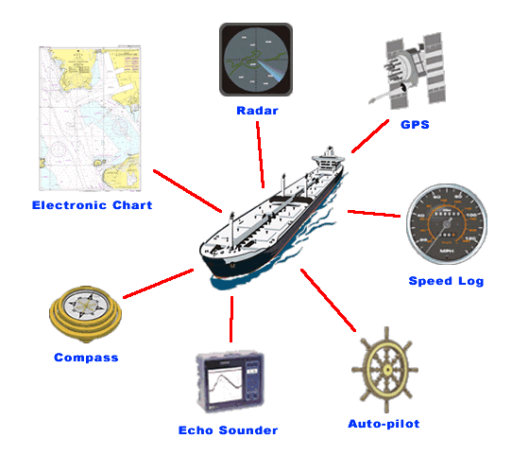
What is an ENC used for?
Provide electronic chart data for electronic chart systems (ECS/ECDIS)
  these are sophisticated vessel navigation information systems, incorporating
    ENC … and also ...
    navigation sensor data: GPS, gyro, depth, etc.
    water level, current
    vessel speed, course, track
    radar overlay
    etc.
Notes:
Electronic charting systems are intended to permit safe navigation, by the continuous display of the location of a ship on an ENC, and incorporating other real-time information. Results:
improved safety of navigation
improved efficiency of navigation
reduced mental stress, workload and time spent on navigation-related tasks
an ENC just provides one part of the information used by an ECDIS/ECS

Slide 11
Definition of an ECDIS and an ECS
Electronic Chart Display & Information System
  ECDIS: ‘A navigation information system which, with adequate back-up, can be accepted as complying with the up-to-date chart requirement by regulation V/20 of the 1974 SOLAS Convention, by displaying selected information from a system navigational chart (SENC) with positional information from navigational sensors to assist the mariner in route planning and route monitoring, and by displaying additional navigation-related information if required.’
Electronic Charting System (ECS)
  performs most of the same functions, but does not match the stringent ECDIS ‘Type Approval’ process
Notes:
Note on Electronic Charting Systems (ECS)
An ECS performs most of the same functions, but does not comply with the very stringent ECDIS ‘Type Approval’ process.
ECS systems are much cheaper, and much more widely used, than ECDIS.
Note that not all ECS systems support S-57 ENC data
they may only support raster nautical charts, for example
One list of ECDIS system manufacturers can be found at:
http://www.ukho.gov.uk/ECDIS_display_systems.html

Slide 12
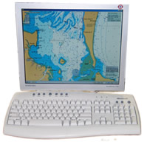
Key Features of ECDIS/ECS
ENC Data
  chart information use in ECDIS must be
  latest edition
  must conform to IHO standards
Updating
  ECDIS/ECS must be capable of accepting ENC updates & keep record of the updates
Colours & Symbols
  must conform to specifications contained in IHO S-52 Standard - ‘Specification for Chart Content and Display of ECDIS’

Slide 13
Definition of an SENC
ECDIS/ECS converts an ENC to a ‘SENC’
A ‘System ENC’ (SENC) is
  ‘The database resulting from the transformation of the ENC by the ECDIS for appropriate use, updates to the ENC by appropriate means, and other data added by the mariner. It is this database that is actually accessed by ECDIS for the display generation and other navigational functions, and is equivalent of a up-to-date paper chart. The SENC may contain information from other sources.’

Slide 14
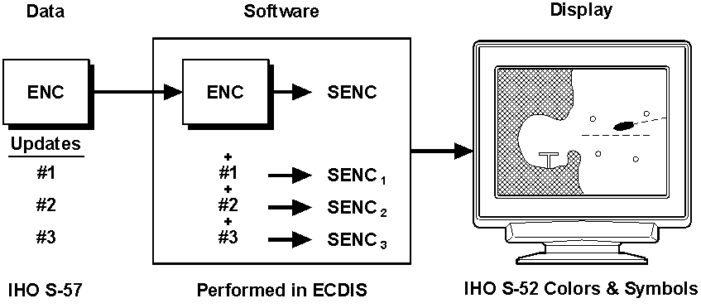
SENCs in an ECDIS
The SENC must be updated periodically with new ENC updates from the data provider

Slide 15

Summary: Benefits of ENCs
Using ENCs in ECDIS
  Accident avoidance, reduced risk of grounding, …
  Savings in fuel costs, time saving, …
  Improved operational efficiency, e.g. better route planning, more efficient updating of ENCs, better use of bridge personnel
Results: improved safety, time/cost savings

Slide 16
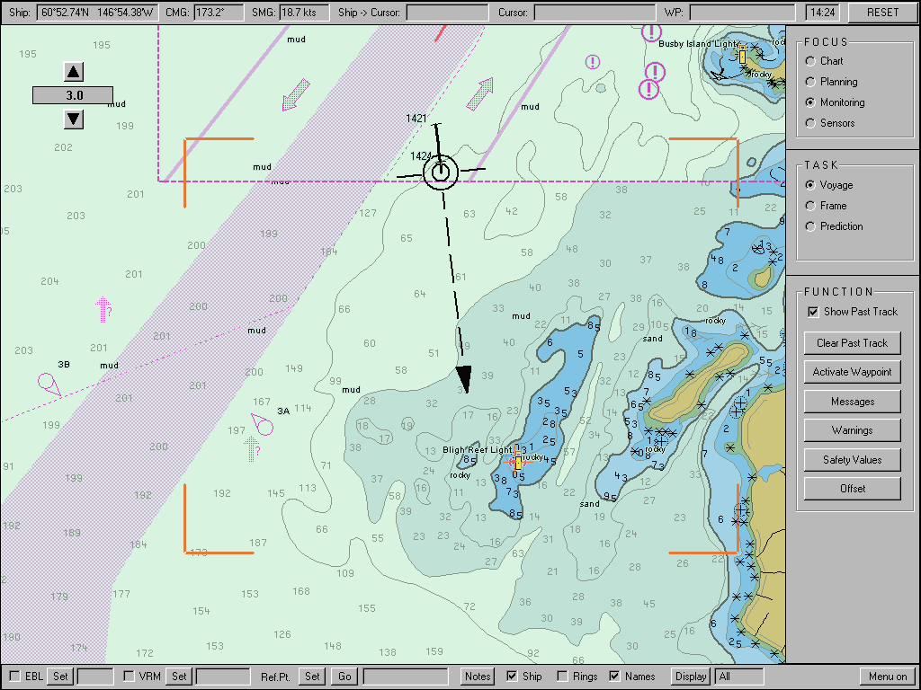
Example: Exxon Valdez Grounding
What if it had an ECDIS...?
  ECDIS software can provide alarms, warnings and use “intelligence” of ENC data
If the Exxon Valdez had an ECDIS, 4 alarms, warnings would have sounded:
  1. leaving outbound lane
  2. entering inbound lane
  3. exiting traffic separation scheme
  4. safety depth warning
Bligh Reef, Prince William Sound, Alaska - site of EXXON VALDEZ grounding on 23rd March, 1989
The worst spill in terms of damage to the environment worldwide.

Slide 17
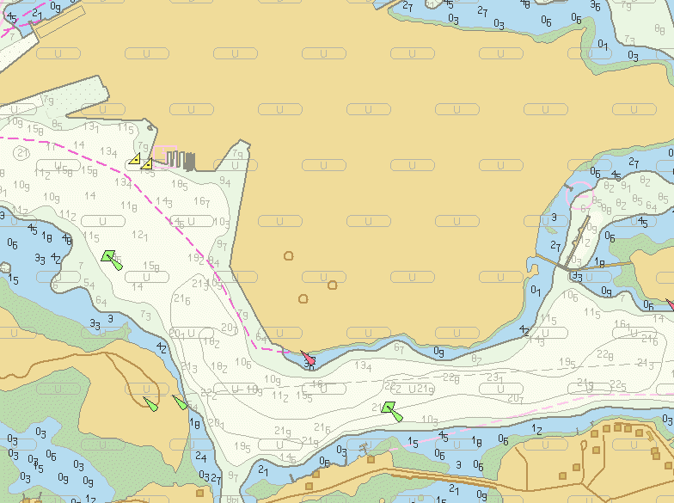
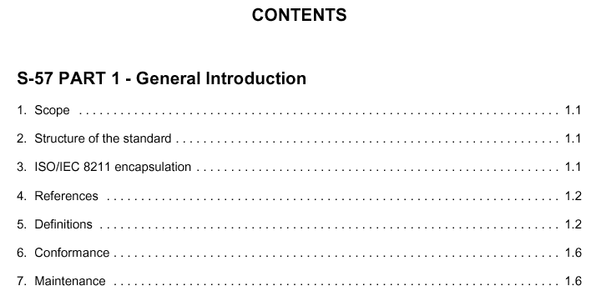
1. S-57 Transfer Standard
S-57 General Information

Slide 18

History of S-57
Earlier editions
  1987: DX-87
  1990: S-57/DX-90
  1994: S-57 version 2
  1996: S-57 Edition 3.0
Current edition
  2000: S-57 Edition 3.1, very similar to Ed 3.0 – only 40 new attribute values
  2001: “will remain valid indefinitely” (IHO, Nov 2001)
  Future: S-100 is planned to be available in late 2007

Slide 19
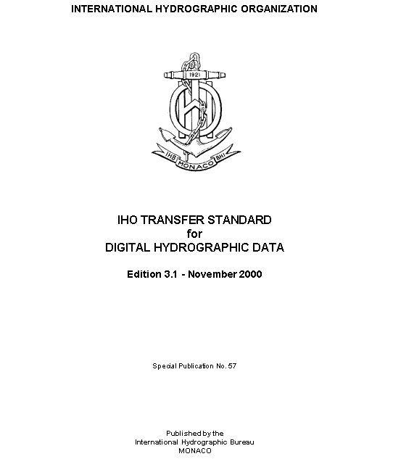
Contents of S-57
S-57 is the ‘IHO Transfer Standard for Digital Hydrographic Data’ – the main sections are:
  Part 1 General Introduction
  Part 2 Theoretical Data Model
  Part 3 Data Structure
  Appendix A IHO Object Catalogue
    Chapter 1 - Object Classes
    Chapter 2 - Attribute Classes
  Appendix B.1 ENC Product Specs.
    Annex A - Use of the Object Catalogue for ENC
Periodic S-57 Maintenance Documents
  clarifications and corrections to S-57

Slide 20
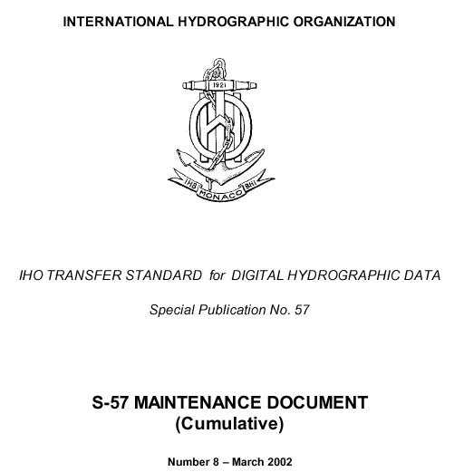
Other Periodical S-57 Documents
S-57 Maintenance Document (MD)
  Clarifications: improvement to the wording
    used to clarify unclear and/or ambiguous statements
  Corrections: changes to Standard
    used to correct factual errors and make necessary amendments
  Extensions: extensions, or other significant changes to the Standard
    these are approved by the Working Group and will be included in the next edition of the standard
Notes:
The latest available S-57 MD is MD8 - March 2002

Slide 21
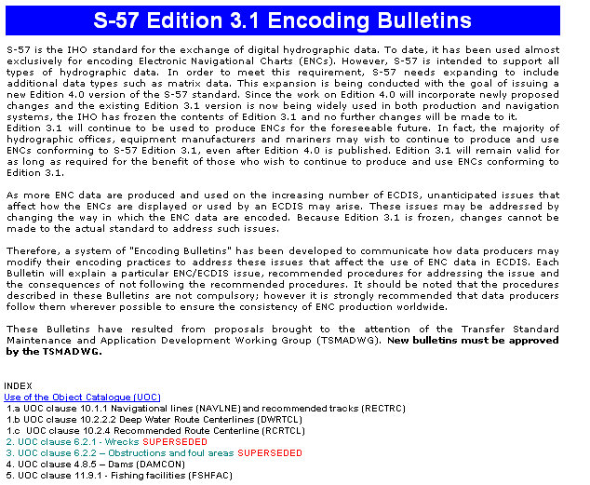
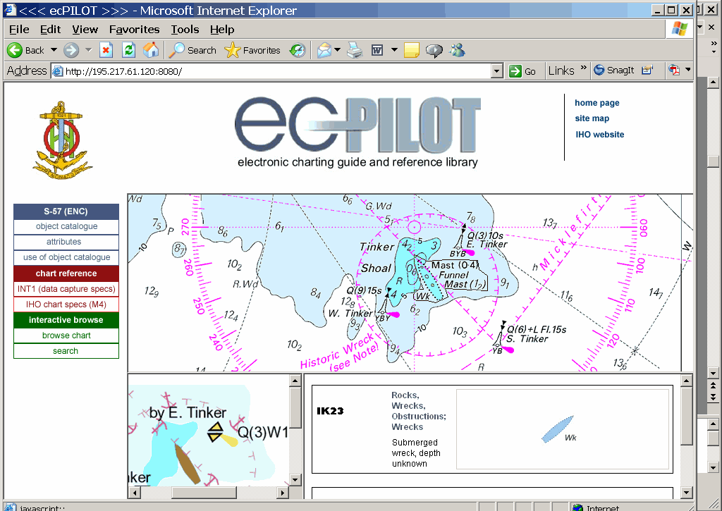
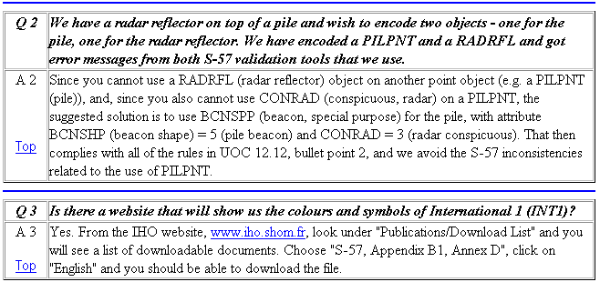
Other IHO S-57 Resources
The IHO website includes further S-57 resources
  S-57 / ENC Encoding Bulletins
  Frequently Asked Questions
  ‘ENC Pilot’
  Recommendations for Consistent
  ENC Encoding
Notes:
S-57 / ENC Encoding Bulletins: ‘http://www.iho.shom.fr/ECDIS/bulletin_faq/S-57_bulletin.htm’
ENC FAQs: ‘http://www.iho.shom.fr/ECDIS/bulletin_faq/S57_faq.htm’
ENC Pilot: ‘http://195.217.61.120:8080/’
ENC Encoding Recommendations: ‘http://www.iho.shom.fr/ECDIS/bulletin_faq/ENC_Encoding_Recom.pdf’

Slide 22
The Future of S-57
Future edition
  A new parallel S-57 Edition 4.0, is under development, “intended for release in 2007” (IHO, Nov 2004)
  Decision to rename S-57 Ed 4.0 as S-100 and to create a new S-101 ENC Product Specification based on S-100, but unlikely to come into effect before 2012 (IHO, Mar. 2005)
  Requirement to develop an intermediate revision of S-57 called Edition 3.1.1, to support new paper chart features, e.g. PSSAs and ASLs, to come into effect in 2007 or 2008 (IHO, Sept. 2005)
Notes:
PSSA: Particularly Sensitive Sea Areas
ASL: Archipelagic Sea Lanes

Slide 23
Useful Abbreviations
  DBWG Data Base Working Group
  ECDIS Electronic Chart Display & Information System
  ECS Electronic Chart System (not an ECDIS)
  ENC (Official) Electronic Navigational Chart
  HO National Hydrographic Office
  IHB International Hydrographic Bureau
  IHO International Hydrographic Organization
  IMO International Maritime Organization
  SENC System Electronic Navigational Chart
  TSMAD Transfer Standard Maintenance and Development Working Group

Slide 24
IHO Standards Related to S-57
S-52 - Specifications for Chart Content and Display Aspects of ECDIS (see later)
S-58 - Recommended ENC Validation Checks
  Edition 2.0, Oct 2003 (formerly part of S-57)
  Checks for Errors and Warnings, based on S-57 data structure, conformance to ENC Product Specification and Use of Object Catalogue, etc.
S-62 - IHO Codes for Producing Agencies
  Edition 2.0, Dec 2004 (formerly a part of S-57)
S-63 - IHO Data Protection Scheme
  Edition 1.0 Oct 2003
Notes:
S-65 – Electronic Navigational Charts (ENCs) Production Guidance, written by UKHO for IHO
Edition 1.0, Mar 2005

Slide 25
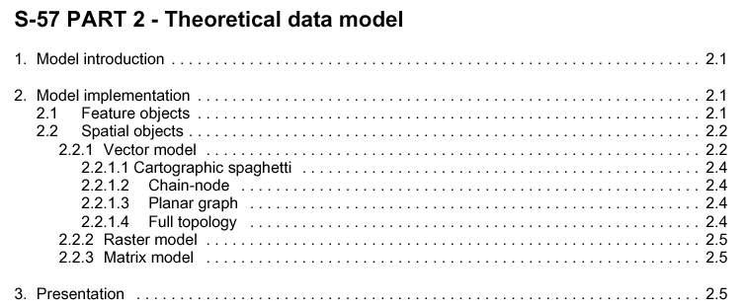
2. S-57 Transfer Standard
Theoretical Data Model
Notes:
S-57 is the ‘IHO Transfer Standard for Digital Hydrographic Data’:
Part 1 General Introduction
Part 2 Theoretical Data Model - this section is discussed next
Part 3 Data Structure
Appendix A - IHO Object Catalogue - this appendix is discussed too
Chapter 1 - Object Classes
Chapter 2 - Attribute Classes
Appendix B.1 - ENC Product Specs.
Annex A - Use of the Object Catalogue for ENC

Slide 26
S-57 Data Model
Highly simplified model of hydrographic reality
  consists of positional and non-positional aspects
Object
Feature Object
Spatial Object
1+
Points
Lines
Areas

Slide 27


S-57 Data Model
Information in S-57 is stored as ‘objects’
  Feature objects contain the descriptive information
    ~170 feature object classes are defined in S-57
    feature objects are defined by a set of attributes
    ~190 attribute classes are defined in S-57
  Spatial objects contain the positional information
    Latitude, longitude and depth, etc.
Notes:
S-57 Object
an identifiable set of information in the S-57 Data Model
Feature Object
an object which contains the non-positional information about real world entities
a feature object is encoded as a ‘feature record’ in the S-57 data structure
Attributes
a characteristic of an object, implemented by a defined attribute acronym, a definition and applicable values
Spatial Object
an object which contains locational information about real world entities
a spatial object is encoded as a ‘spatial record’ in the S-57 data structure

Slide 28
S-57 Object Example
A navigational aid might consist of
2 parts: a beacon with a light
and in S-57 this becomes:
Feature Objects - non-positional:
BCNLAT LIGHTS
BCNSHP LITCHR
COLOUR COLOUR
CATLAM ...
...
55.35° N
Spatial Object - position:
12.41º E
Notes:
Feature Objects contain descriptive attributes and do not contain any geometry (shape and position of a real world entity). In other words, the feature object would store the shape and colour attributes of a buoy, beacon, etc.
Spatial Objects must contain geometry (location information) and may also contain descriptive attributes. For example, the spatial object would store the real world position of a buoy, beacon, etc.
Relationships
a feature object is located by a relationship to one or more spatial objects
a feature object may exist without referencing a spatial object
each spatial object must be referenced by a feature object

Slide 29
S-57 Feature Object Types
The S-57 data model defines four types of feature objects:
  Geo - containing descriptive characteristics of real-world entities (most objects are of this type: 159)
  Meta - containing information about other objects (13)
  Collection - describing the relationship between other objects (3)
  Cartographic - containing information about cartographic representation of real-world entities (5)
Feature objects have unique 6-character codes
  e.g. DEPARE (depth area); LNDARE (land area); BOYLAT (buoy, lateral); LNDMRK (landmark); etc.

Slide 30
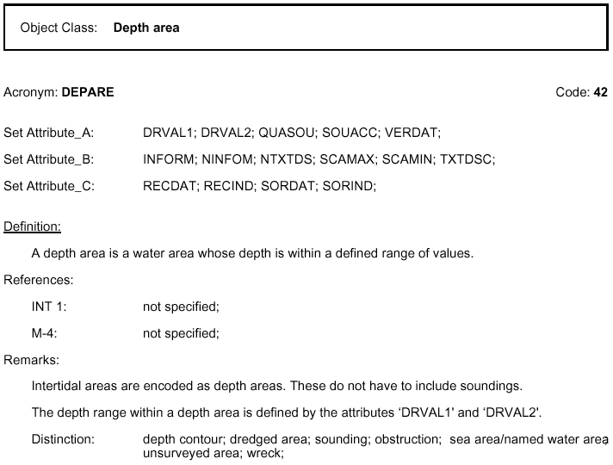
S-57 Object Class Example
Notes:
S-57 Appendix A is the IHO Object Catalogue - Chapter 1 lists all S-57 Object Classes
Each object class is specified in a standardized way, in S-57 Appendix A, under the headings:
Object: Object name
Acronym: six character code for the Object
Code: 2-byte integer code used in the internal coding of data in S-57 structure
Attributes: for each object class, the attributes are defined in 3 sets:
Attribute A: used to define the individual characteristics of an object
Attribute B: used to provide additional information, related to presentation (e.g. scale) or, additional textual/pictorial information
Attribute C: used to define administrative information about the object
Definition: each object class is defined (and usually the source is quoted)
INT 1: reference to the number of the chart feature in INT 1 (if applicable)
M-4: reference to the paragraph number in M-4 (if applicable)
Remarks: further comments and notes are given
Distinction: similar or related but distinct S-57 object classes are listed here

Slide 31
S-57 Attributes
Three Attribute categories: Set A, Set B, Set C
Attributes can be of the following types:
  ‘E’: Enumerated - 1 value selected from a list of values
  ‘L’: List - 1 or more values selected from a list of values
  ‘F’: Floating point number - range, resolution, units, format given
  ‘I’: Integer value - range, units and format is given
  ‘A’: Coded string - format is given
  ‘S’: Free format string
Attributes not (yet) set have the value ‘undefined’
Attributes with no known value are ‘unknown’
Attribute acronyms also have 6-character codes
  e.g. DRVAL1 (depth value 1), OBJNAM (object name), VERCLR (vertical clearance), COLOUR, etc.
Notes:
For each feature object class there are three attribute categories (as seen above):
Attribute Set A: used to define the individual characteristics of an object
Attribute Set B: used to provide information for presentation or for an information system
Attribute Set C: used to define administrative information about the object
If an attribute code needs to be present but the value is missing, or not known, the value
for this attribute is set to ‘UNKNOWN’.
If the attribute code is not present or not needed, the value is ‘UNDEFINED’.

Slide 32
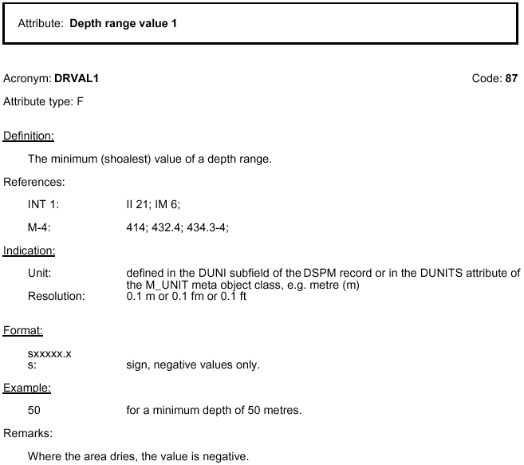
S-57 Attribute Class Example
Notes:
S-57 Appendix A is the IHO Object Catalogue - Chapter 2 lists all S-57 Attribute Classes
Each attribute is also specified in a standardized way, under the headings:
Attribute: Attribute name
Acronym: six character code for the Attribute
Code: integer code to be used in the coding of data
Attribute type: one character code for the type (there are six types - see earlier)
Indication: units, etc.
Format: required format for the attribute
Example: example of possible value with the required formatting, etc.
Remarks: additional comments, etc.

Slide 33
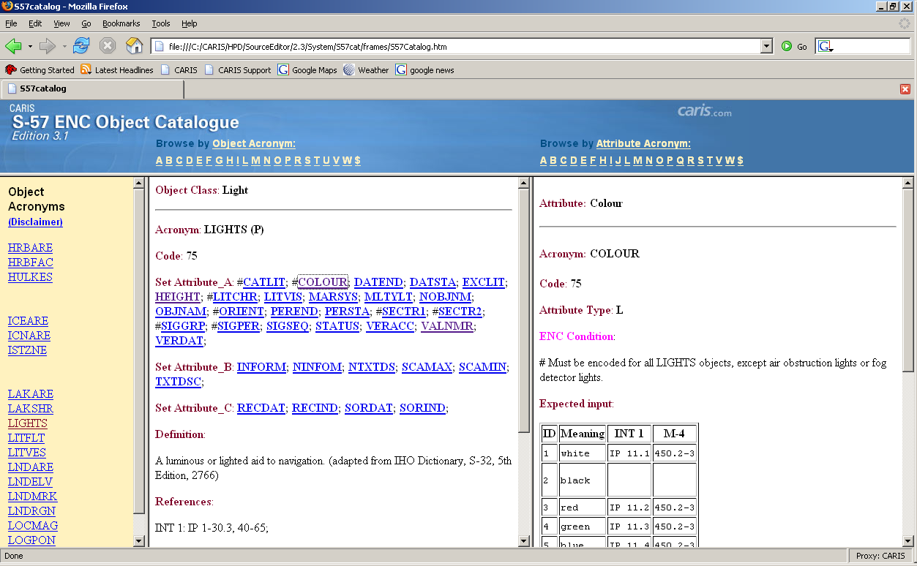
CARIS HTML S-57 Object Catalogue
Notes:
CARIS has produced an HTML version of the IHO S-57 Object Catalogue
CARIS Website: http://www.caris.com
information about CARIS software products, company news, events, etc.
general information about ENCs and links to other ENC websites
The complete HTML version of the S-57 Object Catalogue at:
http://www.caris.com/s-57
then follow the links to the ‘S-57 Catalogue’
then examine any S-57 object class, and any S-57 attribute

Slide 34
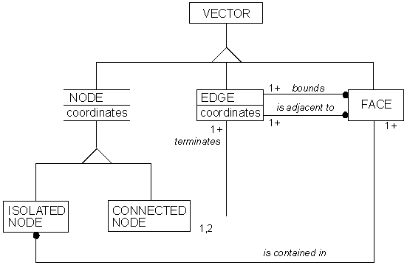
Topology in S-57
S-57 also describes vector data relationships, including topology
Four topology levels can be
derived in S-57
  1. Cartographic Spaghetti
  2. Chain-Node
  3. Planar Graph
  4. Full Topology
  higher topology levels allow for more sophisticated analysis to be performed on the data
  the ENC Product Spec. uses Chain-Node topology
Notes:
Spatial Objects
the S-57 data model currently only allows for vector data
Vector
spatial objects of type vector can have zero (points), one (lines) or two (areas) dimensions
the third dimension is expressed as an attribute of an object (feature object)
Topology
deals with the properties of geometric relationships between features
depending on the level of topology used, the three dimensions (points, lines, areas) will be defined in a slightly different way - in general:
- points are nodes (isolated or connected)
- lines are edges which may start and end with a connected node, and
- areas are either joined edges or faces (which are bounded by edges)

Slide 35
S-57 Data Model: 1. Points
Point feature objects exist at a single location
Examples
  Beacons, buoys, topmarks
  Obstructions, wrecks, rocks
  Buildings, landmarks
  Harbour facilities
  Lights
  Summits
  Berths, cranes
  Etc.
BCNCAR
Feature Objects
Spatial Objects
55.35º N
12.41º E
Notes:
Points are vector spatial objects having zero dimension - also called ‘Nodes’.

Slide 36
S-57 Data Model: 1. Points (cont)
Feature Objects may share Spatial Objects
TOPMAR
BCNCAR
LIGHTS
Feature Objects
Spatial Objects
55.35º N
12.41º E
Notes:
Point objects sharing a spatial location/object are related using a ‘Master/Slave Relationship’

Slide 37
S-57 Data Model: 2. Soundings
Soundings are special point objects in S-57
  The depth value is stored in the spatial object
Depths of other objects become attribute values
  Wrecks
  Obstructions
SOUNDG
Feature Objects
Spatial Objects
X,Y,Z
4
5
Notes:
Soundings are treated as a special type of vector point spatial object in S-57.

Slide 38
S-57 Data Model: 2. Soundings (cont)
Soundings with identical attribute values can be grouped into one Feature Object
        Result is more efficient storage of sounding data
SOUNDG
Feature Objects
Spatial Objects
X,Y,Z, X,Y,Z X,Y,Z, ….....
5
8
9
6
3
2
3
4
7
7
5
4
2
6
1
8

Slide 39
S-57 Data Model: 3. Lines
Line feature objects are continuous edges
Examples
  Coastline
  Artificial shorelines
  Depth, land contours
  Mooring lines
  Navigation lines
  Cables, pipelines
  Roads, rail lines
  Etc.
COALNE
Feature Objects
Spatial Objects
X,Y, X,Y, X,Y, X,Y, X,Y, …...
Notes:
Lines are vector spatial objects having one dimension - also called ‘Edges’.

Slide 40
S-57 Data Model: 3. Lines (cont.)
Identical lines are chained - spatial objects remain
COALNE
Feature Objects
Spatial Objects
X,Y, X,Y, X,Y, X,Y, X,Y, …...
X,Y, X,Y, X,Y, X,Y, X,Y, …...
X,Y, X,Y, X,Y, X,Y, X,Y, …...

Slide 41
S-57 Data Model: 4. Areas
Areas are defined by edges (chain-node model)
Examples
  Land, depth (water) areas
  Docks, locks
  Anchorages
  Restricted areas
  Harbours
  Traffic separation areas
  Buildings, built up areas
  Etc.
RESARE
Feature Objects
Spatial Objects
X,Y, X,Y, X,Y, X,Y, X,Y, …...
X,Y, X,Y, X,Y, X,Y, X,Y, …...
Notes:
Areas are vector spatial objects having two dimensions - also called ‘Faces’.

Slide 42
S-57 Data Model: 5. Shared Geometry
Feature Objects can share Spatial Objects
Therefore edges (and points) are only written once to the S-57 file for efficiency
LNDARE
DEPARE
E
Area: E, C, B, A
Area: A, B, C, F
A
B
C
RESARE
D
COALNE
Area: B, D
F
Line: A, B, C
Notes:
Areas are defined by series of edges
Edges for different objects may be placed on different layers in the vector data file
Therefore edges that are shared by multiple objects must be identical, i.e.
have the same start and end nodes
may need to split arcs to ensure they have the same starting and ending nodes
must be identical along their entire length
may need to copy (duplicate) arcs from one layer to another to ensure this is true
edges failing to meet these criteria are termed “colinear lines” are must be corrected

Slide 43
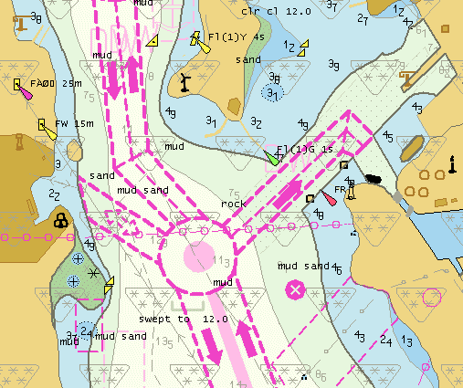
S-57 Data - S-52 Display
S-57 is a data transfer standard
  contains no data presentation rules
The related S-52 Standard defines
presentation, colours, and
symbology for S-57 ENC data
viewed in an ECDIS
S-52 provides specifications regarding the
  issuing and updating of ENCs: must be S-57 format
  display of ENC data: colours and symbols to use
Note: ENC data users have ...
  some control on what is displayed, but no control of the appearance of the displayed S-57 objects
Notes:
S-52 was developed by the IHO and the IMO (International Maritime Organization), and defines the IMO Performance Standards for Electronic Chart Display & Information Systems.
S-57 Data Presentation
“The model described in the S-57 Standard does not contain any rules for the presentation or display of information. It provides only the means for the factual description of the real world. The presentation of this information may vary to suit a particular use. The concept of keeping information storage independent of presentation provides for greater versatility and flexibility. It allows the same data to be used for many purposes without requiring any change to its structure or content.” (S-57 Part 2, Chapter 3)

Slide 44
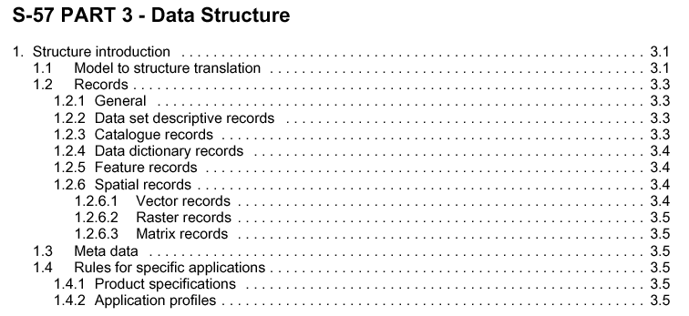
3. S-57 Standard
S-57 Data Structure
Notes:
S-57 is the ‘IHO Transfer Standard for Digital Hydrographic Data’:
Part 1 General Introduction
Part 2 Theoretical Data Model
Part 3 Data Structure - this section is discussed next
Appendix A - IHO Object Catalogue
Chapter 1 - Object Classes
Chapter 2 - Attribute Classes
Appendix B.1 - ENC Product Specs.
Annex A - Use of the Object Catalogue for ENC

Slide 45
S-57 Data Structure
The real world is simplified by modeling reality as described in the S-57 Data Model
The Data Model in translated into a data structure which is described in S-57 Part 3 Data Structure
  consists of records and fields
  rules and constraints for these
  as well as their content
The structure is then encapsulated in a physical transfer standard
Real World
Model
Structure
Physical Exchange
Notes:
The Physical Data Structure is dealt with in the S-57 Standard, Part 3:
the S-57 file structure is known as an Exchange Set
the S-57 Data Structure has both ASCII and binary implementations (ENC data is binary)
S-57 uses the ISO/IEC 8211 international standard as the means of encapsulating data
IMPORTANT:
the user does not need to know this in detail - the CARIS software looks after the physical data structure and creating the ENC exchange set files.

Slide 46
S-57 Data Structure: Fields, Records
Data Model - Objects are referred to as as Feature Objects, Spatial Objects, and subsets of those objects such as Meta Objects, Geo Objects, & Vector Objects
Data Structure - refer to Objects as Records and relationships between Objects as Pointer Fields; and attributes of objects are referred to as Attribute Fields
Model
Structure
Feature object…………………………………………… Feature record
Geo feature object……………………………………… Geo feature record
Spatial object……………………………………………. Spatial record
Vector object……………………………………………. Vector record
Isolated node object……………………………………. Isolated node vector record
Attributes………………………………………………… Feature or spatial attribute field
Relationships - feature & spatial objects…………….. Pointer field

Slide 47
S-57 Data Structure: Exchange Set
Note that:
  an exchange set consists of one or more files
  a file consists of one or more records
  a record consists of one or more fields
  a field consists of one or more sub fields
  the S-57 Data Structure has both ASCII and binary implementations
Exchange Set
File
Record
Field
Sub
Field
Notes:
Usually, in one S-57 Exchange, there are many objects involved, which implies that there
are many records involved.
To manage the records, they are grouped into files.
All the files put together (a set of information) and called an Exchange Set.

Slide 48
S-57 Structure: Updating Mechanism
Updates to the S-57 ‘base’ data set are compiled based on changed information only.
The changed information is sent to the end user, where the update is applied
The updates can be of type:
  INSERT, DELETE, MODIFY
Data Producer
End User
Base Data
Locate only
changed data from
Base Data
Update
Information
Apply
changed
data
End User
Base Data
Update
Base Data
Notes:
Base data – S-57 conforming data at the data producer’s site that does not contain any update records; once the data is exchanged it becomes the target data at the appliers site.
Target data – data on which an update operation is performed by the applier.
Applier – the software controlling the application of the update information.
Update Information (record) – the data needed to update the target data automatically, comprised of one or more update records. An update record is a feature or spatial object (record) with update instructions (insert, delete, modify).
Updating
There are two S-57 Application Profile types:
one for the base file (EN)
one for the update to the base file (ER)
The standard has defined a mechanism for the updating of the S-57 data set file. Since this mechanism allows for updating of individual records, fields, and sub fields within the data, old exchanged data can be brought up-to-date without having to re-issue an entire new data set.
Special fields have been added to the feature and spatial (vector) records to allow for the updating mechanism. These special fields can only be used for updating purposes.

Slide 49
S-57 Summary: Basic Principles
S-57 is a hydrographic data transfer standard
  it contains no presentation information
  S-52 defines the S-57 ENC presentation for ECDIS
Based on simplified hydrographic data model
  Objects consist of Feature Objects & Spatial Objects
  4 Class Types (Geo, Meta, Collection, Cartographic)
  170 object classes defined by S-57 Object Catalogue
Feature Attributes further define S-57 objects
  Attributes are divided into three groups (A, B, and C)
  190 Attributes classes defined for S-57
  6 value types of Attributes: E, L, F, I, A, S
4 Topology Levels defined in S-57 data structure

Slide 50

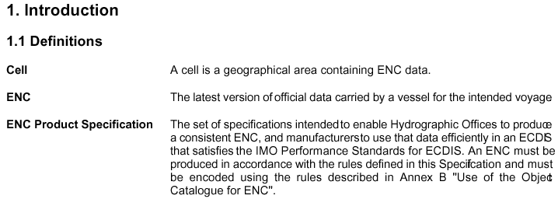
4. S-57 Product: The ENC
S-57 Electronic Navigational Chart (ENC) Product Specification
Notes:
S-57 is the ‘IHO Transfer Standard for Digital Hydrographic Data’:
Part 1 General Introduction
Part 2 Theoretical Data Model
Part 3 Data Structure
Appendix A - IHO Object Catalogue
Chapter 1 - Object Classes
Chapter 2 - Attribute Classes
Appendix B.1 - ENC Product Specs. - this section is discussed next
Annex A - Use of the Object Catalogue for ENC
S-57 Appendix B-1 ENC Product Specification:
an ENC is a product based on the S-57 Standard.
a set of specifications intended to enable the producers to create a consistent ENC, and manufacturers to use that data efficiently in an ECS/ECDIS
an ENC must be produced in accordance with the rules defined in the ENC Specification and must be encoded using the rules in the ‘Use of the Object Catalogue’ (see later).

Slide 51
Electronic Navigational Chart (ENC)
An ENC is a product based on the S-57 transfer standard
  the ENC product is a defined subset of S-57
  S-57 Edition 3.0: ENC Product Specification 1.0
  S-57 Edition 3.1: ENC Product Specification 2.0
An ENC is a database, standardized to content, structure and format, issued for use with an ECDIS on the authority of a Government authorized hydrographic office
  from IMO Performance Standards for ECDIS
Notes:
An Electronic Navigational Chart (ENC)
‘Means the dataset, standardized as to the content, structure and format as issued for use with ECDIS on the authority of government-authorized hydrographic offices. The ENC contains all the chart information necessary for safe navigation, and may contain supplementary information in addition to that contained in the paper chart (e.g. sailing directions) which may be considered necessary for safe navigation’
IMO Performance Standards for ECDIS (IMO 1995)
An Electronic Navigational Chart (ENC)
‘Electronic Navigational Charts (ENCs) consist of digitised data conforming to the IHO’s S-57 ENC Product Specification that records all the relevant charted features necessary for safe navigation, such as coastlines, bathymetry, buoys, lights, etc.’
IHO S-65 Ed1.0 ENC Production Guidance (Draft Copy, 2004)

Slide 52
ENC Cells
ENCs are split into user defined cells, also known as data set files, with a unique file name
Cells must be rectangular, defined by 2 meridians and parallels
  actual data coverage within a cell can be any shape
S-57 has no pre-defined cell tiling scheme
Cells may overlap (but see next page)
Recommended max. size of ENC cell is <5MB
Cell
Cell
Cell
Notes:
Cell – ‘a geographical area containing ENC data’.
ENC – the latest version of the official data carried by a vessel for the intended voyage.
Rectangular - for ease of display and computation, the ECDIS/ECS display treats latitudes and longitudes as X,Y coordinates displayed on a rectangular grid. Areas further from the equator will therefore be distorted (stretched) more in longitude than areas closer to the equator.
Point or line feature objects which are at the border (i.e. fall directly on/along the edge) of two ENC cells, with the same navigational purpose, must be part of only one cell; they are put in the south-west cell.

Slide 53
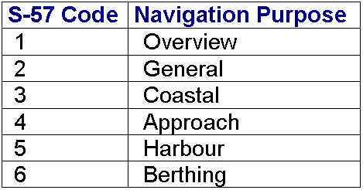
ENC Navigational Purpose
ENC cells have a single navigational purpose
  the navigational purpose code is used in the cell name
Cells with the same navigational purpose can overlap, but the data must be in one cell only
  data can be ‘repeated’ in cells of different navigational purposes covering the same geographic area
Notes:
S-57 does not define scale ranges for the different navigational purposes
Typical scale ranges might be:
1. Overview smaller scales than 1:500,000 (route planning; ocean crossing)
2. General 1:150,001 - 1:500,000 (navigating oceans, approaches to coasts; route planning)
3. Coastal 1:50,001 - 1:150,000 (navigating along coastline, inshore or offshore)
4. Approach 1:20,001 - 1:50,000 (navigating the approaches to ports/major channels;
or through intricate or congested waters)
5. Harbour 1:2,001 - 1:20,000 (navigating within ports, harbours, rivers and
canals; for anchorages)
6. Berthing larger scales than 1:2,000 (detailed aid to berthing)

Slide 54
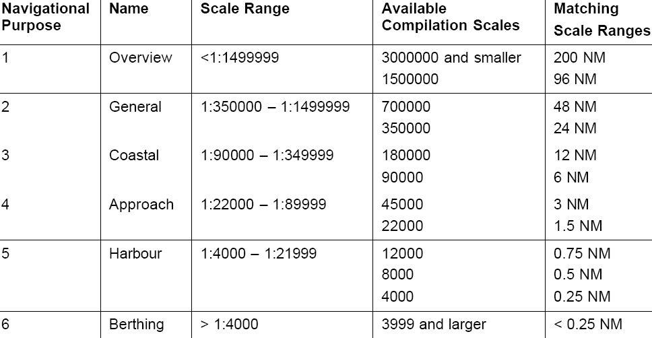
Scales for Navigational Purposes
Recommendations for Consistent ENC Encoding
  possible scale ranges for ENC navigational purposes
Notes:
As stated above, S-57 does not define scale ranges for the different navigational purposes
However, the recent IHO document ‘Recommendations for Consistent ENC Data Encoding’ (2004) suggests these “possible” scale ranges, with comparable compilation scales

Slide 55
ENC Unique Feature Object IDs
Each feature object must have a unique world-wide identifier – the Feature Object ID (FOID)
  Feature Object ID’s must not be re-used, even if the object has been deleted
  Exception: the same feature shown on an ENC of another navigational purpose can have the same FOID
A special code is used, comprised of:
  Producing Agency Code (2-characters, e.g. ‘CA’)
  Feature Identification Number (1 to ~4 billion)
  Feature Identification Subdivision(1 to ~65,000)
  e.g. CA 0000000001 00001
Roughly 260,000,000,000,000 possible values!
Notes:
Some existing ENC Producing Agency Codes include:
AU - Australian Hydrographic Service
CA - Canadian Hydrographic Service, Canada
GB - United Kingdom Hydrographic Office
US - Office of Coast Survey, NOAA, USA
U1 - National Imagery and Mapping Agency, USA
U2 - Naval Oceanographic Command, USA
U3 - the new code for the US Army Corps of Engineers
Note:
when contractors are involved in creating ENC cells for a hydrographic agency, feature object IDs assigned to different contractors must be carefully coordinated.

Slide 56
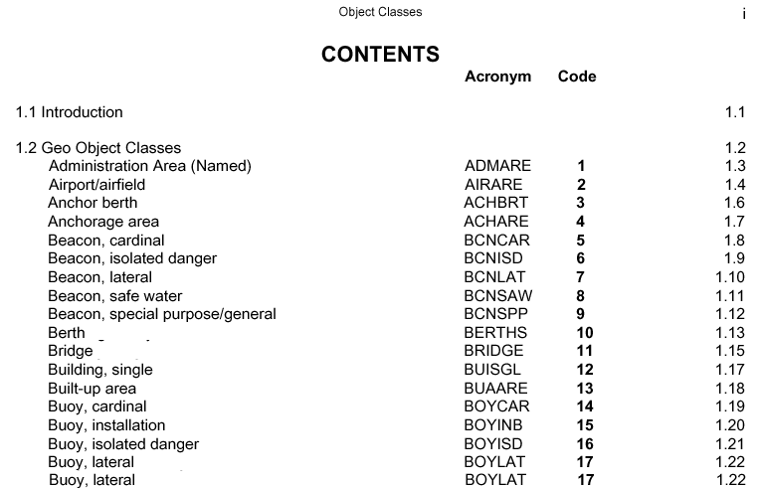
Objects in ENCs
ENC Product Specification states that only objects defined in the S-57 Object Catalogue (S-57 Appendix A) may be used in an ENC
Notes:
In other words, an official ENC can only contain valid, existing defined S-57 objects.
S-57 permits the creation of new S-57 objects, and attributes, but these cannot appear in
an official S-57 ENC. This includes new AML Objects, Marine Information Objects, etc.

Slide 57
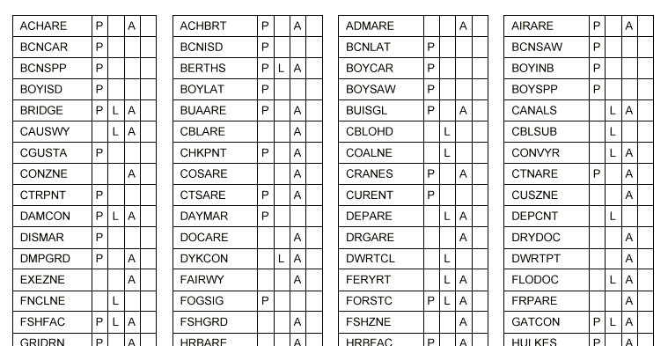
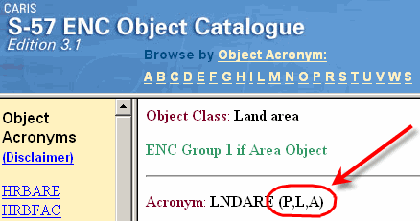
ENC Geometric Primitives
The ENC Product Specification specifies the geometric primitives for each feature object
  Point, Line, Area (or None for Collection objects)
Notes:
The CARIS S-57 ENC Object Catalogue Browser shows the permitted object geometries beside each object acronym
- P, L, A (point, line, area)
- N (collection objects)

Slide 58
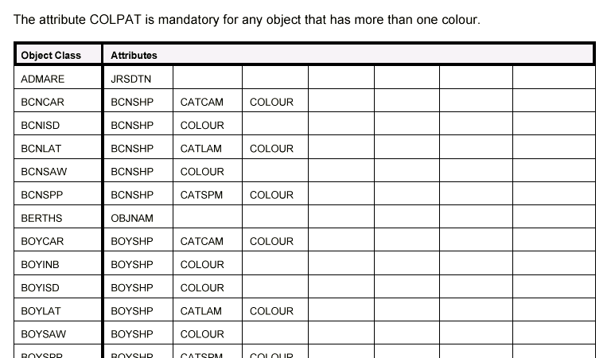
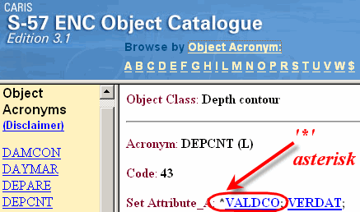
ENC Mandatory Attributes
The ENC Product Specification specifies all the mandatory attributes for objects in an ENC
Notes:
If an ENC object has an attribute entry in this table, those attributes are mandatory
a value must be supplied for all mandatory attributes
If an ENC object is not listed in this table, then it has no mandatory attributes
The CARIS S-57 ENC Object Catalogue Browser indicates mandatory attributes with an asterisk (‘*’) character

Slide 59
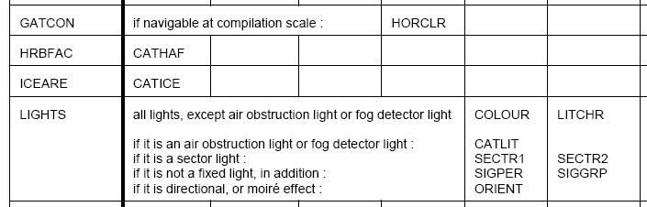
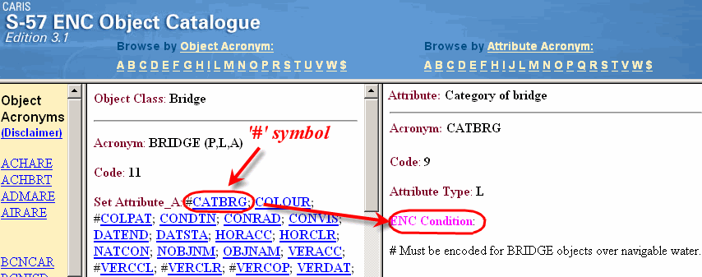
ENC Conditional Mandatory Attributes
The ENC Product Specification also specifies conditional mandatory attributes for objects
  e.g. sector lights, opening bridges, etc.
Notes:
Some entries in this table are conditional - e.g. one of two or more attributes are mandatory
in some cases, attributes are conditional depending on another attribute value selected
The CARIS S-57 ENC Object Catalogue Browser indicates conditional attributes with a ‘#’ character
clicking on a conditional attribute shows the ENC Condition details in the Attributes panel

Slide 60
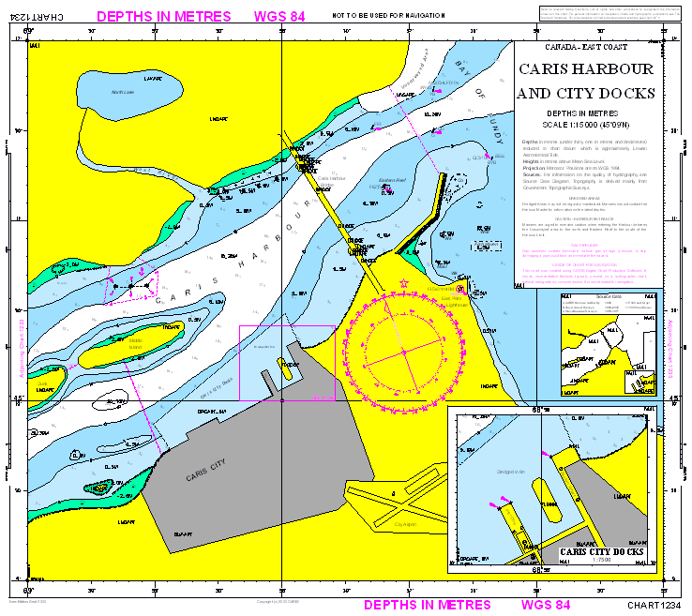
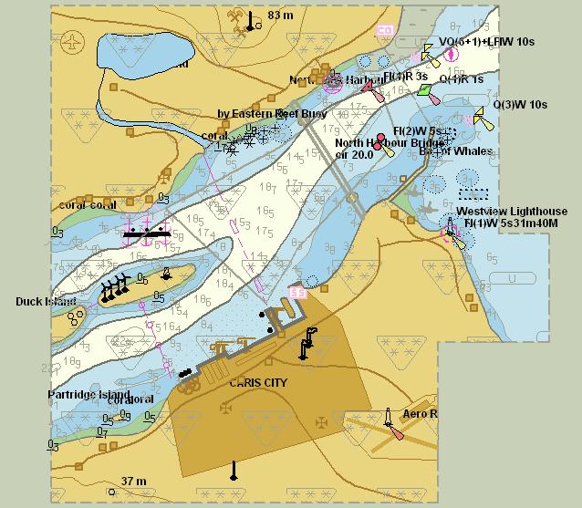

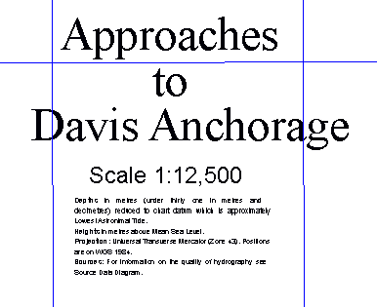
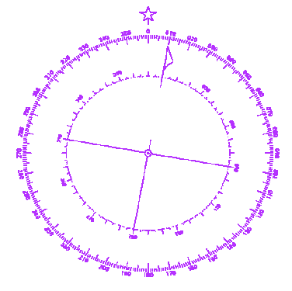
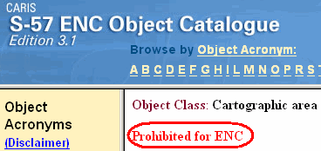
ENC Prohibited Objects & Attributes
The ENC Product Specs prohibit some feature objects and attributes from use in an ENC:
  prohibited Feature Object classes
    CANBNK, LAKSHR, RIVBNK, SQUARE
    M_HDAT, M_PROD, M_UNIT
    C_STAC
    $AREAS, $LINES, $CSYMB, $COMPS, $TEXTS
  prohibited Attributes
    CATQUA, DUNITS, HUNITS, PUNITS
    RECDAT, RECIND
    SCAMAX
    HORDAT (only for object M_HOPA)
Notes:
Note: all S-57 ‘cartographic’ objects are prohibited for ENCs (those starting with ‘$xxxxx’)
an ENC must not contain: grids, map title, most text, north arrows/compass roses, etc.
text in an ENC is represented using attributes of objects
The CARIS S-57 ENC Object Catalogue Browser indicates which object and attribute classes are prohibited for ENCs

Slide 61
ENC Meta Objects
Meta Objects are special area objects used to reduce attribution on individual objects
  if groups of objects share common characteristics, meta objects can be created to represent that commonality.
The following Meta Objects are required for every ENC cell, and must provide completed non-overlapping coverage:
  M_COVR: limits of data and no data areas in a cell
  M_NSYS: defines the navigational system of markings
  M_QUAL: defines the bathymetric data quality
Notes:
These mandatory meta objects must be added to all ENCs
Other non-mandatory ENC meta objects exist - including:
M_ACCY - area of uniform accuracy of non-bathymetric data
M_SDAT - area of uniform sounding datum
M_CLSL - area of uniform data compilation scale
M_NPUB - used to relate associated nautical information/publications
M_SREL - source survey reliability information

Slide 62
Meta Objects: Data Coverage
M_COVR encodes where ENC data is present
Cells must be completely covered by M_COVR(s)
  areas with data: M_COVR uses attribute CATCOV=1
  areas with no data: M_COVR uses CATCOV=2
Objects must be split if they appear in overlapping cells - their geometry cannot be duplicated
Data Present
M_COVR
CATCOV=1
No Data Area
M_COVR
CATCOV=2
Notes:
This meta object delimits the area(s) with data and no data in an ENC cell.

Slide 63
Meta Objects: Navigational System
M_NSYS encodes the navigational marks system used in an ENC, where data exists
M_NSYS object(s) with the attribute MARSYS must cover the entire cell where there is data
  identical coverage to M_COVR,CATCOV=1 object(s)
use M_NSYS with attribute ORIENT to show local buoyage direction
M_NSYS
ORIENT
M_NSYS
MARSYS
Notes:
This meta object describes on which side to expect red and green lights/marks.

Slide 64
Meta Objects: Depth Quality
M_QUAL encodes the quality of the bathymetric (depth) data in an ENC, where data exists
One or more M_QUAL with the attribute CATZOC must make a non-overlapping coverage of the cell where data exists (M_COVR, CATCOV=1)
  in practise, the quality value may be “unassessed”
M_QUAL
CATZOC=1
No data
M_QUAL
CATZOC=2
Notes:
This meta object describes the overall quality of bathymetric data.

Slide 65
ENC Relationships: ‘Master/Slave’
Point Feature Objects with same position, can have a ‘Master/Slave Relationship’
‘Slave’
‘Master’
‘Slave’
Feature Objects
Spatial Objects
55.35º N
12.41º E
Notes:
The master object is the ‘structure’ object to which slave object(s) are attached
these relationships are built from point objects, typically representing aids to navigation
they are created from separate features in a file, as long as they exist at the same position
Master/Slave relationships are created automatically from existing valid ENC objects

Slide 66
ENC Relationships: ‘Collections’
Collection Objects have no Spatial Objects
  they only refer to other Feature (or Collection) Objects
Collection Objects allowed in an ENC
  C_AGGR Aggregation - a group of objects form an entity
  C_ASSO Association - independent objects are related
C_AGGR = DAYMAR
DAYMAR
NAVLNE
C_ASSO = UWTROC
C_AGGR
Notes:
These special ENC objects are used to group together related, existing ENC objects
They do not have any geometry or symbolization themselves (i.e. are not points, lines or areas)

Slide 67
ENC Time Varying Objects
Depth information should only be displayed as provided in the ENC
Depth information must not be adjusted for tidal height
Depth information cannot be interpolated, e.g. for a depth contour value not present in the ENC
ENC may contain some “time related” information, collected at discrete points
  magnetic variation, tides, tidal streams and currents
Notes:
Another issue is that an ENC can only show the depth information that is already present
For example, if an ENC shows a 5m and 10m depth contours, and the user wants it to
show the 8m contour, this is not possible.

Slide 68
ENC Line Geometry
Lines must not be encoded with a point density of greater than 0.3mm at compilation scale
  lines must not be digitized as curved arcs
  lines must not be split into numerous small segments
Distance should be >= 0.3mm
Scale 1:10,000
Notes:
0.3 mm at compilation scale, e.g. at scale of 1:10,000, translates into a map projection or “ground distance” of 3 meters
Lines in the ENC therefore take up less space and draw faster on the ECS/ECDIS screen
CARIS includes a utility to filter selected lines to a user-defined filter value

Slide 69
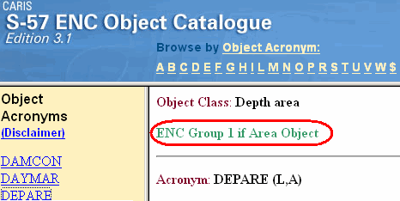
ENC Data Groups
ENC feature objects belong to one of 2 groups
  Group 1: ‘Skin Of The Earth’
  Group 2: everything else
Grouping of data makes it simpler for an ECS/ECDIS to display its ‘Display Base’ objects
  i.e. the minimum display that must always be present
Notes:
Refer to S-57 Appendix B-1 ENC Production Specification - Chapter 3.10 Groups
The CARIS S-57 ENC Object Catalogue Browser reports if the object is part of ENC Group 1

Slide 70
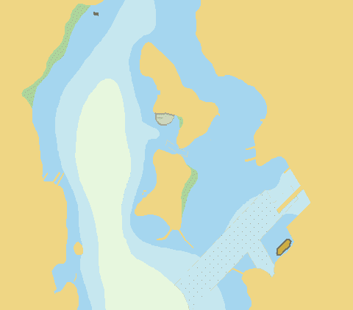
ENC Group 1: ‘Skin of the Earth’
‘Skin Of The Earth’
  a set of area objects which cover, without overlap, the entire area(s) of the cell that have data coverage

Slide 71
ENC Group 1: ‘Skin of the Earth’
The following object classes must be encoded as Group 1, Skin Of The Earth, if they exist in the dataset, as area objects:
  LNDARE - land area
  DEPARE - navigable depth areas
  DRGARE - dredged areas
  FLODOC - floating docks
  PONTON - pontoons
  UNSARE - unsurveyed depth areas
  HULKES - permanently moored ship
No other object classes can exist in Group 1
UNSARE
DEPARE
DEPARE
DEPARE
FLODOC
DRGARE
DEPARE
DEPARE
DEPARE
LNDARE
Notes:
Skin of the Earth objects form a non-overlapping coverage of the cell where data exists.
All other ‘Group 2’ data is placed on other layers, but must be underlain by Group 1 objects.

Slide 72
ENC Group 2: All other Objects
ENC feature objects not belonging to Group 1 are considered Group 2 objects
RESARE Objects
SOUNDG Objects
“NAV. Aids” Objects
0₉
0₈
2₂
RESARE
1₁
2₅
3₄
2₈
2₉
3₁
RESARE
3₅
3₇
3₁
4₂
4₉
4₃
4₄
4₆
4₃
4₈
ROADWY Objects
M_QUAL Objects
M_NSYS Objects
M_QUAL
M_NSYS
M_NSYS
M_QUAL
Notes:
It is much easier to create and process ENC objects if they are layered appropriately.
Consider grouping data based on a scheme like this:
all group 1 data must be located on one layer
several group 2 layers can be created, grouping data by type (e.g. points, lines, areas)
group 2 area objects that overlap must always be placed on different layers
all ENC meta area objects should be located on their own layer(s)
The organization of Group 2 objects is usually based on an ENC layering scheme
implemented as part of the printed navigation chart production process.

Slide 73
Topological Editing for ENCs
Duplicated coincident line geometry is prohibited
  e.g. Group 2 RESARE shares boundary with Group 1 LNDARE/DEPARE (i.e. on a different layer)
  need to split Group 1 line where duplication occurs
Group 1
Layer
(DEPARE,
LNDARE)
Split line here and duplicate onto the other layer
Results
Group 2 layer (RESARE)
Notes:
Here, we have lines which overlap in spatial location. As it stands, both lines would get
written to the S-57 file creating “duplication of coincident linear geometry”
Group 1: LNDARE (land area) and DEPARE (depth area)
Group 2: RESARE (restricted area)
To prevent this, the line on the Group 1 layer must be split where group 2 line overlaps it
Results:
Group 1: previous line is now split into 3 segments, with “pseudonodes” at common points
these separate line segments must not be re-merged into 1 line again
Group 2: the common line segment from the Group 1 layer is duplicated onto this layer
it is now an identical copy (shape, length, position) of the same line on the Group 1 layer
ENC: to save space in the ENC, only one of these identical lines is written to the ENC
Note: this does not apply to, e.g. a pipeline, crossing another line, e.g. a shoreline
it only applies where line segments are “common”/“shared” (or are supposed to be)

Slide 74
ENC Language
The exchange language must be English
  other national languages can be used for optional supplemental information, e.g. object names
When national language is used for object names or information (attributes NINFOM, NOBJNM, NPLDST) the English translation must exist (in related attributes INFORM, OBJNAM, PILDST)
  National geographical names do not need to be translated, but may remain in their original language form, or transliterated (INFORM, OBJNAM, PILDST)

Slide 75
ENC Coordinate Framework
Horizontal positions: Latitude & Longitude in Decimal Degrees
  horizontal datum must be WGS84
  no map projection coordinates in ENC datasets
Horizontal position resolution: chosen by the producer
  units are fractions of decimal degrees
Heights & Depths: in metres
  vertical & sounding datum as paper chart or source
  resolution of depths (soundings) must be 0.1 metres
  values based on feet must be converted to metres first
Distances: in nautical or decimal miles, or metres
Notes:
Refer to S-57 Appendix B.1 ENC Product Specification - Ch 4 Cartographic Framework
Note:
S-57 permits data with
different map projection (e.g. UTM, etc.) coordinates
different ellipsoids
different units, e.g. feet
different resolutions of soundings ...
… however, only the above values are permitted in S-57 ENC cells

Slide 76
ENC Position and Depth Values
Latitude & Longitude values must be converted to integers, using a Coordinate Multiplication Factor, based on the data set resolution
  recommended resolution is 0.0000001 (10⁻⁷) degrees, so the factor is 10000000 (10⁷)
  e.g. latitude 45.3425079 is stored as 453425079 (i.e. 45.3425079 x 10000000)
Depths are also converted to integers, using a 3D Sounding Multiplication Factor
  soundings are always stored to 0.1 metres, so this factor is always 10
  e.g. a depth of 3.7 metres is stored as 3.7*10 = 37
Notes:
The IHO ‘Recommendations for Consistent ENC Data Encoding’ (2004) paper states in paragraph 11:
“Coordinates should be held in ENC production systems at a resolution of 0.0000001 (10⁻⁷) and the [Coordinate Multiplication Factor] COMF value should be set to 10000000 (10⁷) for all cells.”

Slide 77
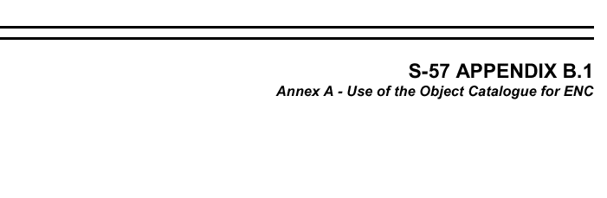
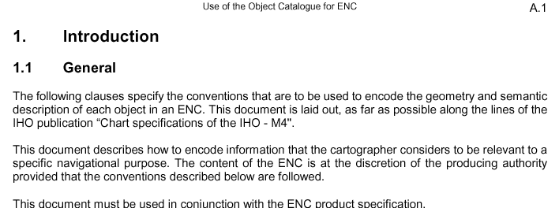
5. ENC Encoding
S-57 Use of the Object Catalogue for ENC
Notes:
S-57 is the ‘IHO Transfer Standard for Digital Hydrographic Data’:
Part 1 General Introduction
Part 2 Theoretical Data Model
Part 3 Data Structure
Appendix A - IHO Object Catalogue
Chapter 1 - Object Classes
Chapter 2 - Attribute Classes
Appendix B.1 - ENC Product Specs.
Annex A - Use of the Object Catalogue for ENC - this section is discussed next

Slide 78
Use of the Object Catalogue (UOC)
Purpose of the UOC
  this Catalogue is to be used to help encode the geometry and description of objects in an ENC
  this allows for a consistent way for ENC objects to be encoded, independent of producer
ENC Data Content Guidelines
  it is up to the data producer to determine what is considered relevant to an ENC cell for a specific navigational purpose
  all mandatory objects and attributes must be encoded
Notes:
S-57 Appendix B-1 Annex A Use of the Object Catalogue for ENC
Ch 1.1 ‘The contents of the ENC is at the discretion of the producing authority …’

Slide 79
UOC: Datums
Horizontal datum
  must be WGS1984; shifts to this can be provided using meta object M_HOPA (shift parameters)
    meta object M_HDAT (horizontal datum) is prohibited
Vertical datum: altitude of objects, clearances, ...
  default value is given in the header for the ENC cell
  where this differs, use meta object M_VDAT (vertical datum), or attribute VERDAT for individual objects
Sounding datum: depths of soundings, wrecks, ...
  default value is given in the header for the ENC cell
  use M_VDAT where this differs; do not use VERDAT

Slide 80
UOC: Units, Dates, Seasonal Objects
Units: metres for depth, heights, & pos. accuracy
  use of meta object M_UNIT (units) is prohibited
Dates: ‘CCYYMMDD’ in these attributes
  CPDATE, DATEND, DATSTA, PEREND, PERSTA, SORDAT, SUREND, & SURSTA
Seasonal Objects: attribute STATUS=5 periodic, intermittent
  start/end dates in PERSTA, PEREND
Times: ‘CCYYMMDDThhmmssZ’ in coordinated universal time (UTC) values in these attributes
  start/end times TIMSTA, TIMEND

Slide 81
UOC: Data Quality Description
Quality and accuracy of bathymetric data
  mandatory meta object M_QUAL (bathymetric data quality) gives overall assessment for areas of the data using CATZOC (zone of confidence) attribute values
  meta object M_SREL (survey reliability) gives more detailed information
  attributes QUASOU, SOUACC, TECSOU may be used for individual objects: sounding, wrecks, obstructions
Accuracy of non-bathymetric data
  meta object M_ACCY (accuracy) gives an overall value
  attribute QUAPOS (qualitative), POSACC (quantitative) can be applied to spatial geo objects

Slide 82
UOC: Data Source and Scale
Bathymetric data
  meta object M_SREL (survey reliability) gives this
  point objects can use attributes SORIND, SORDAT
Non-bathymetric data
  use attributes SORIND, SORDAT
Compilation scale
  default value is given in the header for the ENC cell
  meta object M_CLSL (compilation scale) can be used for areas where this is different

Slide 83
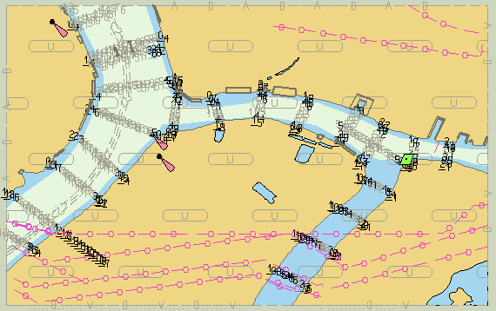
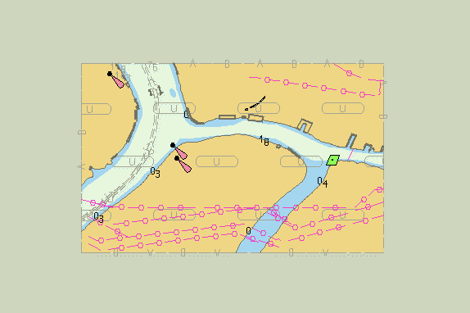
UOC: SCAMIN Attribute
Use of the attribute SCAMIN
  determines the minimum display scale of an object
  this reduces clutter, and assigns priority to the display of objects, and improves ENC drawing speed
  e.g. SOUNDG (sounding) with SCAMIN=10000 is not be displayed when viewed at 10001 & smaller scales
  Group 1 objects must always be displayed

Slide 84
UOC: Text in an ENC
Cartographic objects like text are prohibited
Store text as attributes of objects if possible
  e.g. attribute OBJNAM for buoy, light, city, wreck, …
Short text notes up to 300 characters
  place in attribute INFORM (or national NINFOM)
  e.g. information, caution notes from paper charts, ...
Longer text information is stored in text files
  file names held in attributes TXTDSC (or NTXTDS)
  e.g. longer notes, tables, sailing directions, …
References to other nautical publications
  use meta object M_NPUB (publication)

Slide 85
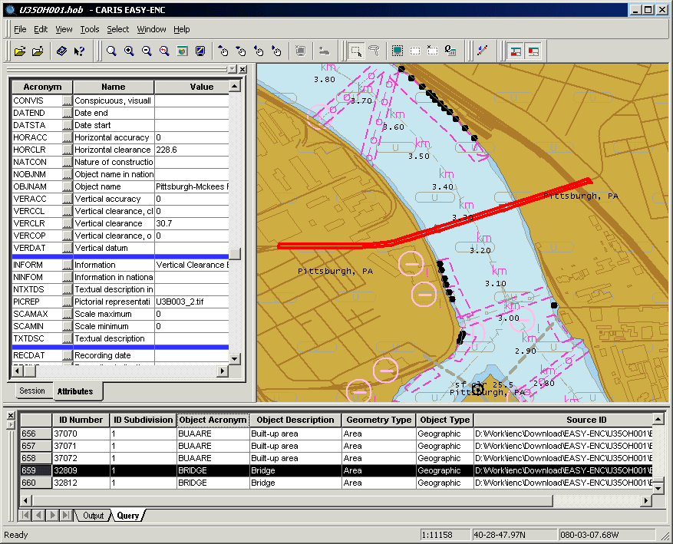
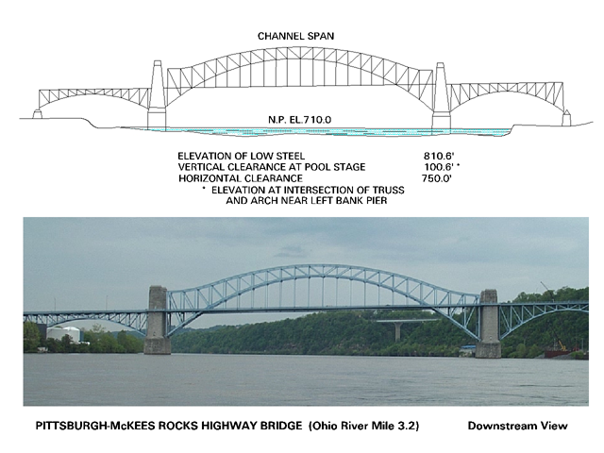
UOC: Images in an ENC
Photographs and drawings can be stored in external graphic image files, in TIFF format
  e.g. bridges, navigation aids, wrecks, etc.
Attribute PICREP holds the image file name

Slide 86
UOC: Height Information
UOC clarifies ENC height and elevation attributes
  ELEVAT: the altitude of the top of natural features, and the base of other features, above vertical datum
  HEIGHT: the altitude of the top of a feature, above the vertical datum
  VERLEN: the length above ground/water
VERLEN
HEIGHT
ELEVAT
ELEVAT
Vertical datum

Slide 87
UOC: Navigable Water
If the following objects are not considered navigable at compilation scale, they must be encoded as Group 2 areas, on top of LNDARE
  CANALS, DOCARE, LAKARE, LOKBSN, RIVERS
  and, do not encode their shorelines as objects
If these areas are navigable at compilation scale, they must be encoded as Group 1 area objects
  either DEPARE or DRGARE (depth or dredged areas)
  and, do encode their appropriate shoreline objects, COALNE or SLCONS (natural or manmade shoreline)
Notes:
Comments:
CANALS - canal objects
DOCARE - dock area objects
LAKARE - lake area objects
LOKBSN - lock basin objects
RIVERS - river area objects

Slide 88
UOC: Navigable Water
Treat objects differently on different ENC usages
Scale 1:100000
RIVERS
LNDARE
Scale 1:20000
COALNE
DEPARE
LNDARE
COALNE
DEPARE

Slide 89
UOC: Coast/Shorelines
How to encode shorelines
  object COALNE is encoded for natural coastlines
  object SLCONS is encoded for artificial coastlines
  no shoreline is used with lakes, rivers, etc. if these are not navigable at the compilation scale
Example: coast/shorelines around a pier/jetty/etc.
LNDARE’s
COALNE’s
SLCONS’s
DEPARE
Notes:
S-57 Use of Object Catalogue for ENC - Chapter 4.5 Coastline
“In all cases, as coastline/shoreline is encoded as either a COALNE (line) or a SLCONS (line or area). These features form the boundary of the land area (LNDARE).”

Slide 90
UOC: Depth Area Lines
Depth areas (DEPAREs) with line geometry must be created where there are gaps in the natural ‘rhythm’ of standard depth areas
  e.g. around man-made features in water areas
Example:
2 DEPARE lines
DRVAL1=0
DRVAL2=2
2
2
1 DEPARE line
DRVAL1=0
DRVAL2=7
5
5
2 DEPARE lines
DRVAL1=5
DRVAL2=7
7m
Notes:
This is required so that when using an ENC with an ECS/ECSIS, the navigator can display
a continuous “safety contour” without any gaps in it.

Slide 91

UOC: Sector Lights
Two LIGHTS point objects are created from the one light symbol on a chart using attributes SECTR1, SECTR2 to define the sector limits
AZ= 220 degrees
GREEN
RED
AZ= 290 degrees
AZ= 340 degrees

Slide 92

6. ENC Data Delivery
S-57 ENC Exchange Set
Notes:
S-57 is the ‘IHO Transfer Standard for Digital Hydrographic Data’:
Part 1 General Introduction
Part 2 Theoretical Data Model
Part 3 Data Structure
Appendix A - IHO Object Catalogue
Chapter 1 - Object Classes
Chapter 2 - Attribute Classes
Appendix B.1 - ENC Product Specs. - Chapter 5 Provision of Data
Annex A - Use of the Object Catalogue for ENC

Slide 93
ENC Exchange Sets
An ENC is delivered as an ENC Exchange Set
An Exchange Set consists of at least 2 files placed in a folder called ‘ENC_ROOT’
  1 or more ENC cell(s) or data set file(s) and update(s)
  1 ‘catalog’ file with information about all files in the exchange set (i.e. a ‘Table of Contents’)
Optionally it may also contain
  1 ‘README.TXT’ file
  1 or more text file(s)
  1 or more image file(s)
File names are UPPER CASE
ENC_ROOT\ CATALOG.031
CA544357.000
CA544357.001
CA544955.TXT CA222109.TIF
README.TXT
Notes:
ENC cells or data set files
these files contain the description and location of the real world entities as well as descriptive information specific to the data set

Slide 94
Naming of Mandatory Files
Exchange Set mandatory naming convention
  Data Cells: have an ‘8.3’ name, e.g. ‘CA544357.000’
    1-2: ENC producer code (2-letter IHO code of Producer)
    3: ENC usage code - 1: Overview, 2: General, 3: Coastal, 4: Approach, 5: Harbour, 6: Berthing
    4-8: Unique individual cell code (any characters/numbers)
  Data Cell file extensions
    ‘000’ for all new ENCs, New Edition ENCs, or ENC Reissues
    ‘001’ for first ENC update
    ‘002’, ‘003’, … for each new ENC update
  Catalog file: always ‘CATALOG.031’ (S-57 Ed 3.1)
Notes:
ENC file name extensions:
New data sets, Re-issues or New Editions must have a file extension of .000
Updates: the extension is the number of the update (from 001 to 999); the first update after a new data set or a new edition is “001”
Updates to a Re-issue: a re-issue does not interrupt the update sequence
Edition number: a new data set has an edition number of 1 assigned to it; the edition number is increased by one when a new edition is created; a re-issue does not increase the edition number.
the Catalog File holds all this information
Examples of ENC cell naming conventions:
CHS: e.g. CA544357 - where the 44357 = unique ENC cell number
NOAA: e.g. US5LA31M - where LA = State Code, 31 = Sequential number, M = Metric
USACE: e.g. U35AT046 - AT = River Code (Atchafalaya), 046 = River Mile

Slide 95
Naming of Optional Files
Additional optional files for ENC Exchange sets:
  General information file (ASCII format):
    mandatory file name is ‘README.TXT’
  Textual description files (ASCII format):
    First two characters = producer code
    The next six characters is a unique individual file code
    Extension have to be ‘TXT’, e.g. ‘CA544995.TXT’
  Images (TIFF format recommended):
    First two characters = producer code
    Next six characters is a unique individual file code
    For TIF files, extension is ‘TIF’, e.g. ‘CA222109.TIF’
Notes:
Textual description files
typically store larger amounts of text relating to specific features or areas of the ENC
e.g. caution/danger areas, notes about regulations/related documents, etc.
Image files
may store a scanned photo or diagram/drawing of a particular chart feature
e.g. photo of bridges, navigation aids, built-up area, landmarks, etc.

Slide 96
ENC Data Set Types
New data set - all new ENC cells, for which no ENC data has been previously produced for the same area/ navigational purpose
Update - changing some information in an existing data set to reflect an up-to-date chart
Re-issue - takes the base data set and all the updates previously issued and combines then into a new data set. A re-issue does not contain any new information not previously issued by updates
New edition - a re-issue plus new updates not previously distributed by updates
Cancellation - when an ENC is removed from use

Slide 97
ENC Header Information
General information applying to the entire cell
Data Set Identification Field - includes
  intended usage/navigational purpose; data set name and producing agency; edition/update number; issue and update application dates; S-57 version number; product specification and number; comment;
  summary of total number of objects, nodes, edges; ...
Data Set Parameter Field - includes
  horizontal, vertical, sounding datums; compilation scale; depth, height, positional accuracy units; coordinate, sounding multiplication factors; ...

Slide 98
ENC Updates
Changes are made to an ENC in a similar way to applying ‘notices to mariners’ to printed charts
  consist of additions, modifications, deletions
Update the ENC with the new information, then create a new ENC Update data set
  updates are small, only containing the ENC point, line, area objects that have changed, and nothing else
  the ENC Update data set is then added to the existing ENC Exchange Set, as a ‘001’ file (for the fist update)
Note: ENC updates are not cumulative
  updates must be applied to the ENC in the right order

Slide 99
Updating ENC Exchange Sets
Only data cells in an exchange set are updated
  A New Edition (‘000’) replaces all previous cells including updates
  New Updates numbers restarts as ‘001’
  A Re-issue (‘000’) replaces all previous cells including updates
  Updates numbers does not restart
  Text and Image files have to be deleted or replaced
Edition number is stored in each cell including update cells

Slide 100

ENC Updating Example
Example of ENC data set file names over time:
Notes:
Note:
each type of ENC (new cell, update, re-issue) stores the current Edition and Update number internally in its ‘header’, so that it can be uniquely identified when loading it into an ECDIS or ECS system

Slide 101


ENC Distribution
The data producer works in its own format
The ENC transfer format is S-57
ECDIS/ECS keep unmodified copies of all ENC data sets, and use their own operating formats,
  ‘System Electronic Navigational Chart’ (SENC)
ECDIS
ECDIS
Data Producer (HO)
Screen
“SENC”
ENC (S-57)
ENC
SENC

Slide 102





ENC Distribution Options
Data made available on media: CD-ROM, diskette
May provide electronically: Internet, e-mail
Notes:
The diagram above shows the prototype graphical NOAA ENC selection for download site,
based on the CARIS Chart Server technology.
It can be viewed on the CARIS website at the following address:
http://chartserver.caris.com - request a password (info@caris.com)
This website shows a number of demonstrations of CARIS Chart Server
The demo shown above shows how a customer can allow potential customer can
view available products (here an ENC, but could also include paper charts, raster charts, etc.).
Products are listed either as a text-based list, or by a graphical view, allowing the
customer to zoom to an area of interest, and query properties of individual products.
In the above case, screen captures of the products are available for inspection.
From here, the customer can select product(s) of interest, then place an order.
The Chart Server software also includes payment options for products that are not free.
The CARIS Spatial Fusion program even allows an ENC to be viewed on the Internet:
http://ntfusion3.spatialcomponents.com/USACEIndex.html

Slide 103


ENC Distribution in Practice
Hydrographic agencies have adopted the following distribution approaches
  Distribute ENC cells themselves – e.g. NOAA, USACE, using the Internet from which ENC cells can be downloaded
  Appoint independent distributors for digital products –who bundle ENC cells together, offering a small number of CD-ROMs covering different regions
  Use a Regional ENC Centre (RENC) that operates to as a single point of contact distributing ENC cells for several countries – e.g. IC-ENC, PRIMAR (Europe)

Slide 104
ENC Pricing
Hydrographic agencies face a dilemma
  To provide ENC cells for safety of navigation, but also perhaps the responsibility for cost recovery
  In the future, with greater ENC availability, costs will go down … or is it the other way around?
National policies and pricing varies
  Range from no charge to US$25+ per ENC cell
  Prices may vary depending on cell size/complexity
  Typically extra charges for an ENC updating service

Slide 105
ENC Challenges and Issues
Challenges for implementing ENCs and ECDIS
  new skills for Hydrographic Agencies and users
  requires sophisticated data and software
  in-depth understanding of and familiarity with ENC specifications and content rules
ENC data is powerful and flexible
  enhances electronic navigation capabilities with intelligent vector data – not just a raster picture
  on-the-fly change of chart display
  display of new objects (e.g. weather data)

Slide 106

Global ENC Coverage
Notes:
Sources:
- IC-ENC Website: http://www.ic-enc.org/page_coverage_catalogue.asp
Global ENC Coverage - July 2005: http://www.ic-enc.org/page_coverage_country.asp
- official cells produced per country (brackets means not commercially available)

Slide 107
Summary
S-57 is an international standard that provides a data model and physical data structure for defining hydrographic features
  Data model is based on objects, attributes and values
S-57 includes specifications for an Electronic Navigational Chart (ENC) product
  The ENC product is based on a subset of S-57
ENC products are gaining acceptance and popularity worldwide as more ENC data and electronic charting systems become available

Slide 108


