Slide 1


CiakTime
Human-Computer Interaction
Mauro Ficorella 1941639
Valentina Sisti 1952657
Martina Turbessi 1944497

Slide 2
Idea
We are presenting CiakTime, an app designed for cinema lovers.
This app offers the following functionalities:
Search for movies by title, by members of the cast and genre
Read information about plot, cast, year of release, duration, genre, movie director, streaming platform on which the movie is available and if it’s available at cinemas
Look for new and upcoming movies
Keep track of already watched movies
Add new movies in a watchlist to track the movie the user wants to watch
Add movies to “favourite movies” list
Review and rate watched movies
Comment and thumb-up or thumb-down reviews made by other users
CiakTime
Pagina <number>
Mauro Ficorella - Valentina Sisti - Martina Turbessi

Slide 3




Competitors analysis
IMDb
+100mln downloads
Strengths:
Huge fanbase
Reference app regarding cinema and movies
Limitless cinema database
Offers information about showtimes and theaters
Suggests movies based on users’ watchlists
Weaknesses:
No exchange of opinions between users
No possibility to keep track of already watched movies
No possibility to save favourite movies in a list
It’s not very intuitive retrieve movies specific information due to the high number of functionality offered by the application
CiakTime
Pagina <number>
Mauro Ficorella - Valentina Sisti - Martina Turbessi

Slide 4


Competitors analysis
Cinemaniac
+500k downloads
Strengths:
Keep track of seen movies
Possibility to save favourite movies in a list
Statistics about user watch history and preferences
Weaknesses:
Interface not so user friendly
No user interaction
No information about streaming platform
Search about movies not intuitive
In-app purchases to remove advertisements and unlock some functionalities
CiakTime
Pagina <number>
Mauro Ficorella - Valentina Sisti - Martina Turbessi

Slide 5


 | CiakTime | IMDb | Cinemaniac
User profile
Search
Movie info
Streaming platform
Upcoming movies
Watch history
Watch list
Favourite movies
Review movies
Rate movies
Comment other reviews
Thumb up/down other reviews
No ads
CiakTime
Pagina <number>
Mauro Ficorella - Valentina Sisti - Martina Turbessi

Slide 6



User profile
Age | 18-50 years
Gender
Profession | Any
Education | Any
Location | Any
Technology | Basic smartphone experience
Passions | Cinema, movies
CiakTime
Pagina <number>
Mauro Ficorella - Valentina Sisti - Martina Turbessi

Slide 7
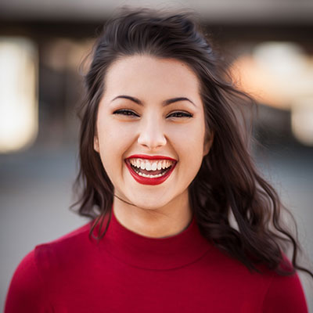
Persona
Vittoria is 25 years-old and comes from Rome. She is a university student and in the free time her main hobby is watching movies and tv-series on her favourite streaming platforms.
During her study breaks she likes to keep in touch with her friends on various social apps.
Scenario
Vittoria has just terminated an intense study session and now she only wants to relax watching a movie. She decides to call her best friend to spend the evening together. Once she arrives, in order to choose which movie to watch, they both open the app to compare their watchlists. After a while they realize that both have “La La Land“ in their watchlists and so decide to watch it together.
At the end of the evening they both check it as “watched“ in their app.
CiakTime
Pagina <number>
Mauro Ficorella - Valentina Sisti - Martina Turbessi

Slide 8
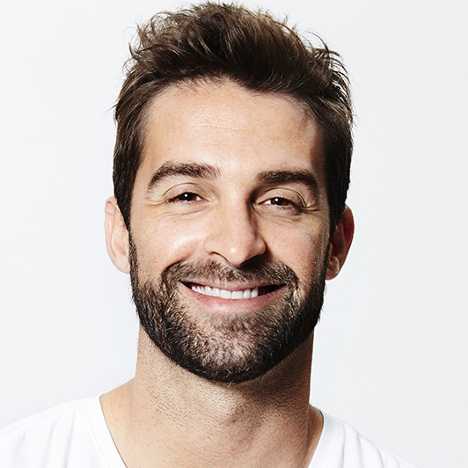
Persona
Emanuele is 33 years-old and comes from Torino. He is a programmer and he likes very much going to the cinema with his girlfriend.
As a programmer, he is addicted of technology in general, and more specific of mobile devices; moreover he is a very organized guy, and so he likes to keep under control everything he does in his life using mobile apps.
Scenario
It is an afternoon autumn day. Emanuele and his girlfriend would have liked to go out for a walk, but since it’s raining, they don’t know what to do. So, Emanuele opens the app in search of new movies available in cinemas. In this list he founds that is just available a new action movie with his favourite actor Vin Diesel; since also his girlfriend likes action movies, they decide to go to the cinema to watch it and spend a good afternoon together.
CiakTime
Pagina <number>
Mauro Ficorella - Valentina Sisti - Martina Turbessi

Slide 9

Questionnaire
What’s your age?
  < 18
  18 - 25
  26 - 35
  36 - 50
  > 50
What’s your gender?
  Male
  Female
What’s your occupation?
  Student
  Employee
  Unemployed
  Retiree
What’s your educational level?
  Elementary school
  High school
  Degree
  Master degree
How frequently do you use your phone?
  < 1hr per day
  1 - 3hrs per day
  > 3hrs per day
How many times do you go to the cinema?
  One time per week
  One or two times per month
  Few times per week
  One or two times per years
  Never
How many times do you watch movies on streaming platforms/tv?
  One time per week
  One or two times per month
  Few times per week
  One or two times per years
  Never
CiakTime
Pagina <number>
Mauro Ficorella - Valentina Sisti - Martina Turbessi

Slide 10
Questionnaire (contd.)
Which streaming platforms do you know? (multiple choice)
  Netflix
  Disney+
  Amazon Prime Video
  NowTV
  AppleTV
  No one
  Other
Which streaming platforms do you use? (multiple choice)
  Netflix
  Disney+
  Amazon Prime Video
  NowTV
  AppleTV
  No one
  Other
Do you use any movies related app?
  Yes
  No
If you use any movies related app, which one? ___________________________________
Which features you think are most useful in such an app?
(possible ratings: not important – not very important – important – very important)
  Information about movies
  Watchlist
  A list to track already watched movies
  Preferred movies
  Upcoming movies
  Making reviews
  Exchange opinions about movies with other users (i.e. through comments)
CiakTime
Pagina <number>
Mauro Ficorella - Valentina Sisti - Martina Turbessi

Slide 11
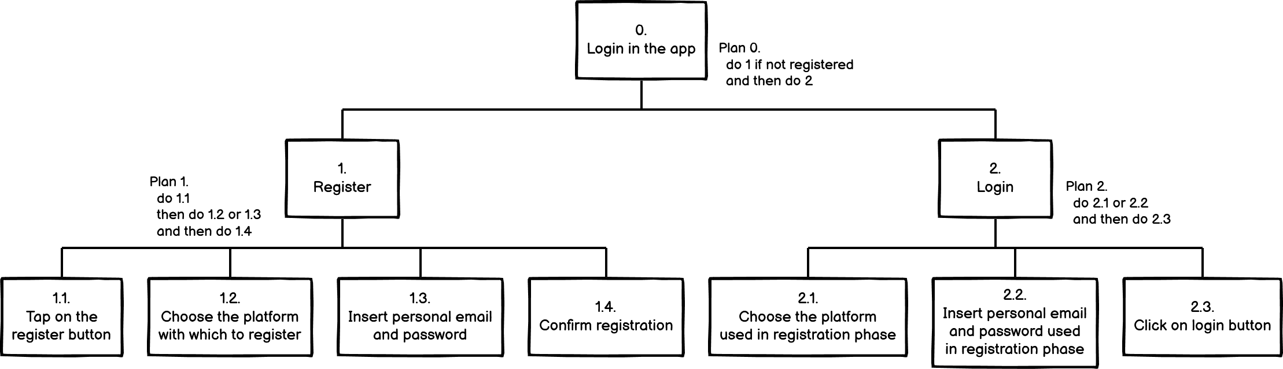
Login
The user can login into the app if registered, either through online platforms (Google, Facebook) or using his personal email and password, in order to save in the cloud all his data regarding the app.
From now on, in the following HTAs, we assume that the user is logged in.
HTA
CiakTime
Pagina <number>
Mauro Ficorella - Valentina Sisti - Martina Turbessi

Slide 12
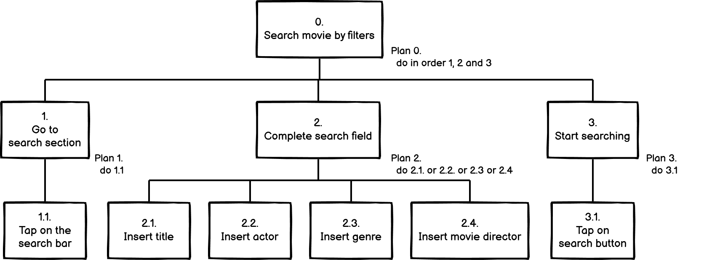
Search movie by filters
The user searches the movie he wants to know information about. He can do research by title, actor or genre and, when the results are shown, he selects the movie he is interested in.
From now on we assume that the user searched for a movie and is in the page regarding that movie.
HTA
CiakTime
Pagina <number>
Mauro Ficorella - Valentina Sisti - Martina Turbessi

Slide 13
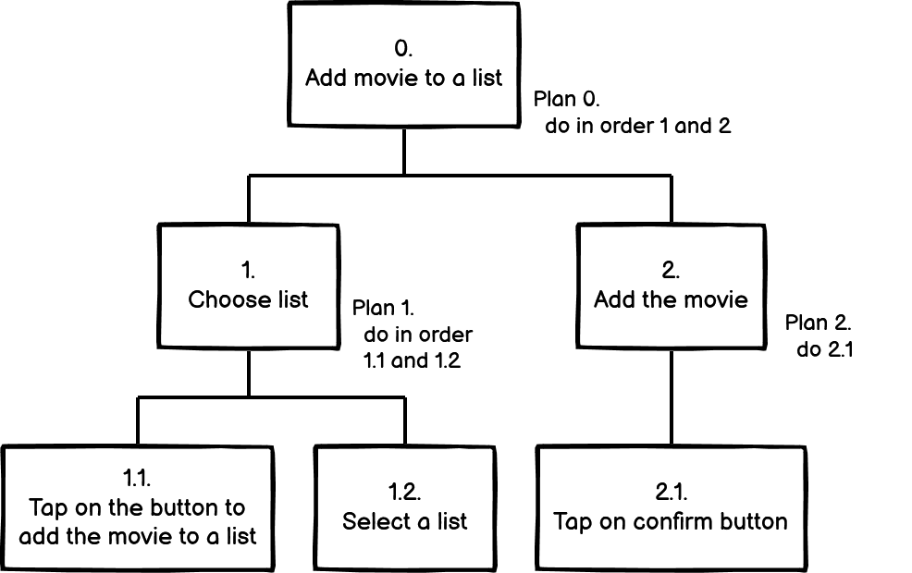
Add movie to a list
The user can add a movie into a list: he can choose between a watchlist that contains movies to watch in the future, a list containing movies already watched and a list containing favourite movies.
HTA
CiakTime
Pagina <number>
Mauro Ficorella - Valentina Sisti - Martina Turbessi

Slide 14
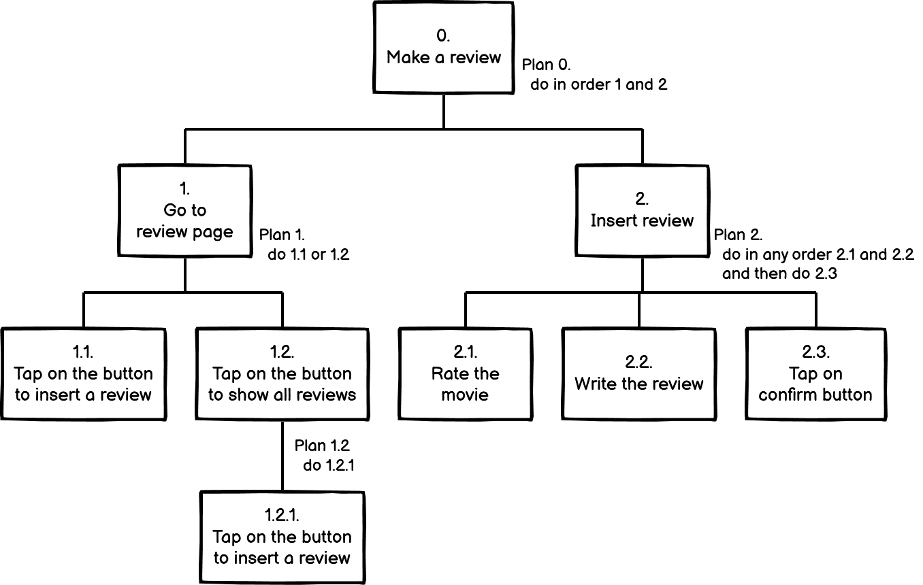
Make a review
The user can make a review regarding a movie. In particular, once he selected a movie, he can go to the review page either from the movie page or from the page containing all reviews.
HTA
CiakTime
Pagina <number>
Mauro Ficorella - Valentina Sisti - Martina Turbessi

Slide 15
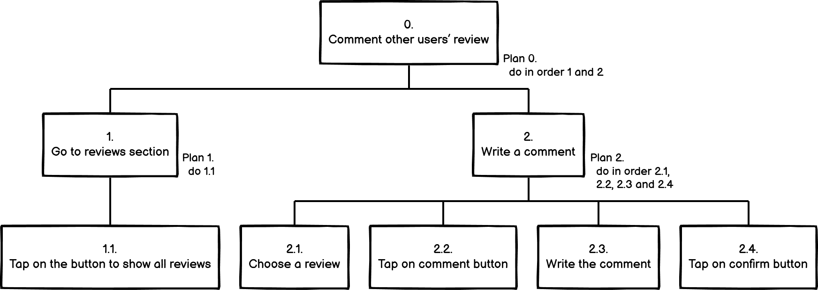
Comment other users’ reviews
The user can comment a review written by another user. In particular he can go to the page containing all the reviews, choose one of them and comment it.
HTA
CiakTime
Pagina <number>
Mauro Ficorella - Valentina Sisti - Martina Turbessi

