Slide 1

MyPics
Mauro Ficorella – 1941639 Martina Turbessi – 1944497 Valentina Sisti - 1952657

Slide 2
Idea
Interactive dashboard to look for images uploaded by other users.
Functionalities:
Show the dashboard with most popular images and images uploaded by followed users
Manage user authentication
Show a page related to users’ profiles containing all the images uploaded by them
Allow users to upload, search and see images
Allow users to follow other users to easily access their user profile and images

Slide 3
User stories & Prototypes

Slide 4
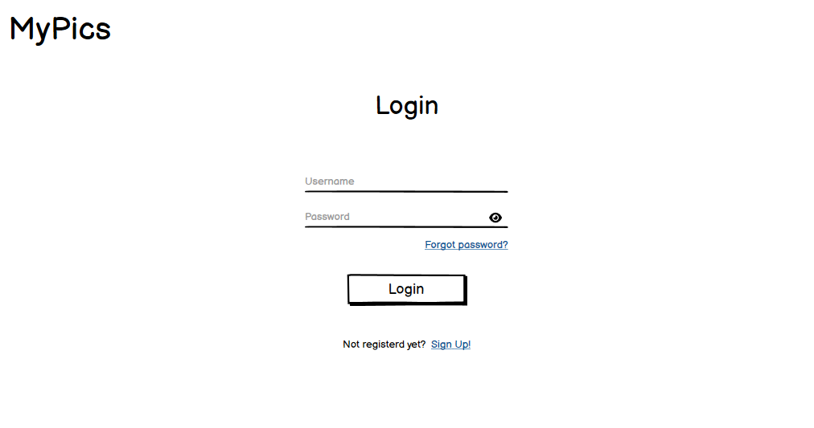
Login

Slide 5
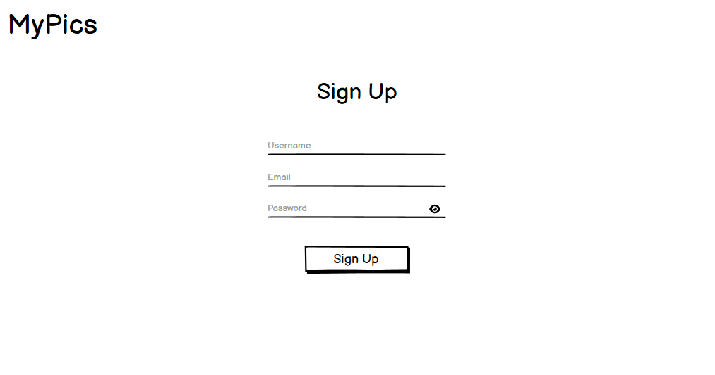
Sign up

Slide 6
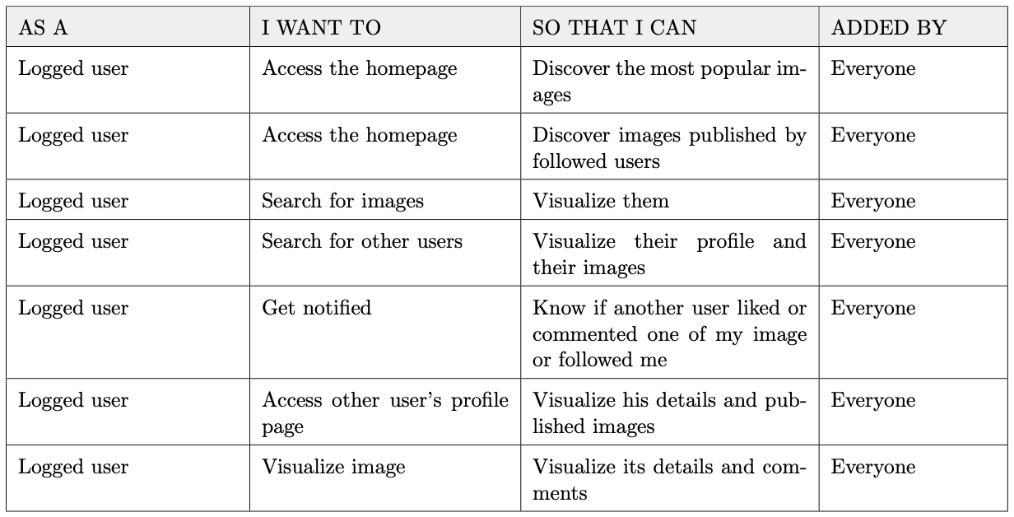
Main

Slide 7
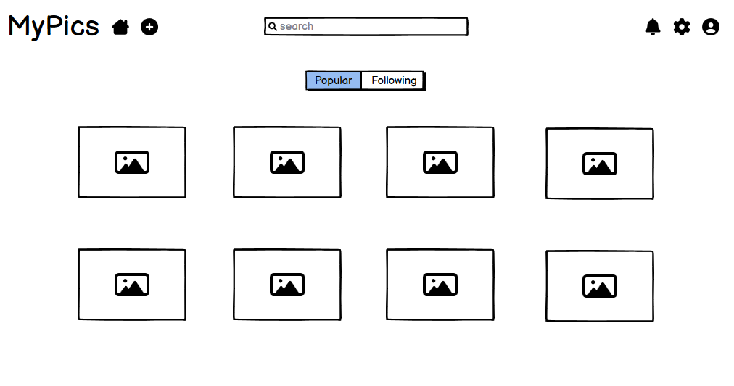
Main

Slide 8
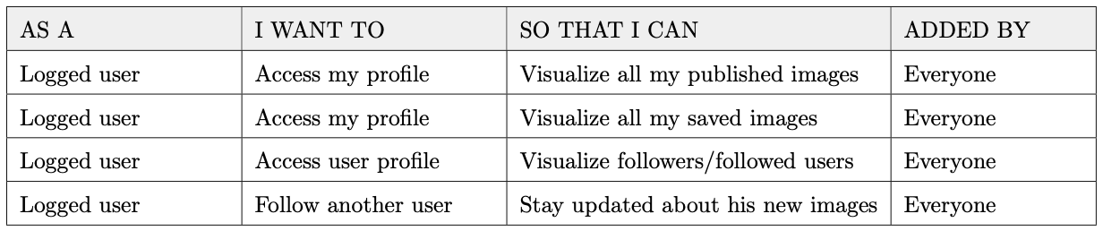
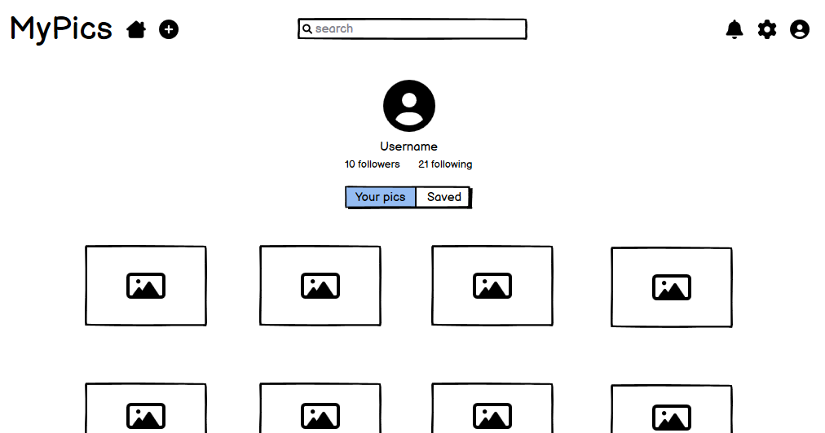
User profile

Slide 9
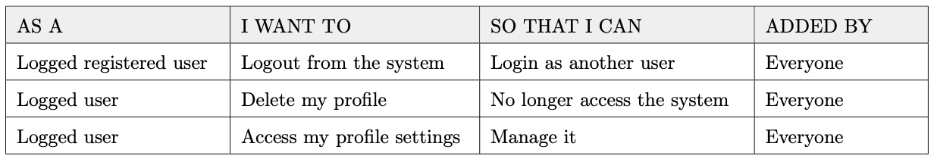
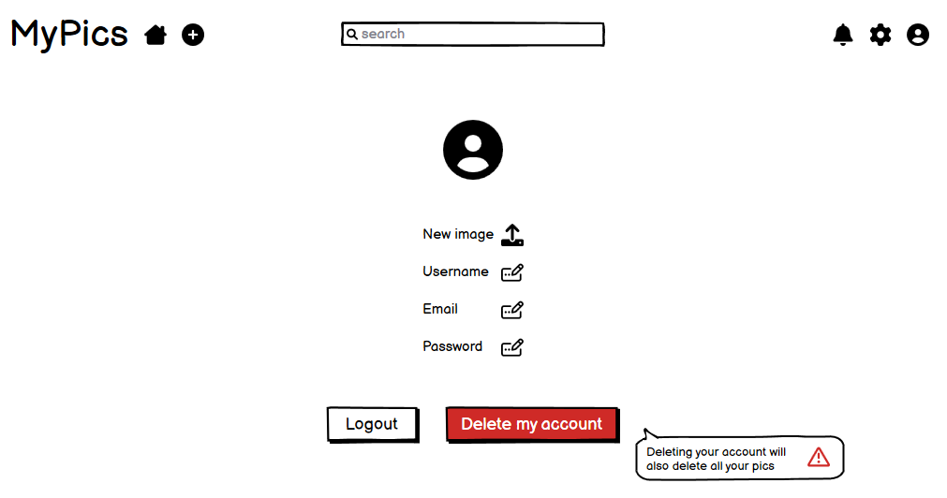
User settings

Slide 10
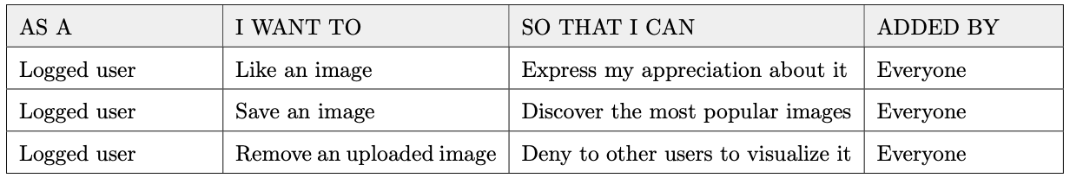
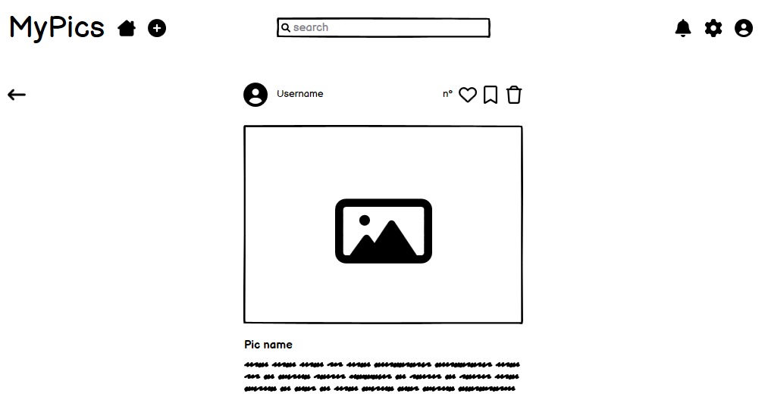
Pic

Slide 11
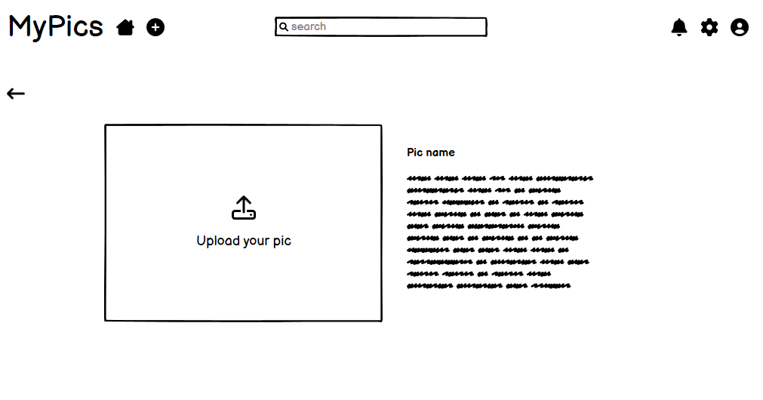
Add pic

Slide 12
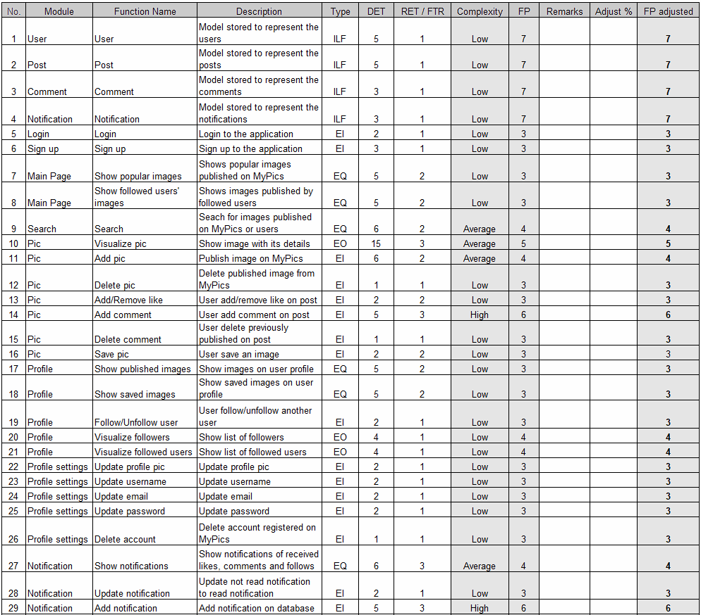
Effort estimation
We use Function Points and CoCoMo II to estimate the complexity of the software development
Unadjusted function points = 116
Equivalent SLOC in Java 6148
Effort = 7.2 person-months
Schedule = 6.8 months

Slide 13
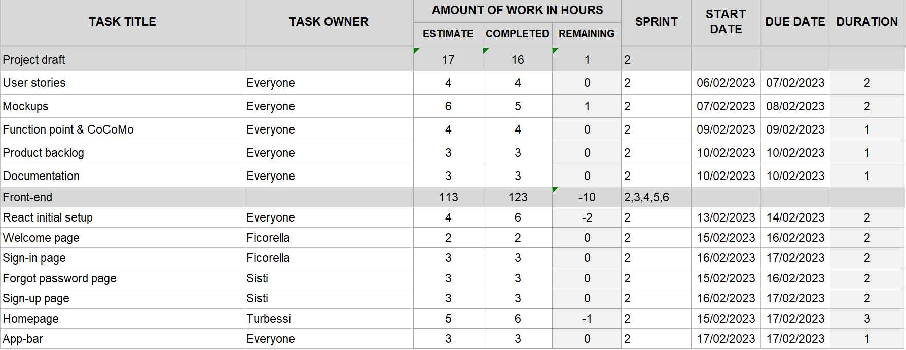
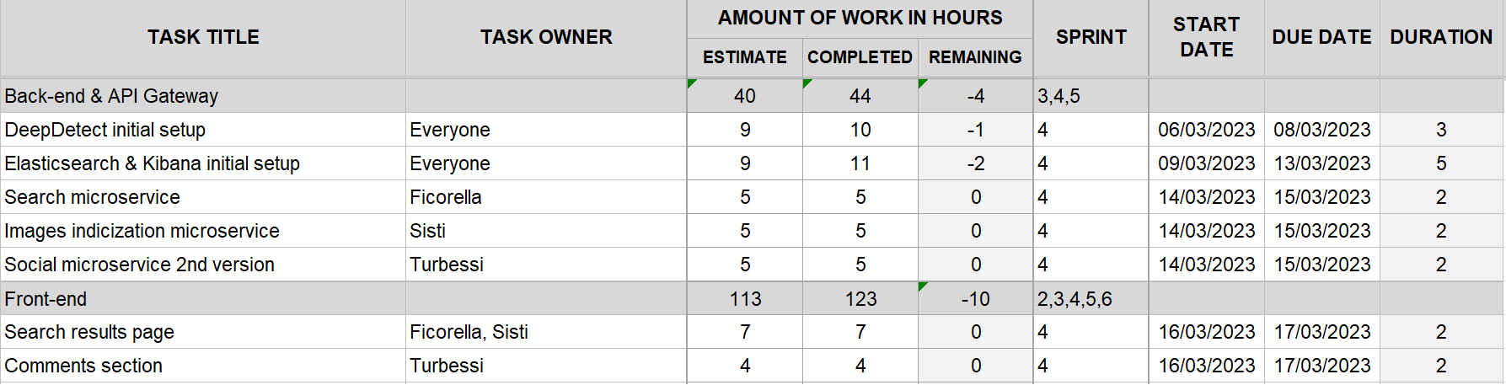
Work Analysis
6 Sprints
60 Total Days
201 Estimated Hours
3.35 Avg Estimated Hours per day
216 Completed Hours

Slide 14
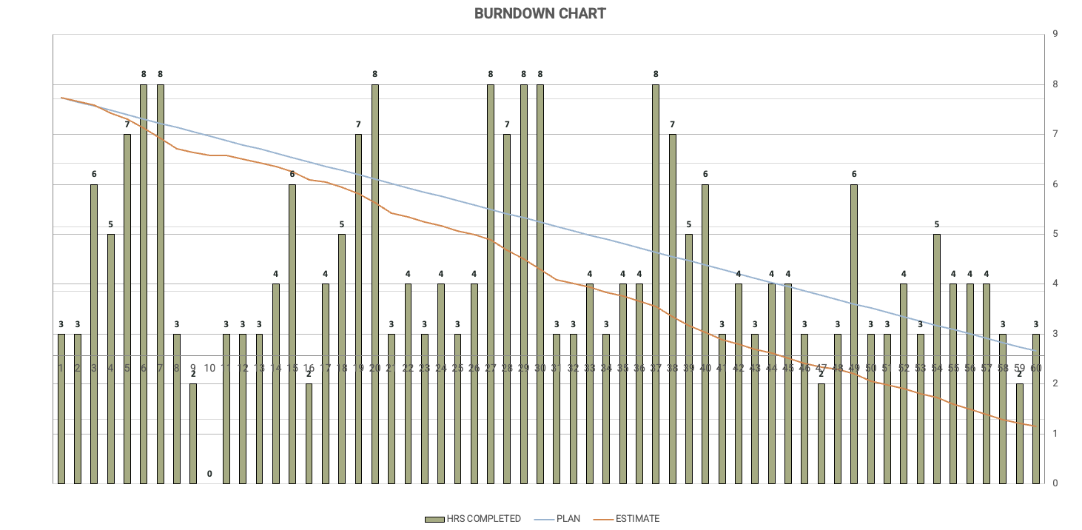
Burndown Chart

Slide 15
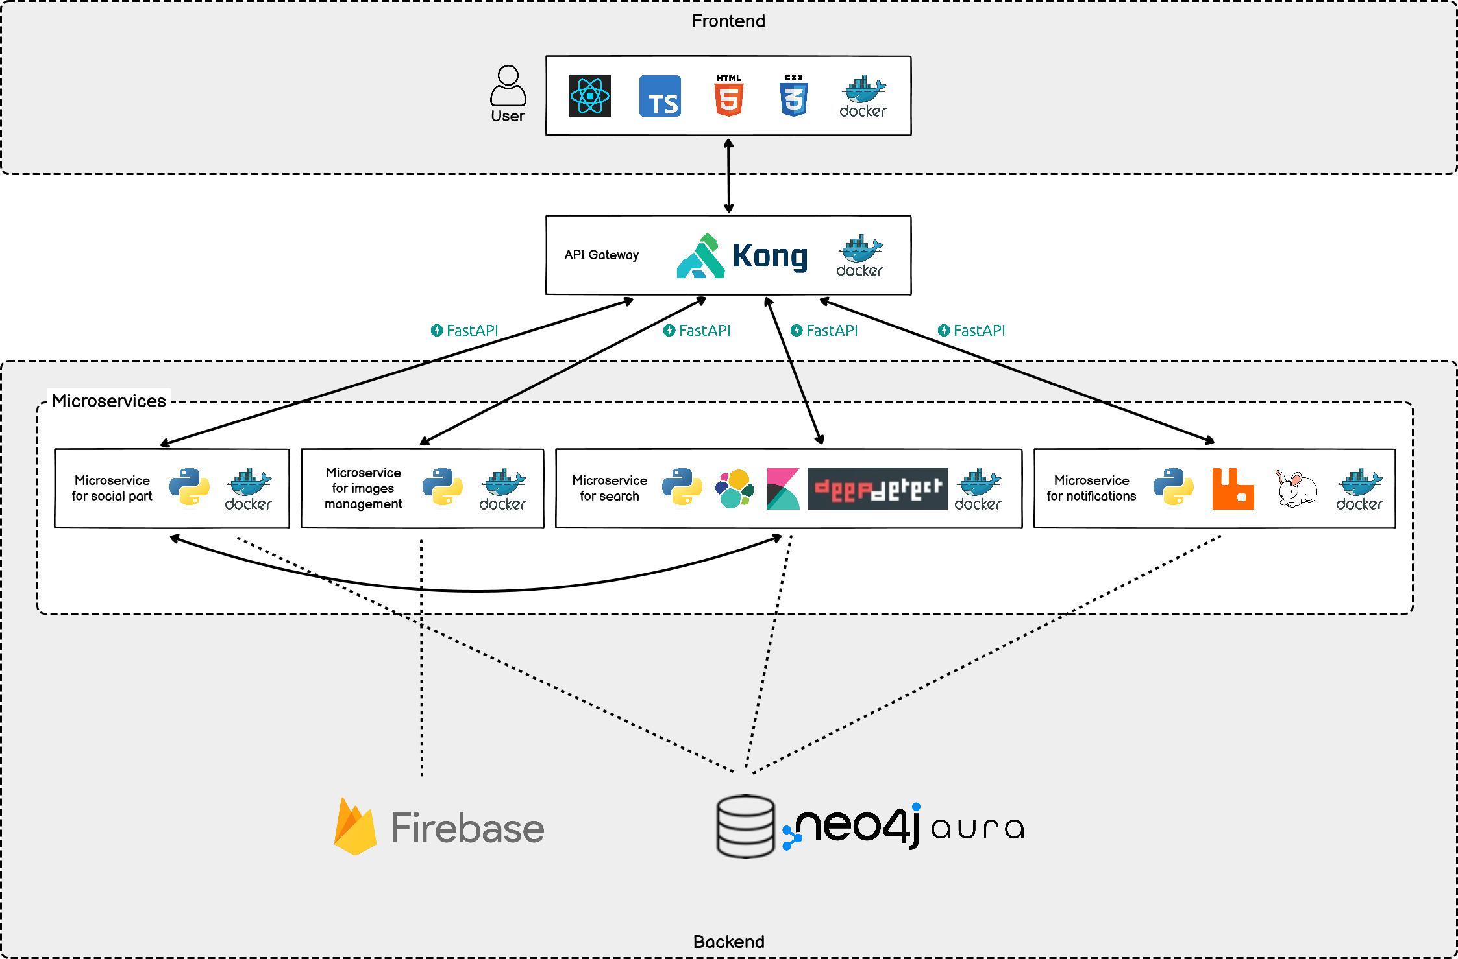
System architecture

Slide 16

Containerization
The system architecture is based on microservices, each running on its own Docker container and each accessing its own data
These containers are orchestrated through Docker Compose

Slide 17




Frontend
Responsible for the UI, dealing with the visualization and interaction with the user

Slide 18

Api Gateway
Lightweight, fast, and flexible cloud-native API gateway
Single entry point for the client
Reverse proxy that allows to manage, configure, and routes requests to the proper microservice

Slide 19


Social and image management microservices
Expose APIs to:
Manage all social aspects of the system (i.e. user registration, likes, comments, new posts)
Upload images on the Firebase cloud storage

Slide 20



Search microservice
Elasticsearch is used as search engine
Kibana provides search and data visualization capabilities for data indexed in Elasticsearch
Deepdetect deep learning platform offers pre-trained models for classifing images’ based on represented subjects and the ability to search for images based on them through Elasticsearch

Slide 21


Notifications microservice
RabbitMQ is a message oriented middleware
CloudAMQP provides managed RabbitMQ servers in the cloud, in order to be able to access all the different queues in the cloud from any device

Slide 22

Persistence
Neo4j NoSQL graph database is used in order to store all the system data
Neo4j AuraDB offers a database instance in the cloud with which all the before mentioned microservices can communicate

