Slide 1

MyPics
Mauro Ficorella – 1941639 Martina Turbessi – 1944497 Valentina Sisti - 1952657

Slide 2
Idea
Interactive dashboard to share images and look for the ones uploaded by other users.
Functionalities:
Show the dashboard with most popular images and images uploaded by followed users
Manage user authentication
Show a page related to users’ profiles containing all the images uploaded by them
Allow users to upload, search and see images
Allow users to follow other users to easily access their user profile and images
Notes:
The idea of our project was to define an interactive dashboard to share and visualize images uploaded by other users.

Slide 3
User stories & Prototypes

Slide 4
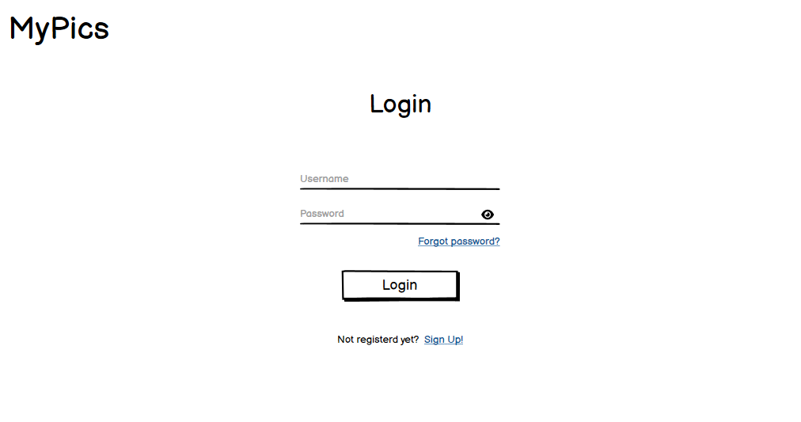
Login
Notes:
In particular, the system offers various functionalities that we expressed in the form of user story, such as the possibility to login into the system

Slide 5
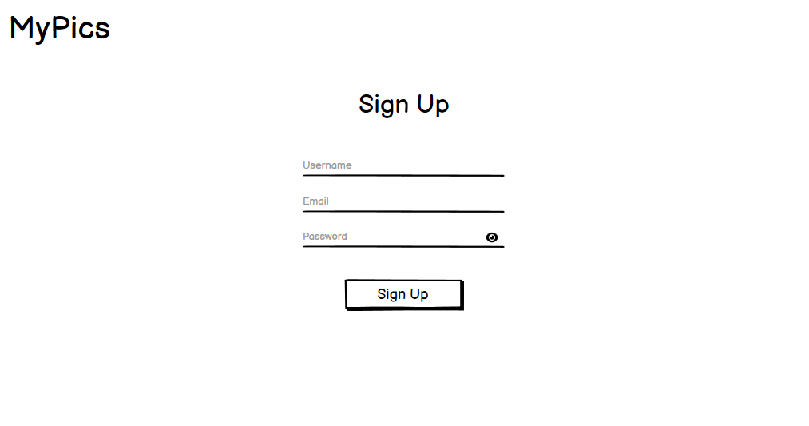
Sign up
Notes:
to register into the system

Slide 6
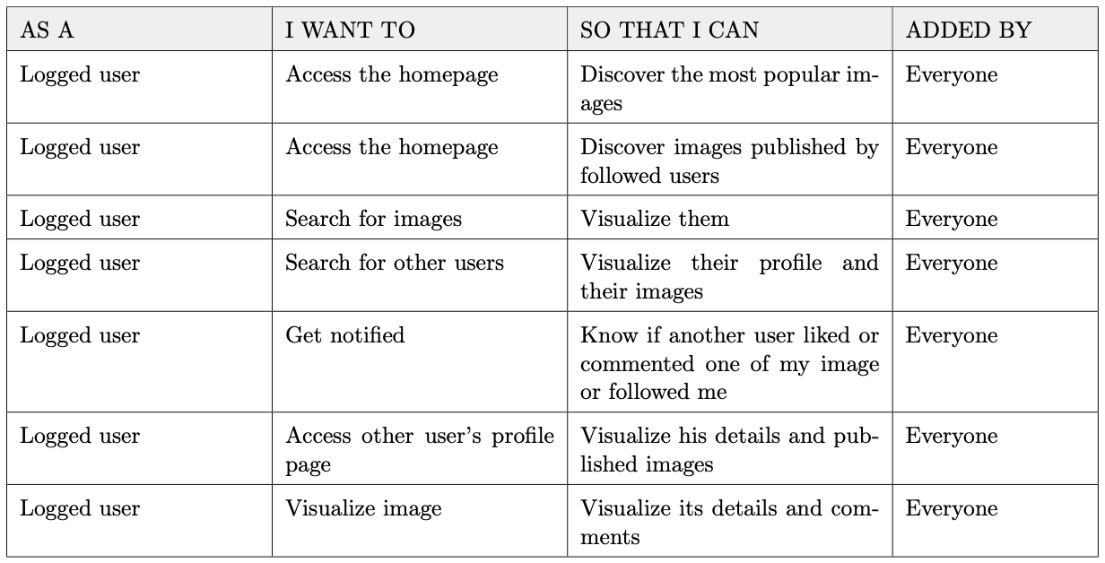
Main
Notes:
to access the homepage to discover most popular images and images published by followed users, to search for images and for other users and to get notified about new likes, comments or followers.

Slide 7
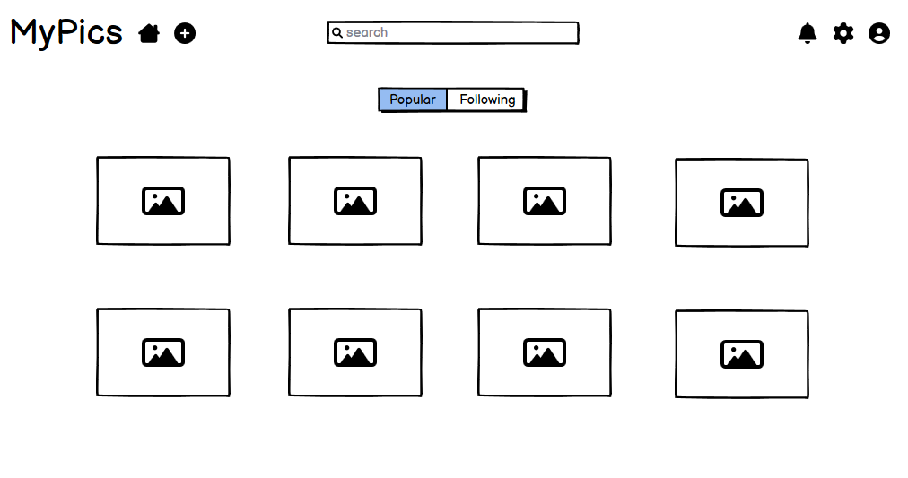
Main

Slide 8
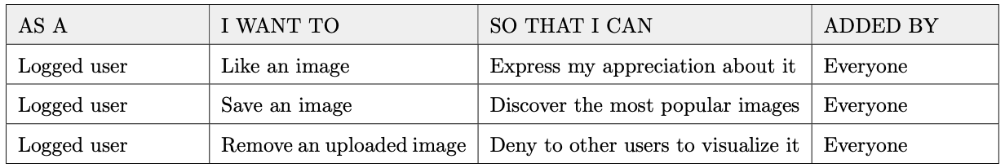
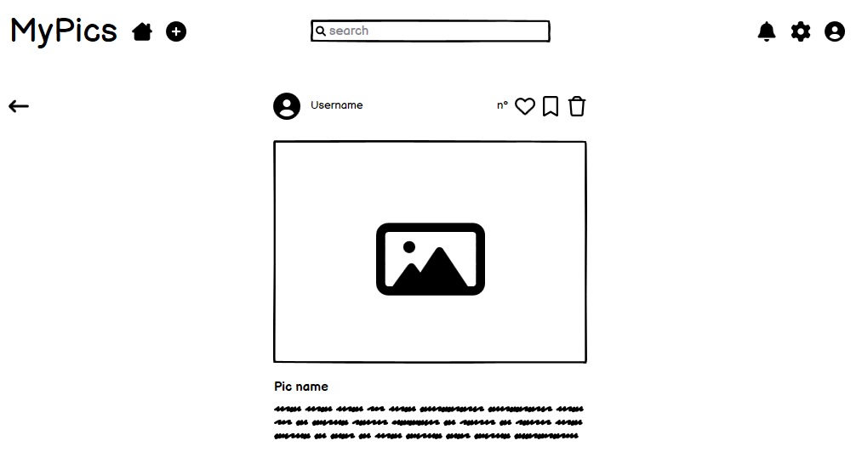
Pic
Notes:
More precisely, regarding images, the users can visualize them, the related comments, like, save, comment them and also remove their own images.

Slide 9
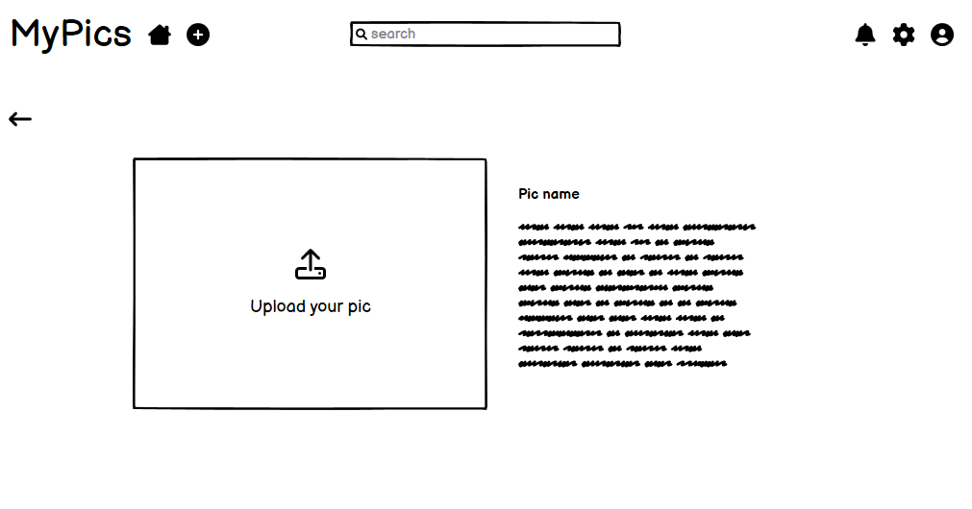
Add pic
Notes:
Moreover users can also upload a new image in the system with title and description.

Slide 10
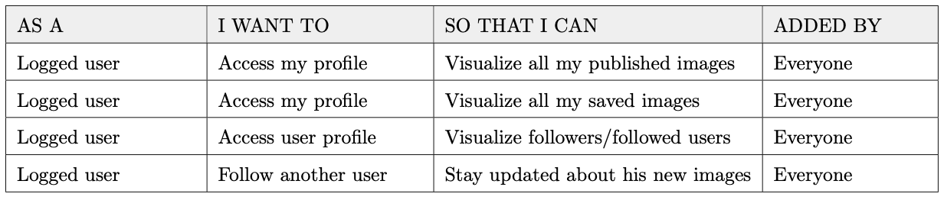
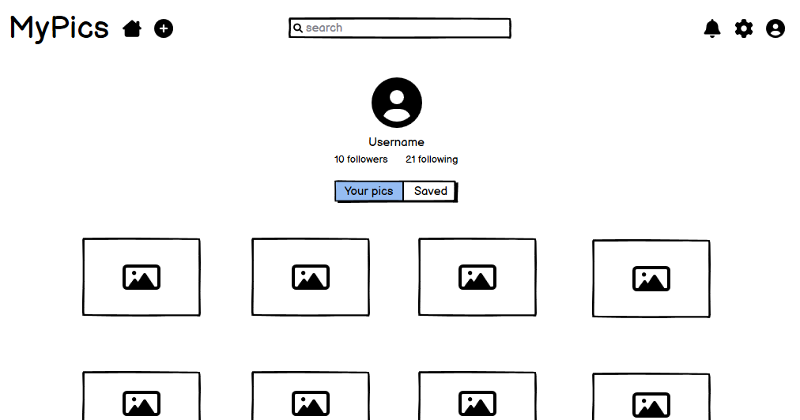
User profile
Notes:
Finally, users can access both their own and other users’ profile to visualize their images and follow information.

Slide 11
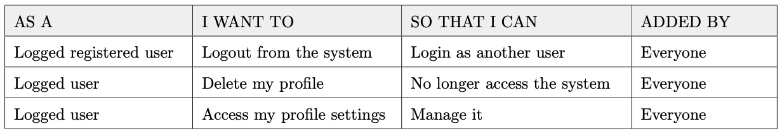
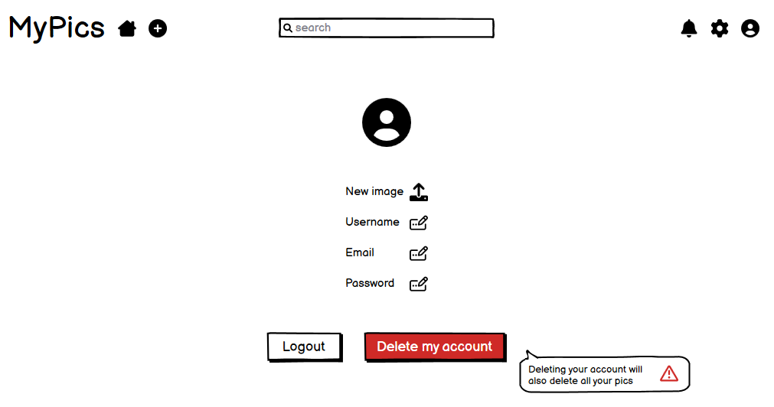
User settings
Notes:
Moreover they can logout, manage their profile information and delete it.

Slide 12
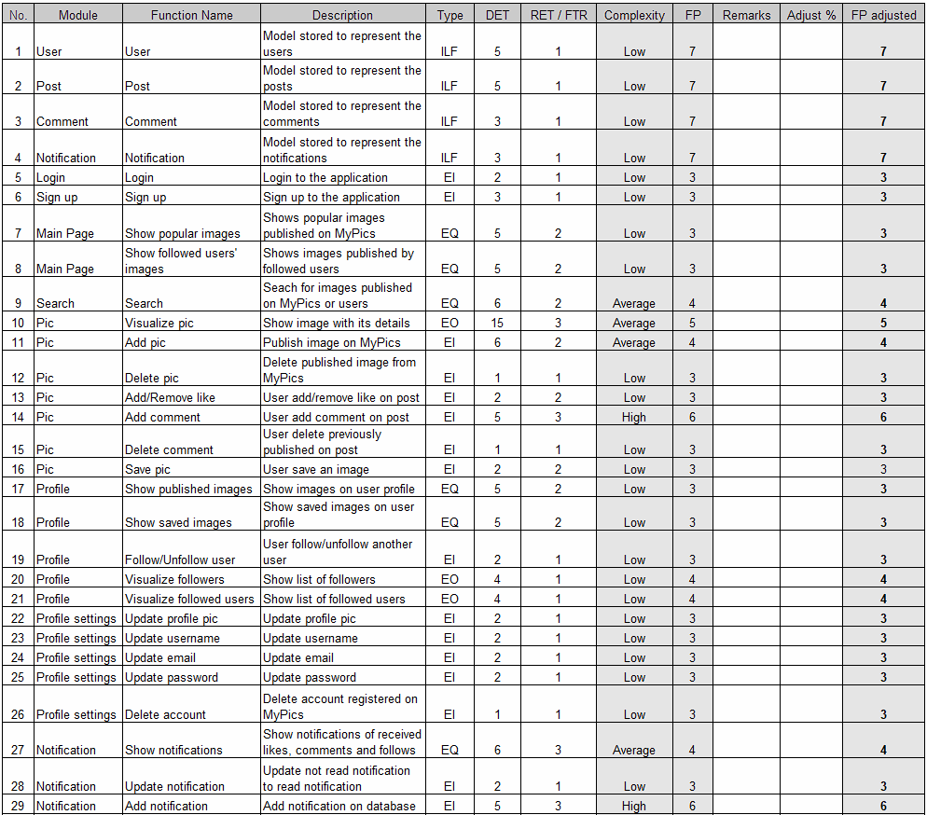
Effort estimation
Unadjusted function points = 116
Equivalent SLOC in Java 6148
Effort = 7.2 person-months
Schedule = 6.8 months
Notes:
Martina:
Regarding effort estimation we used function points and cocomo II to estimate the complexity of the software development. In particular,
unadjusted function points are 116 (one hundred sixteen),
equivalent source line of code in java are 6148 (six thousand one hundred forty-eight),
the required effort is 7.2 person-months
and the total time schedule is 6.8 months.

Slide 13
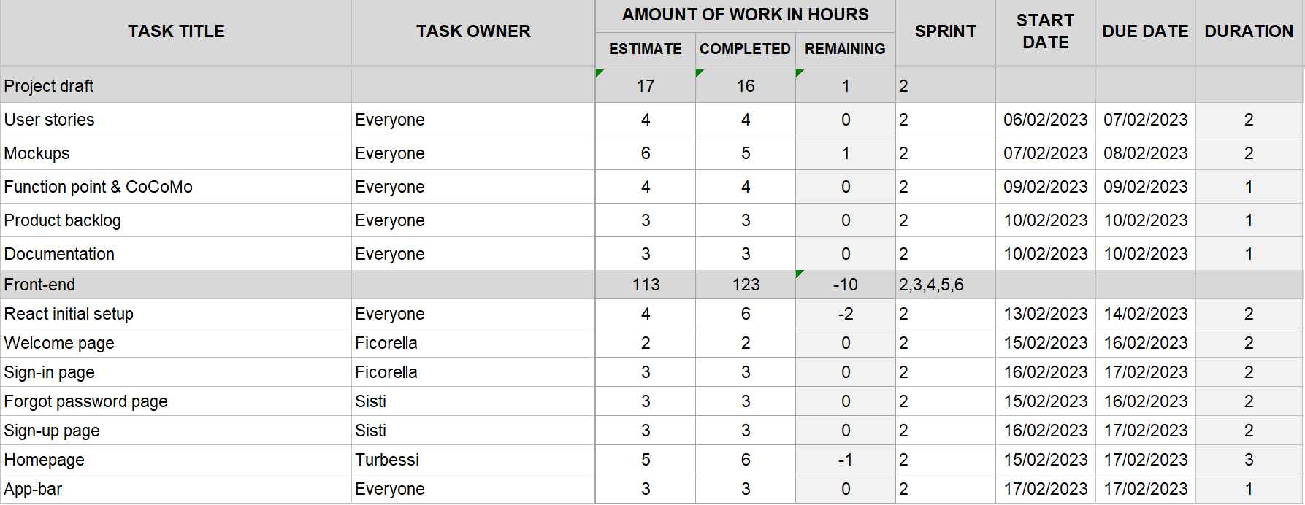
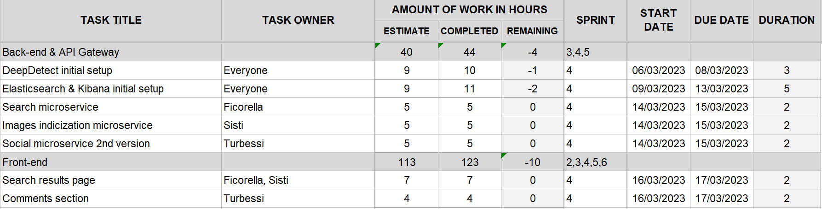
Work Analysis
6 Sprints
60 Total Days
201 Estimated Hours
3.35 Avg Estimated Hours per day
216 Completed Hours
Notes:
Martina:
We used SCRUM agile framework to handle the software development process, consisting of 6 sprints, each of 2 weeks, for a total of 60 days.
This resulted in
a total of 201 (two hundred one) estimated hours,
3.35 average estimated hours per day
and 216 (two hundred sixteen) completed hours.

Slide 14
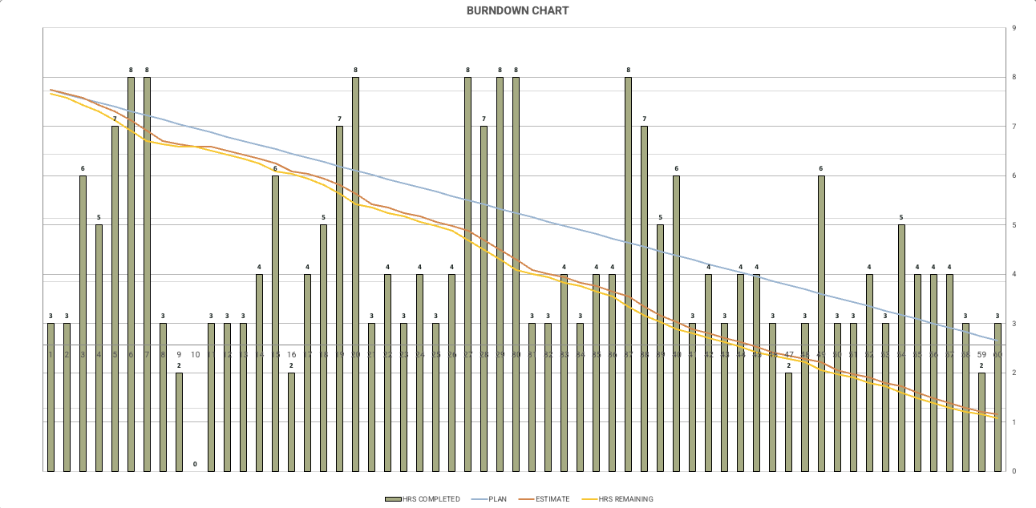
Burndown Chart
Notes:
Martina:
In this slide can be seen the burndown chart, that shows the amount of work that has been completed for each of the 60 days.
In particular the blue line represents the plan,
the orange one the estimated hours
and the yellow one the remaining hours.
As can be seen we were not able to respect the hours estimated going over 15 hours.

Slide 15
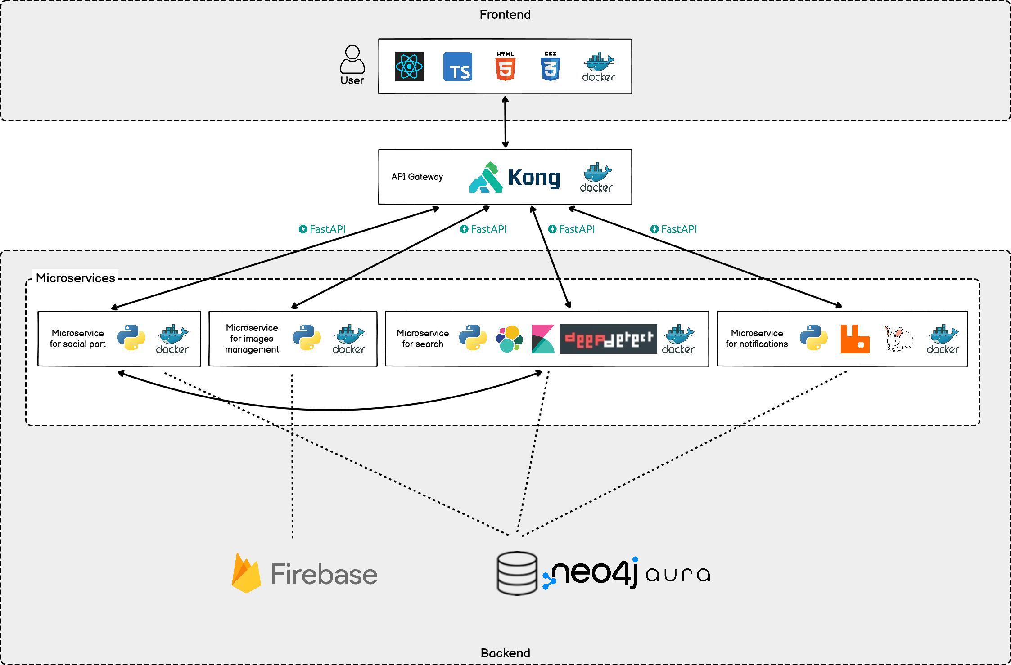
System architecture
Notes:
Martina:
Regarding system architecture, in this slide can be seen an overview of the system architecture.

Slide 16

Containerization
The system architecture is based on microservices, each running on its own Docker container and each accessing its own data
These containers are orchestrated through Docker Compose
Notes:
Martina:
First of all, the system architecture is based on microservices that run on their own Docker container and that are orchestrated by means of Docker Compose.

Slide 17




Frontend
Responsible for the UI, dealing with the visualization and interaction with the user
Notes:
Regarding the frontend of the system, through which the user interacts with the system, we used React framework based on html, css and typescript.

Slide 18

Api Gateway
Lightweight, fast, and flexible cloud-native API gateway
Single entry point for the client
Reverse proxy that allows to manage, configure, and routes requests to the proper microservice
Notes:
In order to allow the communication between the frontend and backend microservices we used Kong, which is a lightweight and fast api gateway, as reverse proxy that in particular allows to route requests to the proper microservice.

Slide 19

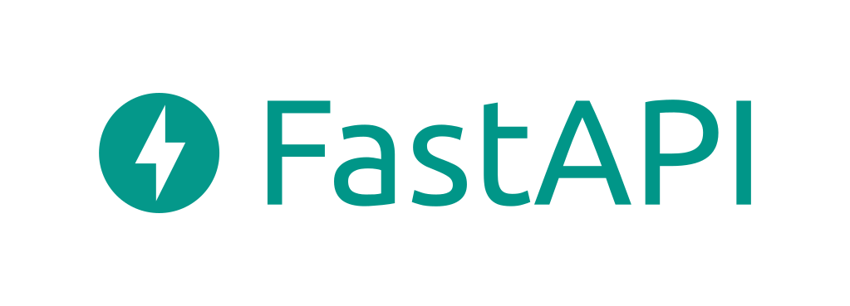
Backend
The backend microservices were developed using Python
All of them expose a REST interface that leverages on FastAPI framework.
Notes:
Regarding the backend of the system, python was used to develop all the microservices and all of them expose a REST interface that we defined using FastAPI framework.

Slide 20

Social and image management microservices
Expose APIs to:
Manage all social aspects of the system (i.e. user registration, likes, comments, new posts)
Upload images on the Firebase cloud storage
Notes:
In particular, there are the social and image management microservices that are in charge of managing all the social aspects of the system and uploading images on a cloud storage which is firebase in our case.

Slide 21
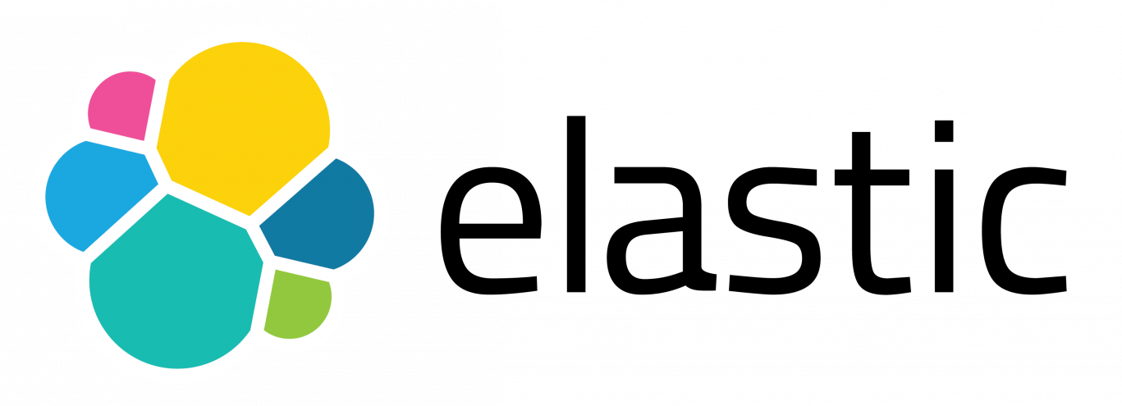


Search microservice
Elasticsearch is used as search engine
Kibana provides search and data visualization capabilities for data indexed in Elasticsearch
Deepdetect deep learning platform offers pre-trained models for classifing images’ based on represented subjects and the ability to search for images based on them through Elasticsearch
Notes:
Then there is the search microservice based on Elasticsearch engine and Kibana data visualization dashboard. Moreover we used Deepdetect, which is a deep learning platform offering pretrained models to classify images based on represented subjects.

Slide 22


Notifications microservice
RabbitMQ is a message oriented middleware
CloudAMQP provides managed RabbitMQ servers in the cloud, in order to be able to access all the different queues in the cloud from any device
Notes:
Then, regarding notifications, we used RabbitMQ message oriented middleware through CloudAMQP cloud platform in order to be able to access the queues from everywhere.

Slide 23

Persistence
Neo4j NoSQL graph database is used in order to store all the system data
Neo4j AuraDB offers a database instance in the cloud with which all the before mentioned microservices can communicate
Notes:
Finally, regarding the persistence layer, we used the NoSQL graph database Neo4j. In particular we used the Neo4j auraDB cloud platform in order to make the database available on the cloud for everyone using the system.

Slide 24
Thank you for your attention!

