Slide 1

MyPics
Mauro Ficorella – 1941639 Martina Turbessi – 1944497 Valentina Sisti - 1952657

Slide 2
Idea

Slide 3
Effort estimation
We use Function Points and CoCoMo II to estimate the complexity of the software development
Unadjusted function points = 116
Equivalent SLOC in Java 6148

Slide 4
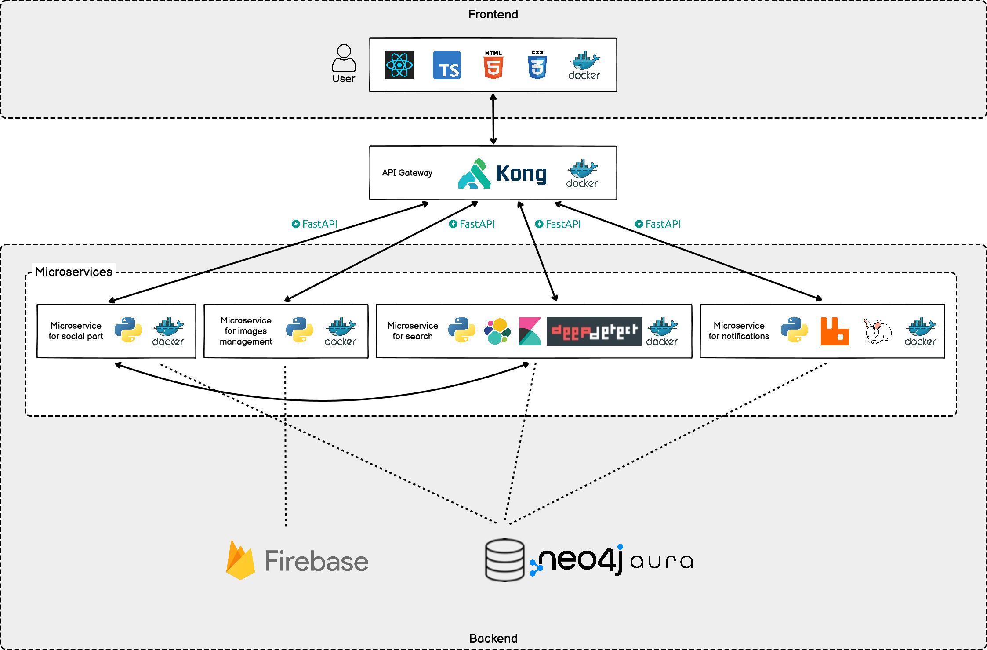
System architetture

