Slide 1

MyPics
Mauro Ficorella – 1941639 Martina Turbessi – 1944497 Valentina Sisti - 1952657

Slide 2
Idea
Interactive dashboard to look for images uploaded by other users.
Functionalities:
Show the dashboard with most popular images and images uploaded by followed users
Manage user authentication
Show a page related to users’ profiles containing all the images uploaded by them
Allow users to upload, search and see images
Allow users to follow other users to easily access their user profile and images

Slide 3
User stories & Prototypes

Slide 4
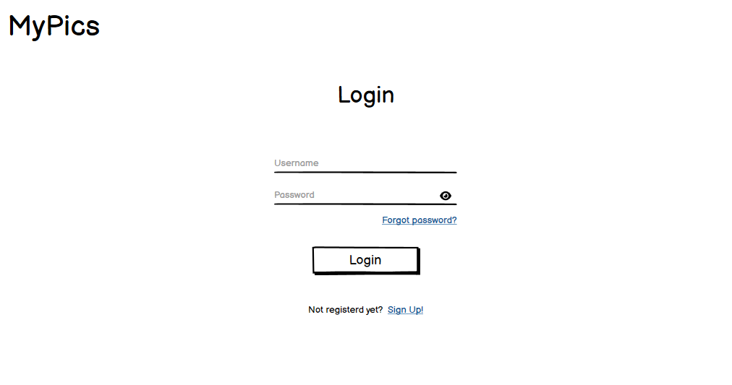
Login

Slide 5
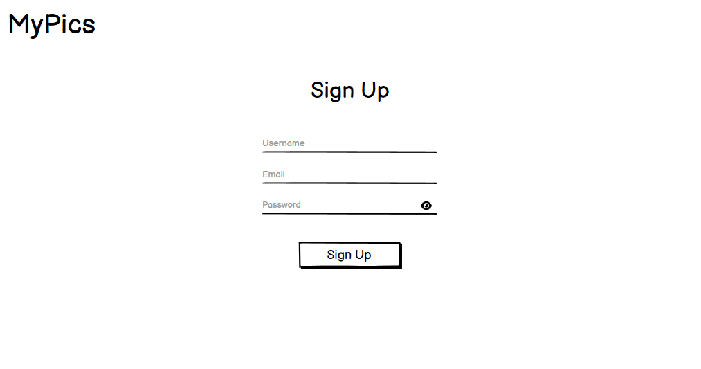
Sign up

Slide 6
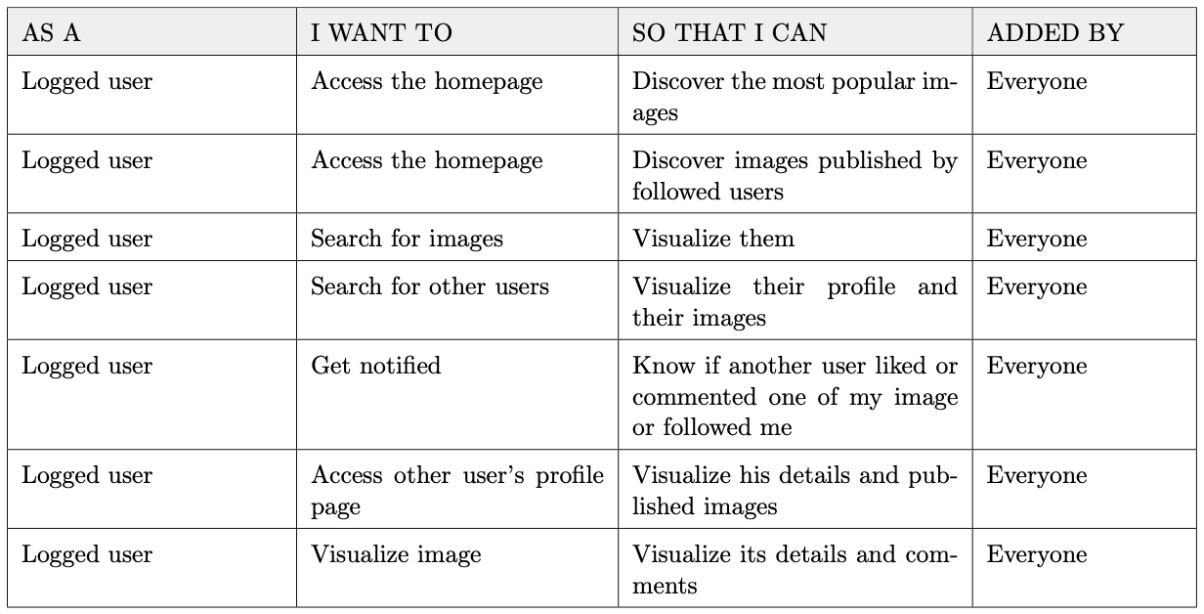
Main

Slide 7
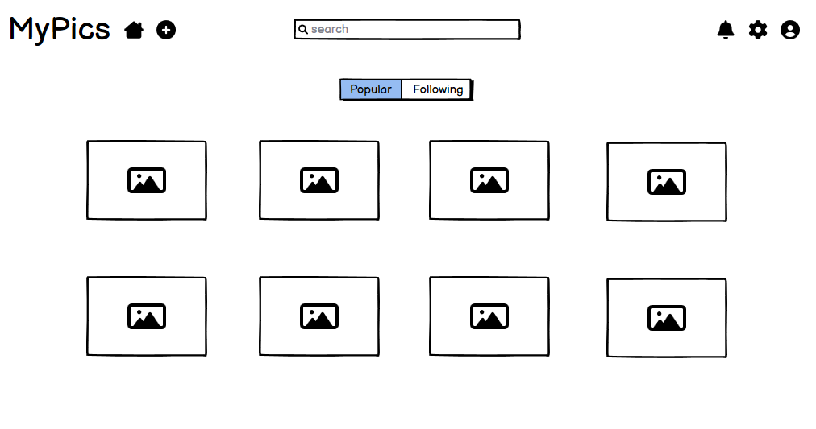
Main

Slide 8
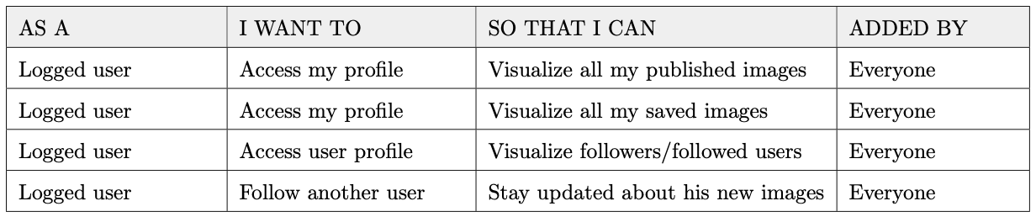
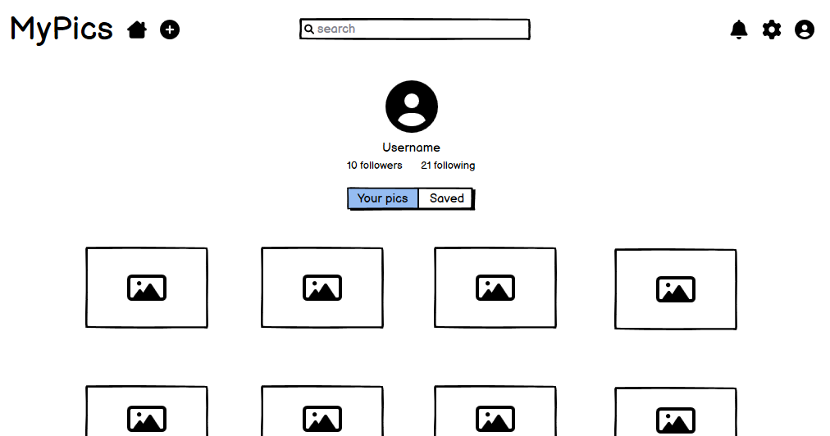
User profile

Slide 9
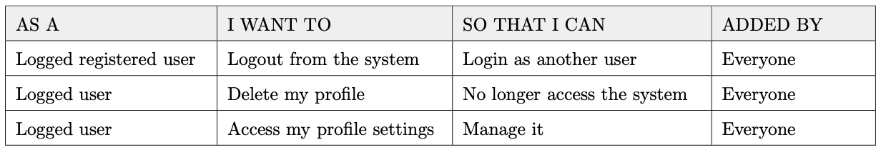
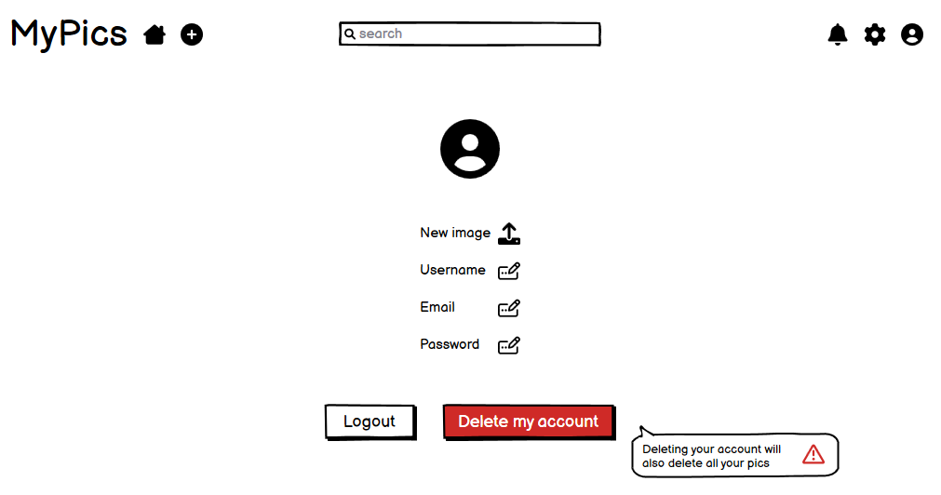
User settings

Slide 10
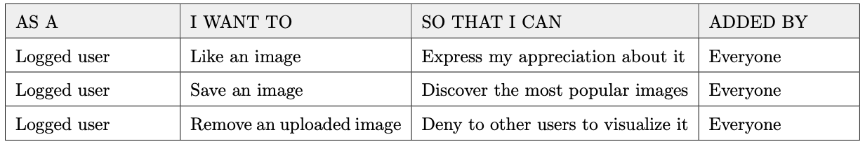
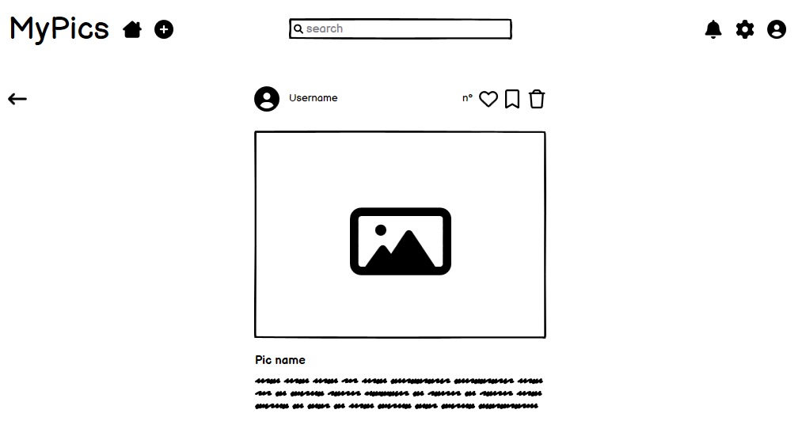
Pic

Slide 11
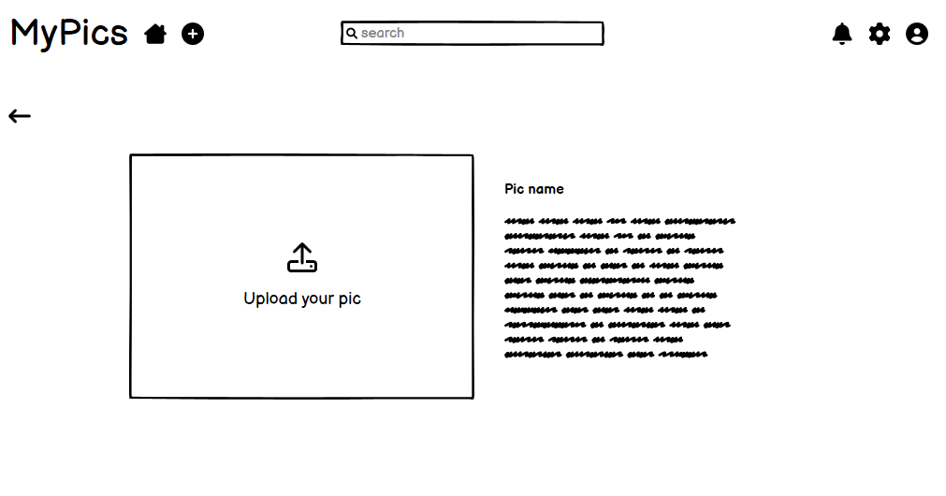
Add pic

Slide 12
Effort estimation
We use Function Points and CoCoMo II to estimate the complexity of the software development
Unadjusted function points = 116
Equivalent SLOC in Java 6148

Slide 13
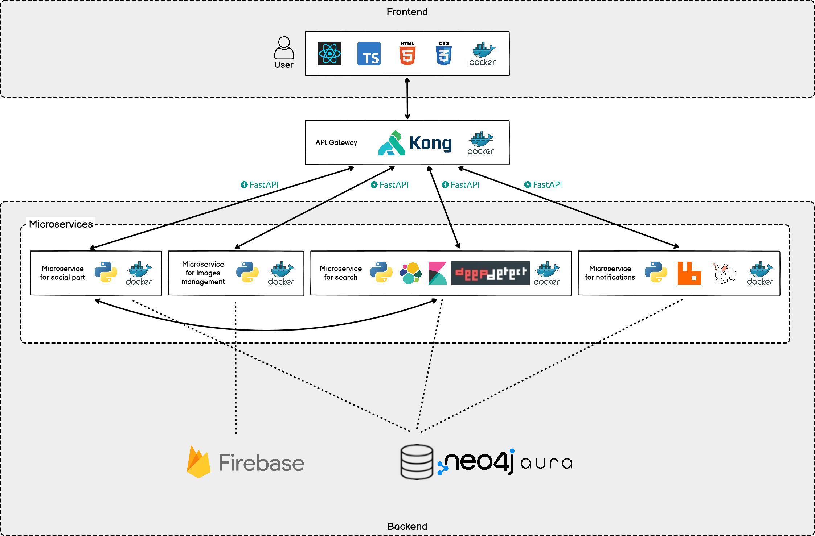
System architecture

