Slide 1
A framework for the fine‑grained evaluation of the instantaneous expected value of soccer possessions
By: Javier Fernández · Luke Bornn · Daniel Cervone
Mauro Florez
Rice University

Slide 2
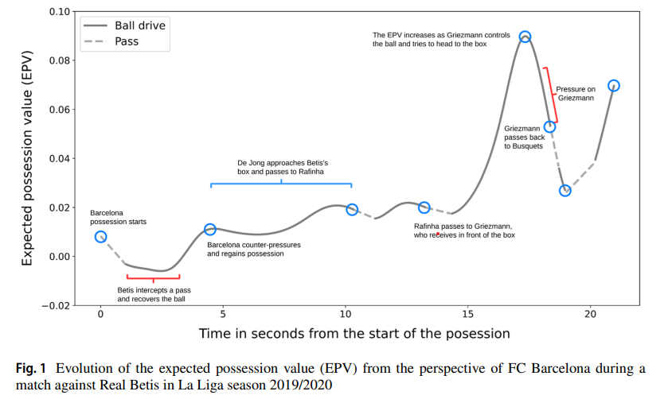
Expected Possesion Value
The expected possession value (EPV) of a soccer possession represents the likelihood of a team scoring or conceding the next goal at any time instance.

Slide 3
Expected Possesion Value
The EPV is essentially an estimate of which team will score the next goal at any given time, given all spatiotemporal information available (e.g the locations of the players and the ball, and observed actions).
In this paper, the authors proposed a framework for estimating the instantaneous expected outcome of any soccer possession.

Slide 4
Expected Possesion Value
The EPV expression is decomposed into a series of subcomponents that model their influence on the expected outcome of a possession
Passes
Ball drives
Shots
This allows to obtain fine-grained visual interpretations from neural network-based components.
This is the first EPV approach in soccer that uses this decomposition and incorporates the dynamics of the 22 players and the ball through tracking data.

Slide 5
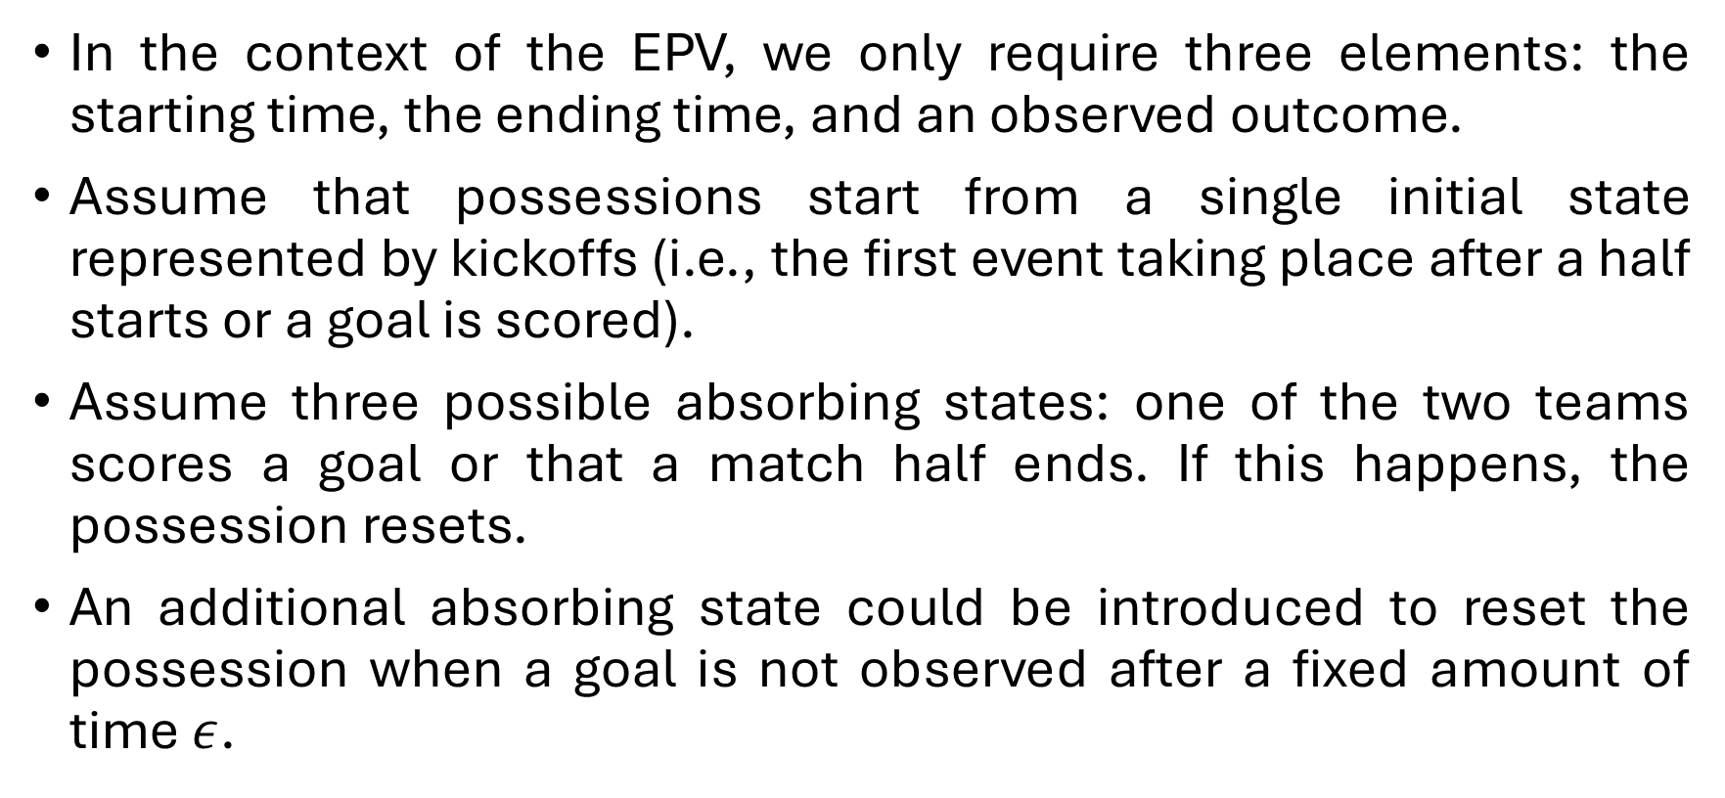
Possessions in soccer
In the context of the EPV, we only require three elements: the starting time, the ending time, and an observed outcome.
Assume that possessions start from a single initial state represented by kickoffs (i.e., the first event taking place after a half starts or a goal is scored).
Assume three possible absorbing states: one of the two teams scores a goal or that a match half ends. If this happens, the possession resets.
An additional absorbing state could be introduced to reset the possession when a goal is not observed after a fixed amount of time $ε$.

Slide 6
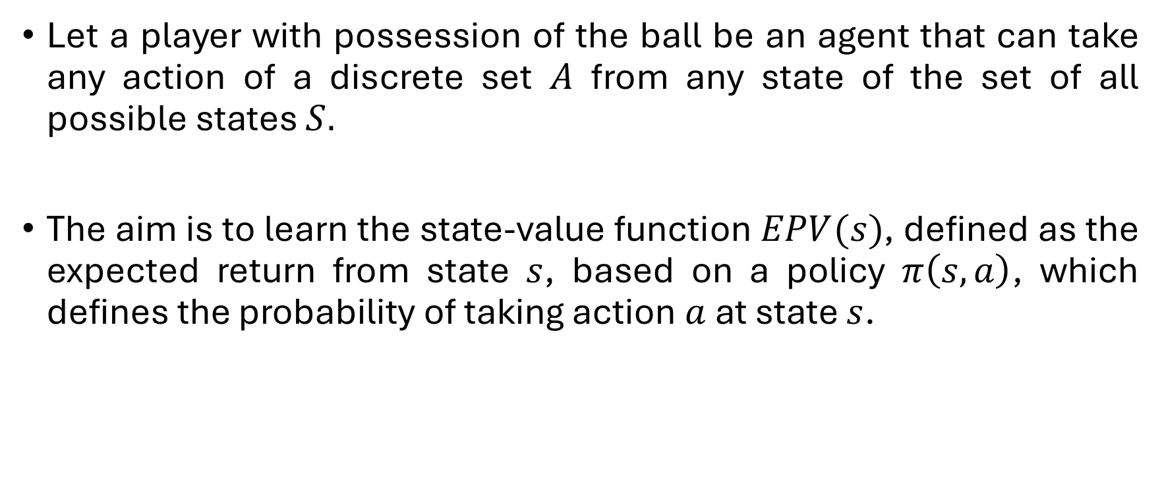
EPV as a Markov Decision Process
Let a player with possession of the ball be an agent that can take any action of a discrete set $A$ from any state of the set of all possible states $S.$
The aim is to learn the state-value function $EPV(s)$, defined as the expected return from state $s$, based on a policy $π\left(s,a\right)$, which defines the probability of taking action $a$ at state $s$.

Slide 7
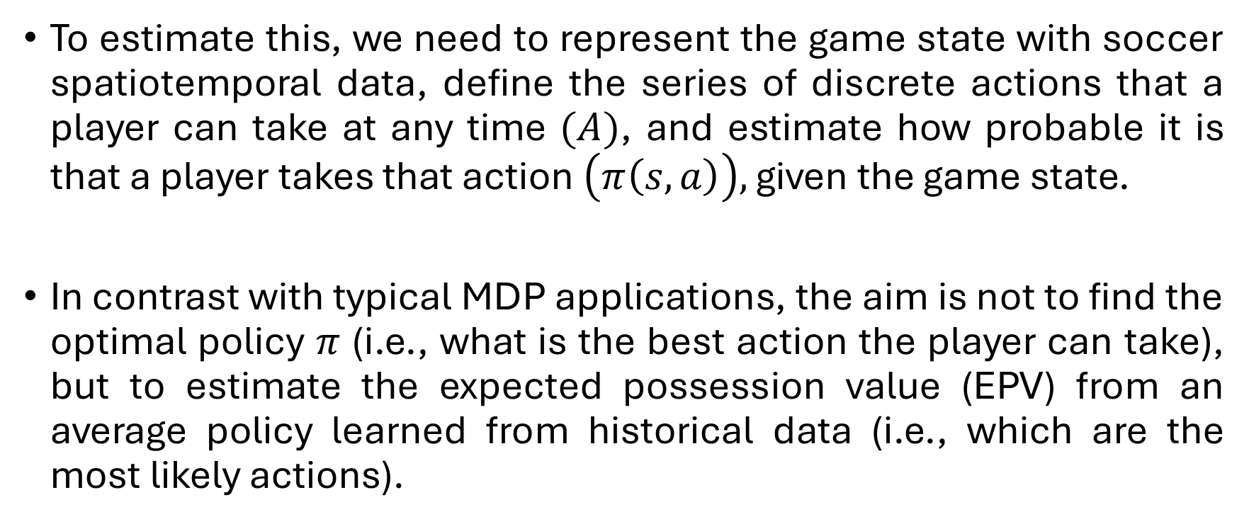
EPV as a Markov Decision Process
To estimate this, we need to represent the game state with soccer spatiotemporal data, define the series of discrete actions that a player can take at any time $(A)$, and estimate how probable it is that a player takes that action $\left(π\left(s,a\right)\right),$ given the game state.
In contrast with typical MDP applications, the aim is not to find the optimal policy $π$ (i.e., what is the best action the player can take), but to estimate the expected possession value (EPV) from an average policy learned from historical data (i.e., which are the most likely actions).

Slide 8
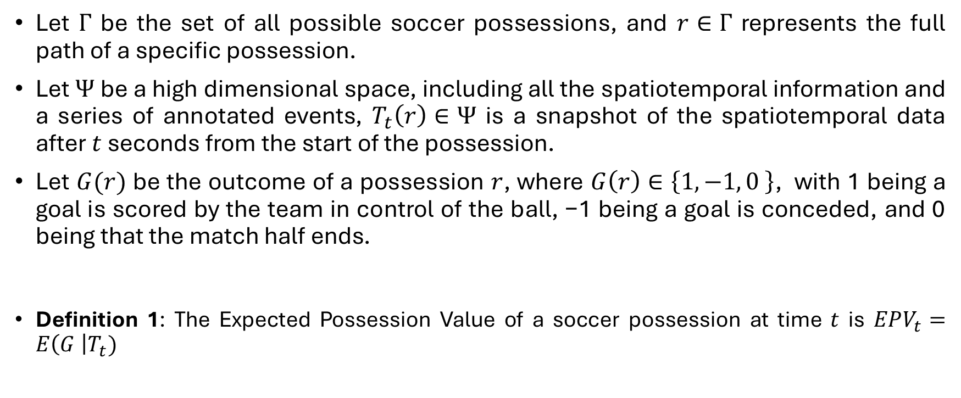
EPV Model
Let $Γ$ be the set of all possible soccer possessions, and $r∈Γ$ represents the full path of a specific possession.
Let $Ψ$ be a high dimensional space, including all the spatiotemporal information and a series of annotated events, $T_{t}\left(r\right)∈Ψ$ is a snapshot of the spatiotemporal data after $t$ seconds from the start of the possession.
Let $G(r)$ be the outcome of a possession $r$, where $G\left(r\right)∈\left\{1, −1, 0 \right\}$, with 1 being a goal is scored by the team in control of the ball, −1 being a goal is conceded, and 0 being that the match half ends.
Definition 1: The Expected Possession Value of a soccer possession at time $t$ is $EPV_{t}=E\left(G \right|T_{t})$

Slide 9
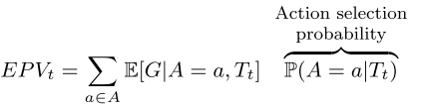
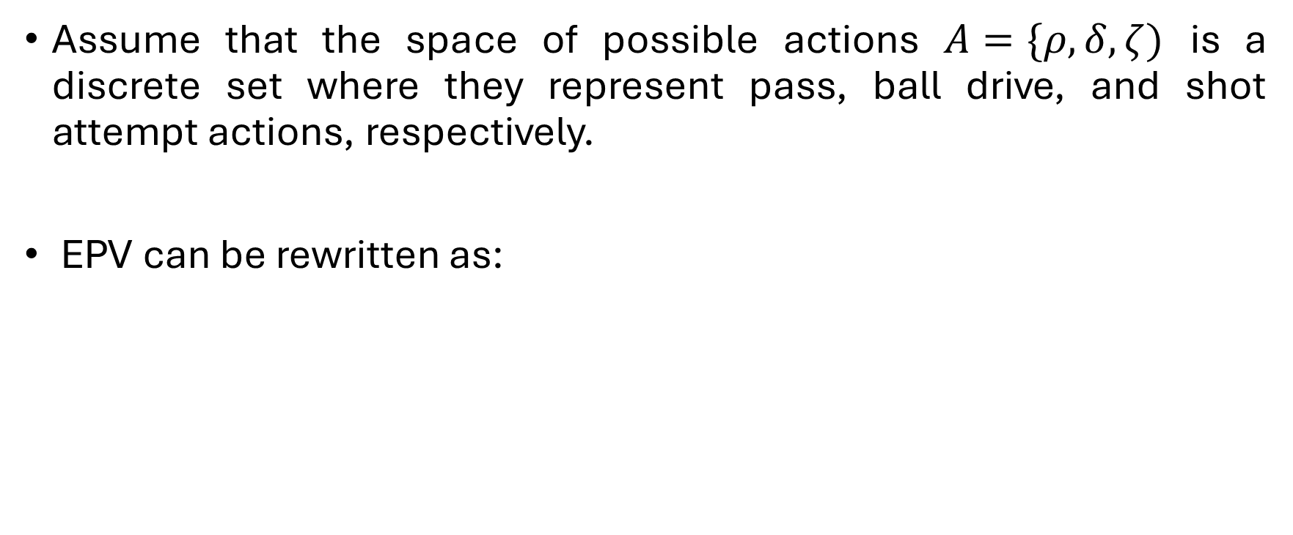
EPV Model
Assume that the space of possible actions $A=\{ρ, δ, ζ)$ is a discrete set where they represent pass, ball drive, and shot attempt actions, respectively.
EPV can be rewritten as:

Slide 10
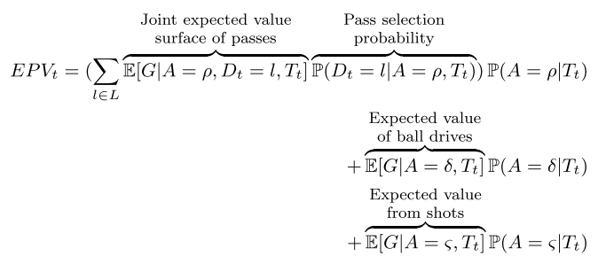
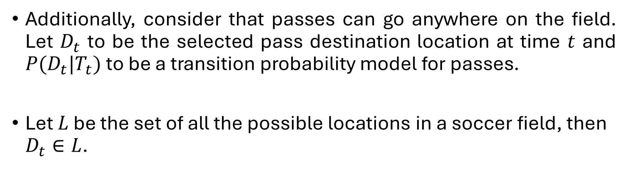

EPV Model
Additionally, consider that passes can go anywhere on the field. Let $D_{t}$ to be the selected pass destination location at time $t$ and $P(D_{t}|T_{t})$ to be a transition probability model for passes.
Let $L$ be the set of all the possible locations in a soccer field, then $D_{t}∈L$.
$$+ ⋯$$

Slide 11

EPV Model - Decomposed
On the other hand, for ball drives ($δ$) and shots ($ζ$) we do not consider the destination location of the action.

Slide 12
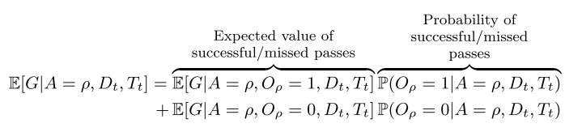
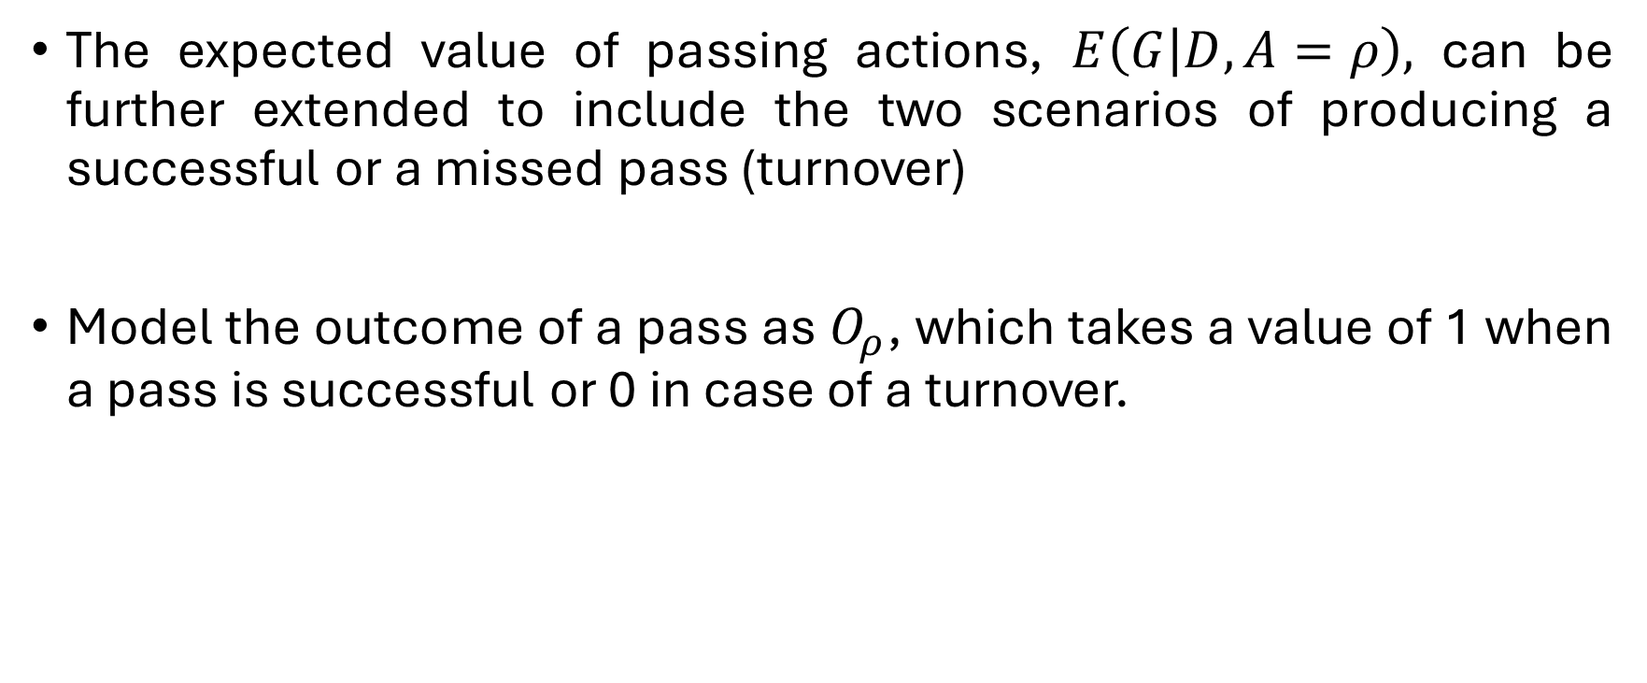
EPV Model - Passing
The expected value of passing actions, $E\left(G | D, A=ρ\right),$ can be further extended to include the two scenarios of producing a successful or a missed pass (turnover)
Model the outcome of a pass as $O_{ρ}$, which takes a value of 1 when a pass is successful or 0 in case of a turnover.

Slide 13
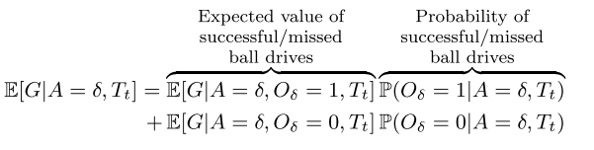
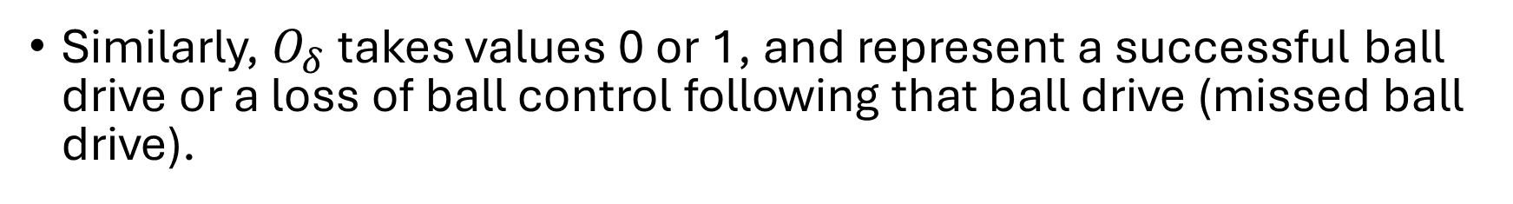
EPV Model - Driving
Similarly, $O_{δ}$ takes values 0 or 1, and represent a successful ball drive or a loss of ball control following that ball drive (missed ball drive).

Slide 14

EPV - Shots
$E(G|A=ζ)$ is equivalent to an expected goals model, a popular metric in soccer which models the expectation of scoring a goal based on shot attempts (xG).

Slide 15
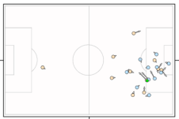
EPV – Model: Summary

Slide 16
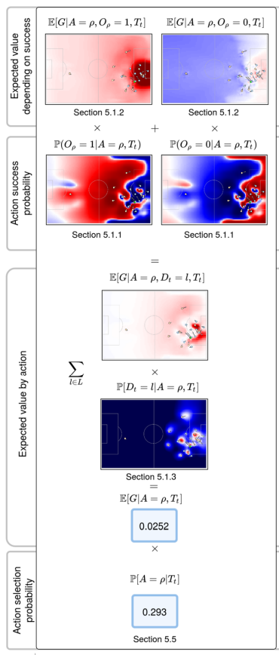
EPV – Model: Pass

Slide 17
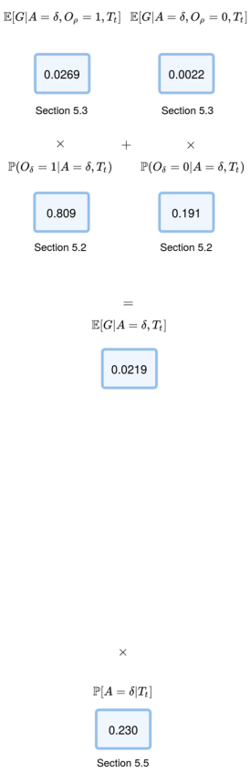
EPV – Model: Summary

Slide 18
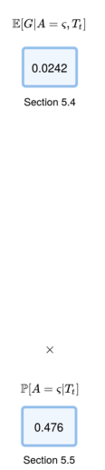
EPV – Model: Summary

Slide 19
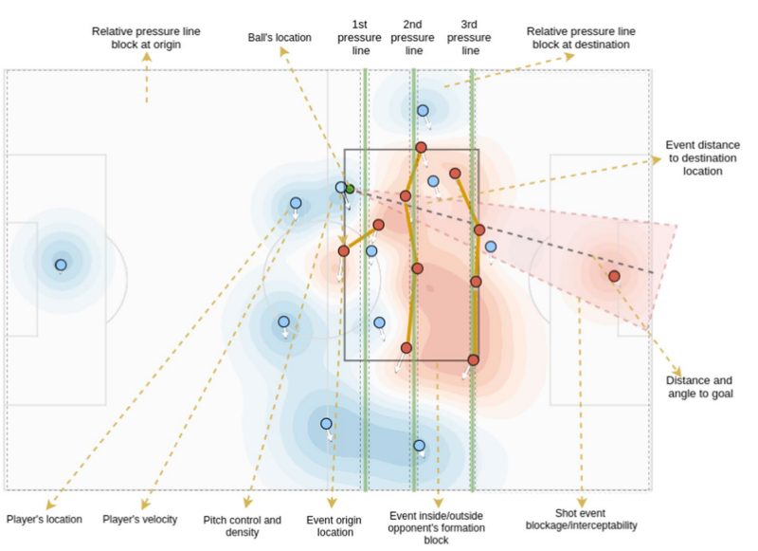
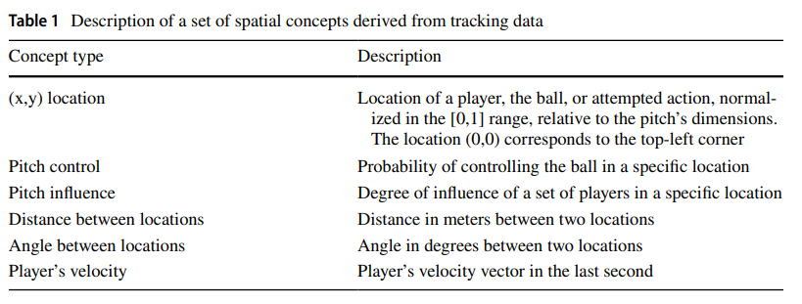
Spatial Features

Slide 20
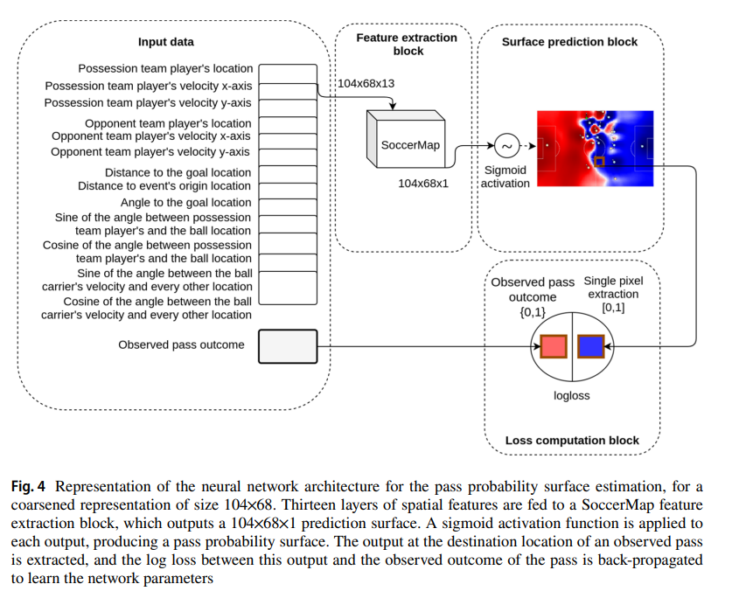
Pass probability Model

Slide 21
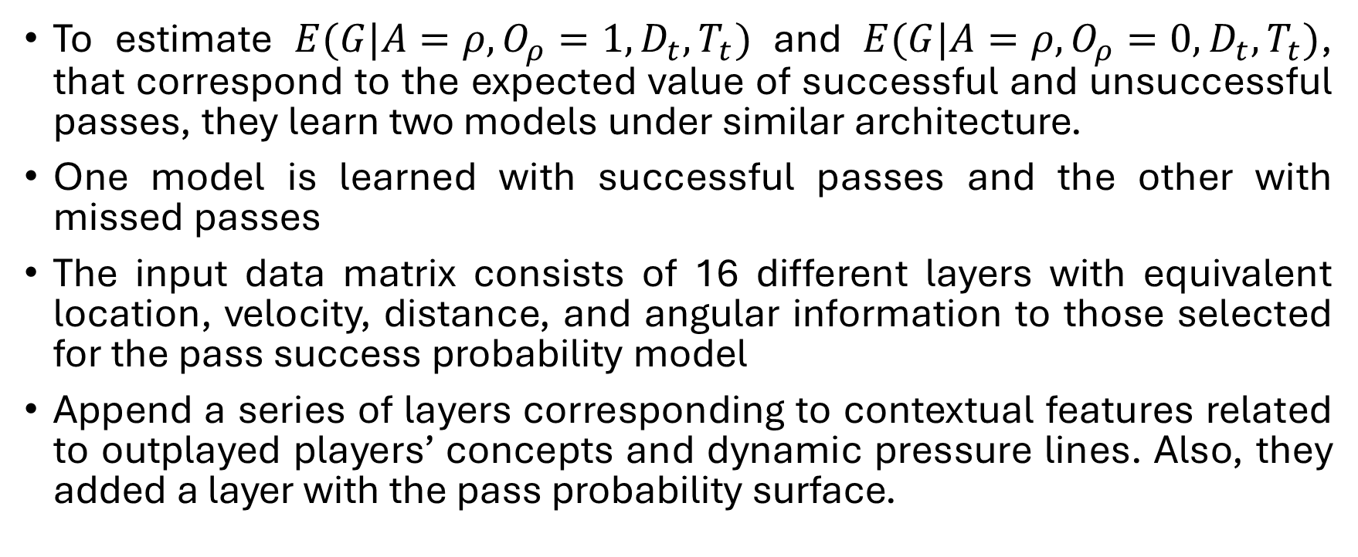
Pass expectation model
To estimate $E(G|A=ρ, O_{ρ}=1, D_{t}, T_{t})$ and $E(G|A=ρ, O_{ρ}=0, D_{t}, T_{t})$, that correspond to the expected value of successful and unsuccessful passes, they learn two models under similar architecture.
One model is learned with successful passes and the other with missed passes
The input data matrix consists of 16 different layers with equivalent location, velocity, distance, and angular information to those selected for the pass success probability model
Append a series of layers corresponding to contextual features related to outplayed players’ concepts and dynamic pressure lines. Also, they added a layer with the pass probability surface.

Slide 22
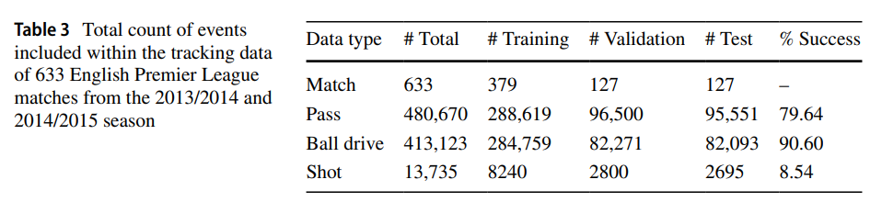
Experimental Setup
633 English Premier League from the 2013/14 and 2014/15 season. Tracking data source consists of every player’s location and the ball at a 10Hz sampling rate, obtained through semi-automated player and ball tracking performed on match videos.

Slide 23
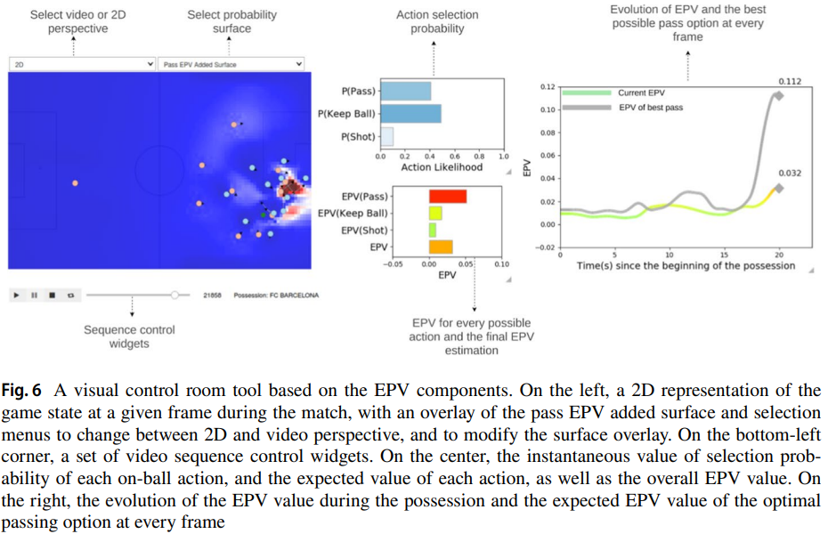
A real‑time control room

Slide 24
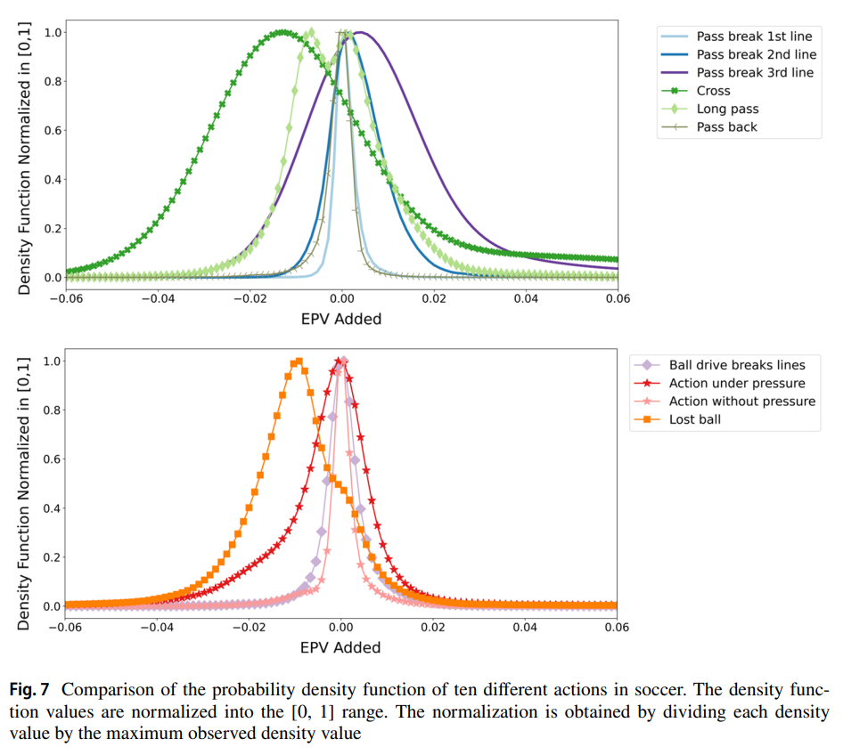
Comparison of actions

Slide 25
Off-ball & on-ball: The on-ball advantage is calculated as the sum of the EPV added of passes with positive EPV added. On the other hand, the off-ball advantage is calculated as the sum of positive potential EPV added. We then say that a player has an off-ball advantage if he is located in a position where, in case of receiving a pass, the EPV would increase.
This section uses EPV passing components and dynamic pressure lines to analyze how to press Brendan Rodgers’ Liverpool (season 14/15).

Slide 26
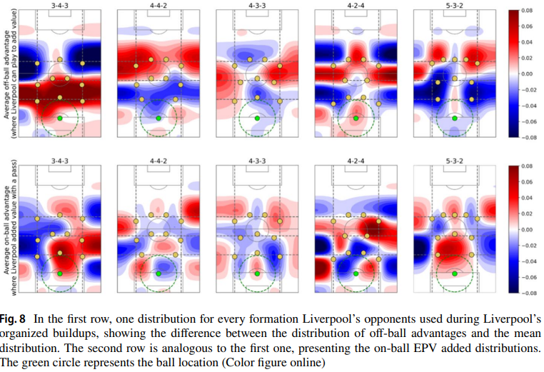
Pressing Liverpool
Against 3-4-3:
Liverpool can create higher off-ball advantages before the second pressure line. Manages to break the first line by the inside.
4-4-2:
Liverpool has more difficulties in breaking the first line, facilitate long ball to the sides.
4-3-3:
An ideal pressing formation for avoiding Liverpool playing inside the pressing block.
5-3-2:
Provides significant advantages to Liverpool that can create spaces both by the inside above the 1st pressure line and behind the defenders.

Slide 27
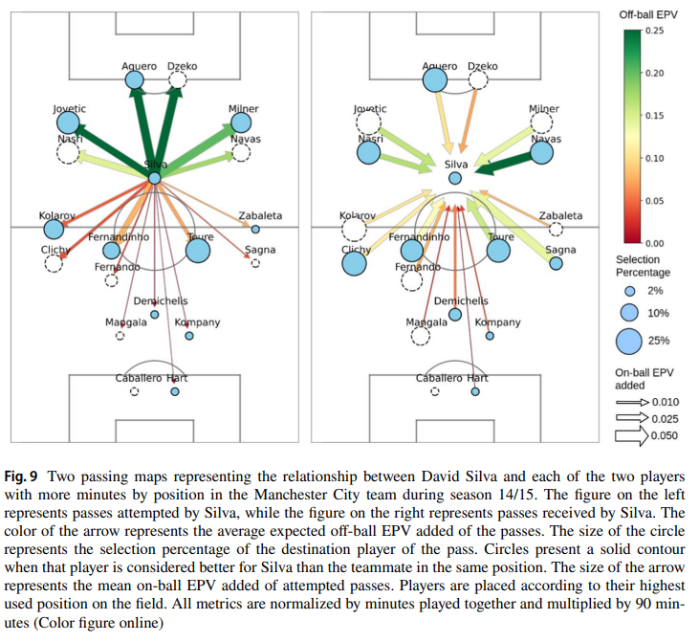
David Silva
We can see that both the wingers and forwards generate space for Silva and receive high added value from his passes.
The most frequently selected player is Yaya Touré, who also looks for Silva often and is the midfielder providing the highest value to him.
This information allows the coach to gain a deeper understanding of the effective off-ball and on-ball value relationship that is expected from every pair of players and can be useful for designing playing strategies before a match.

Slide 28
Conclusions
This paper presents a comprehensive approach for estimating the instantaneous expected value of possessions in soccer.
One of the main contributions of this work is showing that by deconstructing a single expectation into a series of lower-level statistical components and then estimating each of these components separately, we can gain greater interpretation insight into how these different elements impact the final joint estimation.
Limitations:
Does not include player and team-specific features. (player skills, strategy, game style)
Meta information of the game and team state (Score, match importance)
Training with more data (Different leagues)

