Slide 1


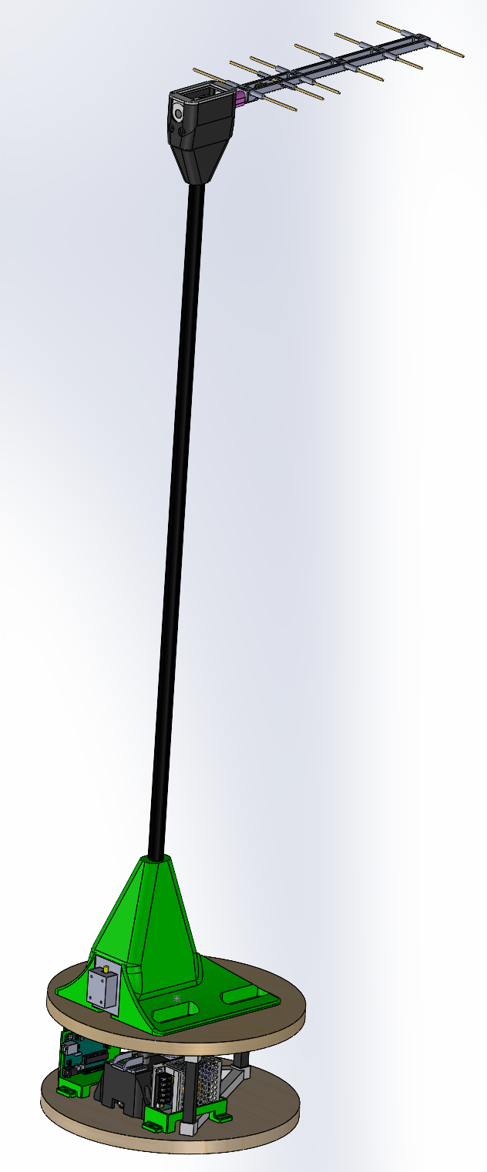
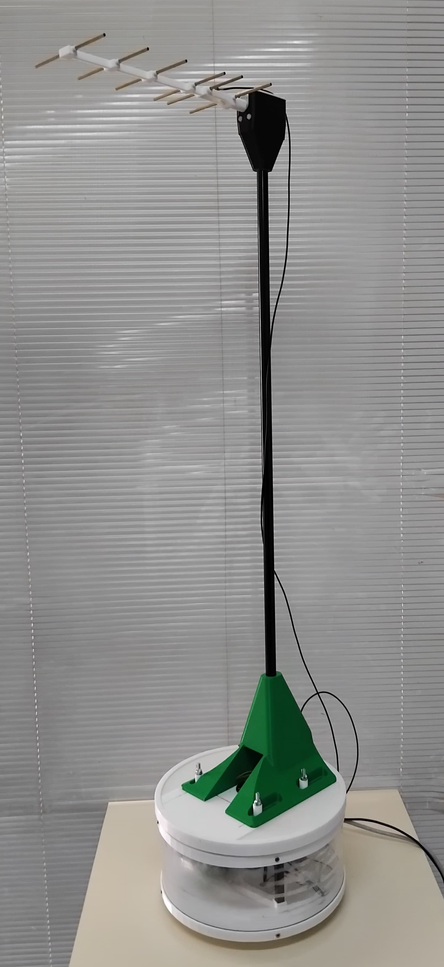
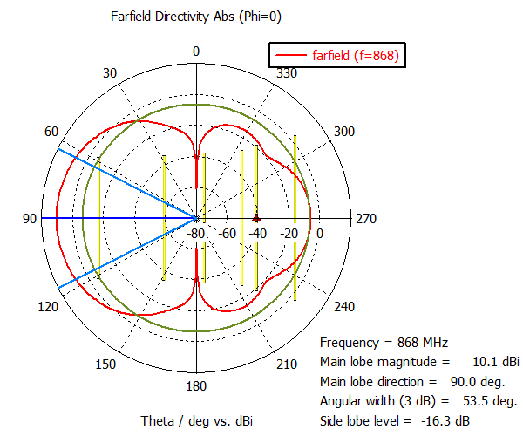
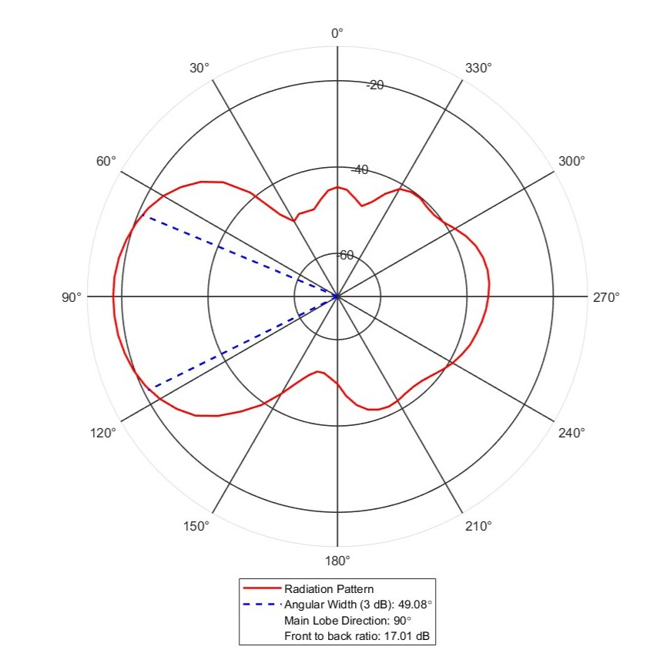




Development of a 2-DoF Antenna Radiation Measurement System
MAURO LEME¹; JOÃO ALEXANDRE COELHO²; JOÃO PAULO COELHO^{1,2}
a52965@alunos.ipb.pt; jpcoelho@ipb.pt.
INSTITUTO POLITÉCNICO DE BRAGANÇA¹ E CeDRI, SusTEC, IPB².
ABSTRACT
Antenna radiation patterns are critical for wireless communication performance, defining signal coverage and interference. Simulations predict patterns, but real-world conditions introduce variations. Commercial measurement systems, though accurate, are costly and complex for educational settings, limiting hands-on learning. This work addresses this gap by developing a low-cost, automated system for measuring antenna radiation patterns, enhancing practical telecommunications education.
OBJECTIVES
METHODOLOGY
This project aims to create an affordable, educational tool to enhance telecommunications training by measuring antenna radiation patterns. The following goals guide the development and application of the two degree of freedom system:
Develop a low-cost, two degree of freedom system for measuring antenna radiation patterns at 868 MHz.
Enable real-time visualisation to enhance telecommunications education
Validate system accuracy by comparing measured patterns with simulation results.
Provide an open-source two degree of freedom platform to support replication and hands-on learning.
Foster student engagement through practical experiments in antenna behaviour analysis.
The two degree of freedom system utilises Arduino-controlled NEMA 17 stepper motors (1.8° resolution) for antenna rotation. An AD8313 RF power detector measures signal strength at 868 MHz. Designed in SolidWorks, the platform integrates with MATLAB for real-time visualisation, enabling automated scanning of radiation patterns.
The prototype is built for educational use, ensuring affordability and replicability. It allows students to capture data for analysis, bridging theoretical knowledge with practical experiments. As shown in Figure 1a and Figure 1b, the system combines a CAD design with a physical setup.
Fig 1a - CAD rendering.
Figure 1b: Physical prototype.
RESULTS AND CONCLUSIONS
BIBLIOGRAPHY
The two degree of freedom system measured a Yagi-Uda antenna at 868 MHz, capturing a primary lobe at 90° with a 3 dB beamwidth of 49.08° (simulated: 53.5°) and a front-to-back ratio of 17.01 dB (simulated: 16.3 dB). Environmental reflections caused minor variations.
The system supports classroom learning, engaging students in antenna analysis. Future enhancements include noise filters, a balun, and digital tutorials. Open-source designs encourage improvements. As shown in Figure 2, measured data align with simulations, validating the system’s educational utility.
Constantine A Balanis. Antenna theory: analysis and design. John Wiley & sons,2016.
Vittorio Picco and Keith Martin. An automated antenna measurement systemutilizing wi-fi hardware., 53(6):173–184,2011. IEEE Antennas and Propagation Magazine
Asep Barnas Simanjuntak, Budi Mulyanti, Enjang Akhmad Juanda, Ade GaffarAbdullah, Muhammad Naufal, and Raksa Reza Pratama. Preliminary design of automatic antenna radiation pattern measurement system for antenna and propagation laboratory course. In Proceedings of the 5th UPI International Conference on Technical and Vocational Education and Training (ICTVET 2018), pages 84–87.Atlantis Press, 2019.
Figure 2a: Simulated outcome.
Figure 2b: Measured data.
Acknowledgements: This work was supported by national funds: UID/05757 - Research Centre in Digitalization and Intelligent Robotics (CeDRI); and SusTEC, LA/P/0007/2020 (DOI: 10.54499/LA/P/0007/2020).

