Slide 1
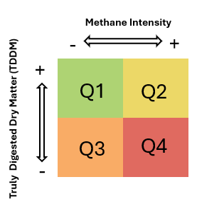
Methane Intensity
-
+
+
Q1
Q2
Truly Digested Dry Matter (TDDM)
Q3
Q4
-

