Slide 1
Automated multi-label text categorization with VG-RAM weightless neural networks
A. F. DeSouza, F. Pedroni, E. Oliveira, P. M. Ciarelli,
W. F. Henrique, L. Veronese, C. Badue.
Neurocomputing, 2009, pp. 2209-2217.
Presenter: Guan-Yu Chen

Slide 2
Outline
Introduction
Multi-label text categorization
VG-RAN WNN
ML-KNN
Experimental evaluation
Conclusions & future work

Slide 3
1. Introduction (1/2)
Most works on text categorization in the literature are focused on single label text categorization problems, where each document may have only a single label.
However, in real-world problems, multi-label categorization is frequently necessary.

Slide 4
1. Introduction (2/2)
2 methods:
  Virtual Generalizing Random Access Memory Weightless Neural Networks (VG-RAM WNN),
  Multi-Label K-Nearest Neighbors (ML-KNN).
4 metrics:
  Hamming loss, One-error, Coverage, & Average precision.
2 problems:
  Categorization of free-text descriptions of economic activities,
  Categorization of Web pages.

Slide 5
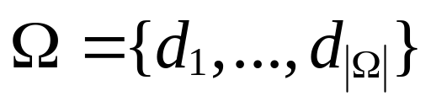
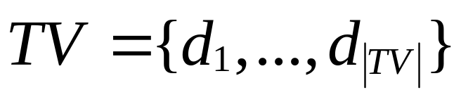
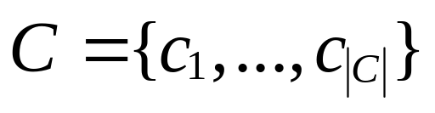
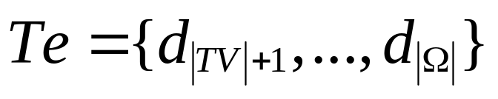

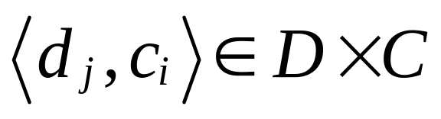
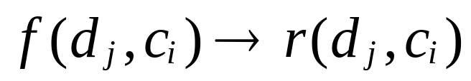

2. Multi-label text categorization

Slide 6
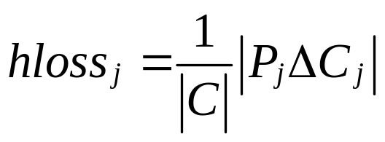
2.1 Evaluation metrics (1/5)
Hamming loss (hloss_{j}) evaluate show many times the test document d_{j} is misclassified:
  A category not belonging to the document is predicted,
  A category belonging to the document is not predicted.
where |C| is the number of categories and Δ is the symmetric difference between the set of predicted categories P_{j} and the set of appropriate categories C_{j} of the test document d_{j}.

Slide 7
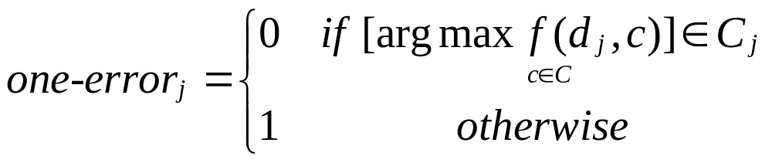
2.1 Evaluation metrics (2/5)
One-error (one-error_{j}) evaluates if the top ranked category is present in the set of proper categories C_{j} of the test document d_{j}:
where [arg max f (d_{j},c)] returns the top ranked category for the test document d_{j}.

Slide 8
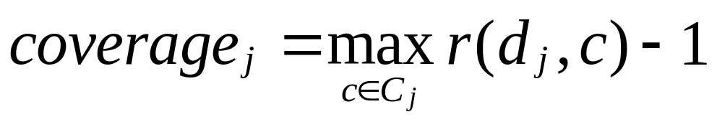
2.1 Evaluation metrics (3/5)
Coverage (coverage_{j}) measures how far we need to go down the rank of categories in order to cover all the possible categories assigned to a test document:
where max r(d_{j},c) returns the maximum rank for the set of appropriate categories of the test document d_{j}.

Slide 9
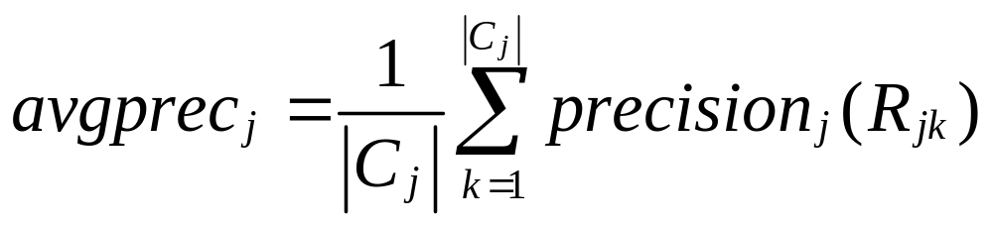
2.1 Evaluation metrics (4/5)
Average precision (average-precision_{j}) evaluates the average of precisions computed after truncating the ranking of categories after each category c_{i} belongs to C_{j} in turn:
where R_{jk} is the set of ranked categories that goes from the top ranked category until a ranking position k where there is a category c_{i} belongs to C_{j} for d_{j}, and precision_{j}(R_{jk}) is the number of pertinent categories in R_{jk} divided by |R_{jk}|.

Slide 10
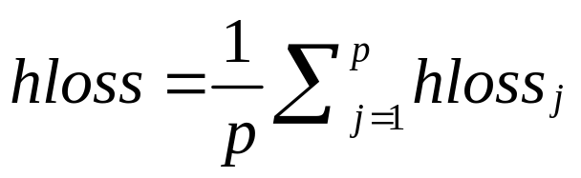
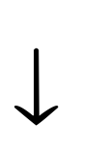
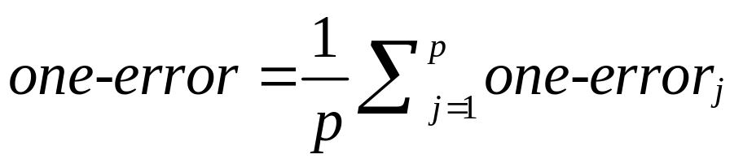
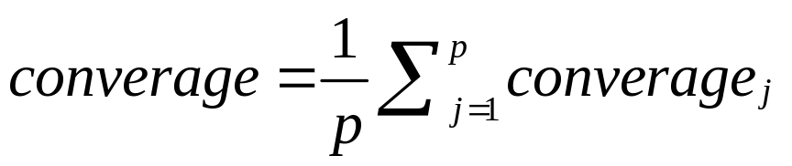
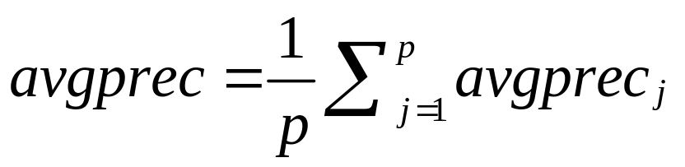

2.1 Evaluation metrics (5/5)

Slide 11
3. VG-RAN WNN (1/5)
Virtual Generalizing Random Access Memory Weightless Neural Networks, VG-RAM WNN.
RAM-based neural networks (N-tuple categorizers or Weightless neural networks, WNN) do not store knowledge in their connections but in Random Access Memories (RAM) inside the neurons.
These neurons operate with binary input values and use RAM as lookup tables.
  Each neurons’ synapses collect a vector of bits from the network’s inputs that is used as the RAM address.
  The value stored at this address is the neuron’s output.
Training can be made in one shot and basically consists of storing the desired output in the address as sociated with the input vector of the neuron.

Slide 12
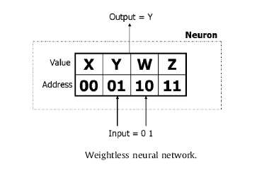
3. VG-RAN WNN (2/5)

Slide 13
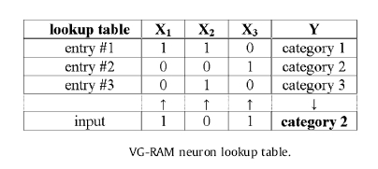
3. VG-RAN WNN (3/5)

Slide 14
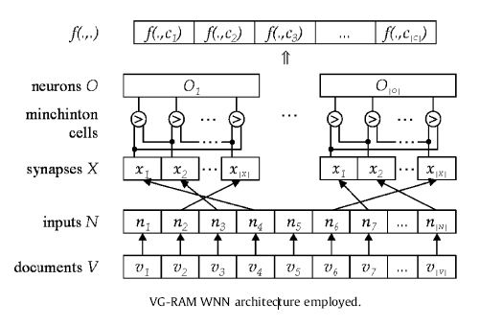
3. VG-RAN WNN (4/5)

Slide 15
3. VG-RAN WNN (5/5)
A threshold τ may be used with the function f(d_{j}, c_{i}) to define the set of categories to be assigned to the test document.

Slide 16
4. ML-KNN
Multi-Label K-Nearest Neighbors, ML-KNN.
  (Zhang & Zhou, 2007)
The ML-KNN categorizer is derived from the popular KNN algorithm. It is based on the estimate of the probability of a category to be assigned to a test document d_{j} considering the occurrence of that category on the k nearest neighbors of d_{j}. If that category is assigned to the majority (more than 50%) of the k neighbors of d_{j}, then that category is also assigned to d_{j} , and not assigned otherwise.

Slide 17
5. Experimental evaluation (1/3)
Event Associative Machine (MAE)
  An open source framework for modeling VG-RAM neural networks developed at the Universidade Federaldo Espírito Santo.
Neural Representation Modeler (NRM)
  Developed by the Neural Systems Engineering Group at Imperial College London.
  Commercialized by Novel Technical Solutions.

Slide 18
5. Experimental evaluation (2/3)
3 differences between MAE and NRM:
  Open source,
  Runs on UNIX (and Linux),
  Uses a textual language to describe WNNs.
MAE Neural Architecture Description Language (NADL)
  A built-in graphical user interface.
  An interpreter of the MAE Control Script Language (CDL).

Slide 19
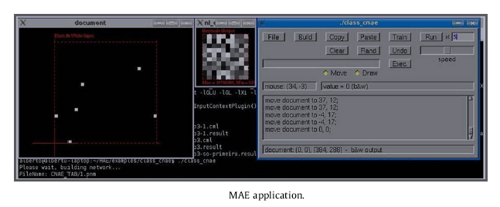
5. Experimental evaluation (3/3)

Slide 20
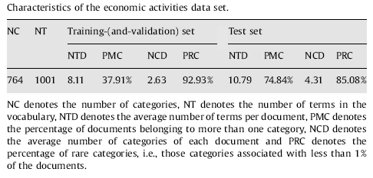
5.1 Categorization of free-text descriptions of economic activities (1/3)
In Brazil, social contracts contain the statement of purpose of the company.
  Classificacão Nacional de Atividades Econômicas, CNAE (National Classification of Economic Activities).

Slide 21
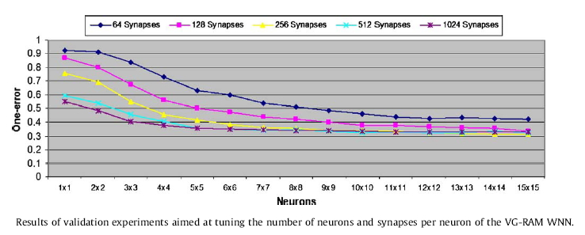
5.1 Categorization of free-text descriptions of economic activities (2/3)

Slide 22
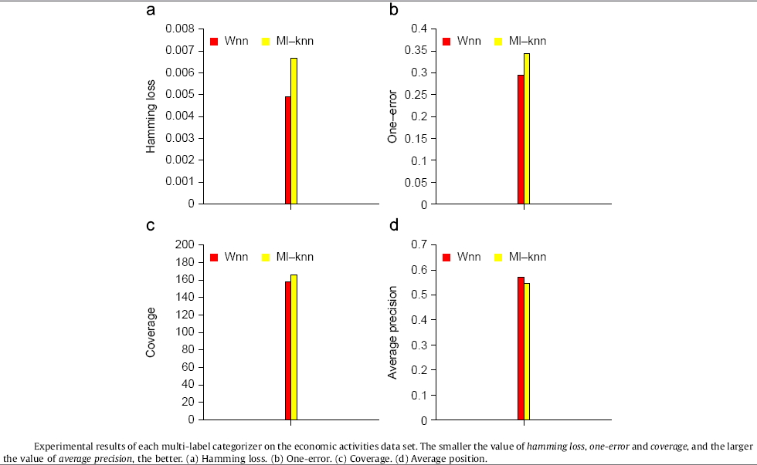
5.1 Categorization of free-text descriptions of economic activities (3/3)

Slide 23
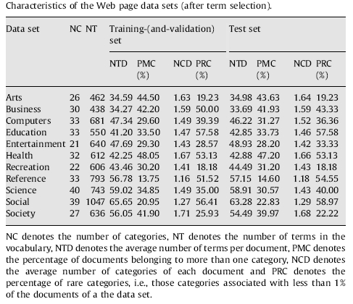
5.2 Categorization of web pages (1/3)
Yahoo directory (http://dir.yahoo.com).

Slide 24
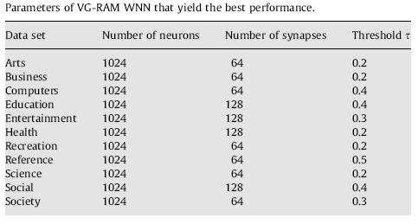
5.2 Categorization of web pages (2/3)

Slide 25
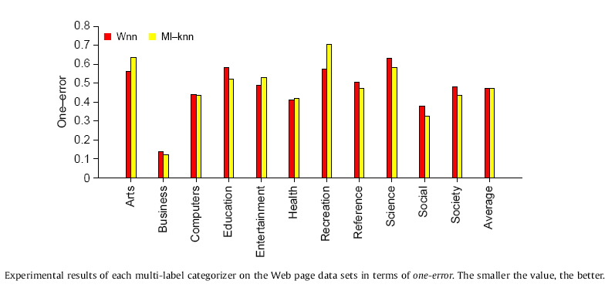
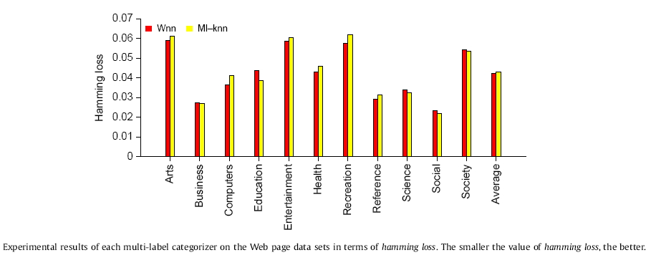
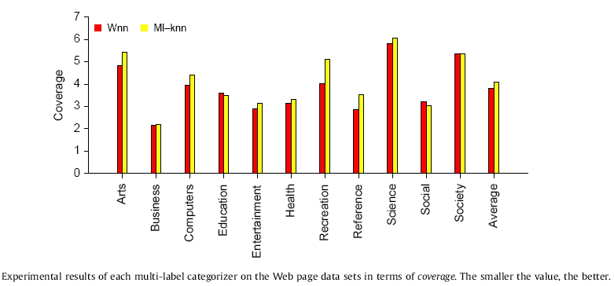
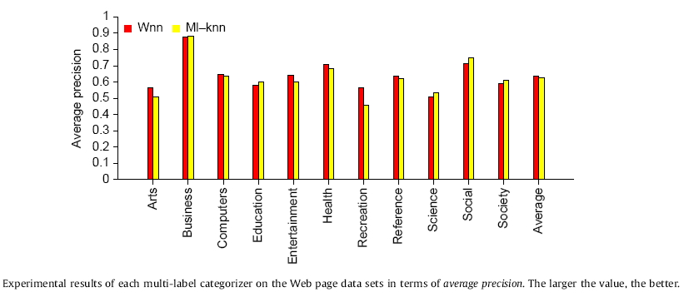
5.2 Categorization of web pages (3/3)

Slide 26
6.1 Conclusions
In the categorization of free-text descriptions of economic activities, VG-RAM WNN outperformed ML-KNN in terms of the four multi-label evaluation metrics adopted.
In the categorization of Web pages, VG-RAM WNN outperformed ML-KNN in terms of hamming loss, coverage and average precision, and showed similar categorization performance in terms of one-error.

Slide 27
6.2 Future work
To compare VG-RAM WNN performance against other multi-label text categorization methods.
To examine correlated VG-RAM WNN and other mechanisms for taking advantage of the correlation between categories.
To evaluate the categorization performance of VG-RAM WNN using different multi-label categorization problems (image annotation & gene function prediction).

