Slide 1

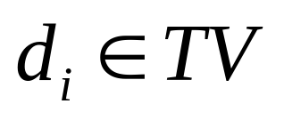
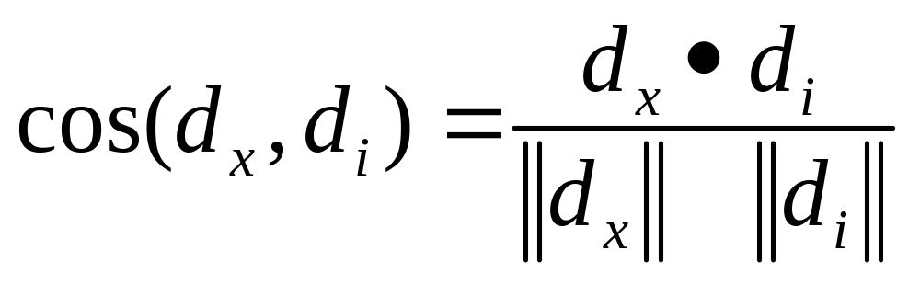
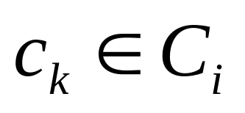
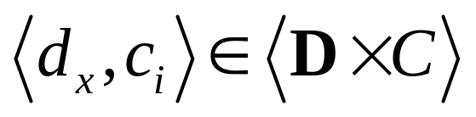

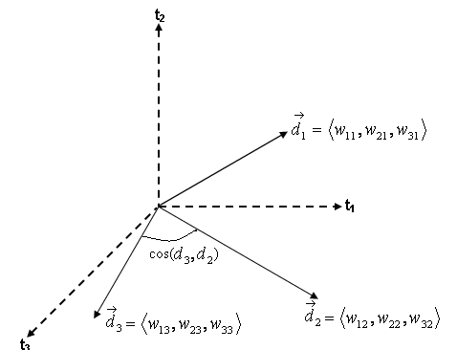
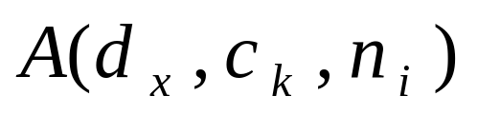
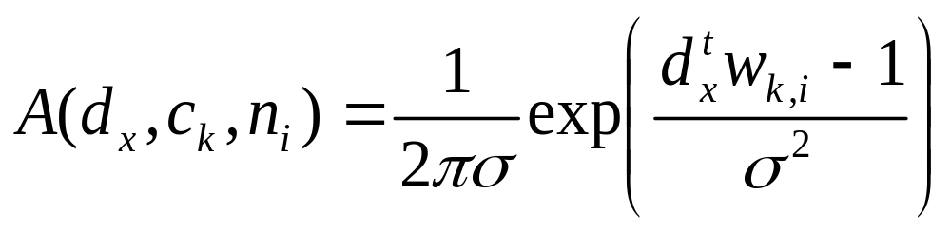

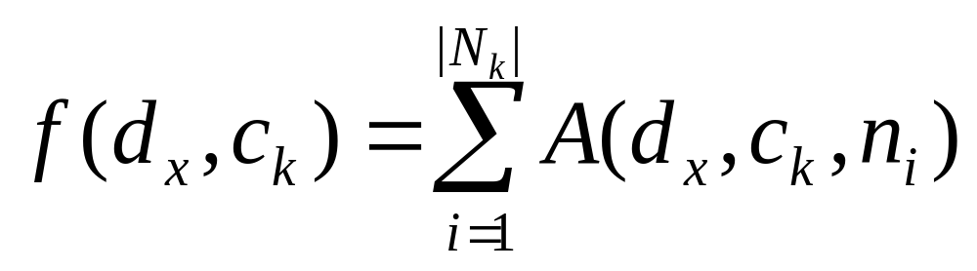
Implementation in C+CUDA of Multi-Label
Text Categorizers
Lucas Veronese, Alberto F. De Souza, Claudine Badue, Elias Oliveira, Patrick M. Ciarelli
Departamento de Informática – Laboratório de Computação de Alto Desempenho
Universidade Federal do Espírito Santo, Av. F. Ferrari 514, 29075-910-Vitória-ES, Brazil
{lucas.veronese, alberto, claudine, elias, pciarelli }@lcad.inf.ufes.br
Introduction
where N_{k} is the number of neurons of the pattern layer associated to ck. The categories c_{k} ranked above a threshold are predicted to the input document d_{x}.
In automated multi-label text categorization problems with large numbers of labels, the training databases are large, which may render the categorization time prohibitive for online systems. In this work, we evaluate the parallel implementation in C+CUDA of two multi-label text categorizers: the first is based on the k-Nearest Neighbors (k-NN) algorithm [1] and the second is based on Probabilistic Neural Networks (PNN) [2]. We implemented these algorithms in three different ways: sequential in C, parallel in C+CUDA, and parallel using the C+CUBLAS library.
d_{x}
w_{1,1}
…
w_{|c1|,i}
w_{|ck|,1}
…
w_{|ck|,i}
pattern layer
k-Nearest Neighbors (k-NN)
The k-NN categorizer finds the k nearest neighbors of an input document dx in the set of previously learned documents, TV, according to some given distance metric. We used the cosine of the angle between the floating-point vector that represents the input document d_{x} (bag-of-words document representation [1]) and each document , cos(d_{x},d_{i}):
f(d_{x},c₁)
f(d_{x},c_{k})
summation layer
Experimental Setup
We ran the C, C+CUDA and C+CUBLAS versions of our categorizers in an AMD Athlon 64 X2 (Dual Core) 5,200+ of 2.7 GHz, with 3GB of 800 MHz DRAM DDR2, and video card NVIDIA GeForce GTX 285, with 1GB of DRAM GDDR3.
The data set used is composed of 6,911 documents categorized into 105 different categories by specialists in the domain of the documents. Each one of these categories occurs in exactly 100 different documents, i.e., there are 100 documents of each category. Each document is represented by a vector of single precision floats of size 3,764 (the number of relevant terms in the system vocabulary).
The k-NN categorizer (i) employs a function f(d_{x},c_{k}) that returns the highest value of cos(d_{x},d_{i}) for and , where C_{i} is the set of pertinent categories for the document d_{i}, and (ii) selects the k pairs
from the top of the ranking derived from .
Results
To evaluate the performance of our categorizers in terms of time, we selected 6,910 documents of the data set for training, and a single one for testing the categorizers. Each categorizer was executed 100 times and the average was used to compare them. Table 1 shows the average times for each categorizer (rows) and categorizer implementation (columns), in addition to the speed-ups over the sequential implementation (last two columns). As the table shows, we achieved speed-ups of about 60 for the C+CUDA version and about 45 for the C+CUBLAS version. These results show that, with CUDA, it is possible to implement on-line text categorization and that, in some cases, it is worth implementing the whole code instead of using C+CUBLAS.
Probabilistic Neural Network (PNN)
The PNN used in this work was proposed by Oliveira et. al [2] and is composed of two feed-forward layers: pattern layer and summation layer. In the training phase, for each document d_{i} is created a set of neurons, one for each category , where each neuron n_{i} stores the vector d_{i} as a vector of term weights, w_{k,i}. In the categorization phase, an input document d_{x} is presented to the pattern layer. The i-th neuron, n_{i}, associated to category c_{k} in the pattern layer, calculates the activation function for document d_{x} given by:
Categ. | C (s) | C+CUDA (s) | C+CUBLAS (s) | Speed-up C+CUDA | Speed-up C+CUBLAS
k-NN | 0.1928 | 0.0030 | 0.0042 | 64.26 | 45.90
PNN | 0.1938 | 0.0033 | 0.0044 | 58.72 | 44.04
k=1, ..., |C|, i=1, …, |D_{k}|
Bibliography
where is a constant for all neurons (adjusted during training for best categorization performance [2]), C is the whole set of possible categories, and D_{k} is the set of documents associated to category c_{k}. In the summation layer, which has as many neurons as |C|, each neuron is associated with a category c_{k} and computes the function f(d_{x},c_{k}):
[1] F. Sebastiani, “Machine Learning in Automated Text Categorization”, ACM Computing Surveys 34(1), 2002, pp. 1-47 .
[2] E. Oliveira, P. M. Ciarelli, A. F. De Souza, and C. Badue. Using a Probabilistic Neural Network for a Large Multi-Label Problem. Proceedings of the 10th Brazilian Symposium on Neural Networks (SBRN'08), pp. 195-200, Salvador, Bahia, Brazil, October 2008.
k=1, ..., |C|

