Slide 1


A k-Nearest Neighbor Based Algorithm for Multi-Label Classification
Min-Ling Zhang zhangml@lamda.nju.edu.cn
Zhi-Hua Zhou
zhouzh@nju.edu.cn
http://lamda.nju.edu.cn
National Laboratory for Novel Software Technology
Nanjing University, Nanjing, China
July 26, 2005

Slide 2
Outline
Multi-Label Learning (MLL)
ML-kNN (Multi-Label k-Nearest Neighbor)
Experiments
Conclusion

Slide 3
Outline
Multi-Label Learning (MLL)
ML-kNN (Multi-Label k-Nearest Neighbor)
Experiments
Conclusion

Slide 4

Multi-Label Objects
e.g. natural scene image
Lake
Multi-label learning
Trees
Mountains
Ubiquitous
Documents, Web pages, Molecules......

Slide 5
Formal Definition
Settings:
: d-dimensional input space ^{d}
: the finite set of possible labels or classes
H: →2, the set of multi-label hypotheses
Inputs:
S: i.i.d. multi-labeled training examples {(x_{i}, Y_{i})} (i=1,2,...m) drawn from
an unknown distribution D, where x_{i}∈ and Y_{i} ⊆
Outputs:
h: →2, a multi-label predictor; or
f : × → , a ranking predictor, where for a given instance x, the labels in 
are ordered according to f(x,·)

Slide 6
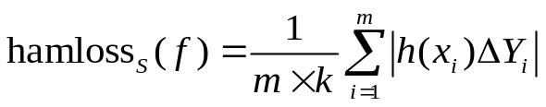
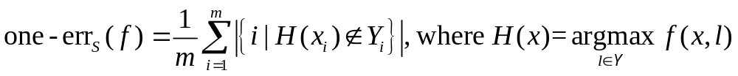
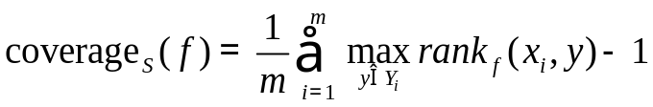
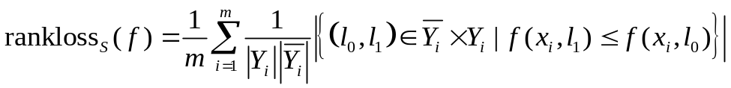
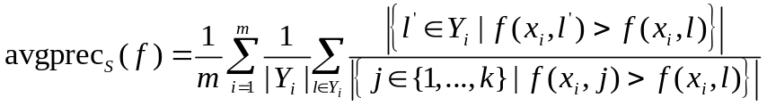
Evaluation Metrics
Given:
S: a set of multi-label examples {(x_{i}, Y_{i})} (i=1,2,...m), where x_{i}∈ and Y_{i} ⊆
f : × → , a ranking predictor (h is the corresponding multi-label predictor)
Definitions:
Hamming Loss:
One-error:
Coverage
Ranking Loss:
Average Precision:

Slide 7
State-of-the-Art I
Text Categorization
BoosTexter [Schapire & Singer, MLJ00]
  Extensions of AdaBoost
  Convert each multi-labeled example into many binary-labeled examples
Maximal Margin Labeling [Kazawa et al., NIPS04]
  Convert MLL problem to a multi-class learning problem
  Embed labels into a similarity-induced vector space
  Approximation method in learning and efficient classification algorithm in testing
Probabilistic generative models
  Mixture Model + EM [McCallum, AAAI99]
  PMM [Ueda & Saito, NIPS03]

Slide 8
State-of-the-Art II
Extended Machine Learning Approaches
ADTBoost.MH [DeComité et al. MLDM03]
  Derived from AdaBoost.MH [Freund & Mason, ICML99]
  and ADT (Alternating Decision Tree) [Freund & Mason, ICML99]
  Use ADT as a special weak hypothesis in AdaBoost.MH
Rank-SVM [Elisseeff & Weston, NIPS02]
  Minimize ranking loss criterion while at the same have a large margin
Multi-Label C4.5 [Clare & King, LNCS2168]
  Modify the definition of entropy
  Learn a set of accurate rules, not necessarily a set of complete classification rules

Slide 9
State-of-the-Art III
Other Works
Another formalization [Jin & Ghahramani, NIPS03]
  Only one of the labels associated with an instance is correct
  e.g. disagreement between several assessors
  Using EM for maximum likelihood estimation
Multi-label scene classification [M.R. Boutell, et al. PR04]
  A natural scene image may belong to several categories
  e.g. Mountains + Trees
  Decompose multi-label learning problem into multiple independent two-class learning problems

Slide 10
Outline
Multi-Label Learning (MLL)
ML-kNN (Multi-Label k-Nearest Neighbor)
Experiments
Conclusion

Slide 11
Motivation
Existing multi-label learning methods
Multi-label text categorization algorithms
  BoosTexter [Schapire & Singer, MLJ00]
  Maximal Margin Labeling [Kazawa et al., NIPS04]
  Probabilistic generative models [McCallum, AAAI99] [Ueda & Saito, NIPS03]
Multi-label decision trees
  ADTBoost.MH [DeComité et al. MLDM03]
  Multi-Label C4.5 [Clare & King, LNCS2168]
Multi-label kernel methods
  Rank-SVM [Elisseeff & Weston, NIPS02]
  ML-SVM [M.R. Boutell, et al. PR04]
However, multi-label lazy learning approach is unavailable

Slide 12




ML-kNN
ML-kNN (Multi-Label k-Nearest Neighbor)
Derived from the traditional k-Nearest Neighbor algorithm, the first multi-label lazy learning approach
Notations:
(x,Y): a multi-label d-dimensional example x with associated label set Y⊆
N(x): the set of k nearest neighbors of x identified in the training set
: the category vector for x, where takes the value of 1 if l∈Y, otherwise 0
: membership counting vector, where counts how many
neighbors of x belongs to the l-th category
H^{l}₁: the event that x has label l
H^{l}₀: the event that x doesn’t have label l
E^{l}_{j}: the event that, among N(x), there are exactly j examples which have label l

Slide 13
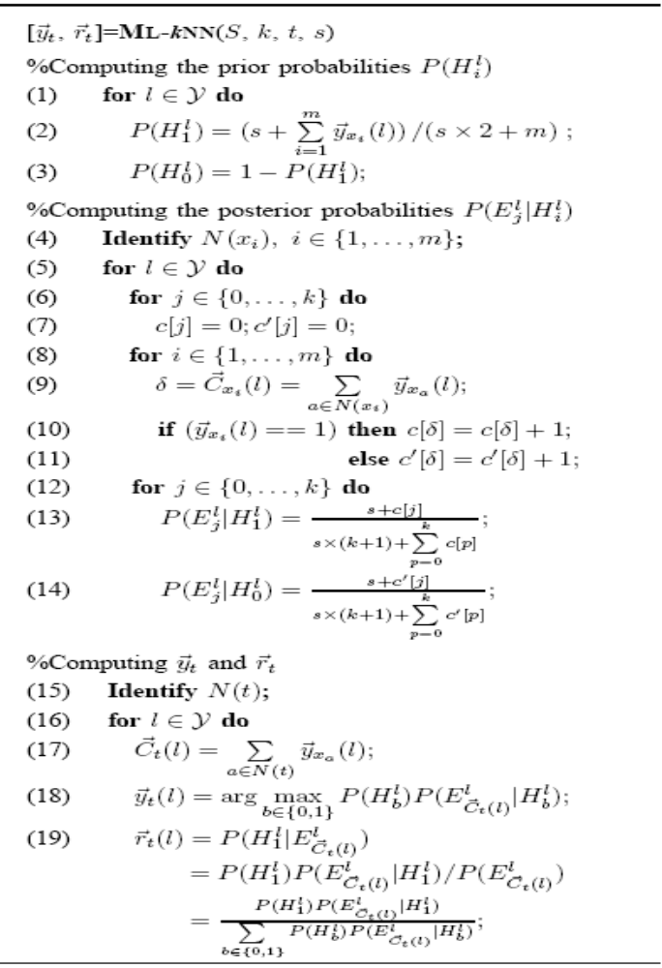







Algorithm
Given test example t, the category vector is obtained as follows:
Identify its K nearest neighbors N(t) in the training set
Compute the membership counting vector
Determine with the following maximum a posteriori (MAP) principle
Prior probabilities
Posteriori probabilities
All the probabilities can be directly estimated from the training set based on frequency counting

Slide 14
Outline
Multi-Label Learning (MLL)
ML-kNN (Multi-Label k-Nearest Neighbor)
Experiments
Conclusion

Slide 15
Experimental Setup
Experimental data
Yeast gene functional data
  Previously studied in the literature [Elisseeff & Weston, NIPS02]
  Each gene is described by a 103-dimesional feature vector
  (concatenation of micro-array expression data and phylogenetic profile)
  Each gene is associated a set of functional classes
  1,500 genes in the training set and 917 in the test set
  There are 14 possible classes and the average number of labels for all genes in the training set is 4.2±1.6
Comparison algorithms
ML-kNN: the number of neighbors varies from 6 to 9
Rank-SVM: polynomial kernel with degree 8
ADTBoost.MH: 30 boosting rounds
BoosTexter: 1000 boosting rounds

Slide 16
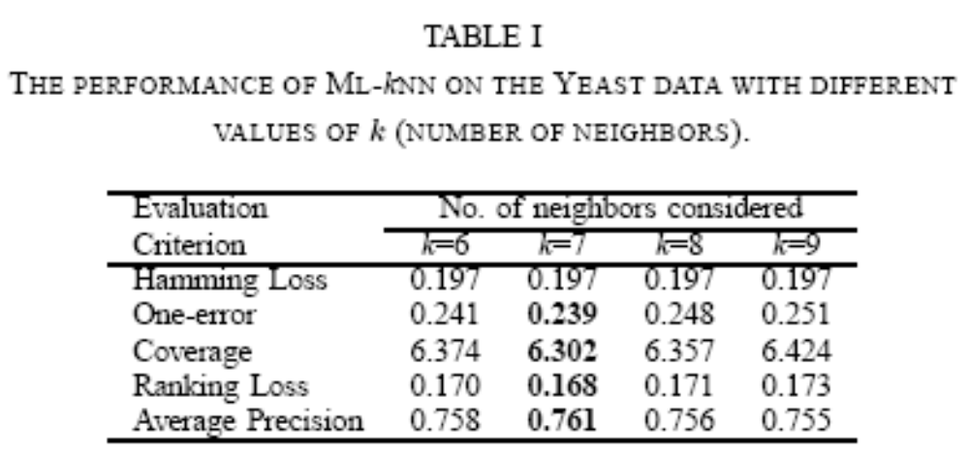
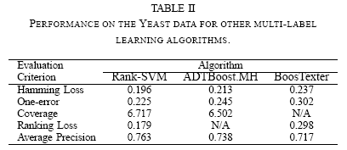
Experimental Results
The value of k doesn’t significantly affect ML-kNN’s Hamming Loss
ML-kNN achieves best performance on the other four ranking-based criteria with k=7
The performance of ML-kNN is comparable to that of Rank-SVM
Both ML-kNN and Rank-SVM perform significantly better than ADTBoost.MH and BoosTexter

Slide 17
Outline
Multi-Label Learning (MLL)
ML-kNN (Multi-Label k-Nearest Neighbor)
Experiments
Conclusion

Slide 18
Conclusion
The problem of designing multi-label lazy learning approach is addressed in this paper
Experiments on a multi-label bioinformatic multi-label data show that ML-kNN is highly competitive to several existing multi-label learning algorithms
Conducting more experiments on other multi-label data sets to fully evaluate the effectiveness of ML-kNN
Whether other kinds of distance metrics could further improve the performance of ML-kNN

Slide 19

Thanks!
Suggestions?
&
Comments?

