Slide 1


BarCampRoc
Building Native Mobile Apps with Titanium
with Tim Poulsen
Trainer & Curriculum Developer
Appcelerator, Inc.
tpoulsen@appcelerator.com
@skypanther

Slide 2
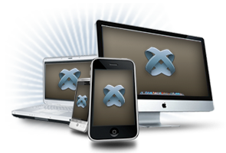
Titanium helps developers build apps that…
Run cross-platform
Look, feel, and perform native
Leverage common skill sets
Fit well in the native app ecosystem
Notes:
THIS IS THE AGENDA

Slide 3
Titanium is…
A JavaScript-based framework
With access to native OS and hardware features
Modular and extensible
Free

Slide 4


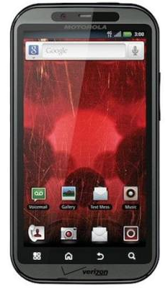
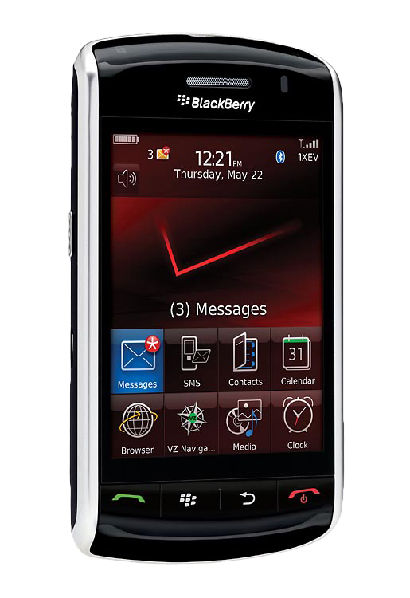
Titanium is cross platform
Notes:
iOS and Android now
Blackberry in beta
Windows Phone in the works

Slide 5
Look, feel, and perform native
Access to native controls
Menus, hardware buttons, notifications, services
Hardware – GPS, camera, accelerometer, etc.
Networking – HTTPclient, sockets, Bonjour

Slide 6
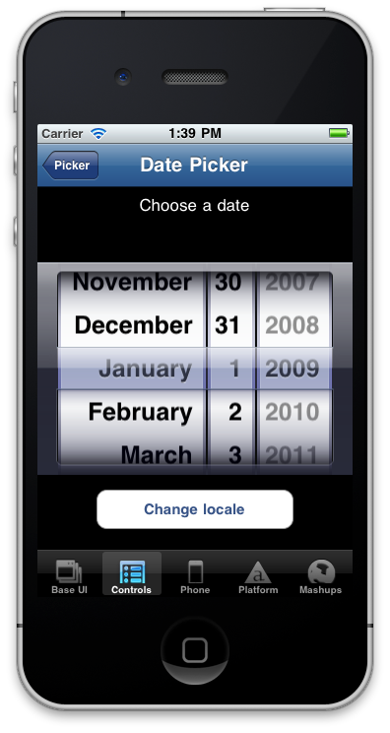
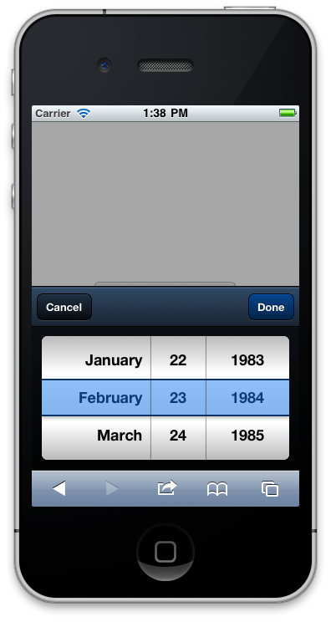
Titanium exposes native controls
Titanium
Not…
Notes:
You’re manipulating actual native controls via Javascript
Better user experience
Faster
You can skin most components for custom UI if you want

Slide 7
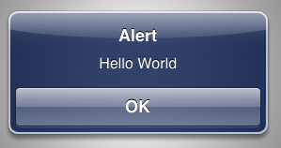
Titanium is easier
// Objective-C
UIAlertView *alert = [[UIAlertView alloc]
initWithTitle:@"Alert"
message:@"Hello World"
delegate:nil
cancelButtonTitle:@"OK"
otherButtonTitles:nil];
[alert show];
[alert release];
Notes:
Titanium lets you leverage skills you have already

Slide 8
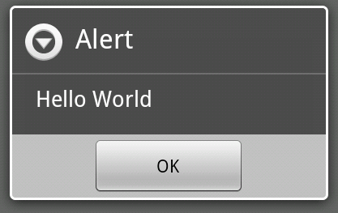
Titanium is easier
// Java/Android
AlertDialog.Builder builder = new AlertDialog.Builder(this);
builder.setMessage("Hello World")
.setCancelable(false)
.setPositiveButton("OK", new DialogInterface.OnClickListener() {
public void onClick(DialogInterface dialog, int id) {
MyActivity.this.finish();
}
});
AlertDialog alert = builder.create();

Slide 9
Titanium is easier
// Titanium
alert("Hello World");
… and it’s cross platform!

Slide 10








Titanium exploits the native ecosystem
Native User Experience
Native performance + Native UI
(tables, animations, gestures…etc.)
Multimedia
Camera, video camera,
streaming/device audio/video
Location-based services
Augmented reality, geolocation, compass, native maps
Analytics
Track usage patterns and adoption
Social sharing
Facebook, Twitter, Yahoo YQL.
Native email/address book
Titanium modules
Appcelerator Marketplace for add-on functionality
Data
Local SQLite, filesystem, properties data store, web services
Development tools
Titanium Studio, integration with native SDK tools

Slide 11
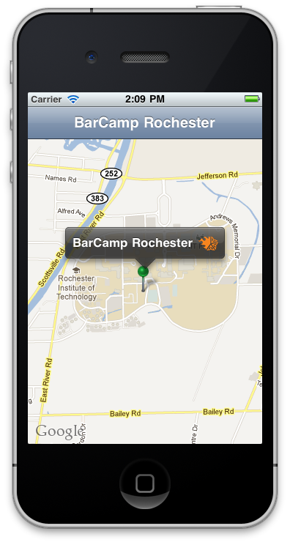
Demo
var map = Ti.Map.createView({
region: {
latitude:43.082602,
longitude:-77.676859,
latitudeDelta:0.01,
longitudeDelta:0.01},
animate:true,
regionFit:true
});

Slide 12


Titanium at 10,000 feet
Your Application
Titanium APIs
Bridge (kroll)
Android
iOS
Notes:
At the top is your app – written in Javascript
At the bottom is the native OS and controls
In between are the kroll bridge and the API it exposes

Slide 13
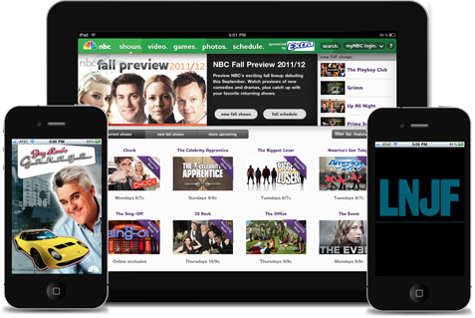
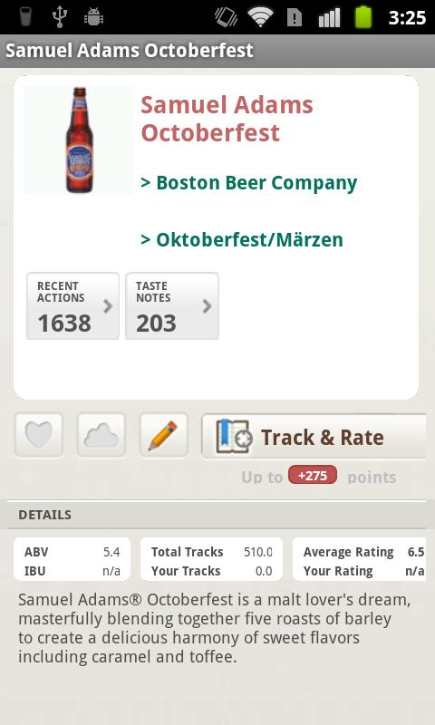
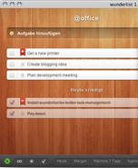
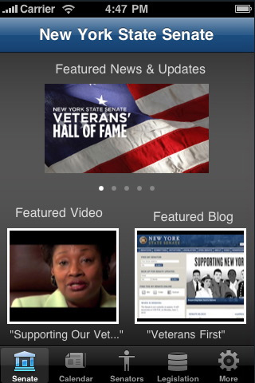
Powered by Titanium
Applications:
NBC apps
NYS Senate
Wunderlist
GetGlue
Companies:
Kellogg’s
NBC/Universal
eBay and PayPal
Anheuser Busch
Jaguar
… and many more
Notes:
200,000+ developers / 27,000 apps “in the wild”

Slide 14
Let’s talk money
Apache 2.0 - free to download, use, and publish your apps
Subscription plans
Indie, Professional, & Enterprise
Pro services, SLA support, training
Modules Marketplace
http://www.appcelerator.com/products/plans-pricing/
Notes:
Subscriptions include access to modules, training materials, varying levels of support, analytics, etc.

Slide 15
Titanium is not …
Just a wrapper around HTML5 content
(though you can certainly do that if you want)
A cross compiler
(it doesn’t create Obj-C / Java code for you)
Going to do the programming for you
(moderate JavaScript and fundamental programming skills are required)

Slide 16
Resources
wiki.appcelerator.org
developer.appcelerator.com
@appcelerator (and more)
#titanium_app (irc.freenode.net)
meetup.com/TiRochester

Slide 17
Questions?
Q&A
Tim Poulsen
Trainer & Curriculum Developer, Appcelerator, Inc.
tpoulsen@appcelerator.com
@skypanther

