Slide 1

Breaking the chain: securing dependencies one by one.
Mauro Parra @mauropm

Slide 2
Problem - Software supply chain
Security – You have few dozens explicit dependencies, and hundreds/thousands of implicit ones. You want to make sure you don’t have vulnerabilities, specially from implicit dependencies unknown to you. Tampering, Malicious Code, Dependencies, Access Control, Incident Response.
Intellectual property value – Are you the owner of your software product? Or just partial owner + other hundred coders that contribute via public code? Software Bill of Materials (SBOM) is a list of the components and modules that make up a software application, along with the supply chain relationships between them. Licensing, copyrights, patents, risk of lawsuits.
Compliance side – Are you able to tell your customers, your board, your government if the code you are redistributing or using is complaint with all different rules? Think: banks, hospitals, insurance.

Slide 3
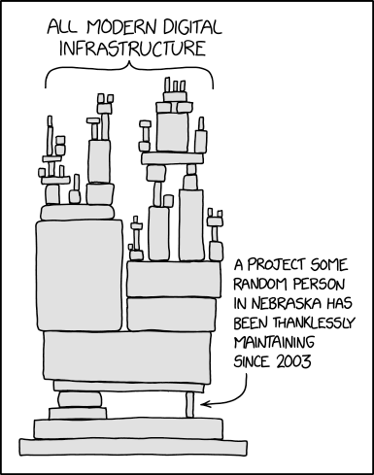
Problem - Software supply chain
Business Efficency – Is npm down? Did someone at github get mad and delete their code? Are you resolving your dependencies at run time? Compile time? Do you depend on the internet? Do you have a connection at all?
QA – Are you doing QA at all? Do you have unit testing? Do you have functional testing? If any dependency changes of version, are you ready to test the change? Is it possible at all?
https://xkcd.com/2347/

Slide 4

“God is in the details.”
—Ludwig Mies van der Rohe
https://www.flickr.com/photos/ettorebiondo/17368537716/

Slide 5
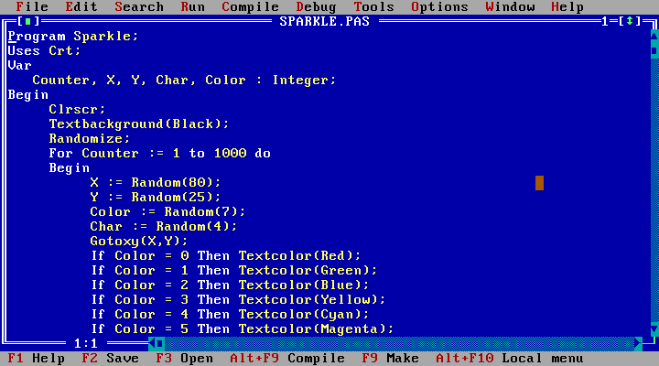
Turbo Pascal
1983+

Slide 6
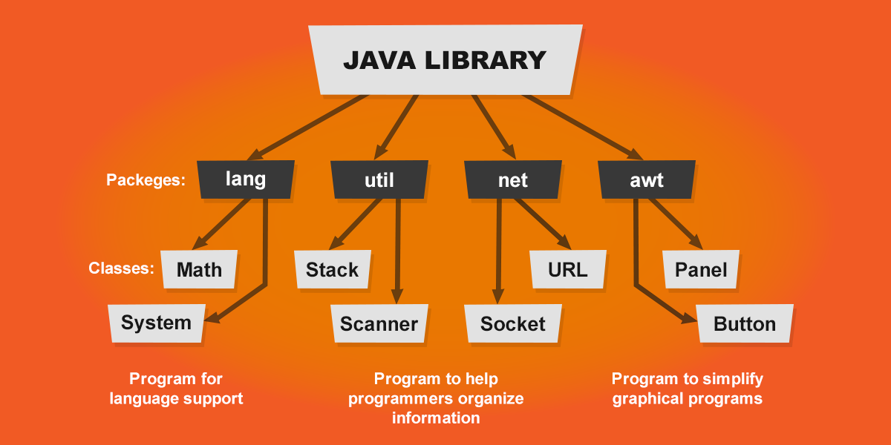
Java
1995+

Slide 7
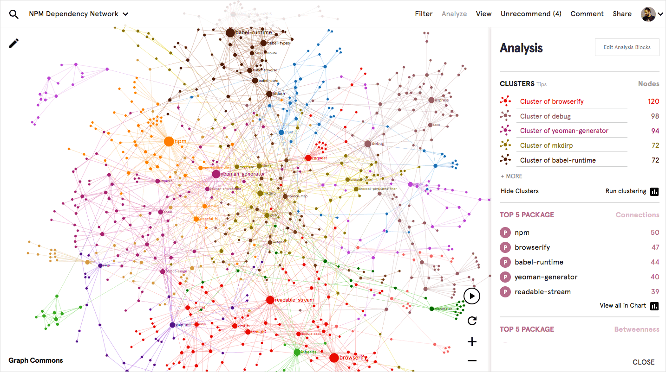
NodeJS
2009+

Slide 8

“The quality of your life is built on the quality of your decisions”
- Wesam Fawzi

Slide 9
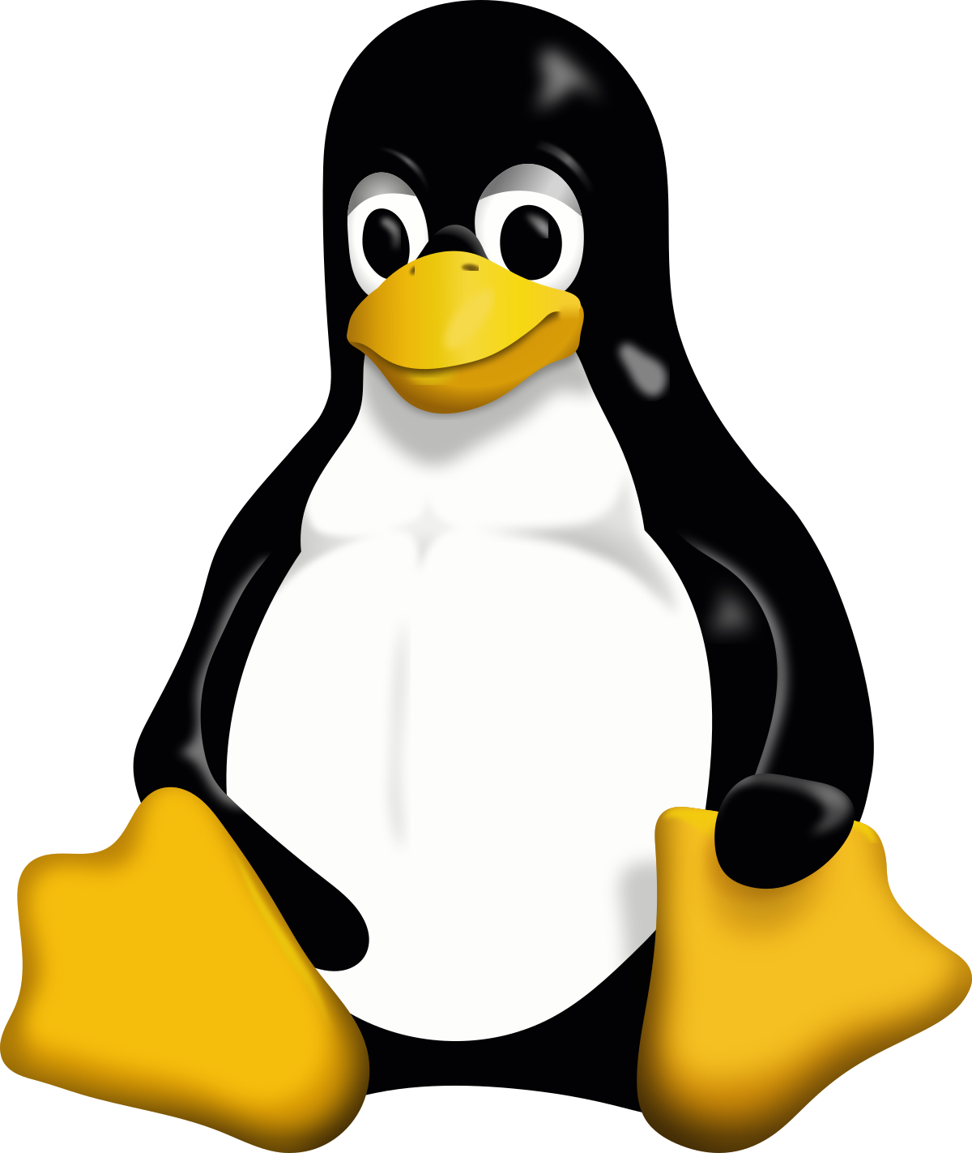
OS issues – Package managers (yum, apt, dnf)
Dependency Hell: When installing a package, it might require specific versions of other packages that conflict with the versions already installed. Example: Installing PackageA might need libX v1.5, but PackageB already uses libX v1.3. Upgrading or downgrading libX to satisfy one package could break the other.
Circular Dependencies: Two or more packages depend on each other, creating a loop that the package manager cannot resolve. Example: PackageA depends on PackageB, and PackageB depends on PackageA.

Slide 10
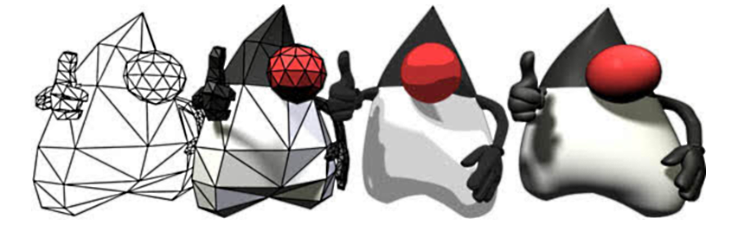
Java – Package managers (maven, gradle)
Transitive Dependency Conflicts: A library might depend on a version of another library that conflicts with a different dependency in the project. Example: LibraryA depends on LibraryC v1.0, while LibraryB depends on LibraryC v2.0. The project cannot resolve which version of LibraryC to use without explicit configuration.
Dependency Bloat: Adding one library can bring in unnecessary transitive dependencies, increasing the project's size and complexity.

Slide 11
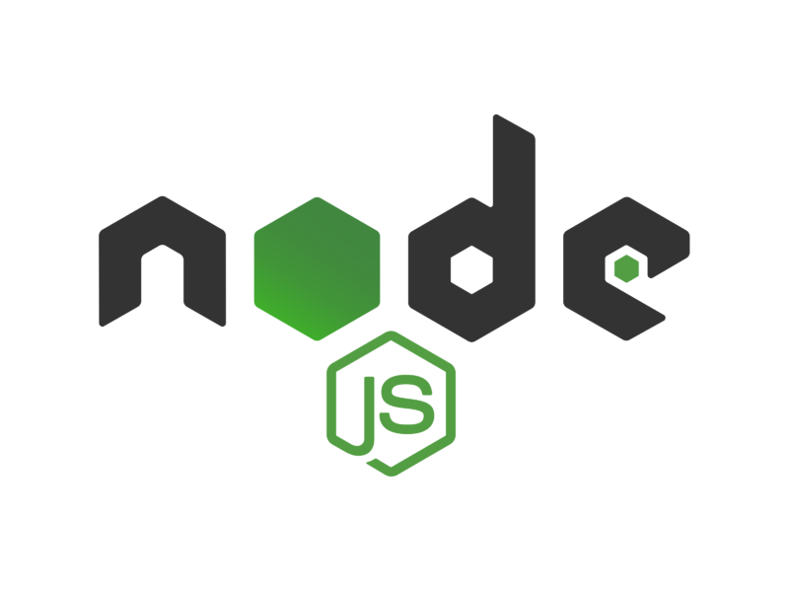
NodeJS – Special horrible corner case - npm
Nested Dependencies: NPM allows multiple versions of the same package to coexist. This can lead to bloated node_modules directories and hard-to-debug issues. Example: PackageX depends on PackageY v1.0, but another library in the project depends on PackageY v2.0. Both versions are installed, potentially causing runtime errors.
Breaking Changes in Semver: Developers sometimes release major changes under minor version updates, violating Semantic Versioning rules and causing projects to break unexpectedly after updates. Example: Updating PackageZ to a patch version introduces an API change that breaks your application

Slide 12
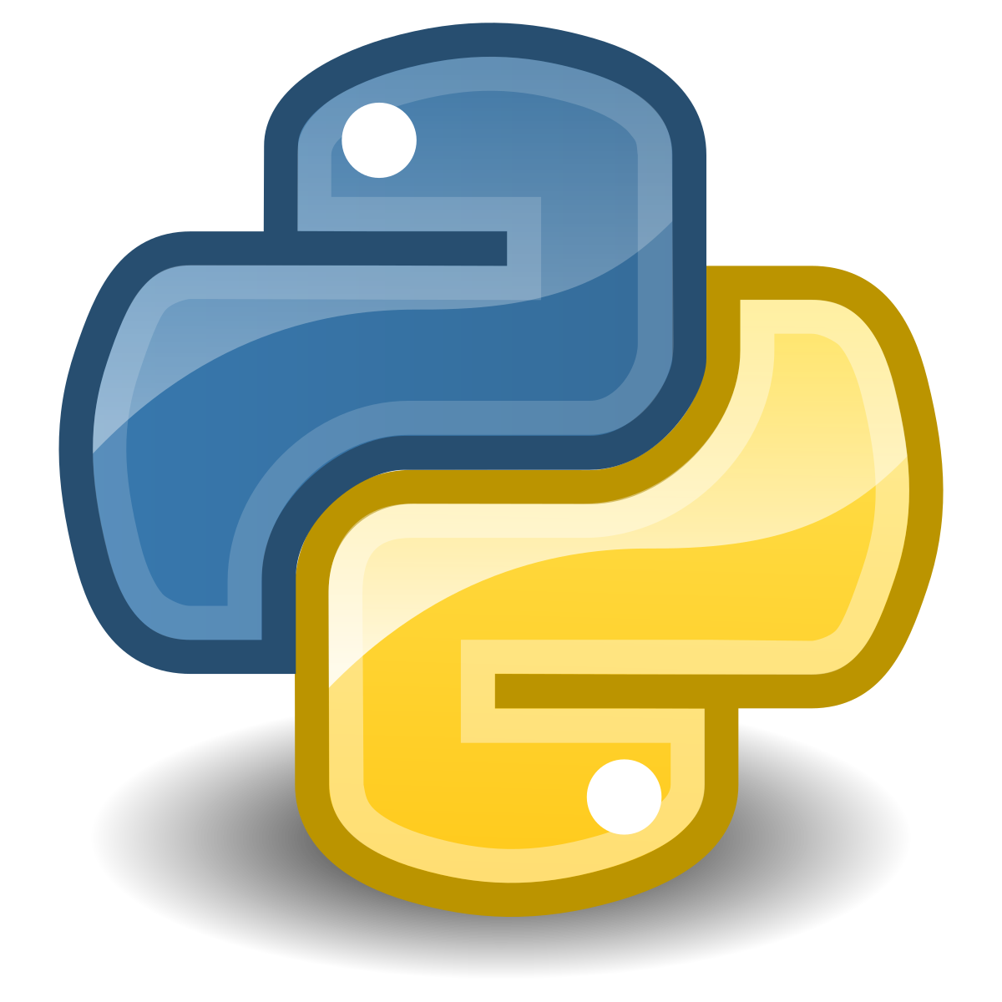
Python – pkg manager (pip, conda)
Version Locking Issues: Installing packages without specifying versions can lead to breaking changes when dependencies are updated. Example: A requirements.txt file specifies pandas but doesn't pin the version, and an incompatible update to pandas later breaks the application.
Incompatible Environment: Different Python environments or versions of the interpreter (e.g., Python 2 vs. Python 3) can cause dependencies to fail to install or run correctly.

Slide 13
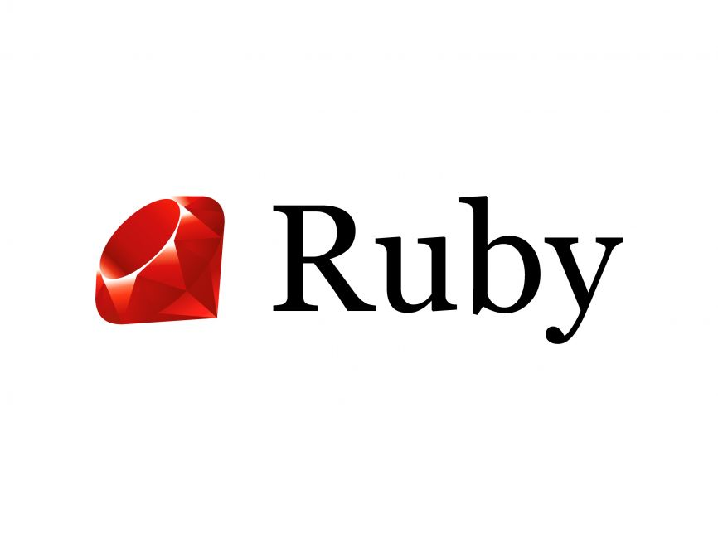
Ruby – pkg manager (bundle)
Gem Dependency Conflicts: Similar to Maven or NPM, a Gem might require a specific version of a dependency that conflicts with another Gem in the project. Example: GemA requires Rails v6.0, but GemB requires Rails v5.2, creating an incompatibility.

Slide 14

Containerization - docker
Image Layer Conflicts: Base images and application layers may include different versions of the same software, leading to runtime errors. Example: A Docker image uses a specific version of glibc that is incompatible with a binary included in the image.
Version Drift: Without version pinning, a Dockerfile can produce different images over time as newer versions of dependencies are installed.

Slide 15
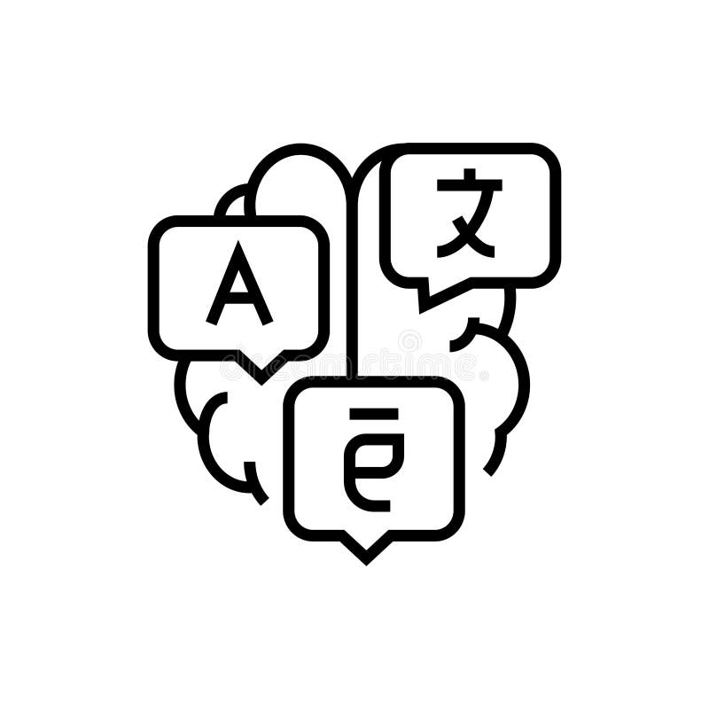
Cross-Lang Issues
Polyglot Projects: When a project uses multiple languages (e.g., Python for backend and Node.js for frontend), each language's dependency manager might bring in conflicting dependencies or libraries that don't work well together. Example: A Python script calls a Node.js library, and an underlying C++ binary dependency conflicts with the OS package version.

Slide 16
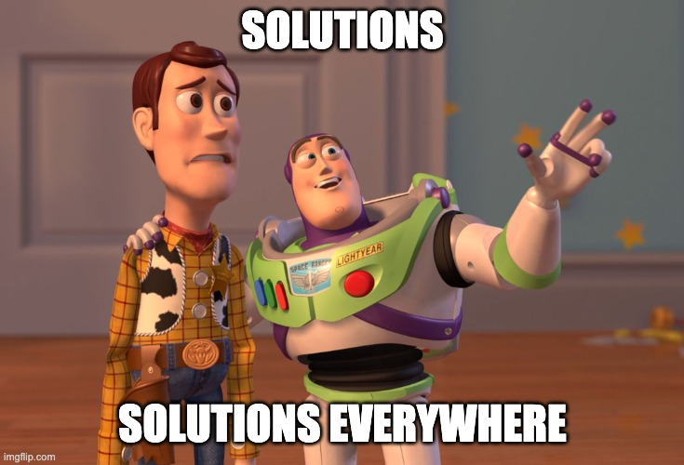

Slide 17
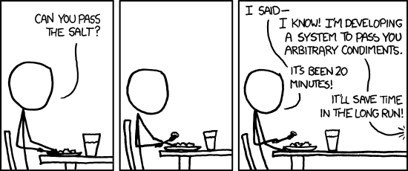
Over engineering.
https://www.xkcd.com/974/

Slide 18
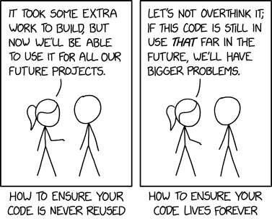
Reuse public code
https://xkcd.com/2730/

Slide 19
(imperfect) solutions
Version Locking - (e.g., package-lock.json, Gemfile.lock, or requirements.txt).
Dependency resolution tools - Use Maven Enforcer or pip-tools.
Audit the PR! - Check for issues in the PR. Take this shit seriously. Test in a clean environment. Follow the CI/CD path and add unit testing as pre-requisite to accept the code.
Patch vulnerabilities and test! – You might find that the ABI/API changed enough to break your project.
Use venvs - Use virtual environments (e.g., Python’s venv) or containerization (e.g., Docker) to isolate dependencies. Run unit tests! Perform at least some smoke testing.
Automate all the things! - Automate testing for compatibility with updated dependencies using CI/CD pipelines with built-in basic testing.

Slide 20
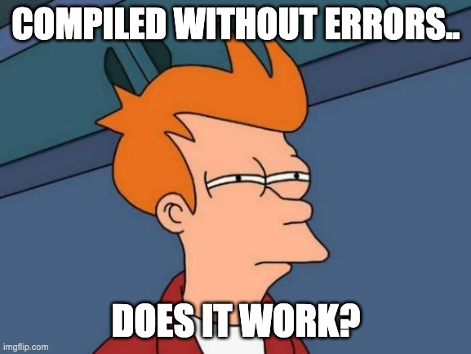

Slide 21
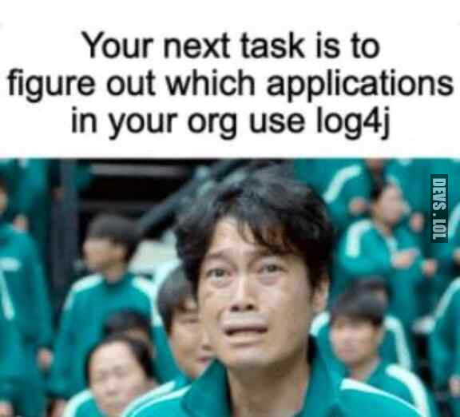
Prepare for (imperfect) solutions
Use a healthy Software Development Lifecycle – Create dev, test, staging/pre-prod, prod environments.
Automate testing – Unit testing, functional testing, UI testing.
Have a plan for failure – Rollback is not a nice to have, it’s a hard requirement!
Create proper logging and use tools to (easily) analyze the logs.
Be prepared to generate a list of dependencies so you can quickly answer if you are affected or not to something (remember log4j).

Slide 22
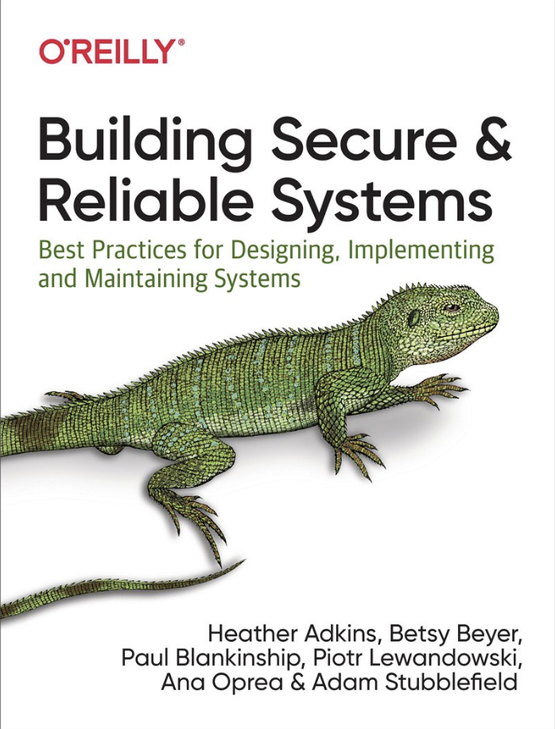
Tools
Syft - A CLI tool and Go library for generating a Software Bill of Materials (SBOM) from container images and filesystems. Exceptional for vulnerability detection when used with a scanner like Grype. - https://github.com/anchore/syft
Gitlab Scans – Gitlab offers security scans built-in your pipeline – see demo: https://gitlab.navattic.com/gitlab-scans
Verdaccio – Your own npm registry, so you don’t depend on nodejs world politics! - https://verdaccio.org/
Building secure & reliable systems - https://google.github.io/building-secure-and-reliable-systems/raw/toc.html

Slide 23
FUTURE WORK

Slide 24
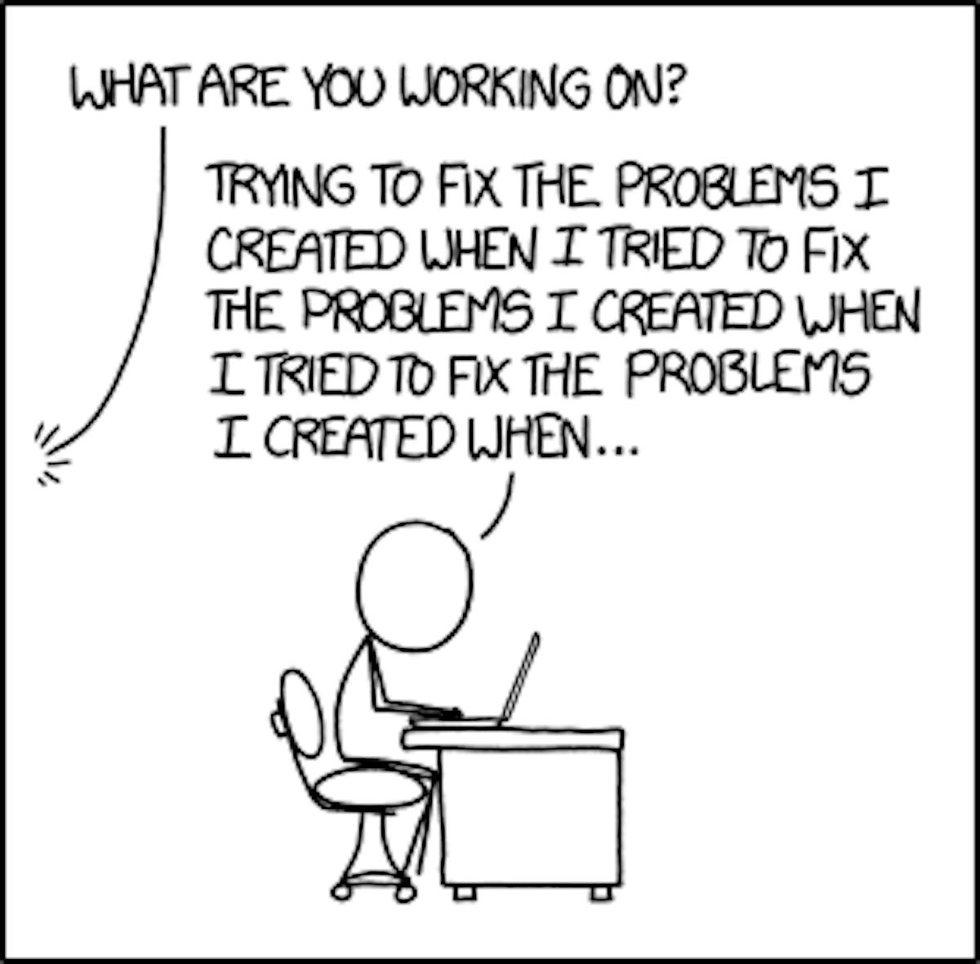
https://xkcd.com/1739/

