Slide 1

BUILD WITH AI · CODE FOR COMMUNITIES 2.0 · TRACK 3
Register Lens
Your register already knows.
Now DVDMS will too.
Smart Health & Supply Chain Resilience
Notes:
Hi, we are presenting Register Lens for Track 3, Smart Health and Supply Chain Resilience. In one line: we read the paper register a PHC already keeps, and use it to keep DVDMS honest.

Slide 2

The notebook is right. The screen is out of date.
Busy OPD, no time to type twice.
Auditors record that DVDMS is not updated regularly because of the rush of work and shortage of staff.
So DVDMS drifts from reality.
Stock differs from the registers, and dispensed medicines can even show as expired.
Everything built on DVDMS inherits it.
Dashboards and forecasts are only as good as the data underneath.
₹14.52 crore
expired drugs reported lying in Haryana
₹23.03 crore
expired drugs reported in Karnataka, 2019–22
Sources: CAG audit findings reported by The Tribune and Deccan Herald; CAG e-Aushadhi IT audit.
Notes:
The paper register is accurate because pharmacists must keep it. DVDMS is the system districts use to plan supply, but it lags because nobody has time to type twice. CAG audits describe exactly this: consumption not entered, stock not matching registers, dispensed drugs appearing as expired. Those are reported figures for expired drugs in Haryana and Karnataka.

Slide 3
Three people pay for the gap
1
2
3
PHC pharmacist
District drug store officer
The patient
Copies the day's register into DVDMS every evening, or does not, and the numbers drift.
Plans indents from a screen that says 40 days of stock when the shelf says 6.
Walks in for ORS or a BP tablet and hears it is out of stock.
The moment we fix: the end of a busy day, register on the desk, DVDMS still open.
Notes:
Three people. The pharmacist who double-enters. The district officer who plans from an untrustworthy screen. And the patient who finds the shelf empty. Our wedge is the end-of-day moment when the register is on the desk and DVDMS is still not updated.

Slide 4
One photo. Four steps. Zero extra typing.
1
2
3
4
›
›
›
Snap
Read
Confirm
Sync
Photograph the day's register page.
Gemini reads Hindi + English handwriting and scores each cell.
The pharmacist checks only flagged cells.
DVDMS bulk entry + Hindi/English district alert.
No new hardware · no new forms · the pharmacist always approves
Notes:
Snap, read, confirm, sync. The pharmacist takes one photo. Gemini reads it and says how sure it is about each cell. The pharmacist checks only the flagged cells. Then we produce a DVDMS-compatible bulk-entry file and a district alert in Hindi and English.

Slide 5
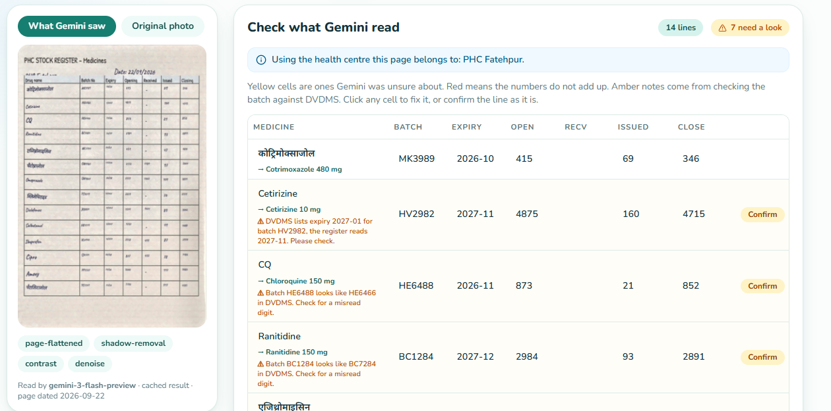
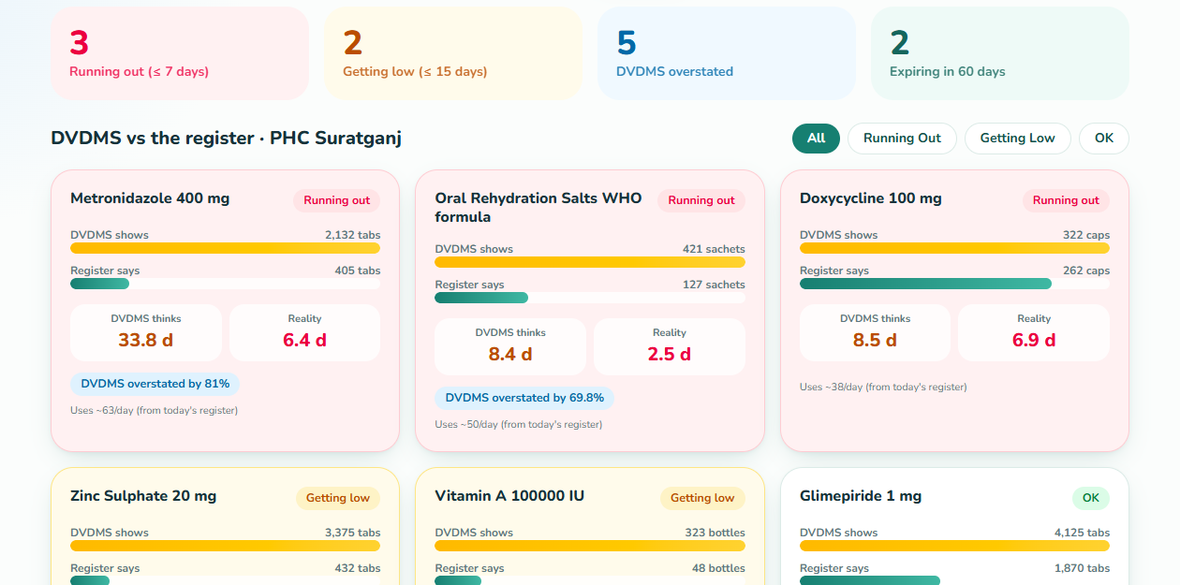
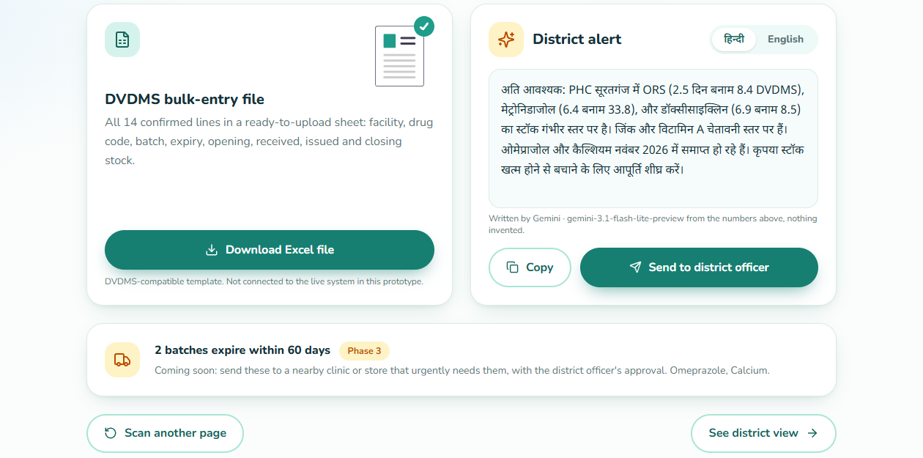
The working prototype
Review: flagged lines with reasons
Reconcile: DVDMS vs the register
Sync: bulk entry + Hindi/English alert
Live end to end: photo upload or sample page, image clean-up, Gemini read, review, reconcile, Excel export, Hindi/English alert, district view.
React + FastAPI + Gemini API · built for a PC browser first
Notes:
This is the working prototype, not a mock-up. Left: the review screen, where flagged lines carry a plain-language reason. Middle: DVDMS versus the register with days of stock. Right: the bulk-entry download and the alert. Sample data is synthetic and labelled as such.

Slide 6
Where AI works, and where plain code does
Photo phone camera
1
Structured output
Gemini returns schema-checked JSON with a confidence score per cell.
OpenCV clean-up flatten page, remove shadows, boost ink
2
Numbers are never generated
Drift and days of stock are computed by checkable code.
Gemini reads handwriting to JSON + confidence
3
Resilient to limits
Fails over across Gemini models, skips exhausted ones, lighter models for alerts, stored readings for demo pages.
Code checks match drugs, balances, DVDMS drift, days of stock
Gemini writes district alert, Hindi + English
4
Names in two languages
PCM, Paracetamol and पैरासिटामोल resolve to one medicine.
The pharmacist confirms between “reads” and “checks”. Nothing is uploaded without a human yes.
Notes:
Gemini does the three jobs a rules-based system cannot: reading messy bilingual handwriting, understanding drug-name variants, and writing the alert. Everything numeric is plain code, so an officer can audit it. We also fail over across Gemini models because free-tier quotas are per model.

Slide 7
Does it work? Measured, with the misses.
168 lines · 12 pages
Drug names and every quantity: 100%.
The 7 misses
All on hard pages, single digits in batch or expiry. Gemini scored every one at 0.95, so its confidence did not catch them.
Our fix
Cross-check against batches DVDMS already lists: 7 of 7 flagged, 0 false alarms on 161 correct lines.
Synthetic handwritten pages; real registers will be messier. The demo DVDMS is a mock seeded with the correct batches, so the cross-check shows the mechanism, not a field catch rate.
Notes:
These numbers are from 12 synthetic pages, 168 lines, checked cell by cell against an answer key. Quantities, which drive the stock-out numbers, were perfect. All seven misses were single-digit errors in batch or expiry on the two hardest pages, and the model was equally confident on them, so we added a cross-check against the batches DVDMS already lists. We are upfront that the demo DVDMS is a mock, so this demonstrates the mechanism.

Slide 8
When it is wrong, a person catches it
Unsure cell
Numbers do not add up
Batch looks off
Highlighted yellow; the pharmacist confirms or edits it.
Opening + received − issued ≠ closing turns red.
Compared with DVDMS batches; “looks like BC7284” prompts a check.
AI unavailable
Alert wording
Upload to DVDMS
Clear message, nothing lost; sample pages work without the API.
Written only from computed numbers; the pharmacist sends it.
Never automatic: the file is downloaded and reviewed first.
Notes:
Our failure contract. A wrong reading costs the pharmacist a tap, not a wrong stock number in the system. Nothing goes to DVDMS automatically.

Slide 9
Pilot-ready in four weeks
Week 1
Week 2
Week 3
Week 4
Collect real register photos from 3–5 PHCs in one district. Measure accuracy.
Map each register template. Match DVDMS bulk-entry fields with the state IT team.
Shadow mode: run beside the current process and compare stock numbers.
Go live with pharmacists, district officer sign-off on alerts.
What it needs: a phone camera, a browser, a Gemini API key. It reads the register that already exists and outputs a bulk-entry file for the existing system, so there is no new hardware and no new workflow to learn.
Notes:
This can be piloted in weeks because we do not ask anyone to change their process. The register stays; we read it. The bulk-entry route into DVDMS already exists according to the audit reports. Week one is measuring on real registers, which is the honest next step after synthetic testing.

Slide 10
Built to travel across states and BRICS nations
Language
Register templates
Medicine catalogue
Phase 2: alerts and screens in the PHC's state language.
Layout differs by state; one template file per register lets Gemini read a new format without retraining.
Each country brings its own essential-medicines list and local aliases.
தமிழ் తెలుగు বাংলা मराठी ଓଡ଼ିଆ ಕನ್ನಡ ગુજરાતી മലയാളം ਪੰਜਾਬੀ
column names · units · date style
NLEM (India) → other national lists
Phase 3: expiry redistribution. Batches close to expiry are routed to the nearby clinic or store that urgently needs them, with the district officer approving every move.
Notes:
Scaling is configuration, not rebuilding: language, register template and medicine catalogue are separate files. Phase two adds state languages. Phase three turns the near-expiry batches we already detect into transfers, always with officer approval.

Slide 11
How this maps to the judging criteria
Criterion | Weight | Evidence you can open
AI / Technical execution | 25% | Gemini reads handwriting to JSON, model failover, OpenCV clean-up, evaluation script and results
Problem–solution fit | 20% | Targets the audit-documented gap: DVDMS vs registers, at the pharmacist's end-of-day moment
Depth & reach across India | 20% | Language, register template and medicine catalogue as separate configs; Phase 2 languages
Deployability & scalability | 20% | No new hardware; DVDMS bulk-entry output; four-week pilot plan; Dockerfile for Cloud Run
Impact potential | 15% | Attacks the stock-out and expiry-loss cycle at the source; reported losses in crores
Deliverables: source code repository · demo video (3–5 min) · this deck · live prototype link.
Notes:
For the judges: each criterion points to something openable. The accuracy evaluation and its caveats are in the repository.

Slide 12

Your register already knows.
Now DVDMS will too.
One photo a day keeps the district's numbers true.
Register Lens · Build with AI: Code for Communities 2.0 · Track 3
Notes:
Thank you. Register Lens: your register already knows, now DVDMS will too.

