Slide 1

NLNLP
CS779 Project
Adversarial Techniques In NLP
Dept. of CSE, IIT Kanpur
Ad
Under the guidance of
Dr. Ashutosh Modi
Assistant Professor
Dept. of CSE
Group 3:
Abhishek Krishna- 20111002 Deeksha Arora- 20111017 Preeti Singh- 20111044 Sambhrant Maurya- 20111054

Slide 2
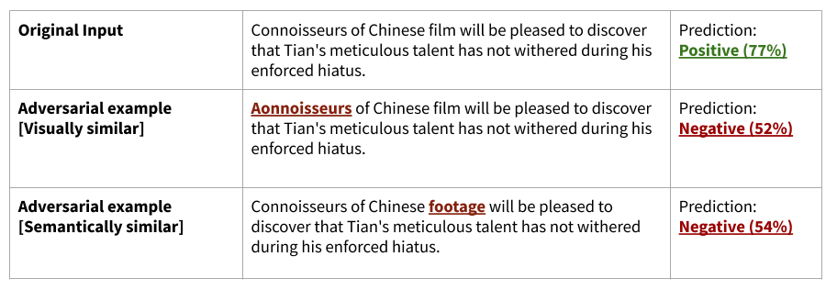
Adversarial attacks on text
Image: https://towardsdatascience.com/what-are-adversarial-examples-in-nlp-f928c574478e

Slide 3
Adversarial attacks on text
Neural Networks are susceptible to adversarial inputs.
Textual adversaries: Try to “fool” the Neural Network by introducing perturbations in the input text.
Image: https://towardsdatascience.com/what-are-adversarial-examples-in-nlp-f928c574478e

Slide 4
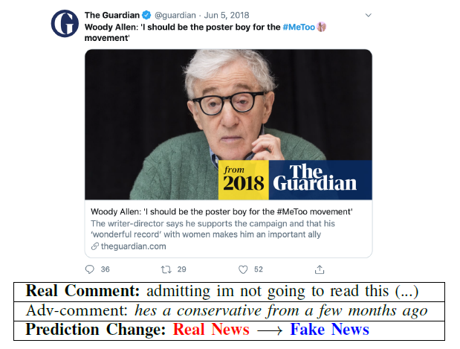
Motivation
Image 1: An adversarial comment causes misclassification of a fake news detector

Slide 5
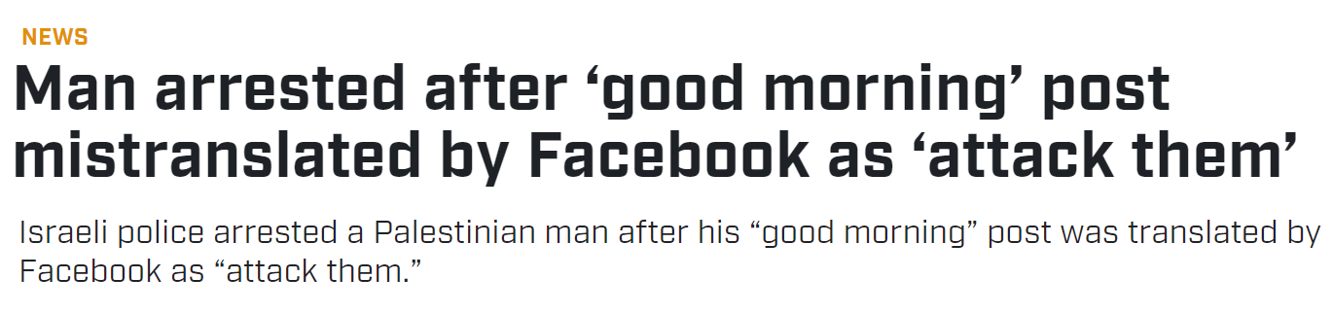
Motivation
Image 1: An adversarial comment causes misclassification of a fake news detector
Image 2: Facebook NMT mistakes input word for another which differs by a single character in Arabic, and wrecks havoc
Image 1: https://arxiv.org/pdf/2009.01048.pdf, Image 2: Article from theguardian.com

Slide 6
Motivation
Image 1: An adversarial comment causes misclassification of a fake news detector
Image 2: Facebook NMT mistakes input word for another which differs by a single character in Arabic, and wrecks havoc
Defence of Neural Networks against adversarial attacks is crucial.
Image 1: https://arxiv.org/pdf/2009.01048.pdf, Image 2: Article from theguardian.com

Slide 7
Existing Research
A recent and very active research area

Slide 8
Existing Research
A recent and very active research area
Some latest attack methods:
DeepWordBug, Gao et.al (2018)[1]
TextBugger, Li at.al. (2018)[2]
*Textfooler, Jin et.al. (2019)[3]
CAM-RWR (Pruthi et.al.,2019)[4]
*BERT-Attack, Li et.al (2020)[5]
Bae, Garg et.al (2020)[6]
*Adv-OLM, Malik et.al (2021)[7]
*Performance benchmarks

Slide 9
Designing Textual attacks
A text attack is built on two main components:
Search methods: Finding which characters/words/sentences to perturb.
Transformations: Replacing the chosen characters/words/sentences with an aim to cause misprediction of the target model.

Slide 10
Designing Textual attacks
A text attack is built on two main components:
Search methods: Finding which characters/words/sentences to perturb.
Transformations: Replacing the chosen characters/words/sentences with an aim to cause misprediction of the target model.
Desirable properties of a good attack method:
Accuracy under attack: low
Attack success rate: high
Perturbation percentage: low
Avg no of queries: low

Slide 11
Designing Textual attacks
A text attack is built on two main components:
Search methods: Finding which characters/words/sentences to perturb.
Transformations: Replacing the chosen characters/words/sentences with an aim to cause misprediction of the target model.
Desirable properties of a good attack method:
Accuracy under attack: low
Attack success rate: high
Perturbation percentage: low
Avg no of queries: low
Most of the existing attacks don’t score high on all 4 properties
Task at hand: Design an attack that does!

Slide 12
Experiments
Tried transformations such as Misspelling Oblivious Word (MOE), GloVe, Word2Vec, FastText and finally concluded to use FastText.
Experimenting on search-methods available in TextAttack framework:
Greedy Search: Rapid, but poor performance
Beam Search: Descent performance, but slow for larger text inputs
Alzantot genetic algorithm[12]: Poor performance, slow
Particle Swarm Optimization[11]: Best performance, but the slowest
GreedyWordSwapWIR[9]: Good performance and fast
Provides a good tradeoff between performance and speed
Compared our attack’s performance against existing recipes.

Slide 13
Introducing “FastAttack”
A novel blackbox attack
Leverages “FastText” embeddings by Bojanowski et.al[8], (Facebook Research) for word transformations

Slide 14
FastText Embeddings
FastText: Open source, free, light-weighted library, developed by Facebook Research.
Allows to learn text representation and text classifiers.

Slide 15
FastText Embeddings
FastText: Open source, free, light-weighted library, developed by Facebook Research
Allows to learn text representation and text classifiers.
Additional ability to obtain word vectors for out-of-vocabulary words.
Two models for computing word representations*:
CBOW(Continuous Bag of Words)
Skip-gram
*https://fasttext.cc/docs/en/crawl-vectors.html

Slide 16
FastText Embeddings
FastText: Open source, free, light-weighted library, developed by Facebook Research
Allows to learn text representation and text classifiers.
Additional ability to obtain word vectors for out-of-vocabulary words.
Two models for computing word representations:
CBOW(Continuous Bag of Words)
Skip-gram
CBOW: predict target word according to its context.
Context represented as BOW containing fixed size window around target.
https://fasttext.cc/docs/en/unsupervised-tutorial.html

Slide 17
FastText Embeddings
FastText: Open source, free, light-weighted library, developed by Facebook Research
Allows to learn text representation and text classifiers.
Additional ability to obtain word vectors for out-of-vocabulary words.
Two models for computing word representations:
CBOW(Continuous Bag of Words)
Skip-gram
CBOW: predict target word according to its context.
Context represented as BOW containing fixed size window around target.
Skip-gram: learns to predict target word thanks to a near-by word.
In practice, skip-gram models works better with subword information than cbow.
https://fasttext.cc/docs/en/unsupervised-tutorial.html

Slide 18
Embeddings used
FastText, Word2Vec and GLoVE
Trained on the text8 corpus*, consisting of first 100,000,000 bytes of plain text from Wikipedia
text8 corpus: http://mattmahoney.net/dc/textdata.html

Slide 19
Embeddings used
FastText, Word2Vec and GLoVE
Trained on the text8 corpus*, consisting of first 100,000,000 bytes of plain text from Wikipedia
Hyperparameters:
Embedding | Model type | Vector size | Window size | Learning rate | Epochs | Threads | Training time (s) | Total words
FastText | Skipgram | 100 | 5 | 0.025 | 5 | 3 | 932 | 17005207
Word2Vec | Skipgram | 100 | 5 | 0.025 | 5 | 3 | 670 | 17005207
Glove | - | 100 | 5 | 0.05 | 5 | 3 | 628 | 17005207
text8 corpus: http://mattmahoney.net/dc/textdata.html

Slide 20
Target models and Datasets
HuggingFace* models with datasets:
Albert-Base-V2
AG News, dataset ag_news, split test
IMDB, dataset imdb, split test
Movie Reviews, dataset rotten_tomatoes, split test
Yelp Polarity, dataset yelp_polarity, split test
Bert-Base-uncased
AG News, dataset ag_news, split test
IMDB, dataset imdb, split test
Movie Reviews, dataset rotten_tomatoes, split test
Yelp Polarity, dataset yelp_polarity, split test
*https://huggingface.co/textattack

Slide 21
Target models and Datasets
HuggingFace* models with datasets:
Distilbert-Base-cased
Quora Question Pairs, dataset glue, qqp, split validation
SST-2, dataset glue, sst2, split validation
Distilbert-Base-uncased
AG News, dataset ag_news, split test
IMDB, dataset imdb, split test
Roberta-Base
AG News, dataset ag_news, split test
IMDB, dataset imdb, split test
Movie Reviews, dataset rotten_tomatoes, split test
SST-2, dataset glue, sst2, split validation
*https://huggingface.co/textattack

Slide 22
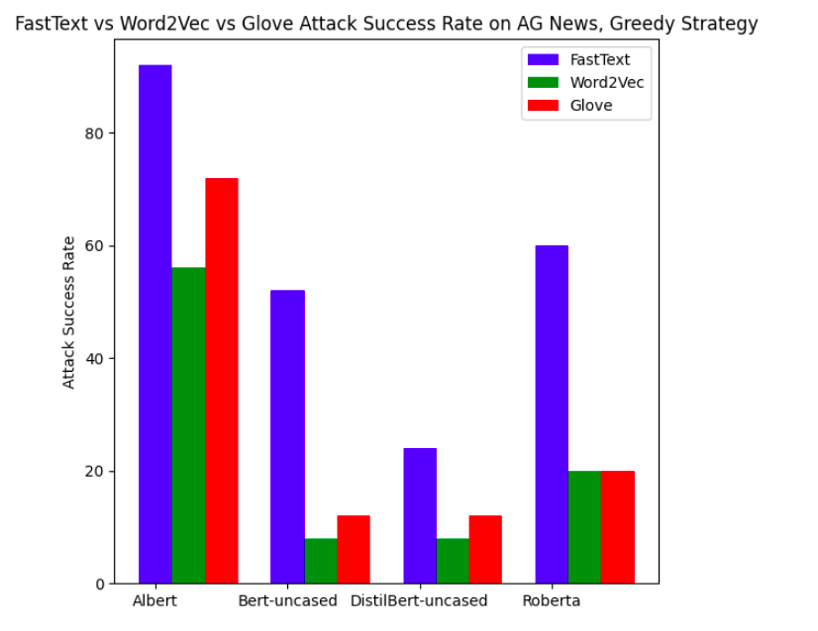
FastText vs Word2Vec vs GloVE

Slide 23
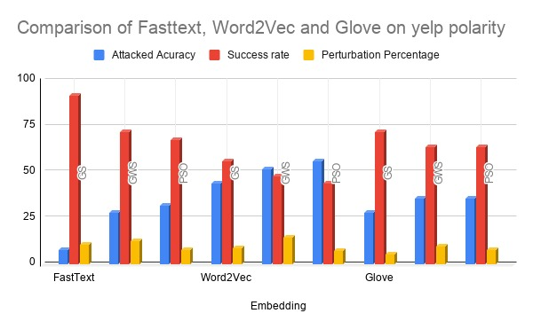
FastText vs Word2Vec vs GloVE
Search methods: GS: Greedy Search, GWS: GreedyWordSwapWIR[9], PSO: ParticleSwarmOptimization[11]

Slide 24
FastAttack implementation
Search method: Uses GreedyWordSwapWIR algorithm[9] with weighted saliency to find the words W to be perturbed.
A tradeoff between speed and accuracy

Slide 25
FastAttack implementation
Search method: Uses GreedyWordSwapWIR algorithm[9] with weighted saliency to find the words W to be perturbed.
A tradeoff between speed and accuracy
Transformation technique: Replace the chosen word w ∈ W with its closest neighbor w’ in the FastText embedding under the following constraints:
w’ should not have w as a substring.
w should not be a stop-word as defined in the NLTK corpora*.
For the same sentence, the same word should not be modified twice.
The case of the replaced word should be preserved.
*https://www.nltk.org/book/ch02.html

Slide 26
FastAttack implementation
Search method: Uses GreedyWordSwapWIR algorithm[9] with weighted saliency to find the words W to be perturbed.
A tradeoff between speed and accuracy
Transformation technique: Replace the chosen word w ∈ W with its closest neighbor w’ in the FastText embedding under the following constraints:
w’ should not have w as a substring.
w should not be a stop-word as defined in the NLTK corpora.
For the same sentence, the same word should not be modified twice.
The case of the replaced word should be preserved.
Goal function: UntargetedClassification
We use the TextAttack framework, Morris et.al.[10] (2020) to frame our attack.

Slide 27
Performance of FastAttack

Slide 28
An Illustration
Sci/tech (98%) --> World (73%) (FastAttack)
E-mail scam targets police chief Wiltshire Police warns about "phishing" after its fraud squad chief was targeted.
E-mail scam targets police chief Wiltshire Police warns about "furnishing" after its bribery squad chief was targeted.
Sci/tech (98%) --> World (54%) (TextFooler)
E-mail scam targets police chief Wiltshire Police warns about "phishing" after its fraud squad chief was targeted.
E-mail scam targets police chief Wiltshire Police warns about "phishing" after its hoax battalion leiter was targeted.

Slide 29
An Illustration
Sci/tech (98%) --> World (73%) (FastAttack)
E-mail scam targets police chief Wiltshire Police warns about "phishing" after its fraud squad chief was targeted.
E-mail scam targets police chief Wiltshire Police warns about "furnishing" after its bribery squad chief was targeted.
Sci/tech (98%) --> World (54%) (TextFooler)
E-mail scam targets police chief Wiltshire Police warns about "phishing" after its fraud squad chief was targeted.
E-mail scam targets police chief Wiltshire Police warns about "phishing" after its hoax battalion leiter was targeted.
Sci/tech (98%) --> World (78%) (DeepWordBug)
E-mail scam targets police chief Wiltshire Police warns about "phishing" after its fraud squad chief was targeted.
E-mail scam targets police chief Wiltshire Police warns about "phishin" after its fruad squad chief was targeted.
Sci/tech (98%) --> World (82%) (BERT-Attack)
E-mail scam targets police chief Wiltshire Police warns about "phishing" after its fraud squad chief was targeted.
E-mail scam targets police chief Wiltshire Police warns about "phitism" after its fraudulent squad chief was targeted.

Slide 30
FastAttack vs CAM-RWR (Pruthi et.al.,2019)
Model | Dataset | Attack method | Successful attacks (Out of 25) | Original accuracy | Attacked accuracy | Success rate | Perturbed % | Avg num queries | Attack time (in seconds)
ALBERT-base-v2 | YELP- polarity | fastattack | 19 | 100% | 24% | 76% | 9.47% | 241.72 | 139.27
 |  | cam-rwr | 2 |  | 92% | 8% | 4.28% | 1666.0 | 924.62
 | IMDB | fastattack | 17 | 89.29% | 28.57% | 68.0% | 2.3% | 420.24 | 271.88
 |  | cam-rwr | 8 |  | 60.71% | 32.0% | 0.53% | 3843.64 | 2493.46
BERT-base-uncased | YELP- polarity | fastattack | 18 | 100% | 28.0% | 72.0% | 11.07% | 241.48 | 128.77
 |  | cam-rwr | 1 |  | 96.0% | 4.0% | 6.67% | 1665.96 | 848.89
 | IMDB | fastattack | 20 | 92.59% | 18.52% | 80.0% | 5.61% | 428.4 | 251.87
 |  | cam-rwr | 10 |  | 55.56% | 40.0% | 0.48% | 3868.6 | 2192.64

Slide 31
FastAttack vs Faster Genetic Algorithm (Jia et.al.,2019)
Model | Dataset | Attack method | Successful attacks (Out of 25) | Original accuracy | Attacked accuracy | Success rate | Perturbed % | Avg num queries | Attack time (in seconds)
ALBERT-base-v2 | YELP- polarity | fastattack | 19 | 100% | 24% | 76% | 11.43% | 242.76 | 114.78
 |  | FGA_Jia | 17 |  | 32% | 68% | 11.6% | 4762.84 | 5833.25
 | IMDB | fastattack | 16 | 96.15% | 34.62% | 64.0% | 17.56% | 63.52 | 28.86
 |  | FGA_Jia | 10 |  | 57.69% | 40.0% | 18.3% | 3358.08 | 3900.52
BERT-base-uncased | YELP- polarity | fastattack | 21 | 100% | 16% | 84% | 12.51% | 238.84 | 100.20
 |  | FGA_Jia | 18 |  | 28% | 72% | 10.12% | 5123.12 | 4985.12
 | IMDB | fastattack | 16 | 92.59% | 33.33% | 64.0% | 21.46% | 65.16 | 32.84
 |  | FGA_Jia | 9 |  | 59.26% | 36.0% | 15.85% | 3292.84 | 3728.22

Slide 32
FastAttack vs TextFooler (Jin et.al.,2019)
Model | Dataset | Attack method | Successful attacks (Out of 25) | Original accuracy | Attacked accuracy | Success rate | Perturbed % | Avg num queries | Attack time (in seconds)
ALBERT-base-v2 | YELP- polarity | fastattack | 19 | 100% | 24.0% | 76.0% | 11.43% | 242.76 | 210.15
 |  | textfooler | 24 |  | 4.0% | 96% | 9.11% | 480.92 | 316.80
 | IMDB | fastattack | 22 | 89.29% | 10.71% | 88.0% | 5.2% | 434.92 | 426.02
 |  | textfooler | 25 |  | 0.0% | 100% | 8.35% | 674.2 | 473.95
BERT-base-uncased | YELP- polarity | fastattack | 21 | 100% | 16.0% | 84.0% | 12.51% | 238.84 | 137.26
 |  | textfooler | 25 |  | 0.0% | 100% | 10.89% | 479.08 | 237.07
 | IMDB | fastattack | 21 | 92.59% | 14.81% | 84.0% | 5.29% | 419.72 | 342.94
 |  | textfooler | 25 |  | 0.0% | 100.0% | 7.99% | 663.64 | 400.18

Slide 33
FastAttack vs BAE (Garg et.al.,2020)
Model | Dataset | Attack method | Successful attacks (Out of 25) | Original accuracy | Attacked accuracy | Success rate | Perturbed % | Avg num queries | Attack time (in seconds)
ALBERT-base-v2 | YELP- polarity | fastattack | 17 | 100% | 32% | 68% | 8.19% | 242.28 | 146.80
 |  | BAE_garg | 11 |  | 56% | 44% | 4.72% | 287.24 | 438.28
 | IMDB | fastattack | 22 | 89.29% | 10.71% | 88.0% | 5.2% | 434.92 | 584.61
 |  | BAE_garg | 16 |  | 32.14% | 64.0% | 2.73% | 512.32 | 1051.52
BERT-base-uncased | YELP- polarity | fastattack | 21 | 100% | 16% | 84% | 12.81% | 238.84 | 252.68
 |  | BAE_garg | 11 |  | 56% | 44% | 6.44% | 314.88 | 764.20
 | IMDB | fastattack | 21 | 92.59% | 14.81% | 84.0% | 5.29% | 419.72 | 268.29
 |  | BAE_garg | 12 |  | 48.15% | 48.0% | 2.97% | 561.52 | 1153.58

Slide 34
FastAttack vs BERT-Attack (Li et.al.,2020)
Model | Dataset | Attack method | Successful attacks (Out of 15) | Original accuracy | Attacked accuracy | Success rate | Perturbed % | Avg num queries | Attack time (in seconds)
ALBERT-base-v2 | YELP- polarity | fastattack | 14 | 78.95% | 5.26% | 93.33% | 14.74% | 34.6 | 12.19
 |  | bert-attack | 15 |  | 0.0% | 100% | 12.52% | 110.8 | 123.67
 | IMDB | fastattack | 15 | 93.75% | 0.0% | 100% | 4.45% | 352.0 | 253.93
 |  | bert-attack | 15 |  | 0.0% | 100% | 1.75% | 347.27 | 404.62
BERT-base-uncased | YELP- polarity | fastattack | 14 | 78.95% | 5.26% | 93.33% | 14.74% | 34.6 | 12.02
 |  | bert-attack | 15 |  | 0.0% | 100% | 12.52% | 110.8 | 121.36
 | IMDB | fastattack | 14 | 93.75% | 6.25% | 93.33% | 5.34% | 365.33 | 238.02
 |  | bert-attack | 15 |  | 0.0% | 100.0% | 1.75% | 347.27 | 420.75

Slide 35
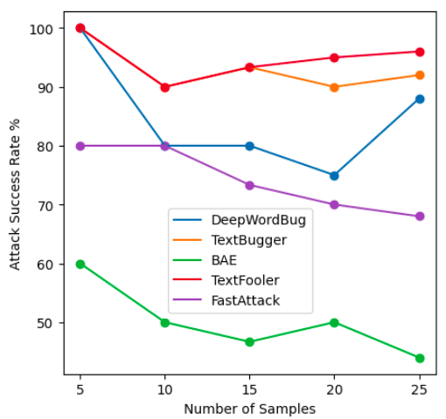
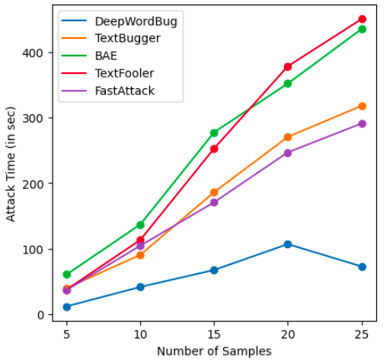
More comparisons

Slide 36
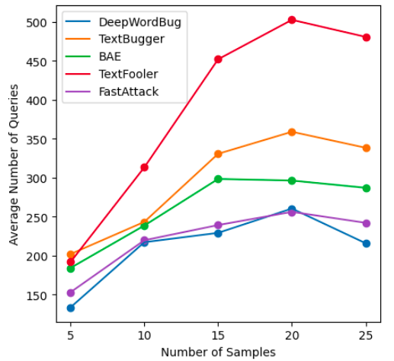
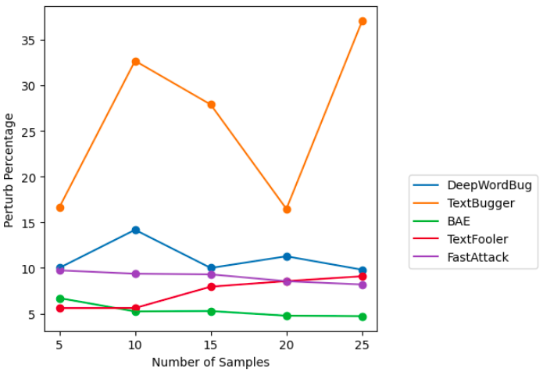
More comparisons

Slide 37
Summarising Results
FastText Embeddings are high-performance embeddings, outperforming Word2Vec and GloVE embeddings in most cases
FastAttack is a simple and highly potent attack
No complex transformers, no language models
Still gives some of the latest attacks a run for their money
Is indeed “fast”
Replacement is done with valid words only
Replacements are always available, even for Out-of-Vocabulary words

Slide 38
References
[1] Ji Gao, Jack Lanchantin, Mary Lou Soffa, Yanjun Qi, “Black-box Generation of Adversarial Text Sequences to Evade Deep Learning Classifiers”, (2018)
[2] J. Li, S. Ji, T. Du, B. Li, and T. Wang, “Textbugger: Generating adversarial text against real-world applications,” Proceedings 2019 Network and Distributed System Security Symposium, 2019.
[3] D. Jin, Z. Jin, J. T. Zhou, and P. Szolovits, “Is bert really robust? a strong baseline for natural language attack on text classification and entailment,” 2020.
[4] D. Pruthi, B. Dhingra, and Z. C. Lipton, “Combating adversarial misspellings with robust word recognition,” 2019.
[5] L. Li, R. Ma, Q. Guo, X. Xue, and X. Qiu, “Bert-attack: Adversarial attack against bert using bert,” 2020.
[6] S. Garg and G. Ramakrishnan, “Bae: Bert-based adversarial examples for text classification,” 2020.
[7] V. Malik, A. Bhat, and A. Modi, “Adv-olm: Generating textual adversaries via olm,” 2021.
[8] P. Bojanowski, E. Grave, A. Joulin, and T. Mikolov, “Enriching word vectors with subword information,” 2017.
[9] S. Ren, Y. Deng, K. He, andW. Che, “Generating natural language adversarial examples through probability weighted word saliency,” 2019
[10] J. Morris, E. Lifland, J. Y. Yoo, J. Grigsby, D. Jin, and Y. Qi, “TextAttack: A framework for adversarial attacks, data augmentation, and adversarial training in NLP,” 2020 [11] Zang et.al. (2020), Word-level Textual Adversarial Attacking as Combinatorial Optimization

