Slide 1


| Tech Management, SRI-B
CLAWS
CLASH OF THE
MSRIT_ByteX
OpenClaw-Powered Autonomous Stock Intelligence Assistant
Maurya Doshi
Mayura Krishna
Meera Kumar

Slide 2
Idea
Problem Statement
Why Theme 3: Productivity?
Indian retail investors waste 2-3 hours daily manually checking stock prices, calculating indicators, and tracking portfolios across 5+ apps. We delegate this to an AI orchestrator that monitors 24/7 and notifies via Telegram.
The Problem
Missed opportunities cost money. You want to buy TCS at ₹3,500 but you're in a meeting → it hits ₹3,500 for 10 minutes → by the time you check, it's ₹3,650. Lost: ₹1,500 per 100 shares.
Who Faces This?
"Rahul" — 28-year-old software engineer, Bangalore
₹5L stock portfolio, works 9-7
Uses 4 different apps: Zerodha (trades), Investing.com (prices), Excel (portfolio), Twitter (news)
Pain: "I'm too busy to monitor stocks, but too worried to ignore them"
Why It Matters
163M Indian demat accounts, but only 2% actively trade due to complexity
₹5,000-₹50,000 lost annually per investor from missed entry/exit points
Financial literacy gap: 80% of beginners don't understand RSI, MACD → make poor decisions
The Hook
Stock monitoring shouldn't require staring at screens. Your phone already has Telegram. Now it has a stock analyst.

Slide 3
Idea
Current Solution & Gaps
Existing Solutions
Traditional Trading Apps (Zerodha Kite, Groww, Upstox)
✅ Live stock prices, portfolio tracking, trading execution
❌ Require constant manual checking — no proactive alerts
❌ Heavy apps (50-100MB), drain battery with constant refreshing
❌ Technical indicators shown as raw numbers (RSI: 68) with no explanation
Stock Screeners (Investing.com, Moneycontrol)
✅ Price alerts, news feeds
❌ Alerts only trigger if app is open/running in background
❌ No portfolio integration — you track manually in Excel
❌ Separate app = context switching kills productivity
Google Finance / Yahoo Finance
✅ Free price data
❌ Zero analysis, zero alerts, zero portfolio tracking
❌ Just a data display — you do all the work
What's Missing/Broken
Gap 1: No True Background Monitoring
Apps stop alerts when closed → you miss price movements

Slide 4
Our solution: 24/7 heartbeat daemon monitors even when Telegram is closed
Gap 2: Technical Analysis Barrier
"RSI 72, MACD -5.2" means nothing to 90% of retail investors
Our solution: AI converts to "Stock looks overbought, consider waiting"
Gap 3: Platform Fragmentation
Average investor uses 4-5 apps: trading, news, alerts, portfolio, screeners
Our solution: Everything in Telegram (already installed by 500M+ Indians)
Gap 4: Cost
Premium features cost ₹500-1000/month (TradingView, Sensibull)
Our solution: 100% free, powered by open APIs
The Opportunity
163M demat accounts, but only 3M active traders. Why? Existing tools are:
Too complex for beginners
Too fragmented for busy professionals
Too expensive for small portfolios
IPO Pulse fills the gap: Conversational, proactive, free, and lives in an app you already use.

Slide 5
Idea
Your Solutions
An AI-powered Telegram bot that monitors Indian stocks 24/7, performs instant technical analysis, and sends proactive alerts. No app download. No subscriptions. Just chat.
Core Ideas Explanation
1. Delegate Monitoring to AI
Background heartbeat checks prices every 2 minutes (even when you're offline)
You set target prices once → bot watches forever
Telegram notification when TCS hits ₹3,500 → you decide to buy
2. Make Technical Analysis Human
Traditional: "RSI: 68, MACD: -5.2, MA20: 3,482"
IPO Pulse: "The stock looks overbought (RSI 68). Consider waiting for a dip. Moving average suggests upward trend."
Powered by Claude Haiku 4.5 — converts numbers to decisions
3. Live Where You Already Are
No separate app → works in Telegram (already on your phone)
Works on 2G/3G → unlike heavy trading apps
Portfolio tracking via chat → no Excel sheets

Slide 6
Key Features
📊 /analyze RELIANCE
Technical indicators: RSI, MA20, MA50
AI-generated plain-English explanation
Response time: <2 seconds
🔔 /alert TCS 3500
Set unlimited price alerts
24/7 background monitoring (no app needs to be open)
Instant Telegram push notification when target hits
💼 /buy TCS 10 3500 + /sell TCS 5
Track portfolio entries/exits conversationally
Auto-calculates average cost, total holdings
Live P&L with current prices
📈 /portfolio
Complete holdings overview
Real-time profit/loss calculation
Single command — no spreadsheet needed

Slide 7
Idea
Demo/Product Walkthrough
Real User Flow: "Smart Stock Monitoring in Action"
📊 Step 1: Get AI-Powered Analysis
User: /analyze infy.nse
Bot responds with:
📊 Price: ₹1179.7
📈 MA20: ₹1225.58 | MA50: ₹1261.33
⚡ RSI: 26.12
🟡 Signal: HOLD
🤖 AI Insight:
"INFY.NSE is trading at ₹1179.7, currently below
its 20-day MA. The short-term average is below
the 50-day MA, indicating a bearish trend. RSI
is below 30, suggesting the stock may be
oversold. Overall signal: HOLD."

Slide 8
💼 Step 2: Record Purchase Instantly
User: /buy infy 30 450
Bot: ✅ Added to portfolio!
📈 INFY ×30 @ ₹450
📈 Step 3: View Portfolio
User: /portfolio
Bot:
💼 Your Portfolio
────────────────
- INFY ×30 @ ₹450.00 (₹13500.00 invested)
────────────────
💰 Total invested: ₹13500.00
🔔 Step 4: Set Price Alert
User: /alert infy 11
Bot: ✅ Alert set!
📈 INFY @ ₹11
ID: 1
You'll be notified when the price crosses this level.

Slide 9
📋 Step 6: Manage All Alerts
User: /alerts
Bot:
🔔 Your Active Alerts
────────────────
#1 INFY @ ₹11
❓ Step 7: Get Help Anytime
User: /help
Bot shows complete command list:
📊 Analysis | 🚀 IPO Tracker | 🔔 Alerts | 💼 Portfolio

Slide 10
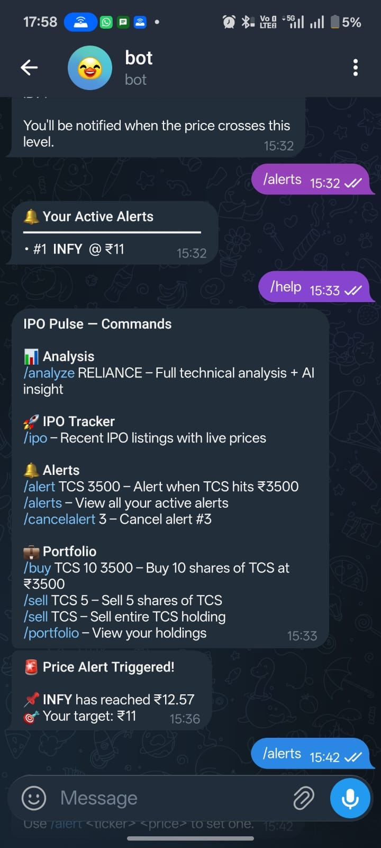
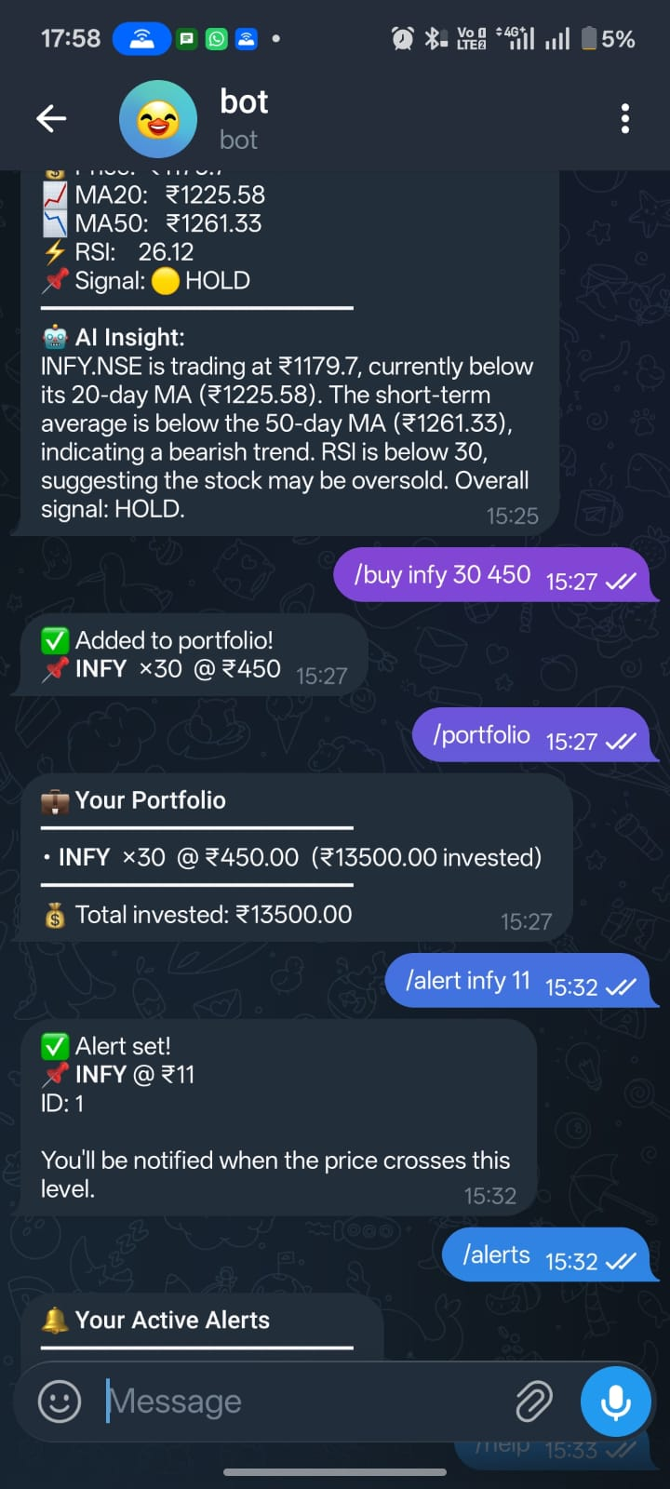
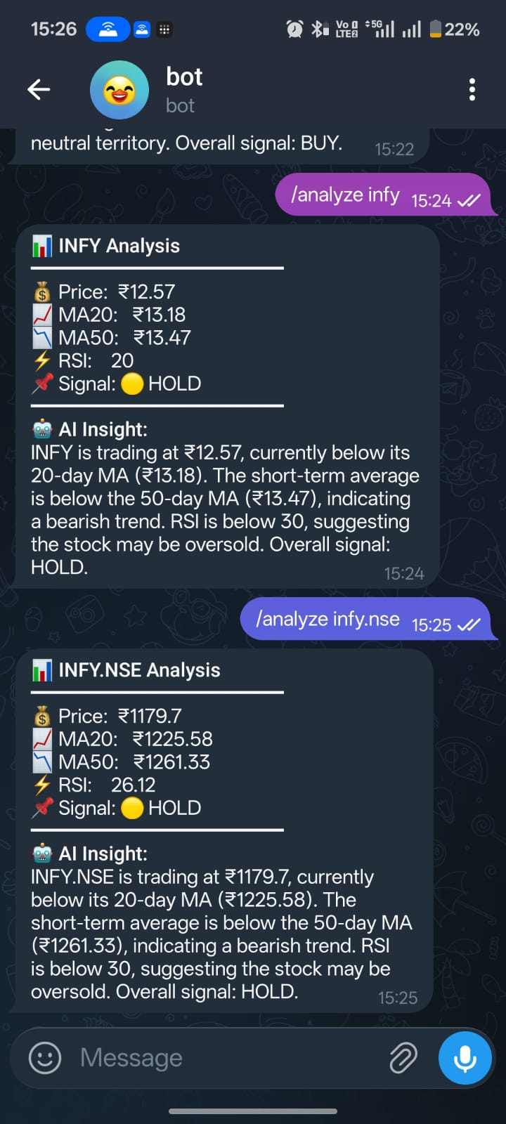
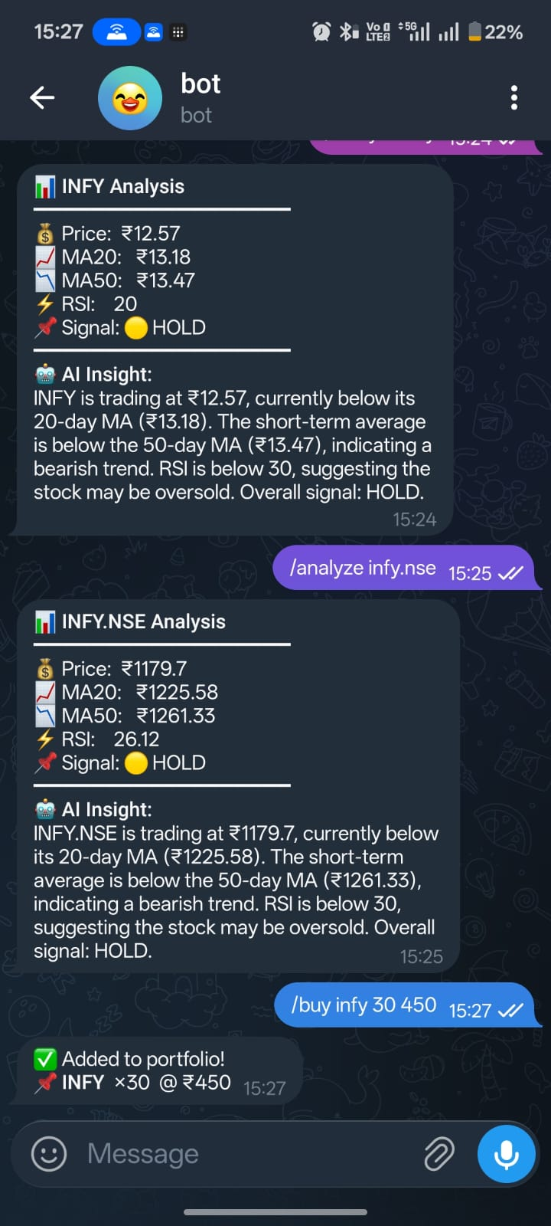

Slide 11
Idea
Tech & Architecture
Tech Stack
Frontend / Interface
Telegram Bot API — User interaction layer (no app needed)
node-telegram-bot-api — Node.js library for bot commands
Backend Services
Node.js (v22+) — Main bot orchestrator (bot.js)
Python FastAPI — API endpoints for stock analysis
SQLite3 — Local database for alerts & portfolio tracking
AI & Data Sources
Claude Haiku 4.5 (claude-haiku-4-5) — Converts technical indicators to plain English
Alpha Vantage API — Primary stock data source (Indian markets)
yfinance — Fallback data provider for redundancy
Framework
OpenClaw — Agent orchestration framework
SOUL.md — Agent personality & tone
HEARTBEAT.md — Background price monitoring daemon
Skill.md — Capability definitions

Slide 12
AI Usage Breakdown
1. Claude Haiku 4.5 — Real-time Analysis Explanations
# explain.py
def get_ai_explanation(symbol, price, ma20, ma50, rsi, signal):
prompt = f"""Analyze {symbol}: Price ₹{price},
MA20: ₹{ma20}, MA50: ₹{ma50}, RSI: {rsi}.
Explain in 2-3 sentences for a beginner investor."""
response = anthropic.messages.create(
model="claude-haiku-4-5",
messages=[{"role": "user", "content": prompt}]
)
return response.content[0].text
2. Local Ollama (Future/Optional) — Offline analysis for speed
3. Rule-Based System — Signal generation (BUY/SELL/HOLD)
if rsi < 30: signal = "🟢 BUY"
elif rsi > 70: signal = "🔴 SELL"
else: signal = "🟡 HOLD"

Slide 13
┌─────────────────┐
│ Telegram User │
│ "Hey, can I use │ /analyze INFY
│ this slide?" │ ────────────────────────┐
└─────────────────┘ │
▼
┌──────────────────┐
│ Node.js Bot │
│ (bot.js) │
│ • Command parser│
│ • SQLite CRUD │
│ • Alert daemon │
└────────┬─────────┘
│ HTTP (axios)
▼
┌──────────────────┐
│ Python FastAPI │
│ (localhost:8000) │
│ • analysis.py │
│ • explain.py │
└────┬────────┬────┘

Slide 14
│ │
┌──────────────────┘ └──────────────────┐
▼ ▼
┌─────────────────┐ ┌─────────────────┐
│ Alpha Vantage │ │ Claude Haiku │
│ + yfinance │ │ API │
│ (Stock Data) │ │ (AI Insights) │
└─────────────────┘ └─────────────────┘
│ │
└──────────────────┬───────────────────────────┘
▼
┌─────────────────────┐
│ Response to User │
│ 📊 Technical data │
│ 🤖 AI explanation │
└─────────────────────┘
┌────────────────────────────────────────────────────────────────┐
│ Background Heartbeat (Every 2 minutes) │
│ ───────────────────────────────────────────────────────── │
│ Node.js → Check SQLite alerts → Fetch prices → Compare → │
│ Send Telegram notification if target hit │
└────────────────────────────────────────────────────────────────┘

Slide 15
Idea
Impact & Use cases
Real-Life Scenarios
🎯 Use Case 1: "The Busy Professional" Persona: Priya, 29, Product Manager at Flipkart, Bangalore Problem: Wants to buy Infosys at ₹1,200 but stuck in back-to-back meetings 9 AM-6 PM Solution: Sets /alert INFY 1200 → Bot monitors 24/7 → Notification fires at 2:47 PM when INFY hits ₹1,198 → Buys during 5-min break Impact: Saved ₹2,000 (missed buying at ₹1,250 last time due to delayed checking)
🎓 Use Case 2: "The Learning Investor" Persona: Arjun, 24, fresher at TCS, first ₹50K investment Problem: Sees "RSI: 68, MACD: -3.2" on Zerodha → Has no idea what it means → Makes random decisions Solution: Types /analyze TCS → Gets "RSI 68 suggests stock may be overbought, consider waiting for a dip" Impact: Makes informed decisions without finance degree → Confidence to invest more → Financial literacy improved
💼 Use Case 3: "The Multi-Stock Tracker" Persona: Vikram, 35, owns 12 different stocks across IT, pharma, energy sectors Problem: Tracks portfolio on Excel → Manual price updates → Constantly miscalculates average buy price Solution: /buy TCS 50 3500, /buy RELIANCE 30 2820 → /portfolio shows real-time P&L with current prices Impact: Eliminated 1 hour/week of Excel drudgery → Accurate P&L in 2 seconds

Slide 16
🚀 Use Case 4: "The IPO Hunter" Persona: Neha, 27, interested in newly listed companies Problem: Googles "recent IPOs India" → Gets outdated listing sites → Prices are from yesterday Solution: /ipo → Live prices for 8 recent IPOs (Swiggy ₹280.5 +0.36%, Hyundai ₹1852.8 +0.93%) Impact: Discovered Sagility India at ₹44.19 (+3.22%) on listing day → Early entry opportunity
Scale Potential
📊 Current TAM (Total Addressable Market)
163M demat accounts in India (SEBI 2024)
Only 3M active traders → 160M inactive accounts
Why inactive? Complexity, cost, time commitment
Our opportunity: Convert inactive → active with frictionless access
🌍 Expansion Roadmap
Phase 1 (MVP — Hackathon): Indian stocks, basic alerts, technical analysis → Target: 1,000 beta users
Phase 2 (6 months):
Multi-language (Hindi, Tamil, Telugu) → Reach tier 2/3 cities
WhatsApp integration (2B users vs Telegram's 900M)
News sentiment analysis ("Reliance Q4 earnings beat → Bullish signal")
Target: 50,000 users
Phase 3 (12 months):
US stocks (NASDAQ, NYSE) via Alpaca API
Crypto tracking (Bitcoin, Ethereum alerts)
Voice commands ("Alexa, ask IPO Pulse about Tesla")
Premium tier: ₹99/month for advanced screeners

Slide 17
Target: 500,000 users → ₹50L MRR
Phase 4 (24 months):
B2B offering for brokerage firms (white-label bot)
Social trading ("Follow Rahul's portfolio → auto-copy trades")
Regulatory approvals for trade execution (SEBI license)
Target: 2M users → Partner with Zerodha/Groww
💰 Monetization (Future)
Freemium model: Basic features free, premium ₹99/month (advanced screeners, instant alerts)
Affiliate commissions: Earn ₹200-500 per referred user who opens demat account
B2B licensing: ₹10L-50L/year per brokerage firm for white-label deployment
🌐 Why This Scales ✅ Zero marginal cost → Bot runs on cloud, scales to 1M users with same infra ✅ Network effects → Users share commands with friends ("Try /analyze INFY") ✅ Platform leverage → Telegram has 500M+ Indian users already ✅ Viral potential → Every alert notification is free marketing

Slide 18
Idea
Differentiation
Why IPO Pulse Stands Out
We're not just "another stock app" — we've built sustainable competitive advantages that are hard to replicate.
MOAT #1: Platform Leverage + Zero Friction = Network Lock-In
The Advantage:
No app download → Users already have Telegram (500M+ Indians)
Instant onboarding → /start = you're in (vs. 5-min signup flow in traditional apps)
Viral coefficient → Every command can be screenshot-shared → "Try /analyze INFY"
Why Competitors Can't Copy:
Zerodha/Groww must protect their apps → Can't abandon 50MB standalone apps with years of dev investment
They need you locked in their ecosystem → Putting features in Telegram = giving up user data/control
We have nothing to lose → We started as a lightweight bot → our entire value prop is frictionlessness
The Moat: Once users save /analyze, /portfolio, /alert as muscle memory in Telegram → switching cost is HIGH even if competitor launches similar bot. Telegram is their "financial command center" now.
Data Point: WhatsApp Business API costs ₹0.30-1.20 per message for competitors → Our Telegram bot is FREE → Cost moat on top of convenience moat

Slide 19
MOAT #2: AI-First Architecture = Continuous Improvement Flywheel
The Advantage:
AI translates jargon to decisions → "RSI 68" → "Stock may be overbought, consider waiting"
Every user query trains our prompts → We learn what explanations resonate
Multimodal future-ready → Can add voice, image analysis (chart pattern recognition)
Why Competitors Can't Copy:
Legacy apps built on static logic → Hard-coded thresholds, rules-based signals → Can't retrain on user feedback
Our core = AI layer → Claude Haiku generates fresh explanations per query → Competitors have to retrofit AI into existing codebases
Data advantage over time → 1,000 users asking "What does this mean?" → We collect 10,000 context examples → Fine-tune models → Better explanations → More users → Data flywheel
The Moat: In 6 months, our AI will explain RELIANCE's RSI in context of oil prices, Jio earnings, and sector trends → Competitors will still show "RSI: 58" with generic tooltip.
Technical Edge:
OpenClaw framework → SOUL.md enforces consistent financial tone → Competitors using ChatGPT API get inconsistent/hallucinated advice
Modular skill architecture → We can add /sentiment (news analysis), /compare TCS vs INFY in days → Zerodha needs quarterly releases

Slide 20
Bonus: Structural Advantages
Dimension | Traditional Apps | IPO Pulse
User acquisition cost | ₹500-1,500 (app install ads) | ₹0 (organic Telegram shares)
Development speed | 3-6 months per feature | 3-5 days (AI + microservices)
Customer support | Call center, tickets | Bot handles FAQs (/help)
Platform risk | App Store/Play Store rules | Telegram = open platform
Infrastructure cost | ₹5-10L/month (10K users) | ₹50K/month (serverless + AI API)
Why This MOAT is Defensible
✅ Not a feature → It's an entirely different distribution model (Telegram vs. standalone app) ✅ Not replicable → Zerodha can't suddenly "move to Telegram" without cannibalizing their app ✅ Gets stronger with scale → More users → more conversational data → better AI → stickier product ✅ Low-cost structure → We can stay free forever → Competitors need ₹999/month premium tiers to justify costs
The Kicker: "WhatsApp for Stock Alerts" vs. "Stock Alert App #47"
When users think:
"I need stock alerts" → They open our Telegram bot (already there)
Not: "Let me download another app, create account, grant permissions..."
That's the moat. Not technology. Behavior change.

Slide 21
Idea
Demo Link
GitHub Repo : https://github.com/maurya-doshi/Samsung-PRISM-Hackathon Demo Link : https://github.com/maurya-doshi/Samsung-PRISM-Hackathon/blob/main/Documentation/project_video_walkthrough.mp4

