Slide 1

Design and Implementation of an Efficient Employee Management System
Aman Maurya
220101003
Semester – V
Department of Computer Science and Engineering
Indian Institute Of Information Technology, Manipur
Under the supervision of
Dr. Nongmeikapam Kishorjit Singh
Department of Computer Science and Engineering
Indian Institute Of Information Technology, Manipur

Slide 2
Table Of Content
Introduction and Motivation
Proposed System
System Design
Implementation
Result and Conclusion

Slide 3
Introduction
The Employee Management System (EMS) is a software tool built using C++ to help organizations easily manage their employee records. It allows administrators to store, update, search, and delete important employee details like names, contact information and addresses. The system is user-friendly and operates through a console interface. A key feature is its secure authentication process, with signup and login options, ensuring only authorized users can access sensitive data.
Motivation
The Employee Management System (EMS) was developed to automate and simplify the management of employee data, addressing the inefficiencies of manual processes like spreadsheets and paper files. As businesses grow, the need for fast, error-free data handling becomes critical. EMS streamlines tasks such as record management, freeing HR staff to focus on strategic activities.

Slide 4
Proposed System
1. Goal:
- To manage employee data efficiently, including details like name, ID, salary, and contact information.
2. User Login:
- A secure login system with username and password to protect employee information.
3. Main Features:
- Add Employee: Enter new employee details.
- View Data: Display all employee records.
- Search: Find an employee by their ID.
- Update: Edit employee information.
- Delete: Remove one or all records.
4. User-Friendly:
- Easy-to-use console interface for smooth navigation and data management.

Slide 5
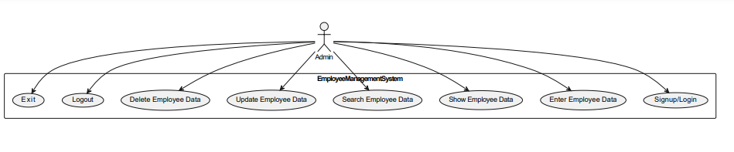
Use Case Diagram
System Design

Slide 6
Implementation
1. Environment:
- Implemented in C++ using a console-based interface for simplicity and efficiency.
2. Core Features:
- Data Entry: Users can input employee information like name, ID, contact, and salary.
- Search: Allows users to search employee records by ID.
- Update: Enables users to modify existing employee data.
- Delete: Provides options to delete specific records or all records.
3. User Authentication:
- Integrated a login system to ensure only authorized users can access employee data.
4. Focus:
- Ensured usability with user-friendly prompts and clear instructions.
- Addressed data validation for accurate and secure data handling.

Slide 7
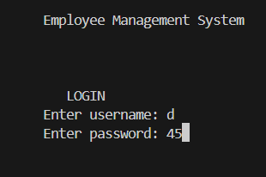
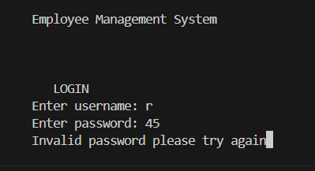
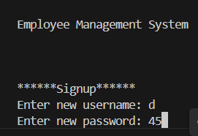
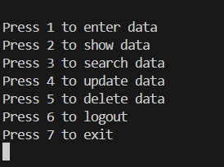
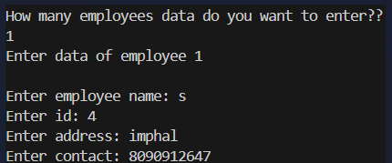
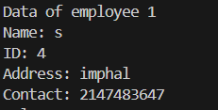
Result

Slide 8
Conclusion
- Project Overview:
- Developed a console-based Employee Management System using C++.
- Key features: data entry, search, update, and delete functionalities.
- Achievements:
- Implemented a secure login system for authorized access.
- Efficient management of employee data with user-friendly prompts.
- Successfully addressed challenges like memory management and data validation.
- Future Scope:
- Integration of a database for persistent data storage.
- Enhancement of security features and potential for a graphical user interface (GUI).
- Final Thoughts:
- EMS provides an efficient solution for managing employee data, with room for further improvement and expansion.

Slide 9
THANK YOU

