Slide 1
Sample Superstore Sales Analysis
DATA ANALYSIS PROJECT
Presented By: ALOK KUMAR MAURYA
STU640956e4423621678333668
alokkumarm9958@gmail.com

Slide 2
OUTLINE
Problem Statement
Proposed System/Solution
System Development Approach
Algorithm & Deployment
Result
Conclusion

Slide 3
Problem Statement
What is Sales and Profit in different Region.
What is Sales and Profit in different Segment.
What is Sales and Profit in different Category.
What is Sales and Profit in different States of US.

Slide 4
Proposed Solution
The Sales Analysis of Super Store project aims to analyze and visualize the sales data of a fictional superstore using Python programming language and popular data analysis libraries such as Pandas, NumPy, and Matplotlib. Through this project, you can gain insights into the store's sales performance, trends, and patterns over time.
Key Features:
Data Collection and Preparation:
Gather sales data from various sources such as CSV files, databases, or APIs.
Use Pandas, a powerful data manipulation library, to clean, preprocess, and organize the data for analysis.

Slide 5
2. Exploratory Data Analysis (EDA):
Perform exploratory data analysis to understand the structure and characteristics of the sales data.
Utilize descriptive statistics, such as mean, median, and standard deviation, to summarize the data.
Identify missing values, outliers, and inconsistencies in the dataset.
3. Data Visualization:
Utilize Matplotlib, a versatile plotting library, to create insightful visualizations of the sales data.
Plot various types of graphs, including line plots, bar charts, histograms, scatter plots, and pie charts.
Visualize sales trends over time, seasonal patterns, sales distribution across different product categories, and geographical regions.
4. Performance Analysis:
Analyze sales performance metrics such as total revenue, average order value, and sales growth rate.
Identify top-selling products, best-performing regions, and customer segments.
Compare sales performance across different time periods, regions, and product categories.

Slide 6
System Approach
The end users of the Sales Analysis of Super Store project can vary depending on the context and purpose of the analysis. Here are some potential end users:
Sales and Marketing Teams
Financial Analysts
Supply Chain Managers
Business Managers and Executives

Slide 7
Algorithm & Deployment
VS-Code
Python Language
Pandas
NumPy
Matplotlib

Slide 8
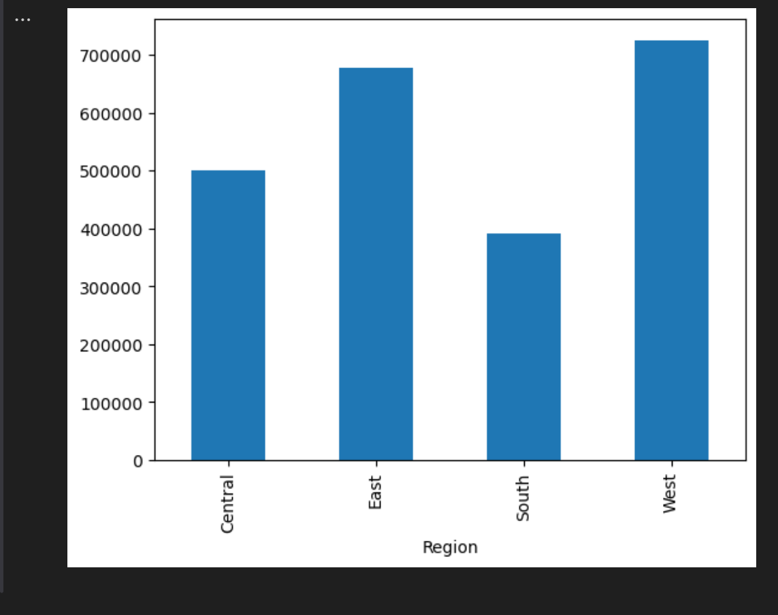
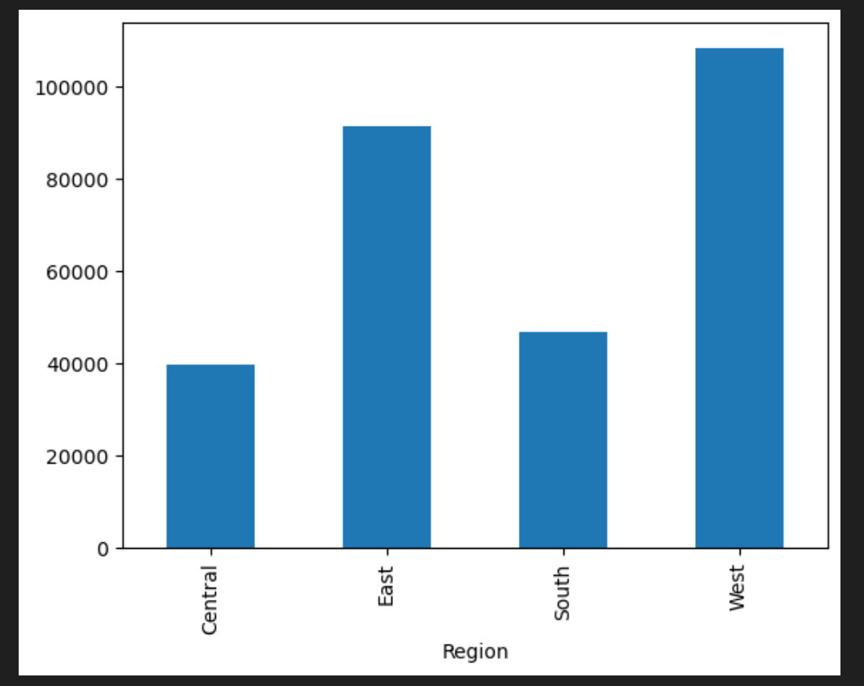
Result
What is Sales and Profit in different Region

Slide 9
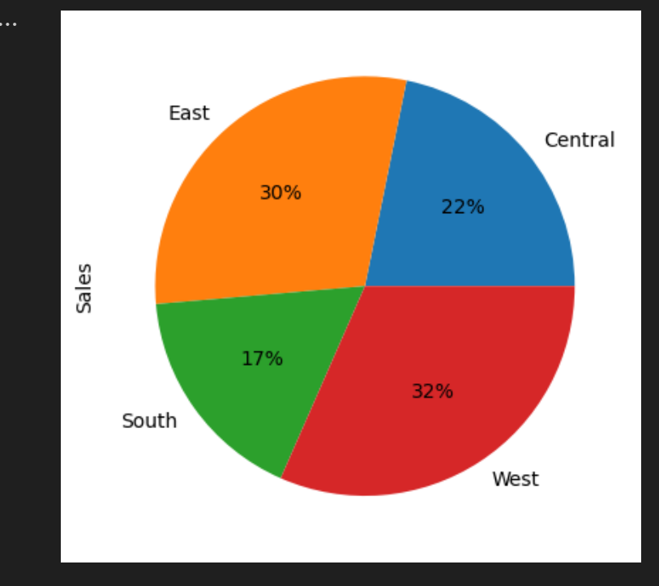
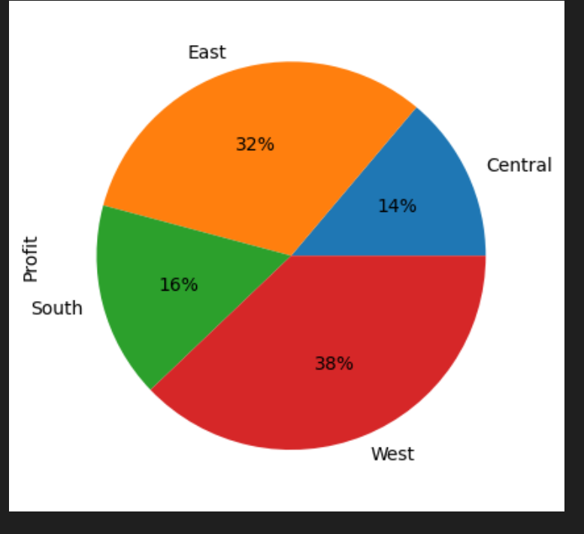
Result
What is Sales and Profit in different Region

Slide 10
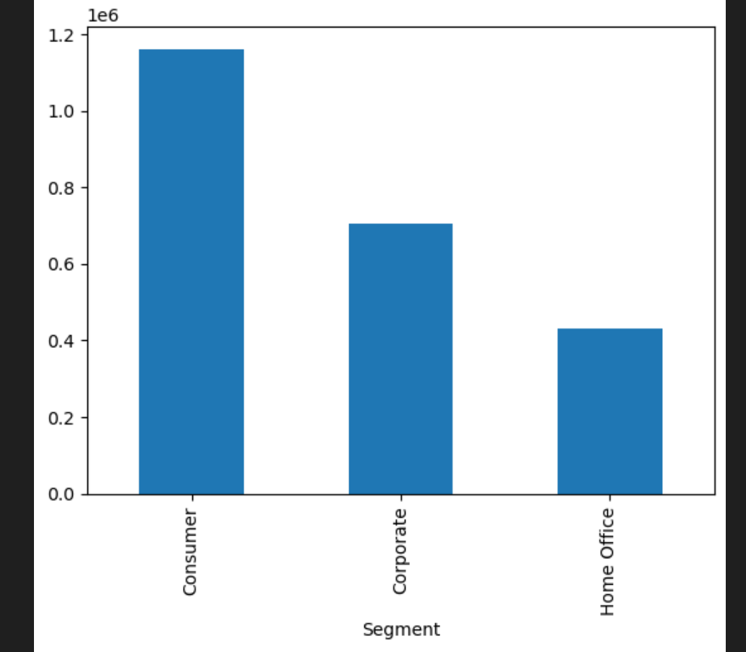
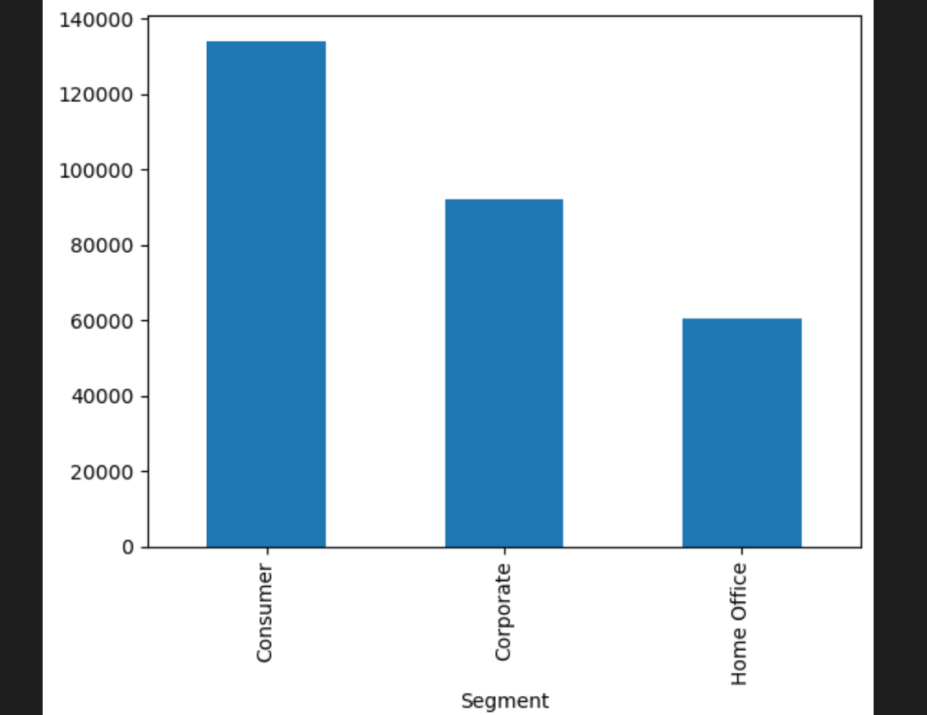
Result
What is Sales and Profit in different Segment

Slide 11
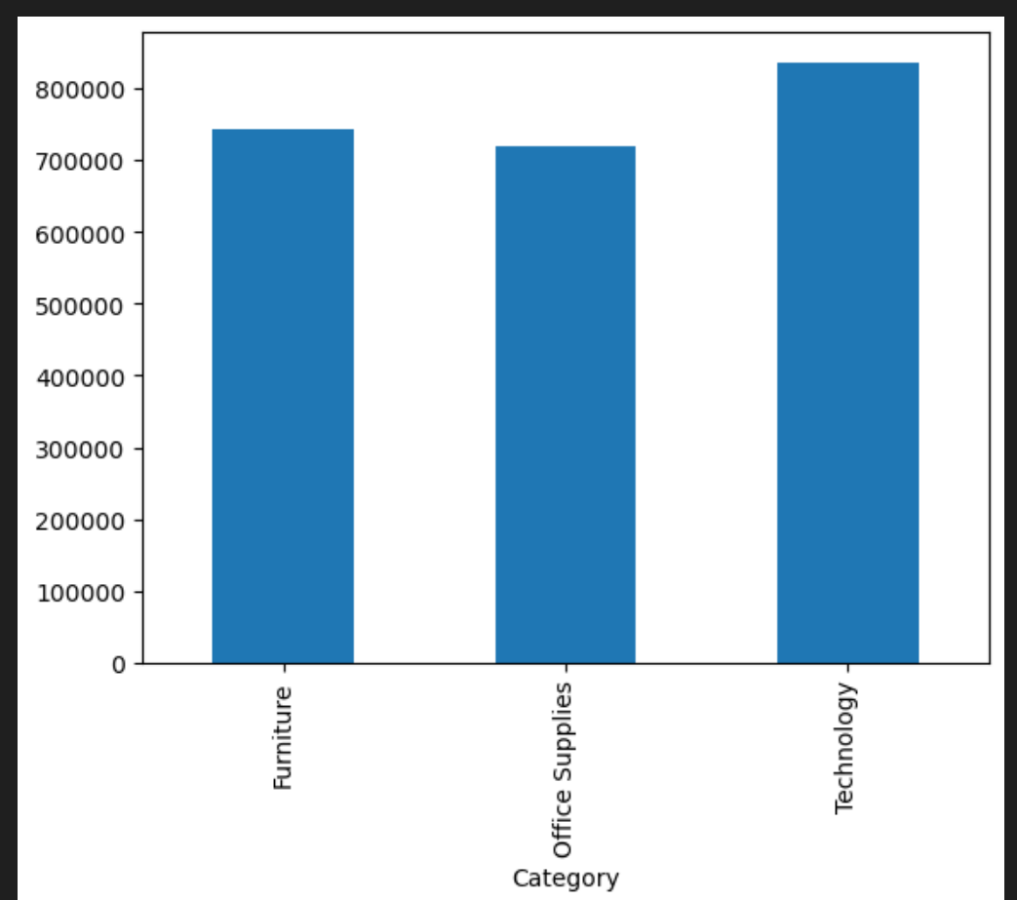
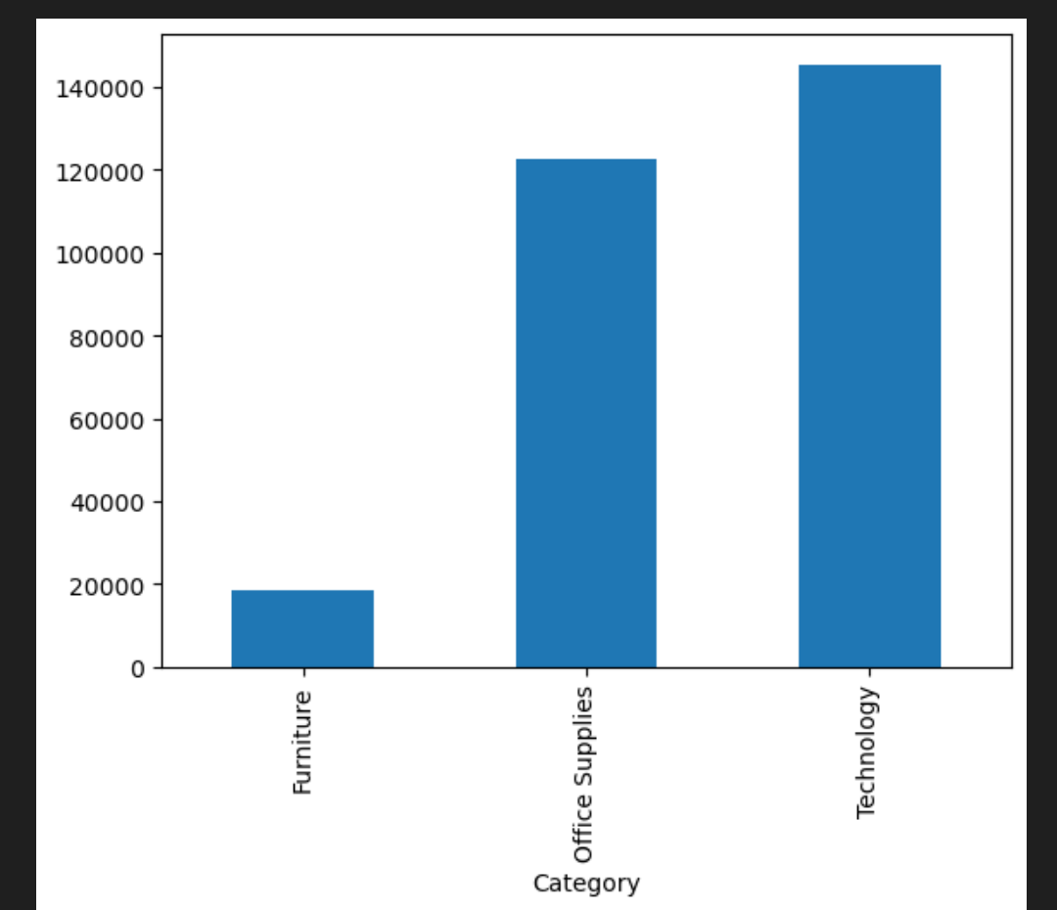
Result
What is Sales and Profit in different Category

Slide 12
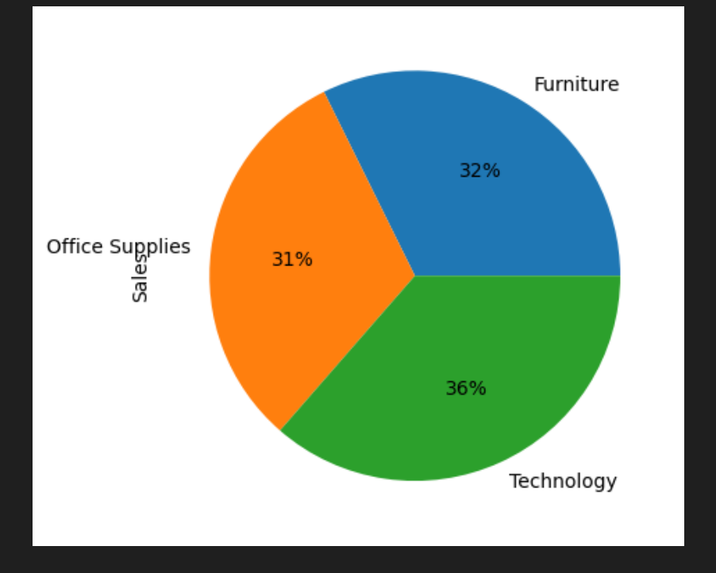
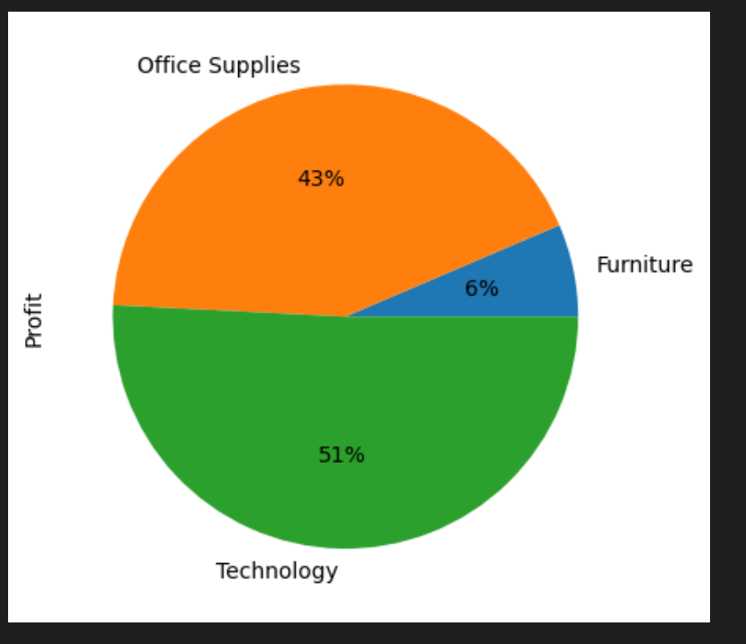
Result
What is Sales and Profit in different Category

Slide 13
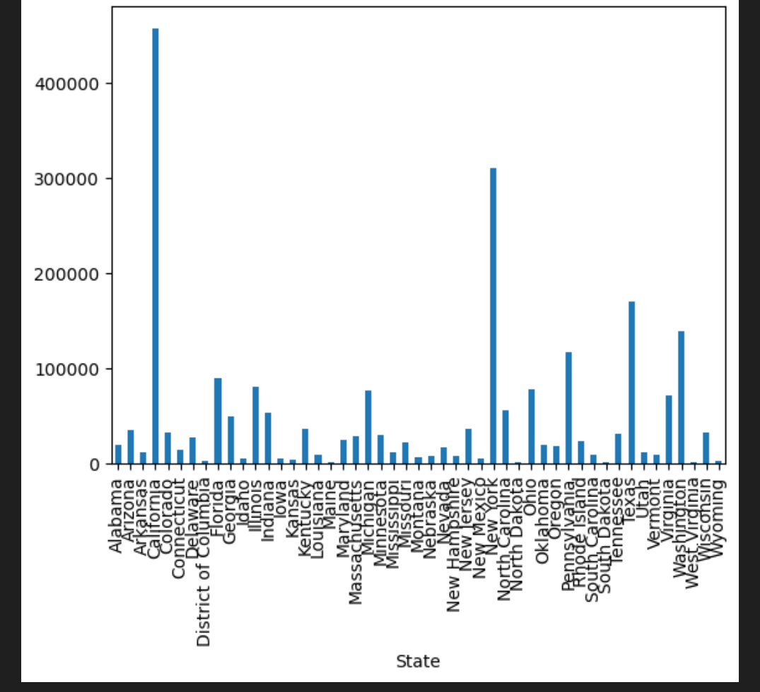
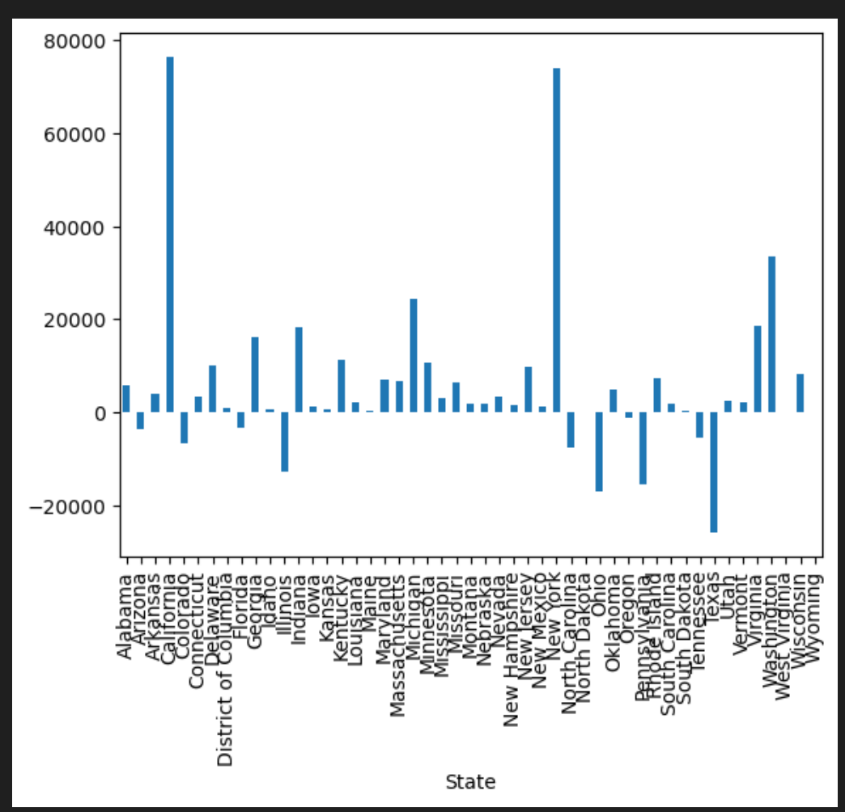
Result
What is Sales and Profit in different States of US

Slide 14
Conclusion
In central region we have 22% sale share but profit share is only 14%.
We need to focus on Home office segment to increase the sale and profit.
In furniture Category we have 32% sale but profit is only 6% a lot of work is needed in this category.
There are 9 states where we have loss especially in Texas.

Slide 15
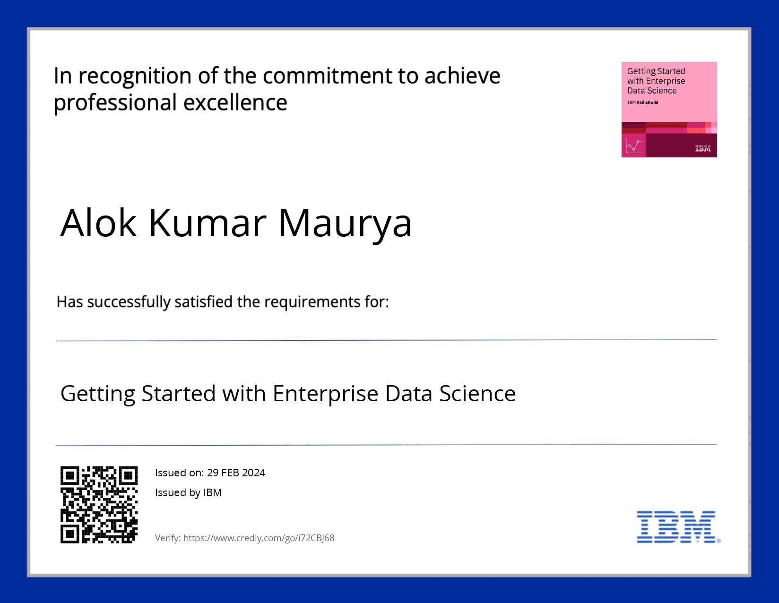
course certificate 1

Slide 16
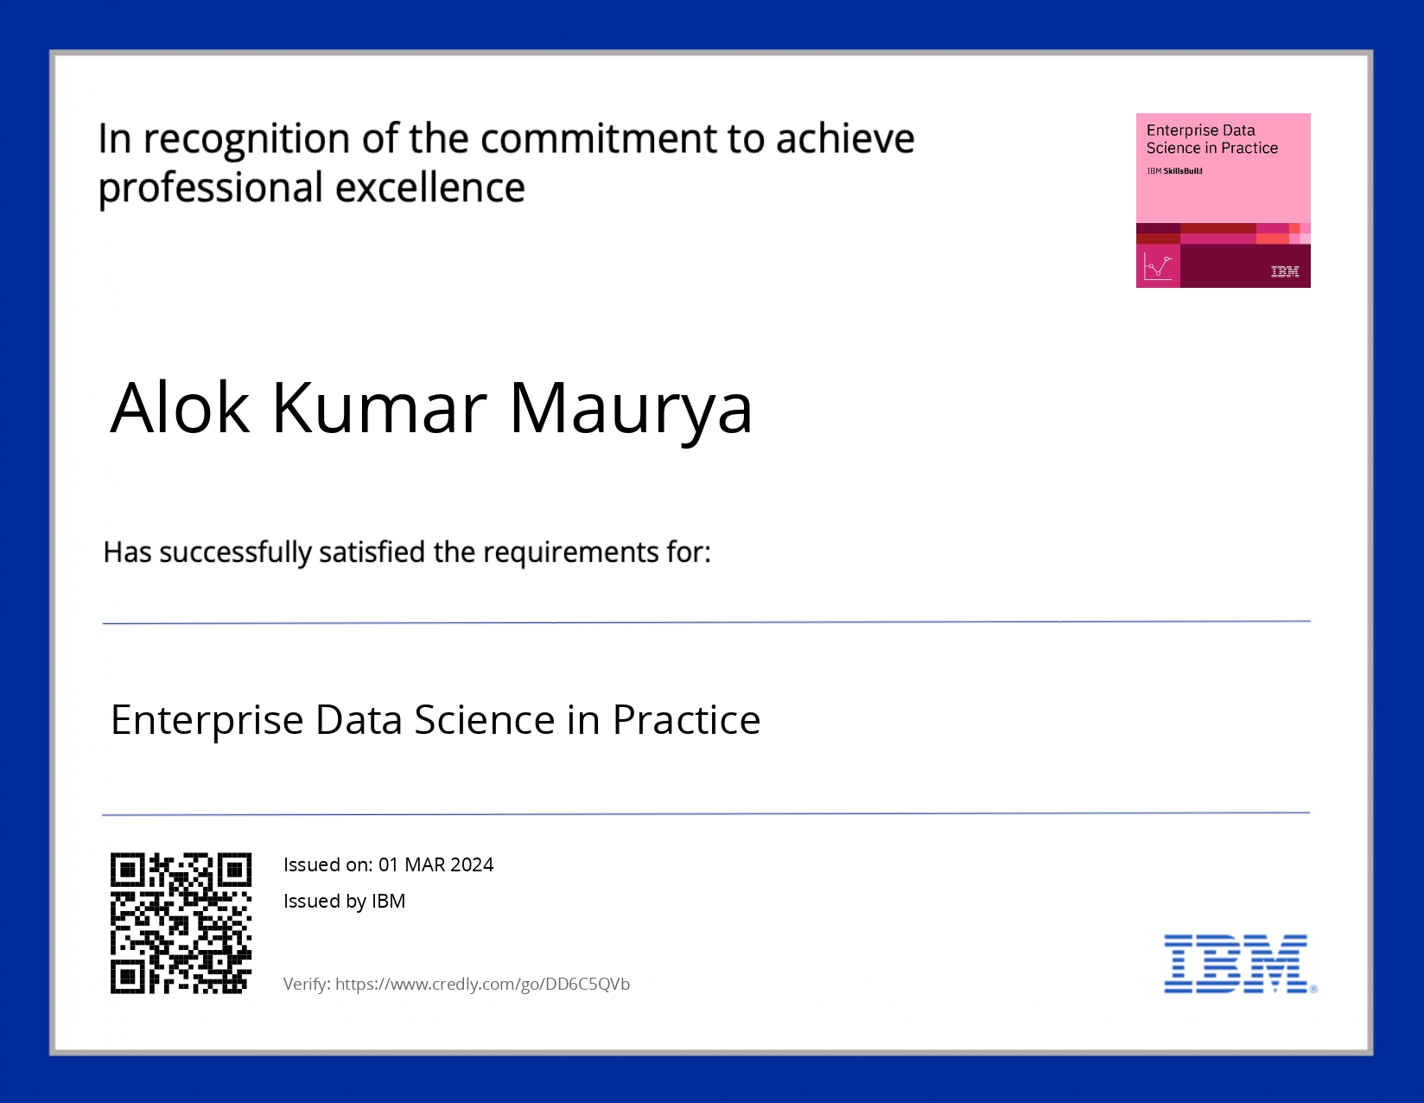
course certificate 2

Slide 17
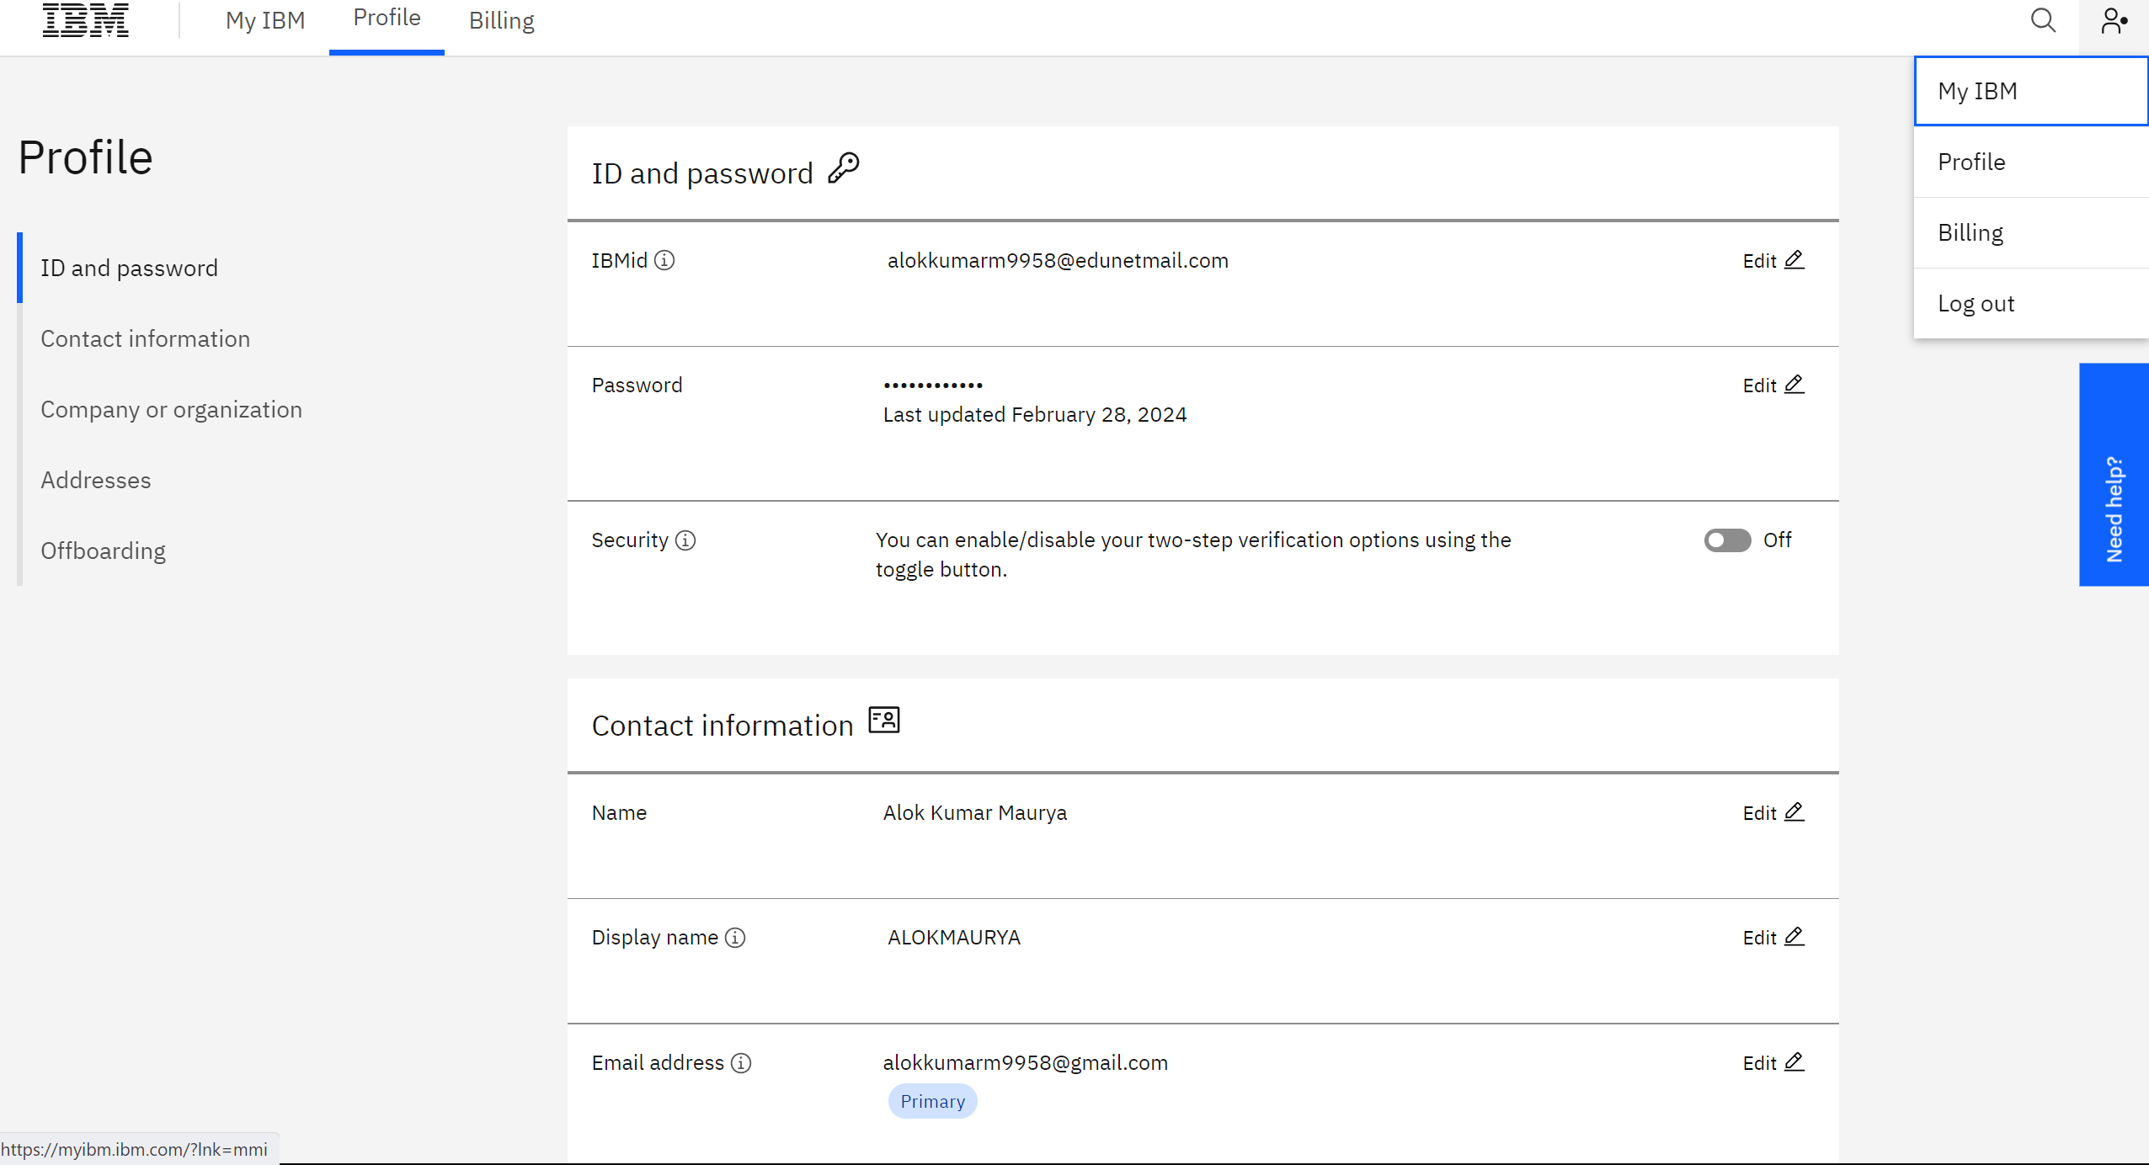
Feature code
ace1a2467c9d4eddf37e8b99e7b2509a

Slide 18
THANK YOU

