Slide 1

Liberty Pro

Slide 2
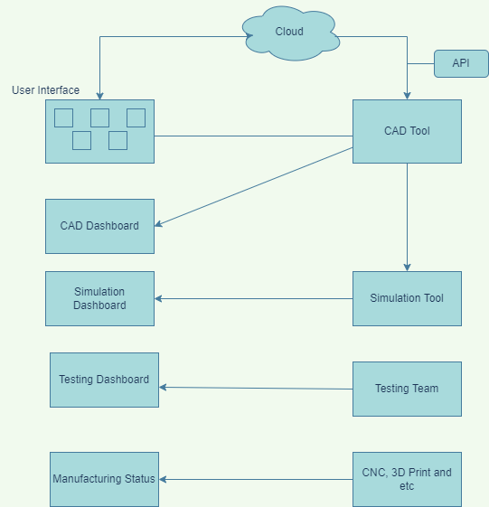

The work flow

Slide 3
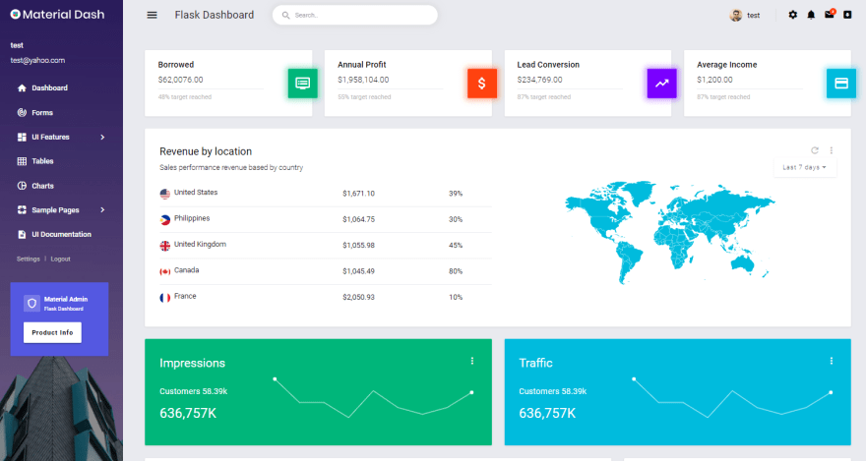

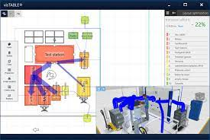
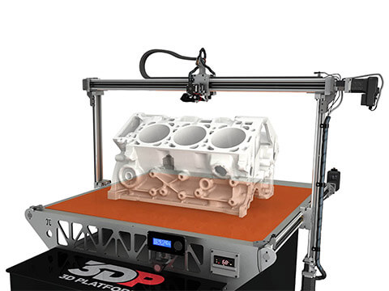

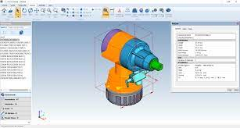
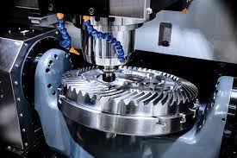
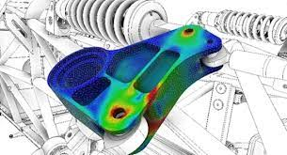
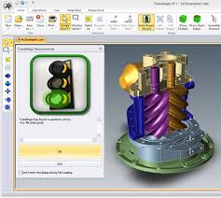
Work Eco system
User Interface
Assembly Software
3D Printing Software
CAD Software
CNC Software
Simulation Software
Testing Software

Slide 4
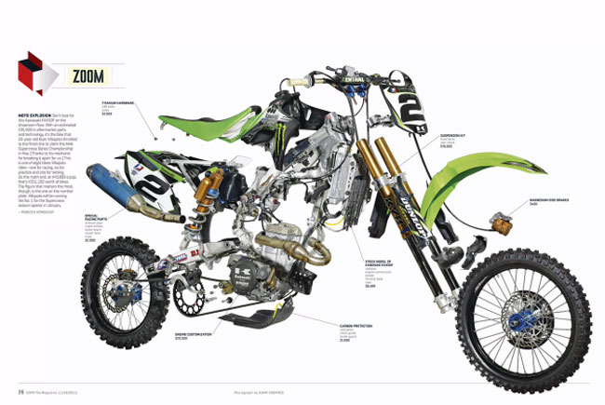
Benefits
1. 80-20% involvement
2. Centralized system
3. AI help reduce error and expedite process
4. Hardware cost reduction
5. Data security
6. domains : aero, marine, automobile, medical etc.,

