Slide 1

Liberty Pro Solution of BluePrint Prototype
Team Members:-
Amit, Taher, Syed

Slide 2
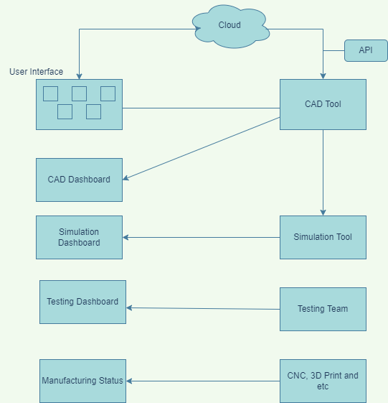

Work Flow Architecture

Slide 3
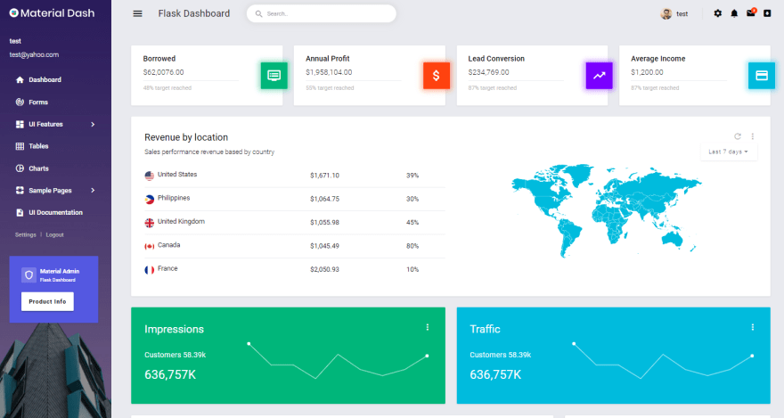

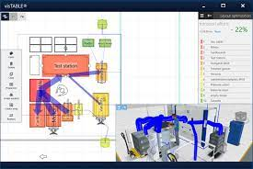
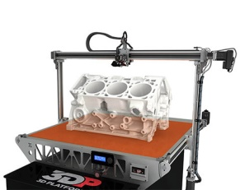

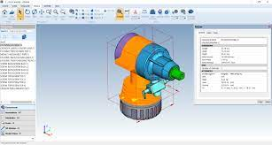
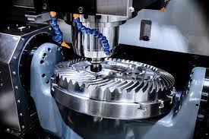
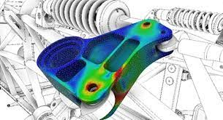
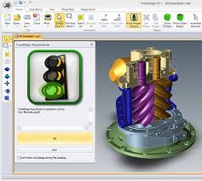
Work Eco system
User Interface
Assembly Software
3D Printing Software
CAD Software
CNC Software
Simulation Software
Testing Software

Slide 4
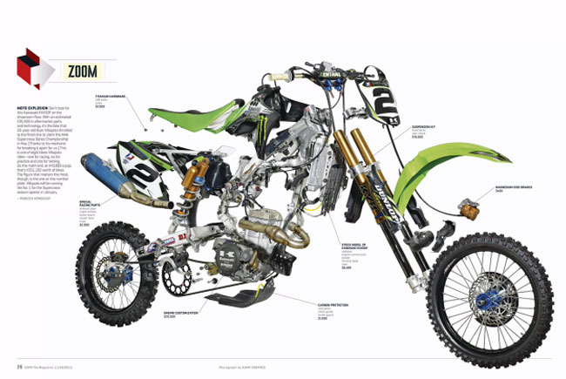
Benefits
1. 80-20% involvement
2. Centralized system
3. AI help reduce error and expedite
process
4. Hardware cost reduction
5. Data security
6. domains : aero, marine, automobile,
medical etc.,

Slide 5
Thank You

