Slide 1
Probabilistic Generative Modeling
Group - Deep Learner
Members -
Achintya Gupta (210101005)
Kannan Rustagi (210101054)
Kshitij Maurya (210101059)
Parth Kasture (210101074)
Shashank Kumar (210101097)

Slide 2
Introduction
Probabilistic generative models are a type of models that learn to model the underlying process of how data is generated.
They learn a joint probability distribution over both inputs and outputs.
In image generation, these models learn a probabilistic distribution over the space of possible images, grasping the patterns, textures, and styles that define images.
By sampling from this distribution, the model can generate new, realistic images that share the same characteristics as the training data.
This process involves training on a large dataset, learning a distribution, sampling from it, and outputting a new image.

Slide 3

Generative Adversarial Nets (GAN)
GANs are trained using a minimax game between the generator and discriminator.
The generator’s goal is to minimize the discriminator’s ability to distinguish between real and generated data. Here, D(G(z)) is the discriminator’s probability that the generated sample G(z) is real.
The discriminator’s goal is to maximize its accuracy in distinguishing between real and fake data. Given real data x and generated data G(z), where z is the noise vector, D(x) is the discriminator’s probability that x is real, and 1 − D(G(z)) is the probability that the generated sample G(z) is fake.

Slide 4

Denoising Diffusion Probabilistic Model
Forward Diffusion Process: In DDPM, the forward diffusion process progressively corrupts data by adding Gaussian noise over time, defined as a Markov chain:
where βt is a variance schedule, and xt is the noisy data at step t.
DDPM learns the reverse process to reconstruct the data from noise, defined as
The simplified loss function aims to minimise the difference between the added noise and predicted noise at each step

Slide 5
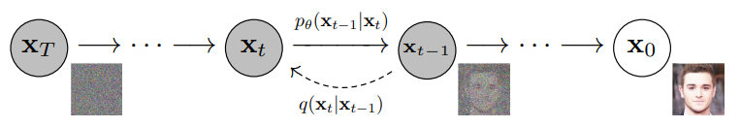
Denoising Diffusion Probabilistic Model
Drawbacks of DDPM
Slow Sampling: DDPM suffers from slow sampling, requiring hundreds or thousands of steps for generating samples.
High Computational Cost: Due to the large number of reverse steps, DDPM is computationally expensive.
Hyperparameter Sensitivity: The performance of DDPM depends heavily on hyperparameters like the variance schedule βt, requiring careful tuning.

Slide 6

Denoising Diffusion Implicit Model
DDIM was introduced to address the slow sampling speed of DDPM while maintaining high-quality generation by reformulating the reverse process.
The forward diffusion process used by DDPMs, which is Markovian is generalised to non-Markovian ones, for which we are still able to design suitable reverse generative Markov chains
Training objective is exactly the same as DDPM
DDIM modifies the reverse process into a deterministic form allowing faster sampling:

Slide 7
Noise Conditional Score Networks
Aims to create a generative model which produces samples using Langevin dynamics using gradients of data distribution perturbed with Gaussian noise, estimated with score matching corresponding to gradually decreasing noise levels.
A generative model where samples are produced via Langevin dynamics using gradients of the data distribution estimated with score matching. Since gradients can be ill-defined and hard to estimate when the data resides on low-dimensional manifolds, the data is perturbed with different levels of Gaussian noise, and the corresponding scores is jointly estimated, i.e., the vector fields of gradients of the perturbed data distribution for all noise levels.
For sampling, an annealed Langevin dynamics is proposed where we use gradients corresponding to gradually decreasing noise levels as the sampling process gets closer to the data manifold.

Slide 8
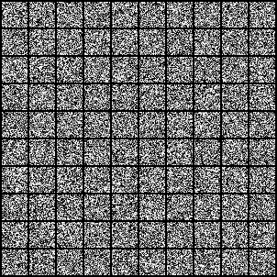
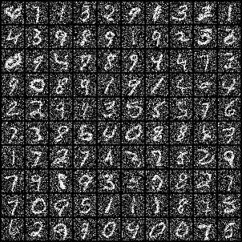
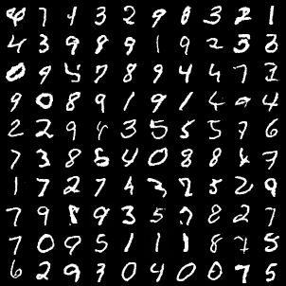
SOTA Implementation of DDPM
We sampled a image using the trained model on MNIST dataset with 1000 steps

Slide 9
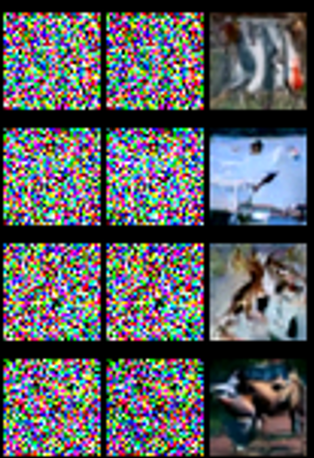
SOTA Implementation of DDIM
We have used the cifar 10 dataset
Trained for 20 epochs
Sampled over 100 steps

Slide 10
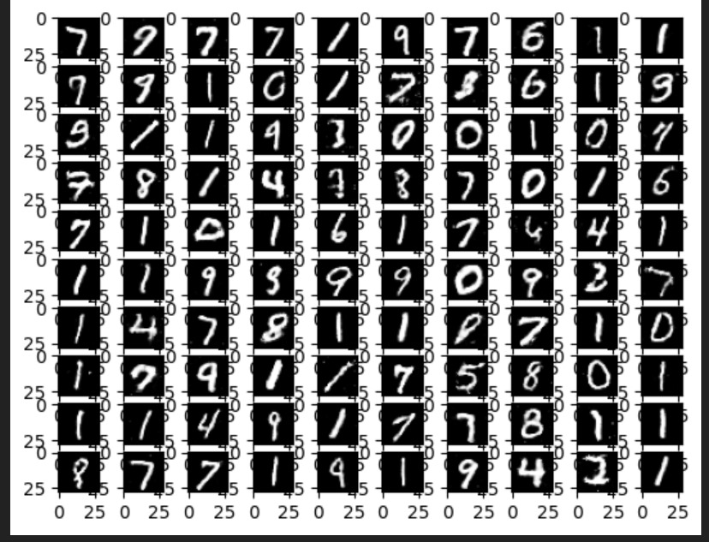
Result using SOTA Implementation of GAN on noise as input

Slide 11
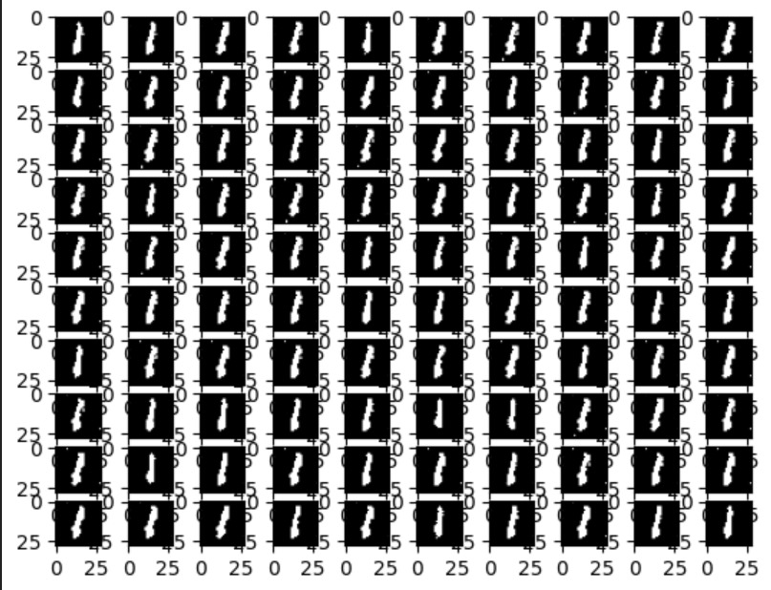
Approach 1: Feeding the output of DDPM to a Pre-Trained GAN
We used the weights of a pre-trained GAN we obtained from github link
DDPM Training Parameters:
10 epochs
100 sampling steps
The Generator only produced 1s as can bee seen in the image.
So we decided to train our own GAN on the MNIST dataset

Slide 12
Approach 2: Feeding the output of DDPM to the
GAN we trained
GAN Training Methodology
The discriminator is trained first by feeding it both real and generated images. It tries to predict whether the image is real or fake.
The generator is trained next. It produces a batch of fake images from random noise, and the discriminator evaluates them. The generator aims to trick the discriminator by improving the quality of the generated images over time.
DDPM Training Parameters:
10 epochs
100 sampling steps
GAN Training Parameters
100 epochs

Slide 13
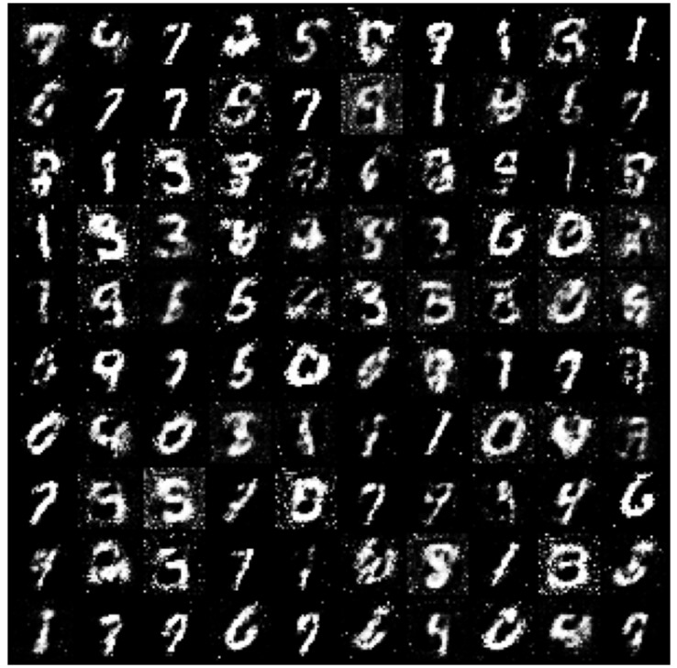
Approach 2: Feeding the output of DDPM to the
GAN we trained

Slide 14
Conclusion
The initial implementation of DDPM was trained with the resources available to us for 50 epochs which took 153 minutes to complete and then to generate each image we used 1000 sampling iterations which were processed at the rate of 6 iterations per second, taking the total sampling time to be around 167 seconds per image generated.
Our implementation of the DDPM and GAN hybrid model involved training the DDPM for 10 epochs, which took about 30 minutes and then sampling noisy images for 100 iterations, taking around 17 seconds. This noisy image was then used as the input for GAN which generated a new image almost instantaneously.
So we were able to reduce the time for image generation from 167 seconds to 17 seconds, although some amount of quality was compromised.

Slide 15
Further Improvements
To improve quality, either we would need to train both the DDPM and GAN for a significantly larger number of epochs which is computationally infeasible for us at this level. Moreover, how this approach would fair on coloured images with multiple channels, as compared to MNIST with just a single channel, is also something that can be explored in the future

Slide 16
Thank You

