Slide 1
Response time reduction during Heart attack
-Rajani Maurya
Under guidance of Dr. Kal Bugrara

Slide 2
OBJECTIVE
Problem Statement
Proposed Solution
Object Model
Key Roles
Key Features
Additional Features

Slide 3
Problem Statement
Patients with heart condition need immediate help in case of heart attack. The time between an attack and medical support is very crucial which should be reduced as much as possible.

Slide 4
Proposed Solution
Hospitals can provide the patients with IOT devices which are capable of detecting heart attack.
This sensor monitors pulse rate, blood pressure and other vital signs and maintains history of this data.
In case of irregularities in these vital signs, the sensor will immediately send the information to the hospital.
Sending ambulance, scheduling medical staff of hospital required in case of heart attack eventually reducing response time with the help of IOT.

Slide 5
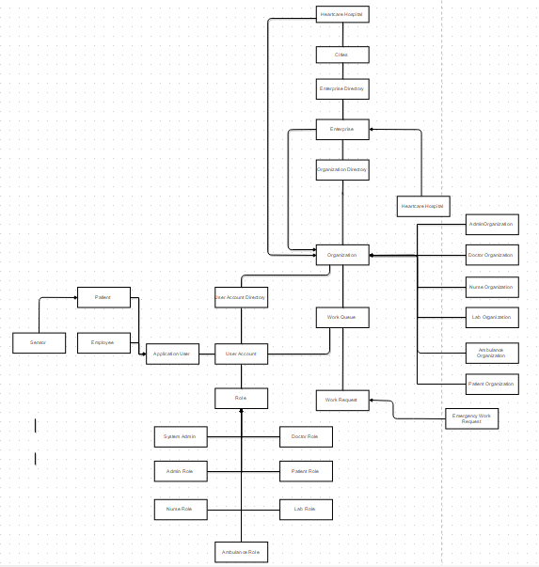
Object Model

Slide 6
Key Roles
Patient (Sensor)
Hospital
Organizations in Hospital
Hospital Administrator
Ambulance
Nurse
Doctor
Lab

Slide 7
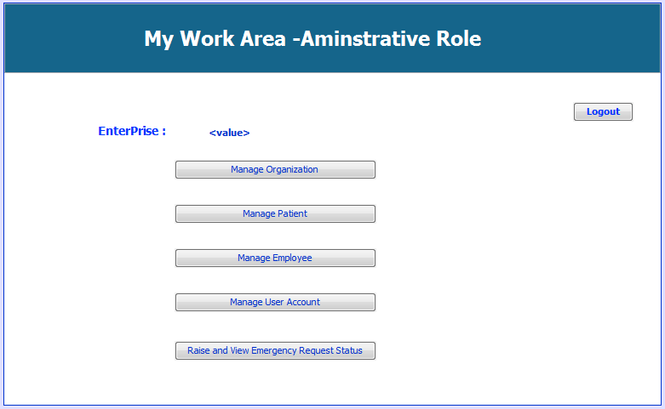
Project Key Roles

Slide 8
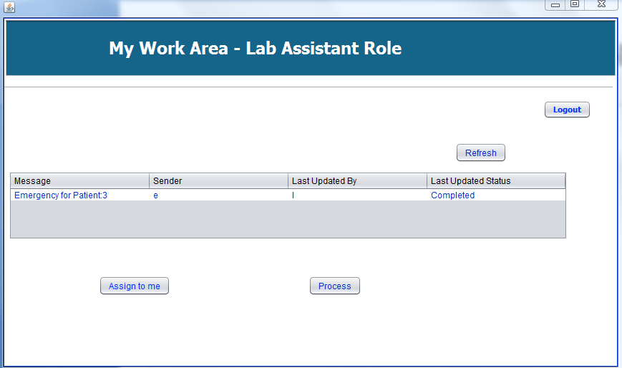
Project Key Roles

Slide 9
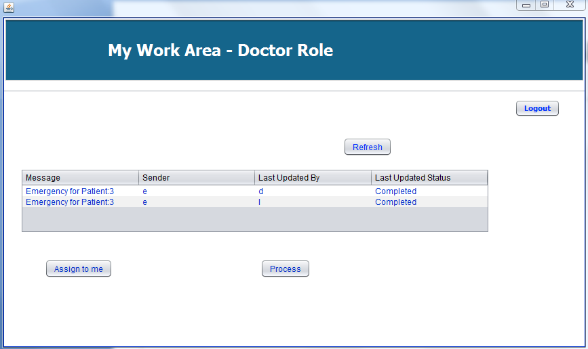
Project Key Roles

Slide 10
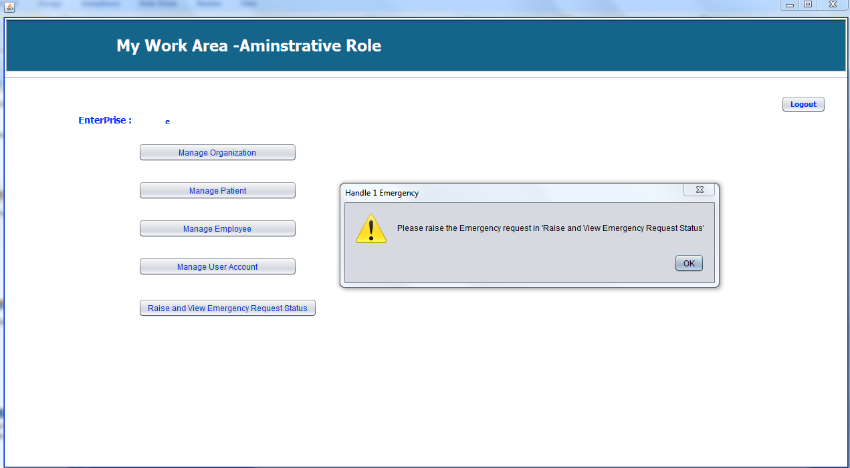
Additional Features Alarm sound when emergency arises

Slide 11
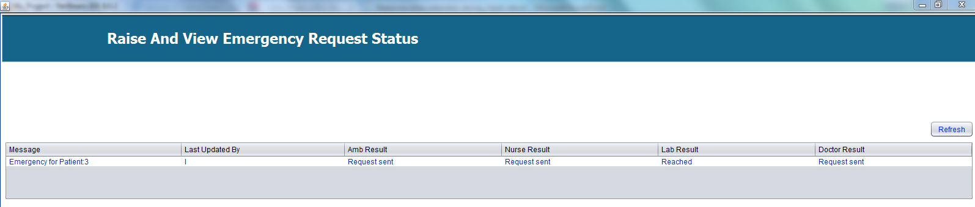
Request Status Update from All Organizations

Slide 12
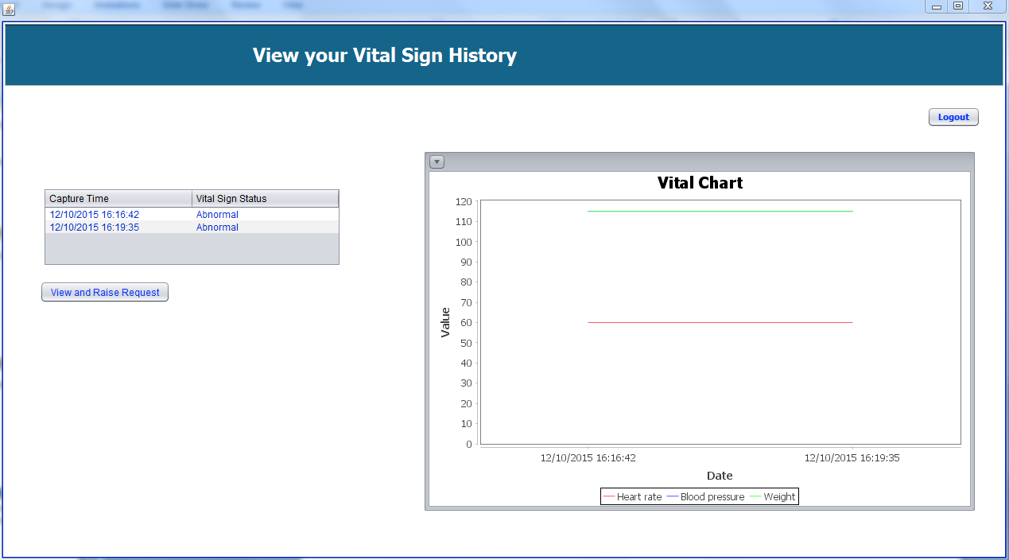
Patient Vital Sign History Chart

Slide 13
References
TED Talk: https://www.youtube.com/watch?v=_AlcRoqS65E
US Ignite: https://www.us-ignite.org/globalcityteams/actioncluster/

Slide 14
Thank you

