Slide 1
AUTOMATED GREENHOUSE SYSTEM FOR ENHANCED AGRICULTURAL PRODUCTIVITY
Intro
Design
Working
Trade-offs
Scope
Apply
By
DIPESH MAHATO
302311701005
BACHELOR IN PRODUCTION ENGINEERING
3 RD YEAR 1ST SEMESTER
JADAVPUR UNIVERSITY
UNDER THE GUIDANCE
OF
MR. SUBIR KUMAR DEBNATH (Associate Professor) DEPARTMENT OF PRODUCTION ENGINEERING JADAVPUR UNIVERSITY

Slide 2
#Contents
Intro
Design
Working
Trade-offs
Scope
Apply
Introduction
Objective
System Design and Components
Block diagram
Working Principle
Flow Chart
Challenges and Benefits
Future Prospects
Reference

Slide 3
#Introduction
Intro
Working
Design
Trade-offs
Scope
Apply
The Automated Greenhouse System (AGS) project has successfully outlined the potential for integrating automation, advanced technologies, and environmental control to revolutionize modern agriculture. By utilizing sensors, actuators, and microcontroller systems, the AGS optimizes the growing conditions for plants, ensuring that temperature, humidity, light, and soil moisture are maintained at levels that maximize crop health and yield. This approach reduces human intervention, increases resource efficiency, and contributes to sustainable farming practices.

Slide 4
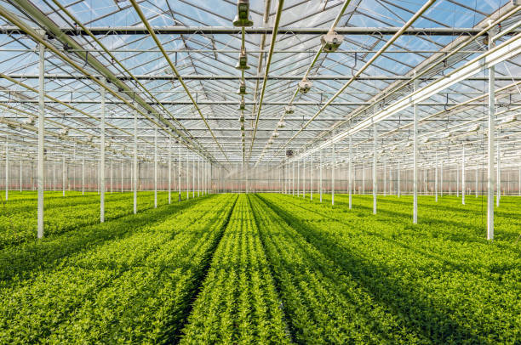
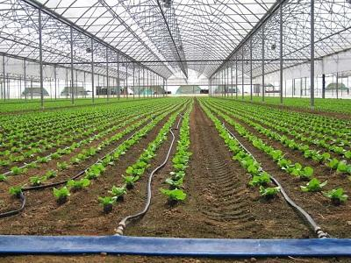
#Objectives
Intro
Working
Design
Trade-offs
Scope
Apply
Develop an automated system to optimize greenhouse conditions for improved plant growth and yield. Enhance resource efficiency by reducing water, energy, and labor usage through automated monitoring and control. Design a system that can be implemented across various scales, from small farms to large commercial setups.

Slide 5
Intro
Working
Design
Trade-offs
Scope
Apply
#Working Principle
Data Collection
Feedback Loop
The greenhouse system continuously collects data from various sensors, monitoring the environmental parameters like temperature, humidity, soil moisture, and light levels.
The system continually adjusts the environmental conditions to maintain them within the desired range. This feedback loop ensures that any fluctuations are quickly corrected.
Decision-Making and Control
The microcontroller or PLC processes the sensor data. If any parameter deviates from the pre-set optimal range, it takes corrective actions. For example:
If the temperature is too high, it triggers the ventilation fans or opens a window.
If soil moisture is low, it activates the irrigation system to water the plants.
If light levels are low, it turns on the grow lights to supplement natural sunlight.
If humidity is too low or too high, it adjusts ventilation to balance it.

Slide 6
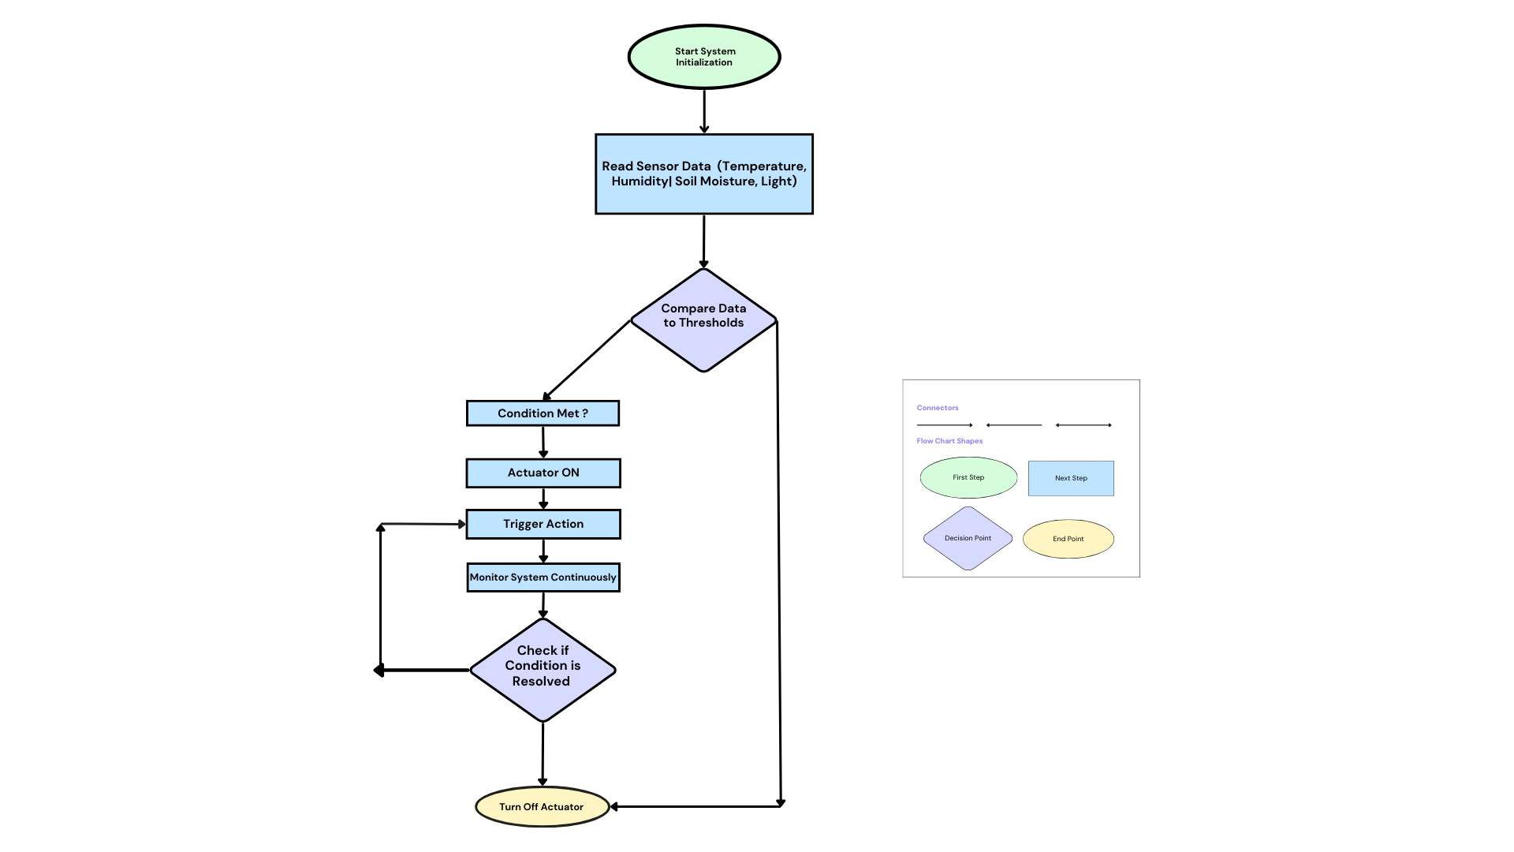
#Flow chart of AGS
Intro
Working
Design
Trade-offs
Scope
Apply
The system starts by reading sensor data.
It then compares the data with preset thresholds and triggers actions when necessary.
If the condition is met (e.g., temperature exceeds the threshold), actuators are turned on.
The system continues monitoring and makes real-time adjustments.
NO
YES
NO
YES

Slide 7
#Code Implementation
Intro
Working
Design
Trade-offs
Scope
Apply
1. Defining Pins:
The first part of the code defines the pins for sensors and actuators:
#define TEMP_SENSOR_PIN A0 // Temperature sensor connected to analog pin A0
#define HUMIDITY_SENSOR_PIN A1 // Humidity sensor connected to analog pin A1
#define MOISTURE_SENSOR_PIN A2 // Soil moisture sensor connected to analog pin A2
#define FAN_PIN 9 // Fan connected to digital pin 9
#define LIGHT_PIN 10 // Light connected to digital pin 10
#define PUMP_PIN 11 // Irrigation pump connected to digital pin 11
TEMP_SENSOR_PIN, HUMIDITY_SENSOR_PIN, and MOISTURE_SENSOR_PIN represent the analog pins where the temperature, humidity, and soil moisture sensors are connected. These sensors provide analog signals that we will read and process.
FAN_PIN, LIGHT_PIN, and PUMP_PIN represent the digital pins connected to the fan, light, and pump, respectively. These actuators are controlled by turning the respective pins HIGH or LOW (on or off).

Slide 8
Intro
Working
Design
Trade-offs
Scope
Apply
2. Defining Thresholds:
3. Setup Function:
The following part defines the threshold values for when the system should activate the actuators:
#define TEMP_THRESHOLD 30
#define HUMIDITY_THRESHOLD 60
#define MOISTURE_THRESHOLD 300
TEMP_THRESHOLD is the temperature value (in °C) above which the fan will turn on.
HUMIDITY_THRESHOLD is the humidity value (in %) below which the light will turn on.
MOISTURE_THRESHOLD is the soil moisture value below which the irrigation pump will activate. This value is read as an analog value (0-1023) from the soil moisture sensor.
The setup() function initializes the serial communication and sets up the pins:
void setup() {
Serial.begin(9600); pinMode(FAN_PIN, OUTPUT); pinMode(LIGHT_PIN, OUTPUT); pinMode(PUMP_PIN, OUTPUT);
}
Serial.begin(9600) Initialize serial communication for monitoring at a baud rate of 9600, allowing data to be sent to the Serial Monitor for debugging or viewing sensor values.
pinMode(FAN_PIN, OUTPUT), pinMode(LIGHT_PIN, OUTPUT), and pinMode(PUMP_PIN, OUTPUT) set the pins controlling the actuators to be OUTPUT, meaning they can send signals to turn the fan, light, and pump on or off.

Slide 9
Intro
Working
Design
Trade-offs
Scope
Apply
4. Main Loop:
The loop() function runs repeatedly to monitor the sensor readings and control the actuators:
void loop() {
// Read sensor values
int tempValue = analogRead(TEMP_SENSOR_PIN); // Read temperature (ranging from 0 to 1023)
int humidityValue = analogRead(HUMIDITY_SENSOR_PIN); // Read humidity (ranging from 0 to 1023)
int moistureValue = analogRead(MOISTURE_SENSOR_PIN); // Read soil moisture (ranging from 0 to 1023)
// Convert analog values to usable units (for simplicity, assume linear scaling)
float temperature = map(tempValue, 0, 1023, 0, 50); // Scale to Celsius (0-50°C)
float humidity = map(humidityValue, 0, 1023, 0, 100); // Scale to percentage (0-100%)
int soilMoisture = map(moistureValue, 0, 1023, 0, 1023); // Direct mapping (0-1023)
// Print sensor values to serial monitor
Serial.print("Temperature: ");
Serial.print(temperature);
Serial.print(" °C, ");
Serial.print("Humidity: ");
Serial.print(humidity);
Serial.print(" %, ");
Serial.print("Soil Moisture: ");
Serial.println(soilMoisture);

Slide 10
Intro
Working
Design
Trade-offs
Scope
Apply
5. Actuator Control:
Based on the sensor values, the system controls the actuators:
// Control actuators based on sensor values
// Temperature control: Activate fan if temperature exceeds threshold
if (temperature > TEMP_THRESHOLD) {
digitalWrite(FAN_PIN, HIGH); // Turn on fan
} else {
digitalWrite(FAN_PIN, LOW); // Turn off fan
}
// Humidity control: Activate light if humidity is below threshold
if (humidity < HUMIDITY_THRESHOLD) {
digitalWrite(LIGHT_PIN, HIGH); // Turn on light
} else {
digitalWrite(LIGHT_PIN, LOW); // Turn off light
}
// Soil moisture control: Activate irrigation pump if moisture is below threshold
if (soilMoisture < MOISTURE_THRESHOLD) {
digitalWrite(PUMP_PIN, HIGH); // Turn on irrigation pump
} else {
digitalWrite(PUMP_PIN, LOW); // Turn off pump
}
digitalWrite(pin, HIGH) turns the actuator on (fan, light, or pump).
digitalWrite(pin, LOW) turns the actuator off.
For each actuator:
The fan will turn on if the temperature is above the defined threshold.
The light will turn on if the humidity is below the threshold.
The irrigation pump will turn on if the soil moisture is below the threshold, indicating that the soil is too dry.
delay(2000);
// Delay for 2 seconds before next reading
his delay ensures the system doesn't overwhelm itself with constant updates. It waits 2 seconds before the loop runs again and reads the sensors and checks the conditions.
6. Delay for Stability:

Slide 11
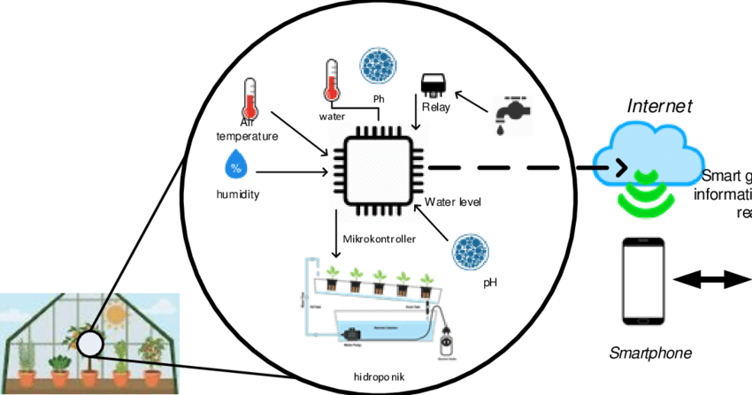
#System Design and Components
Intro
Working
Design
Trade-offs
Scope
Apply
The Automated Greenhouse System (AGS) integrates multiple components sensors, actuators, a control unit, and a power supply to monitor and regulate environmental conditions within a greenhouse. The system relies on a feedback loop where sensors collect data, the control unit processes the data, and actuators make necessary adjustments.

Slide 12
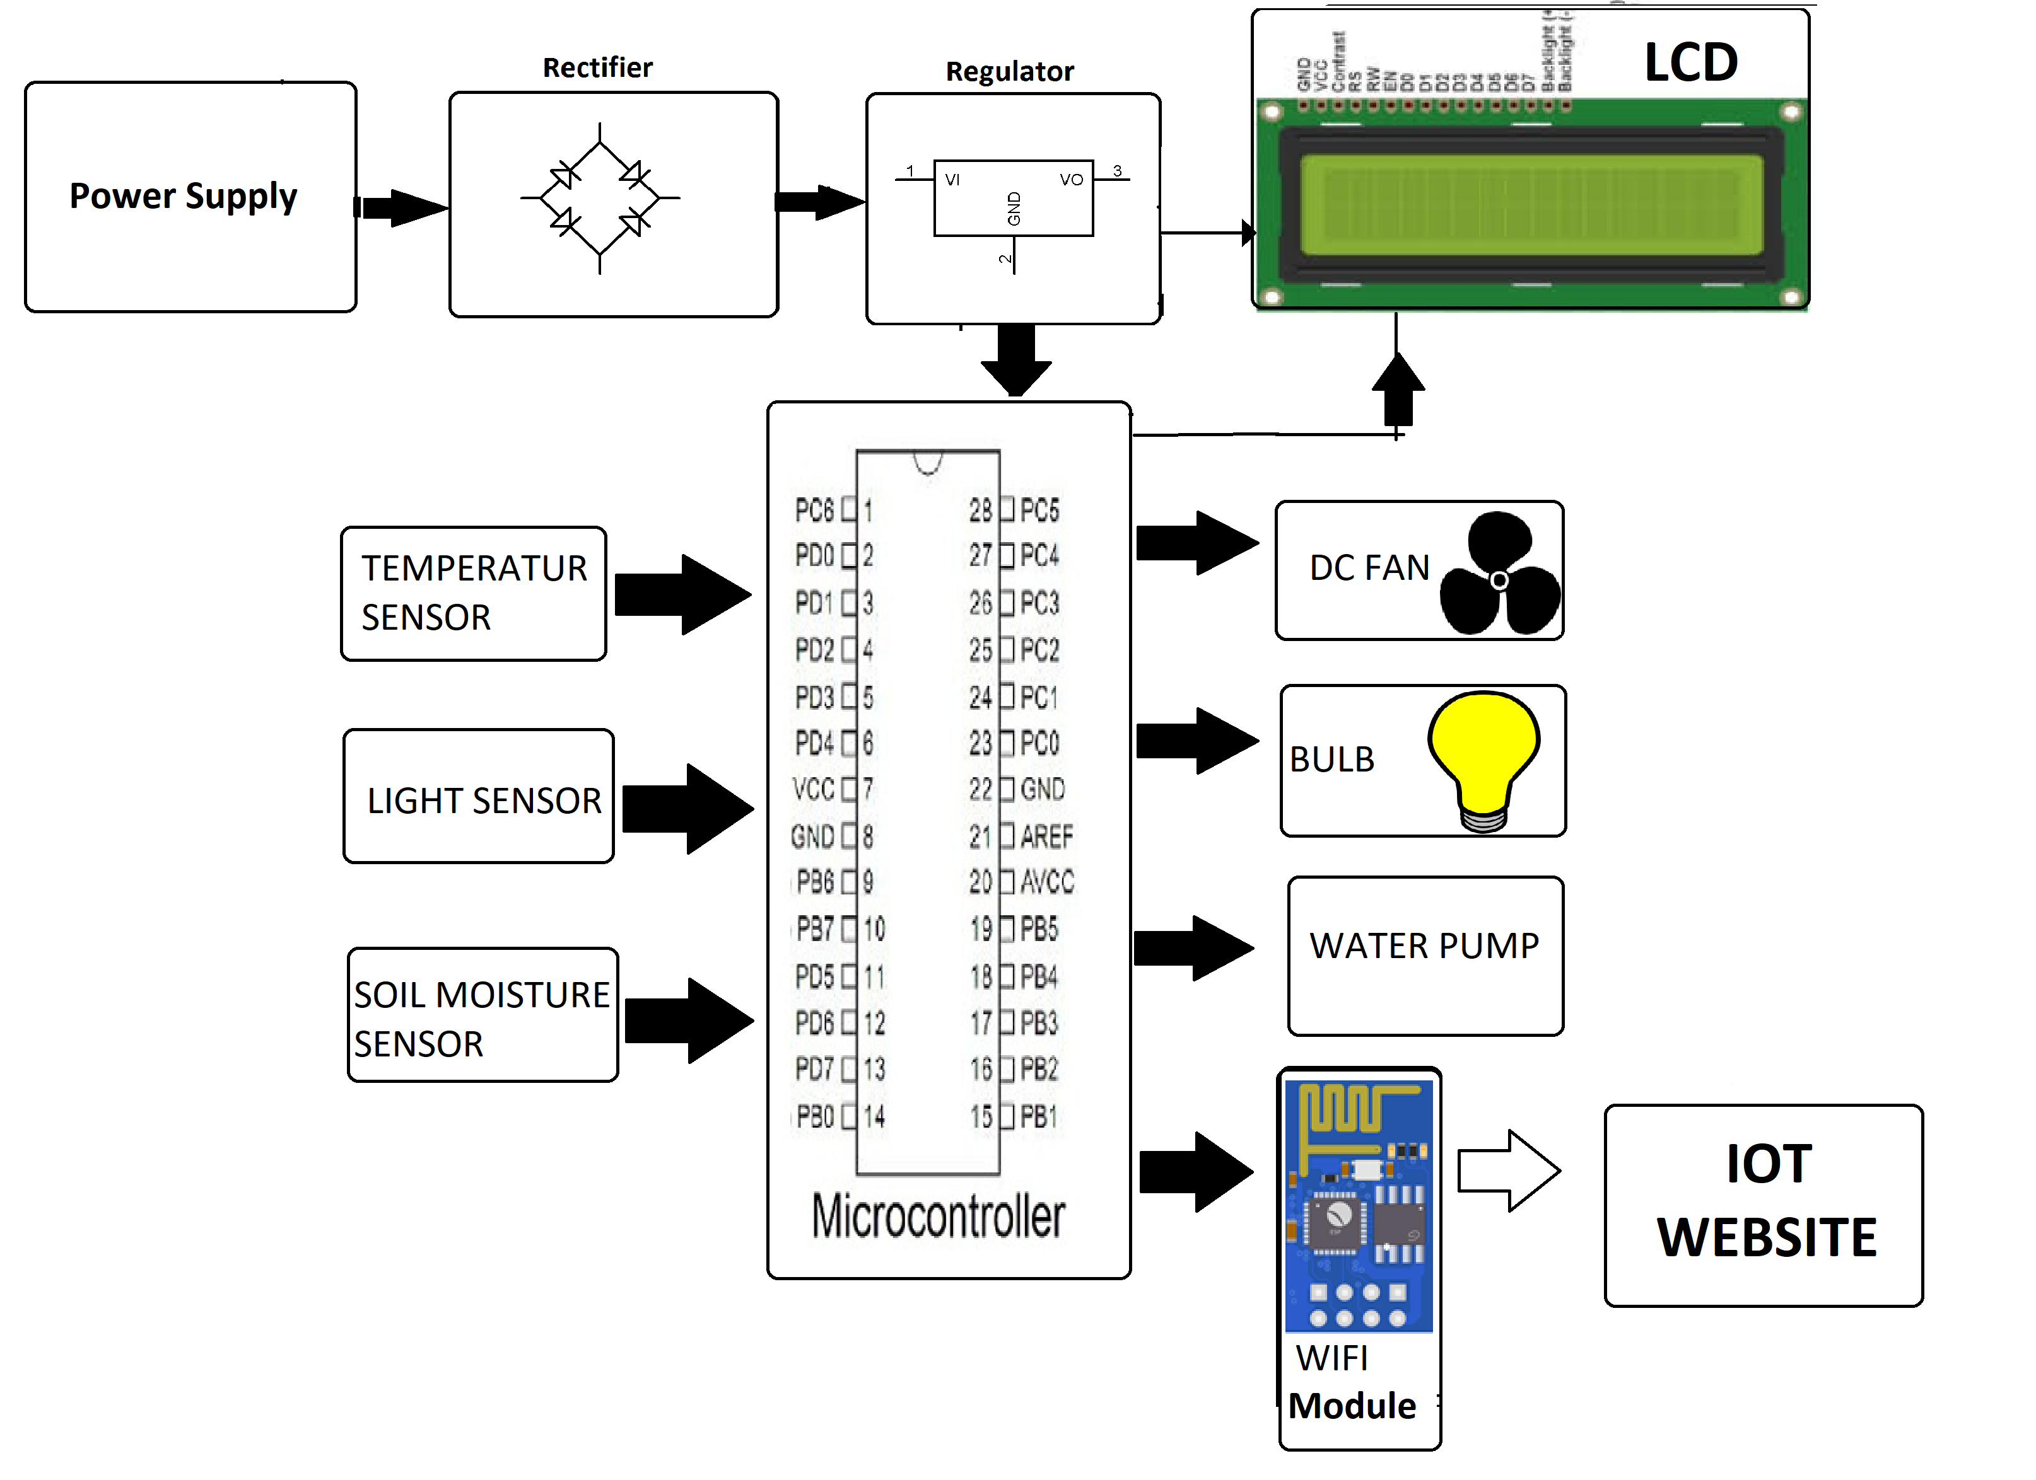
#Block diagram of the project
Intro
Working
Design
Trade-offs
Scope
Apply
Sensors: Collect environmental data such as temperature, humidity, soil moisture, and light intensity.
Microcontroller: Processes sensor data and decides on actions based on predefined thresholds.
Actuators: Adjust environmental conditions through fans, pumps, and lights.
Power Supply: Provides energy for the system, using batteries or solar panels for sustainable operation.

Slide 13
#Challenges and Benefits
Intro
Working
Design
Trade-offs
Scope
Apply
Cost and Scalability : Although the automated greenhouse offers efficiency improvements, initial setup costs can be high.
Power Supply and Backup Solutions : The system needs a reliable power source. Solar panels and battery backups can be used to maintain operation during power outages.
System Maintenance: Regular maintenance is required to ensure the sensors and actuators remain functional.

Slide 14
#Challenges and Benefits
Intro
Working
Design
Trade-offs
Scope
Apply
Increased Efficiency: Reduces water usage and energy consumption by delivering resources precisely when needed.
Remote Monitoring: With internet connectivity, the system can be monitored and controlled from anywhere.
Scalability: Can be implemented in small home greenhouses or large commercial agricultural setups.
Climate Control: Enables year-round cultivation by maintaining optimal growing conditions.

Slide 15
#Future Scope
Intro
Working
Design
Trade-offs
Scope
Apply
Adjusting the System for Diverse Crop Requirements
For instance, cucumbers require high humidity, whereas tomatoes need lower humidity and higher light levels. By monitoring the specific needs of each crop, the system can intelligently adjust environmental parameters to optimize conditions for each plant.
Real-Time Monitoring
Advanced Nutrient Delivery Systems
Advanced Nutrient Delivery Systems
Operators can view sensor data, such as temperature, humidity, light, and soil moisture, in real-time from their mobile phones or computers.
Automated nutrient management can be integrated, allowing precise control over the delivery of fertilizers based on plant growth stages.
Automated nutrient management can be integrated, allowing precise control over the delivery of fertilizers based on plant growth stages.

Slide 16
#Reference
Intro
Working
Design
Trade-offs
Scope
Apply
Agriculture.com
automated-greenhouse.
Tinkernut
Tech With Tim
arduino.cc
iotforall.com.
GreatScottLab
TheDIYSci

Slide 17
#Thank You

