Slide 1
🎵
MyTunes
Ad-Free Social Music Streaming Platform
PROJECT TEAM
Team Member 1
[ Priya Luhar(MCA2504003)]
Team Member 2
[ Khushi Daharwal(MCA2504008) ]
Team Member 3
[Vaibhav Maurya(MCA2504027)]
Team Member 4
[ Tushar Rajpurohit(MCA2504038) ]
Department of Computer Science | Academic Year 2024-25

Slide 2
Introduction
What is MyTunes?
About the Project
Key Highlights
What is MyTunes?
Free & Ad-Free
A free, ad-free music streaming web app that lets users listen to music, build playlists, and connect with friends – all in one place.
No ads, no subscriptions – ever
Why we built it?
Social Platform
Popular platforms like Spotify and Apple Music charge for ad-free listening and lock social features behind premium plans. MyTunes gives everyone these features for free.
Add friends, share music, see what they listen to
Who is it for?
Listen Together
Music lovers who want a free, social streaming experience without ads or subscription fees.
Real-time sync – same song, same moment, different places
Mood Discovery
How it works?
Find music based on your current mood
Users sign up, search for songs, create playlists, like tracks, add friends, and can even listen to the same song together in real time.
Secure & Private
JWT auth, bcrypt passwords, private playlist options
Full-Stack Project
Node.js + MongoDB backend + Vanilla JS frontend

Slide 3
Problem Statement
The gap MyTunes fills
Music lovers today are forced to either tolerate constant ads on free tiers OR pay expensive monthly subscriptions just to enjoy ad-free streaming. Social and collaborative features remain locked behind premium plans – making music a solo, costly experience.
Costly Ad-Free Streaming
No Free Social Features
No Real-Time Group Listening (Free)
Spotify Free = ads every 2-3 songs. Ad-free requires ₹119/month. Many students and users cannot afford premium plans.
Following friends, seeing what they listen to, and sharing music requires paid tiers on most platforms. Free users are isolated.
Listening to the same song together with friends in real time is not available on any major free streaming platform without third-party tools.
Limited Mood-Based Discovery
Complex Privacy Controls
No Unified Platform
Free tiers offer very limited playlist and mood-based browsing. Personalised recommendations are gated behind subscriptions.
Users cannot easily control who sees their playlists. Most platforms lack simple Public / Friends-only / Private options on free plans.
Users juggle multiple apps for streaming, social features, and group listening. There is no single free platform that combines all of these.

Slide 4
Objectives
What MyTunes aims to achieve
Primary Objectives
Secondary Objectives
Build a Free, Ad-Free Platform
Mood-Based Music Discovery
Create a music streaming app that requires no subscription and shows zero ads to users.
Tag songs by mood (Happy, Sad, Energetic, Calm) and let users browse by feeling.
Implement Secure Authentication
User Profiles & Stats
Use JWT tokens and bcrypt hashing so user accounts and passwords are always protected.
Show each user's top tracks, total plays, public playlists, and friends count.
Enable Playlist Management
Automated Testing
Let users create, edit, and delete playlists with Public, Friends-only, or Private visibility.
Write Jest + Supertest test suites to verify all API routes work correctly.
Real-Time Listen Together
Clean & Responsive UI
Build a Socket.io-powered feature so friends can listen to the same song simultaneously.
Build a dark-themed, Spotify-inspired interface that works well at 1440px wide.
Social / Friends System
Structured REST API
Allow users to send friend requests, see friends' activity, and discover music socially.
Design clear, consistent API endpoints with proper HTTP status codes and error messages.
Logging & Monitoring
Use Winston logger to track server events, errors, and API requests for debugging.

Slide 5
Scope of the Project
What is included and what is not
✅ IN SCOPE
❌ OUT OF SCOPE
User Registration & Login (Email + Password with JWT)
Mobile Application
Music Search – search songs by title or artist name
Web app only – no iOS/Android app this semester
Full audio player with play, pause, skip, shuffle, repeat, volume
Offline Mode / Downloads
Playlist creation, editing, and deletion with visibility controls
All streaming requires an active internet connection
Liked Songs – save and manage favourite tracks
ML Recommendations
Mood-Based Browsing – filter songs by mood tags
No AI-based 'you might also like' engine yet
Friends System – send, accept, decline friend requests
Artist / Creator Accounts
Listen Together – real-time group sessions via Socket.io
Only listener accounts; artists cannot upload directly
User Profile – display name, bio, stats, public playlists
Payment / Subscription
Queue management – add songs to a persistent play queue
No premium tier or payment gateway integration
Toast notifications and context menus for song actions
In-App Chat
Automated backend tests with Jest + Supertest
Friends can see activity but cannot send messages yet
Live Radio / Broadcasting
Not a live streaming or radio service
Desktop / Mobile App
Not packaged as an Electron or PWA offline app

Slide 6
Technologies Used
The tech stack that powers MyTunes
Frontend
Backend
Database & Security
Tools & Testing
HTML5 + CSS3
Node.js
MongoDB
Jest + Supertest
Page structure and dark-theme styling with CSS variables and Grid/Flexbox
JavaScript runtime for the server – handles all requests asynchronously
NoSQL document database – stores Users, Songs, Playlists, Sessions
Automated test suite for all API endpoints and controller logic
JavaScript (ES6+)
Express.js
Mongoose ODM
Winston
Vanilla JS SPA – no framework. Handles routing, API calls, DOM updates
Web framework for defining REST API routes and middleware
Schema modeling for MongoDB with validation and relationships
Structured logging of server events, errors, and API requests
Font Awesome 6
Socket.io
JWT
Helmet
Icon library for all UI icons (play, heart, users, etc.)
Real-time bidirectional communication for Listen Together sessions
JSON Web Tokens for stateless authentication (24h access + 30d refresh)
Sets security HTTP headers to protect against common web attacks
Socket.io Client
Multer
bcrypt.js
Deezer API
Connects to the server's WebSocket for real-time sync features
Handles file uploads (profile pictures, cover images)
Hashes passwords before storing – even the admin cannot see passwords
External music API used to fetch song metadata, covers, and previews
Why This Stack?
Node.js + Express
MongoDB
Socket.io
Vanilla JS
Fast, lightweight, perfect for API servers. JavaScript everywhere (front + back).
Schema-flexible – easy to add new fields without migrations. Great for rapid development.
Simplest way to add real-time features; handles WebSocket fallbacks automatically.
No build step, no framework overhead – great for learning fundamentals and fast deployment.

Slide 7
Project Overview
Feature summary
MyTunes is a full-stack, ad-free social music streaming web application built with Node.js/Express (backend) and vanilla HTML/CSS/JS (frontend). It delivers a Spotify-like experience while adding social features – friends, playlist sharing, mood-based discovery, and real-time synchronized group listening via Socket.io.
🔐 Auth & Security
🎵 Music Streaming
📋 Playlists
JWT tokens · bcrypt hashing Remember-Me refresh tokens
Browse, search & stream songs Full-featured audio player
Create, edit & manage playlists Public / Friends / Private
😊 Mood Discovery
👥 Friends & Social
🎧 Listen Together
Browse tracks by mood category Happy, Sad, Energetic…
Send requests · Friend activity Share music in real time
Socket.io room sync Group listening sessions
Tech Stack:
Node.js
Express
MongoDB
Socket.io
JWT
HTML / CSS / JS

Slide 8
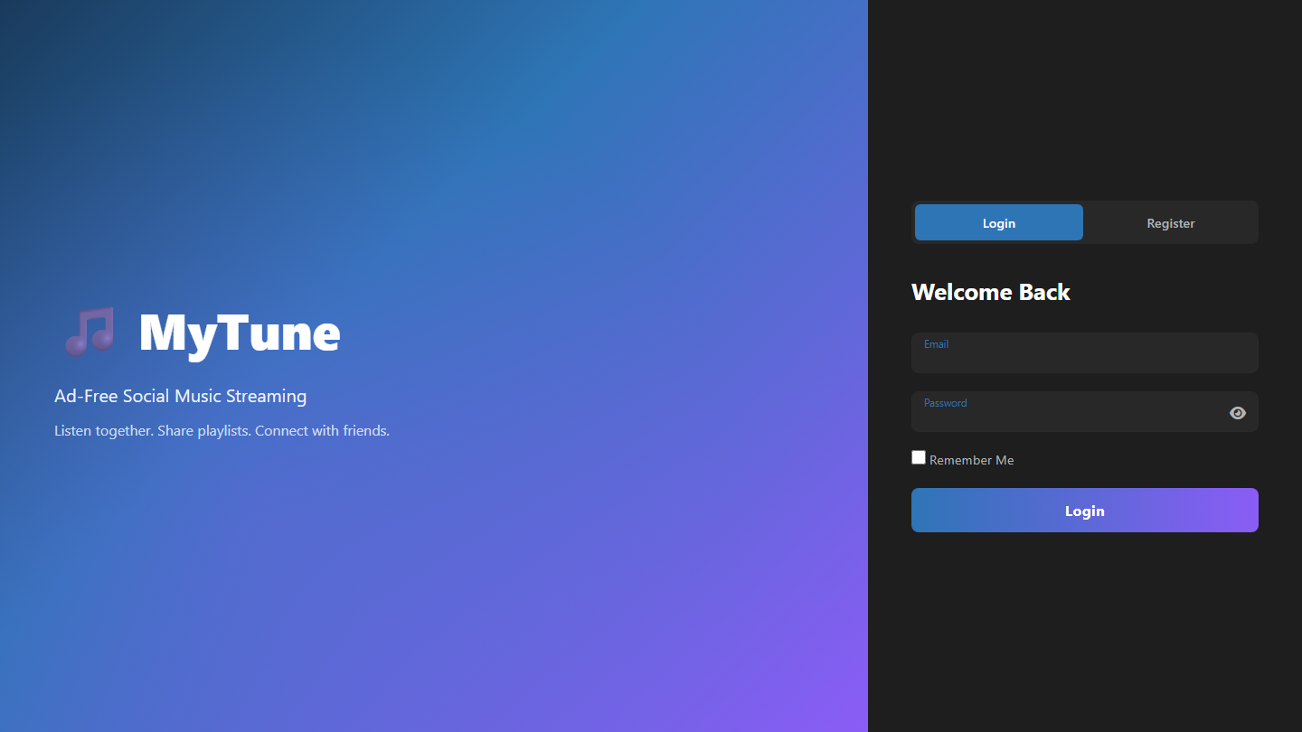
Page 1 – Login & Register
localhost:5500/index.html | Entry point
localhost:5500/index.html
How it Works
Split-Layout Design
Left hero panel shows branding; right card holds Login/Register forms.
Login Flow
Email + Password → POST /api/auth/login → JWT stored → redirect to dashboard.
Register Flow
Username, Email, Password → POST /api/auth/register → auto-login on success.
Remember Me
Issues a 30-day refresh token so users stay signed in across sessions.
Password Toggle
Eye icon switches the password field between hidden and visible text.
Route Guard
If a valid JWT already exists the page skips login and opens the dashboard.

Slide 9
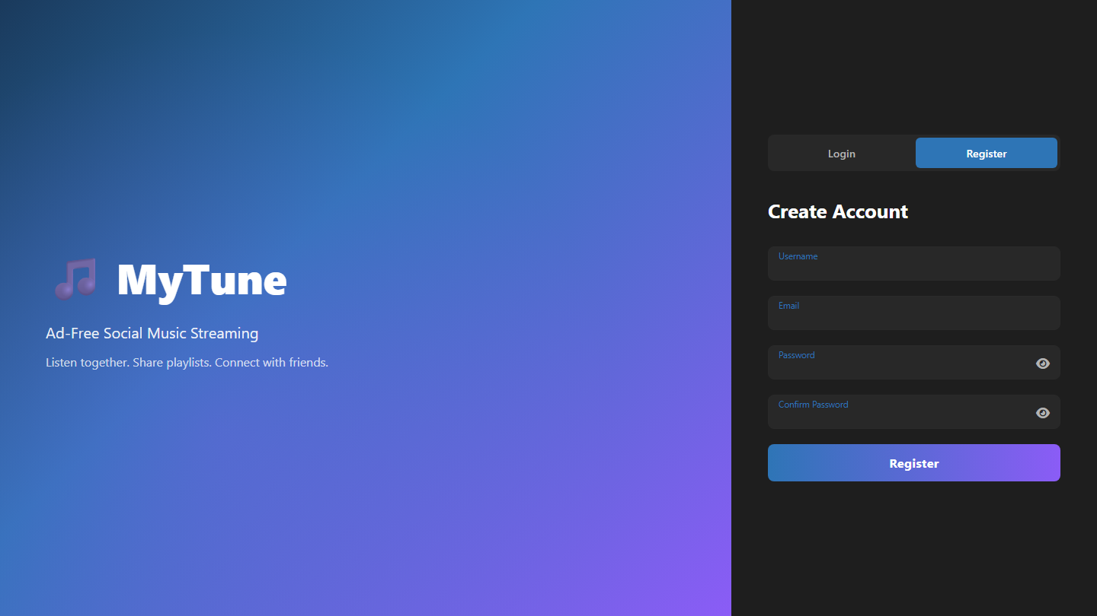
Page 1b – Register Form
localhost:5500/index.html | Register tab
localhost:5500/index.html
How it Works
Username Field
Must be unique. Validated on server via express-validator before saving.
Email Validation
Format checked on client and server. Duplicate email returns 409 Conflict.
Password Rules
Minimum strength rules enforced by validator; bcrypt hashes before storing.
Confirm Password
Client check ensures both fields match before the form is submitted.
Auto-Login
Successful registration returns a JWT and takes user straight to dashboard.
Toggle Back
Login / Register buttons switch between the two forms with a CSS transition.

Slide 10
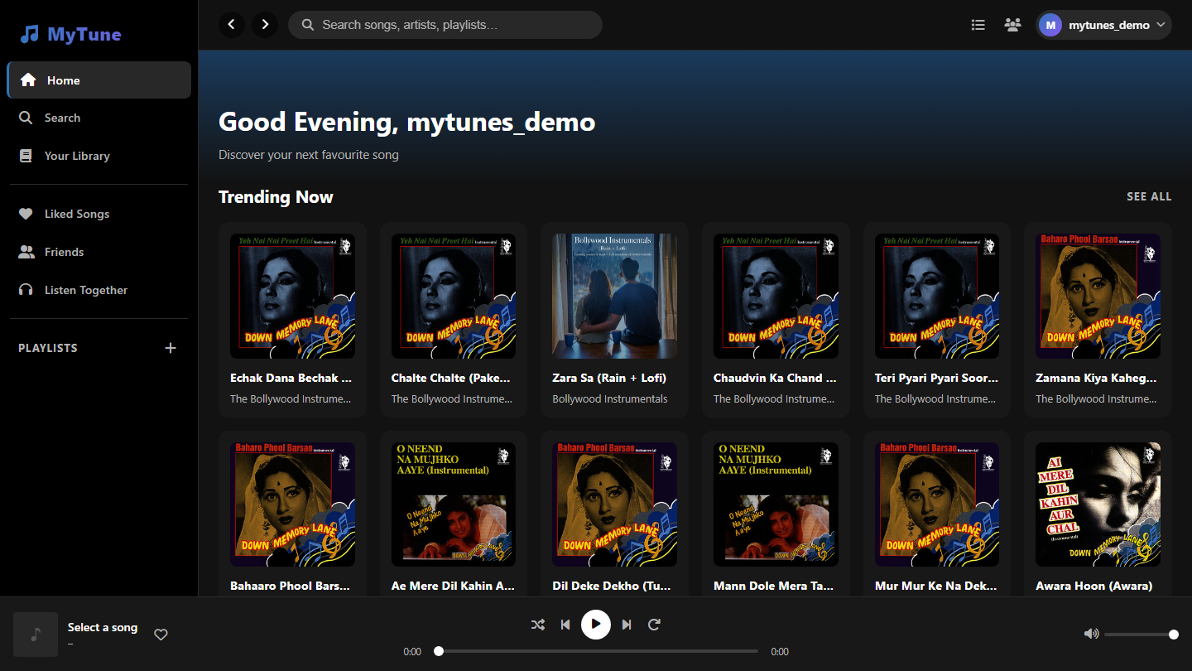
Page 2 – Dashboard: Home
localhost:5500/dashboard.html | Main hub
localhost:5500/dashboard.html
How it Works
3-Column Layout
Sidebar (nav) | Scrollable content area | Optional Queue/Friends panel.
Time-Aware Greeting
Shows Good Morning/Afternoon/Evening based on the user's local time.
Trending Songs
Fetched from GET /api/music/trending. Shown as clickable song cards.
Browse by Mood
6 mood tiles. Each loads GET /api/music/mood?tag=<mood> when clicked.
Your Playlists
Loaded via GET /api/playlists/mine. Click a card to open the full playlist.
Persistent Player
Fixed footer bar: art, title, play/pause, next, prev, shuffle, volume.

Slide 11
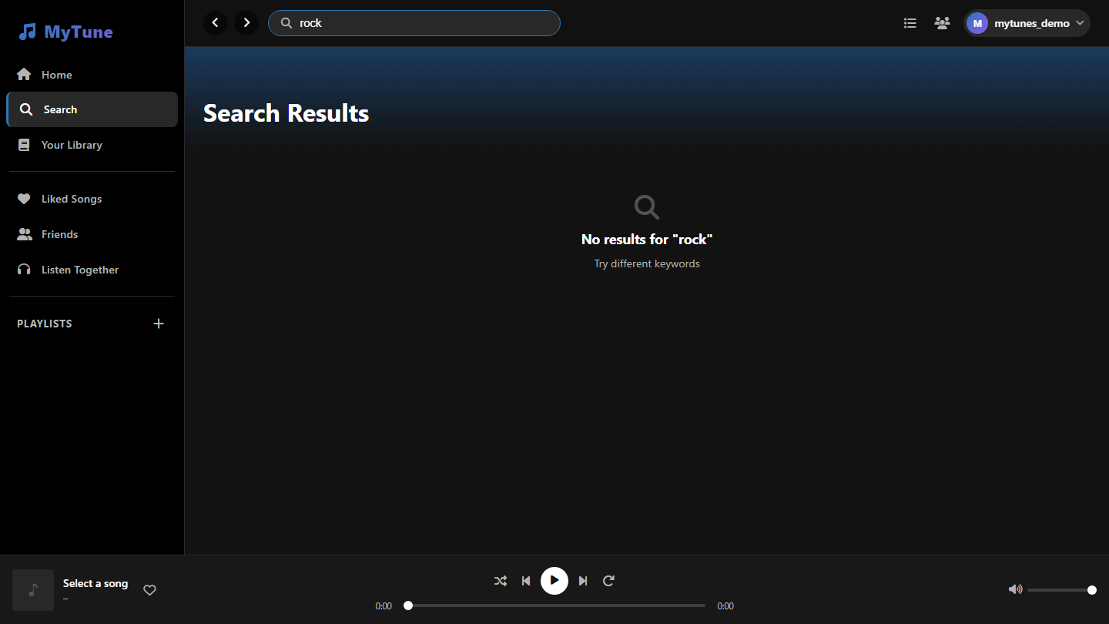
Page 3 – Search
dashboard.html | Search section
dashboard.html
How it Works
Real-time Search
Debounced input hits GET /api/music/search?q=<query> as the user types.
Song Cards
Each result shows thumbnail, title, artist, duration. Click to play instantly.
Like from Results
Heart icon toggles POST /api/music/:id/like. State syncs to Liked Songs.
Add to Playlist
'+' button opens the Add to Playlist modal. Song added via PATCH /api/playlists/:id.
Context Menu
Right-click → Play, Like, Add to Playlist, Add to Queue, Share.
Queue Integration
Songs added to queue appear in the right panel and play in order.

Slide 12
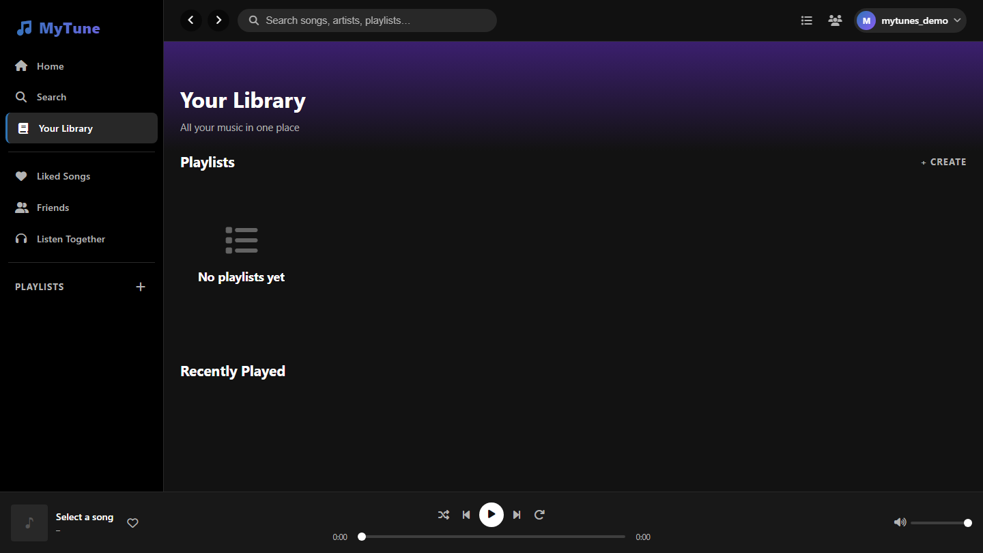
Page 4 – Library
dashboard.html | Library section
dashboard.html
How it Works
Playlists Grid
All user playlists as cards. Create new ones with the + Create button.
Recently Played
Tracks stored in PlayHistory. Fetched from GET /api/music/history.
Create Playlist
Modal: Name, Description, Visibility (Public/Friends/Private).
Playlist Card Click
Opens full detail view with song list, hero image, play/shuffle.
Sidebar Playlists
Playlists also listed in the sidebar for quick access from any page.
Delete Playlist
Trash icon → DELETE /api/playlists/:id after a confirm dialog.

Slide 13
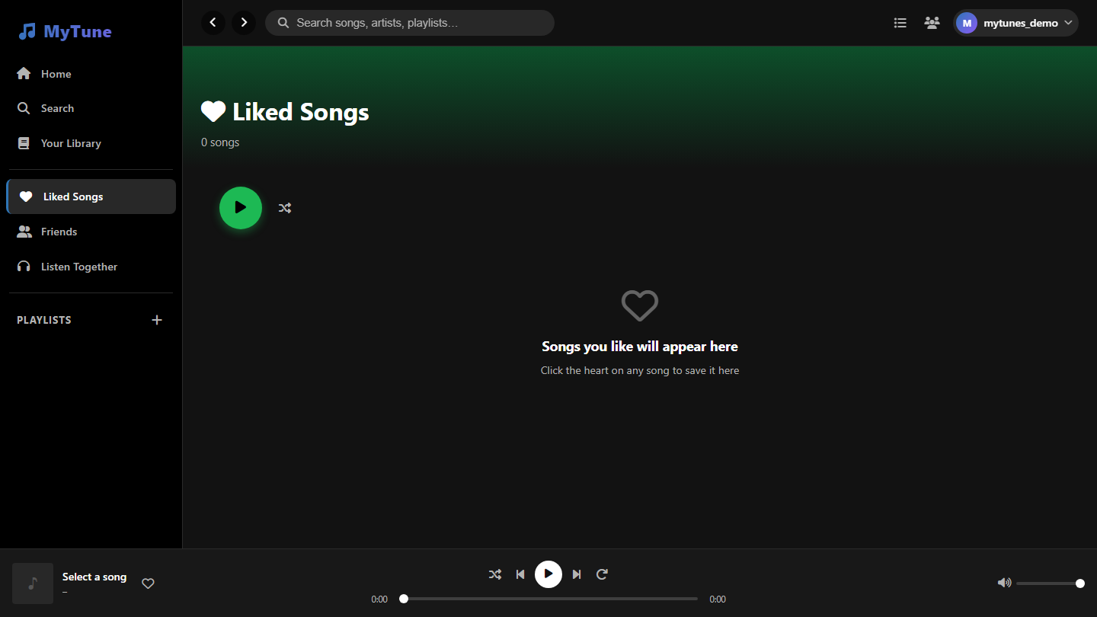
Page 5 – Liked Songs
dashboard.html | Liked Songs
dashboard.html
How it Works
Saved Songs
All liked songs stored here. Fetched via GET /api/music/liked.
Play All
Green play button loads all liked songs into the queue from song #1.
Shuffle
Randomises the playback order of the liked songs queue.
Song Table
Columns: #, Title, Artist, Duration, Like toggle. Click row to play.
Unlike
Click the heart again to unlike. POST /api/music/:id/like toggles state.
Song Count
Total count shown in header, updated dynamically after each like/unlike.

Slide 14
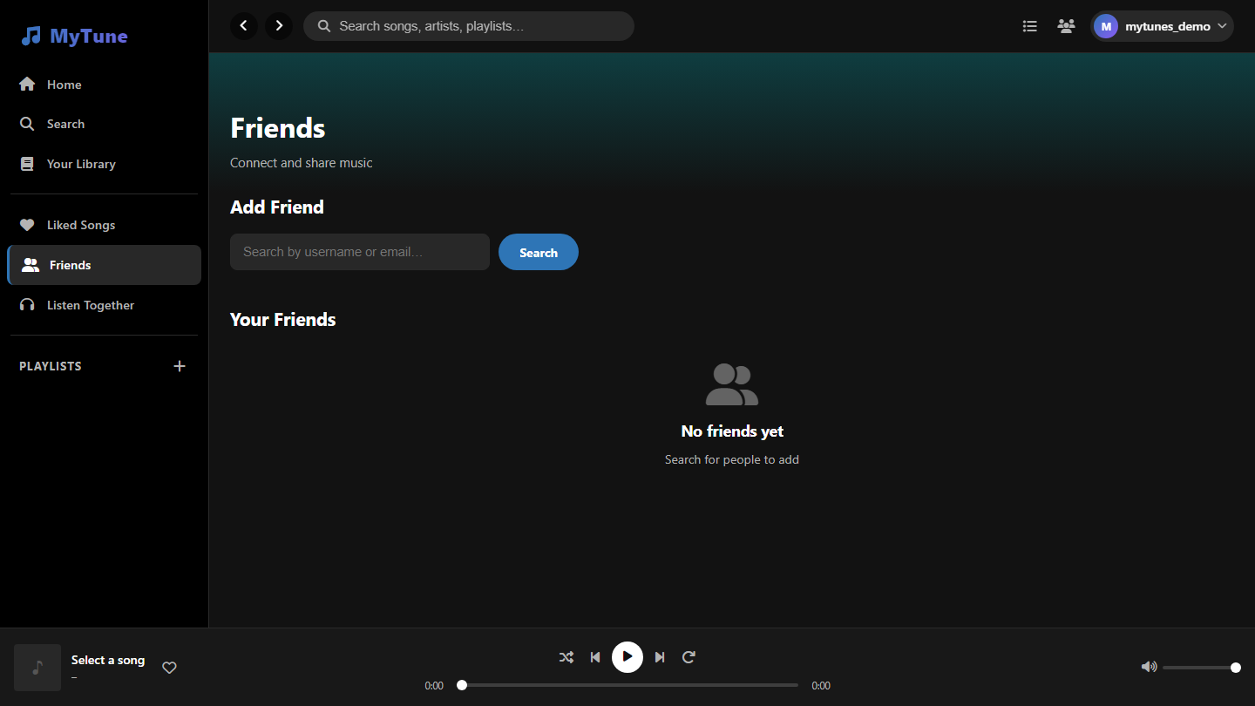
Page 6 – Friends
dashboard.html | Friends section
dashboard.html
How it Works
Search Users
Type a username or email to find users → POST /api/friends/search.
Send Request
Click Add → POST /api/friends/request. Recipient sees it in Pending.
Accept / Decline
POST /api/friends/accept or /decline. Creates a mutual Friendship.
Friends List
Shows confirmed friends. Active friends show their current song.
Real-time Activity
Right panel updates live via Socket.io 'user-listening' events.
Remove Friend
Three-dot menu → Remove Friend. Both users' lists update instantly.

Slide 15
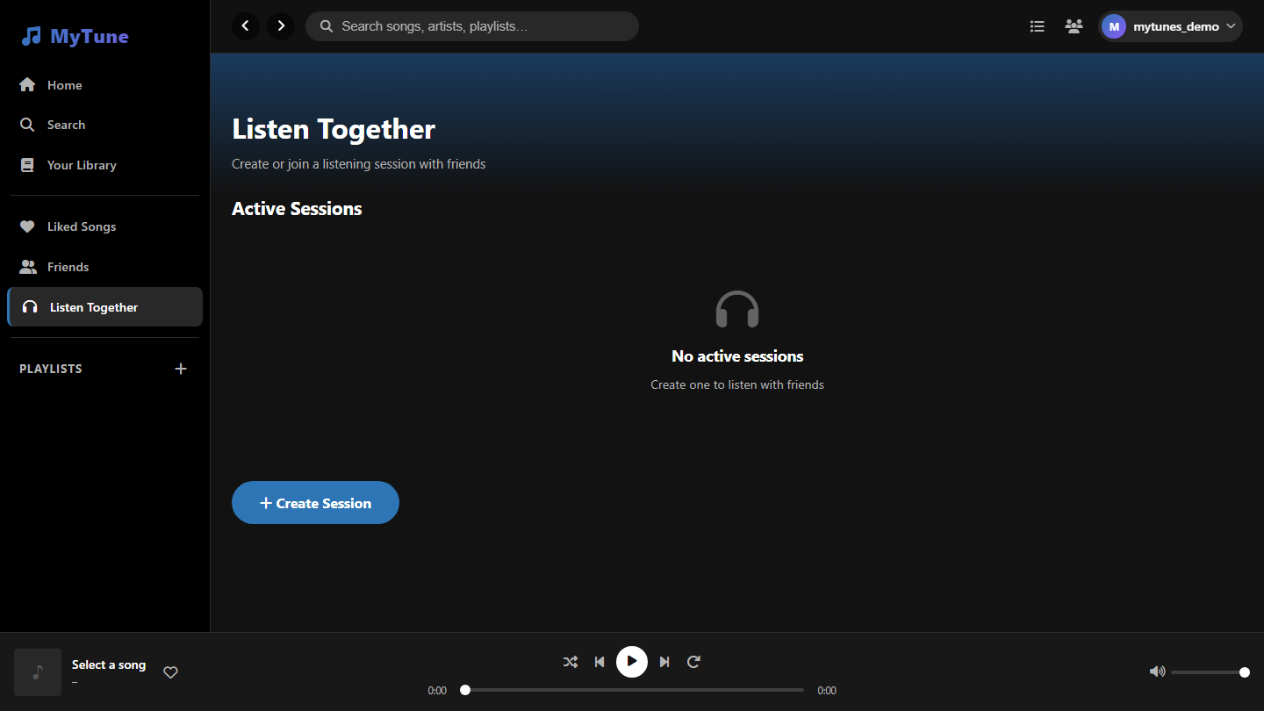
Page 7 – Listen Together
dashboard.html | Listen Together
dashboard.html
How it Works
Create a Session
Host names it, sets visibility. Server generates a unique 6-char code.
Join by Code
Others enter the code in Join modal → POST /api/sessions/join.
Socket.io Sync
Play, Pause, Seek, Skip events broadcast to all room members instantly.
Host Control
Only the host controls the song. All listeners follow host's state.
Live Member List
Shows who is in the session, updated as people join or leave.
Leave Session
Any member can leave. If host leaves, session ends for everyone.

Slide 16
Page 8 – Profile
dashboard.html | Profile section
dashboard.html
How it Works
Profile Hero
Shows avatar, display name, total plays, playlists, and friends count.
Edit Profile
Modal to update Display Name, Bio, picture. PATCH /api/users/profile.
Top Tracks
Most-played songs from PlayHistory, sorted by play count descending.
Public Playlists
Playlists marked Public are visible to other users.
Stats Panel
Plays, playlists, friends counts from GET /api/users/me + history.
Settings
Dark Mode, AutoPlay, Language preferences stored in user document.

Slide 17
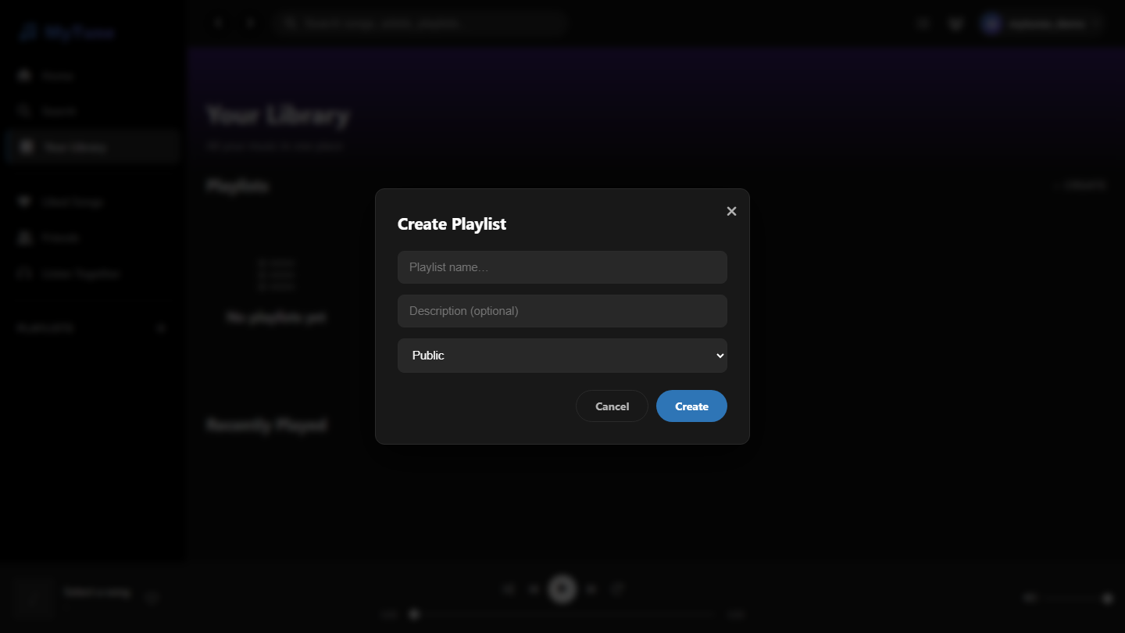
Feature – Create Playlist Modal
Modal overlay from Library or Home page
Modal overlay from Library or Home page
How it Works
Playlist Name
Required. Validated client-side and server-side before saving.
Description
Optional text describing the playlist. Stored in MongoDB document.
Visibility Options
Public – anyone. Friends Only – only friends. Private – only you.
Create Button
POST /api/playlists → New playlist added to sidebar and Library instantly.
Cancel / Escape
Dismisses modal without creating. Escape key also closes it.
Instant Refresh
Playlists grid and sidebar update without a full page reload.

Slide 18
System Architecture
How all layers connect
FRONTEND
REST API
REAL-TIME
DATABASE
HTML · CSS · JS Vanilla SPA • index.html • dashboard.html • playlist.html
Node.js + Express • /api/auth • /api/music • /api/playlists • /api/friends • /api/sessions
Socket.io • Room events: play/pause/seek • Friends activity broadcast
MongoDB + Mongoose ODM • User · Song • Playlist • Friendship • ListeningSession
→
→
→
🔐 Security
🧪 Testing
🚀 Deployment
JWT 24h + 30d Refresh · bcrypt hashing · Protected route middleware
Jest + Supertest · Unit & Integration tests for controllers & routes
Backend: Node.js port 5000 · Frontend: static files via Express/LiveServer

Slide 19
Outcomes & Results
What we achieved by the end of this semester
MyTunes was successfully built and deployed as a fully working full-stack web application. All planned features for this semester were implemented, tested, and are functional.
8+
20+
100%
Jest
Major Features Delivered
REST API Endpoints
Core Features Working
Automated Tests Written
Secure Authentication Working
Friends System Complete
Users can register, login, and stay logged in with JWT + refresh tokens. Passwords are bcrypt-hashed.
Friend requests, acceptance, declination, and removal all work. Friends' listening activity is visible.
Music Streaming Functional
Listen Together Functional
Songs load from the Deezer API. The audio player supports play, pause, skip, shuffle, repeat, and volume.
Multiple users can join a session and listen to the same song in sync via Socket.io rooms.
Playlists Fully Operational
Profile Page Live
Users can create, rename, delete playlists and add/remove songs. Visibility controls work correctly.
User profile shows real stats: play count, playlists, friends. Editing display name and bio works.
Mood Discovery Works
Test Suite Passes
6 mood categories return correct filtered song lists from the backend based on mood tags.
Jest + Supertest tests cover auth routes, music routes, and playlist operations. All passing.

Slide 20
Future Work
Next Semester Implementation Plan
MyTunes has a strong foundation. In the next semester, we plan to expand it with advanced features that make it even more powerful, social, and accessible to users on all devices.
📱 Mobile Application
🤖 ML Recommendations
💬 In-App Chat
Phase 1 Priority
Phase 2
Phase 1 Priority
Build a React Native mobile app for iOS and Android. All existing features (streaming, playlists, friends, Listen Together) available on phone.
Train a recommendation model on user play history to suggest 'You might also like' songs. Personalise the Home page feed for each user.
Add a real-time chat system so friends can message each other. Send song links directly in chat with a one-click play button.
⬇️ Offline Mode
🎤 Artist Accounts
📊 Analytics Dashboard
Phase 2
Phase 2
Phase 1 Priority
Allow users to download songs for offline playback using IndexedDB or a PWA service worker. Syncs back when the connection is restored.
Let artists/creators register a special account, upload their own music, and view streams and listener statistics for their tracks.
Give users a personal stats page: listening time per day, top genres, most-played hours, and monthly listening trends with charts.
Phase 1 features will be completed by mid-next semester. Phase 2 features will be research + prototyped by end of next semester.

Slide 21
🎵
Thank You
MyTunes – Ad-Free Social Music Streaming Platform
Full-stack web app: Node.js + Express + MongoDB + HTML/CSS/JS
Real-time sync via Socket.io for group listening sessions
Secure JWT auth, bcrypt hashing, refresh tokens implemented
Mood-based discovery, friends system & social features delivered
Automated test suite written with Jest + Supertest
Department of Computer Science | Academic Year 2024-25

