Slide 1
🎵
MyTunes
Ad-Free Social Music Streaming Platform
PROJECT TEAM
Priya Luhar(MCA2504003)
Vaibhav Maurya(MCA2504027)
Khushi Daharwal(MCA2504008)
Tushar Rajpurohit(MCA2504038)
Department of Computer Science | Academic Year 2024-25

Slide 2
Project Overview
What is MyTunes?
MyTunes is a full-stack, ad-free social music streaming web application built with Node.js/Express (backend) and vanilla HTML/CSS/JS (frontend). It delivers a Spotify-like experience while adding social features – friends, playlist sharing, mood-based discovery, and real-time synchronized group listening via Socket.io.
🔐 Auth & Security
🎵 Music Streaming
📋 Playlists
JWT tokens · bcrypt hashing Remember-Me refresh tokens
Browse, search & stream songs Full-featured audio player
Create, edit & manage playlists Public / Friends / Private
😊 Mood Discovery
👥 Friends & Social
🎧 Listen Together
Browse tracks by mood category Happy, Sad, Energetic…
Send requests · Friend activity Share music in real time
Socket.io room sync Group listening sessions
Tech Stack:
Node.js
Express
MongoDB
Socket.io
JWT
HTML / CSS / JS

Slide 3
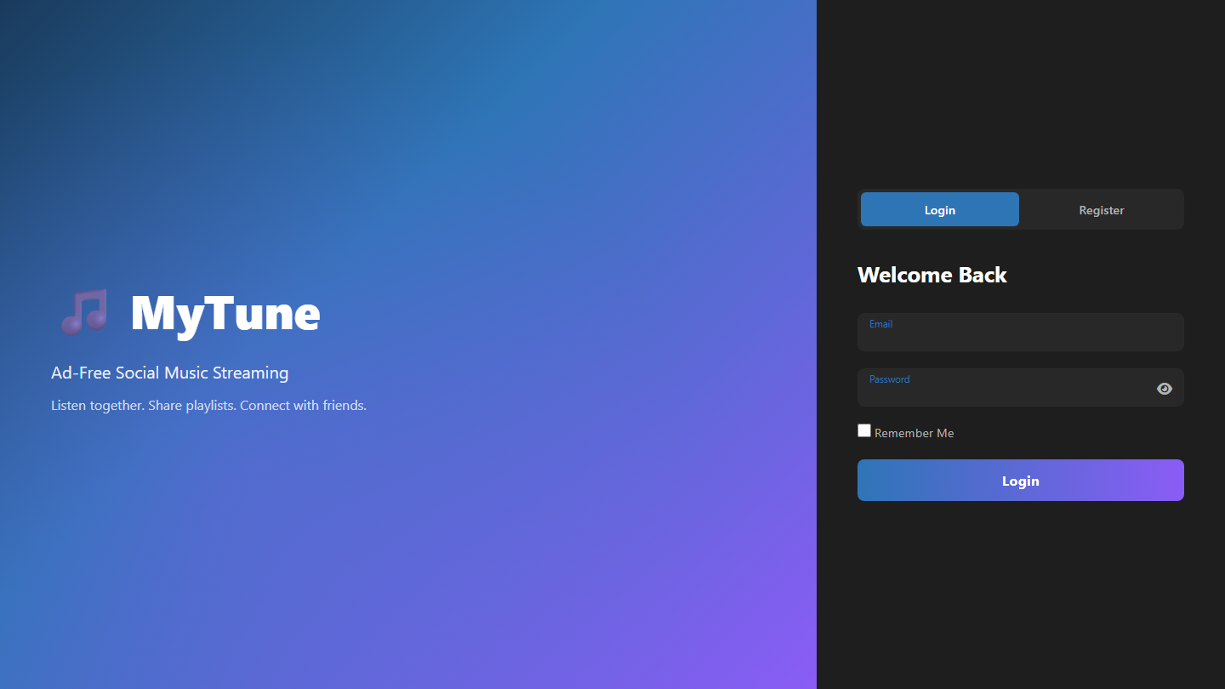
Page 1 – Login & Register
localhost:5500/index.html | Entry point
localhost:5500/index.html
How it Works
Split-Layout Design
Left hero panel shows app branding; right card holds Login/Register toggle forms.
Login Flow
Email + Password → POST /api/auth/login → JWT stored in localStorage → redirect to dashboard.
Register Flow
Username, Email, Password, Confirm → POST /api/auth/register → auto-login on success.
Remember Me
Issues a 30-day refresh token so the user stays signed in across browser sessions.
Password Toggle
Eye icon switches input type between 'password' and 'text' for visibility.
Route Guard
If a valid JWT already exists in localStorage the page redirects to dashboard instantly.

Slide 4
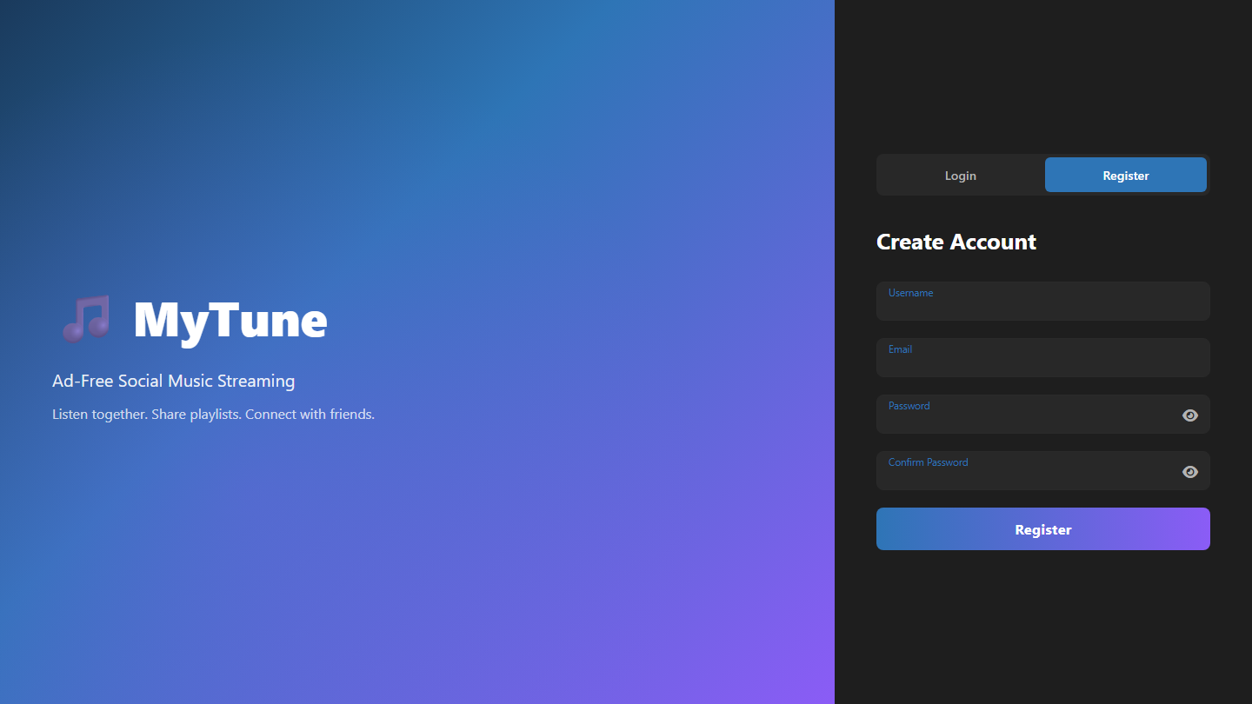
Page 1b – Register Form
localhost:5500/index.html | Register tab
localhost:5500/index.html
How it Works
Username Field
Must be unique across all users. Validated server-side via POST /api/auth/register.
Email Validation
Format validated on client and server. Duplicate email returns 409 Conflict.
Password Rules
Minimum strength enforced by express-validator; bcrypt hashes password before storing.
Confirm Password
Client-side check ensures both fields match before the form is submitted.
Auto-Login
On successful registration the server returns a JWT and the user is taken to dashboard.
Toggle Back
Login / Register buttons switch between the two forms with a smooth CSS transition.

Slide 5
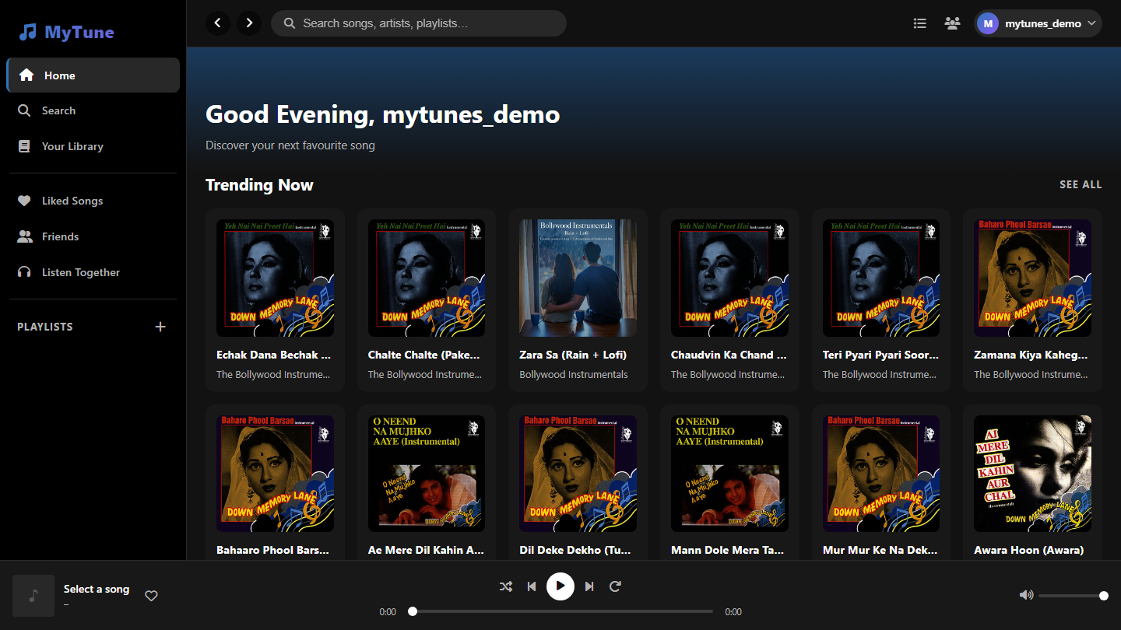
Page 2 – Dashboard: Home
localhost:5500/dashboard.html | Main hub
localhost:5500/dashboard.html
How it Works
3-Column Layout
Sidebar (navigation) | Scrollable main content | Optional right panel (Queue / Friends).
Time-Aware Greeting
Greeting updates dynamically: Good Morning / Afternoon / Evening based on local time.
Trending Songs
Fetched from GET /api/music/trending. Displayed as clickable song cards.
Browse by Mood
6 mood tiles (Happy, Sad, Energetic, Calm, Romantic, Focus). Each loads GET /api/music/mood?tag=<mood>.
Your Playlists
Loaded via GET /api/playlists/mine. Click a playlist card to open its detail view.
Persistent Player Bar
Fixed footer: album art, title, play/pause, next/prev, shuffle, repeat, volume, progress.

Slide 6
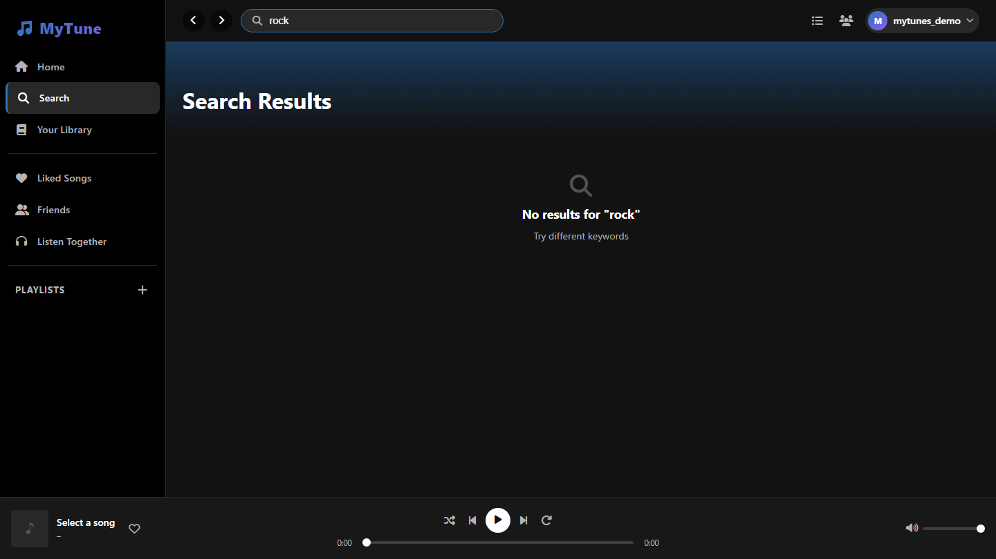
Page 3 – Search
dashboard.html | Search section
dashboard.html
How it Works
Real-time Search
Debounced input calls GET /api/music/search?q=<query> as the user types.
Song Cards
Each result shows thumbnail, title, artist, duration. Clicking a row plays the song instantly.
Like from Results
Heart icon calls POST /api/music/:id/like. Liked state syncs to the Liked Songs page.
Add to Playlist
'+' button opens the Add to Playlist modal listing all user playlists (PATCH /api/playlists/:id).
Context Menu
Right-click any song → Play, Like, Add to Playlist, Add to Queue, Share.
Queue Integration
Songs added to queue appear in the right Queue panel and play in order after the current track.

Slide 7
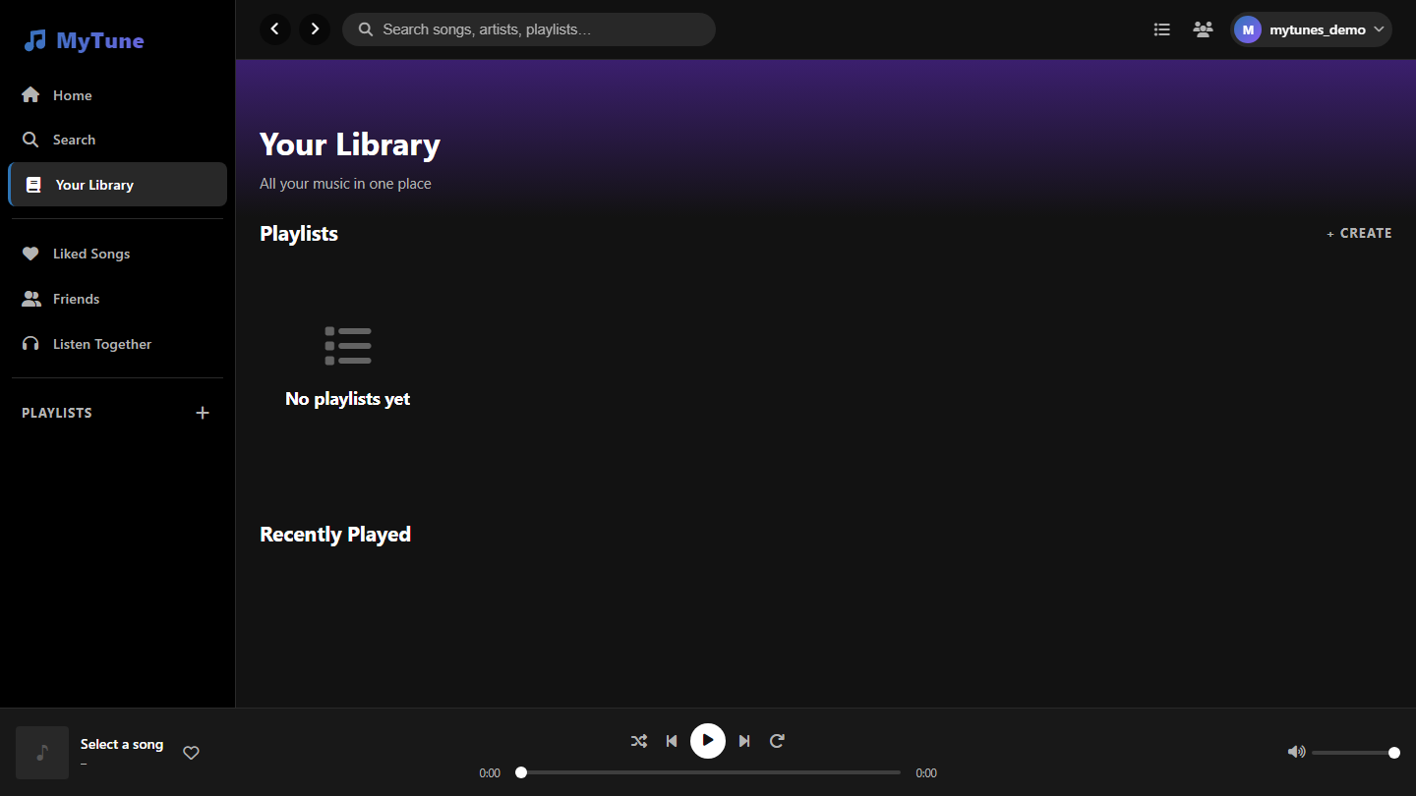
Page 4 – Your Library
dashboard.html | Library section
dashboard.html
How it Works
Playlists Grid
Displays all user playlists as cards. Create new ones with the + Create button.
Recently Played
Tracks the last played songs stored in PlayHistory collection. GET /api/music/history.
Create Playlist
Modal with Name, Description, and Visibility (Public / Friends only / Private) fields.
Playlist Card Click
Opens the full playlist detail view showing all songs, hero image, play/shuffle controls.
Sidebar Playlists
Playlists also listed in the sidebar for quick navigation from any page.
Delete Playlist
Trash icon in playlist detail calls DELETE /api/playlists/:id after a confirm dialog.

Slide 8
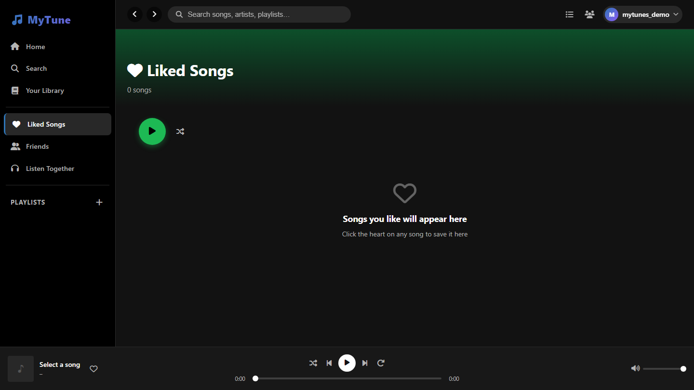
Page 5 – Liked Songs
dashboard.html | Liked Songs section
dashboard.html
How it Works
Saved Songs
All songs the user has hearted are saved here. Fetched via GET /api/music/liked.
Play All
Green play button loads all liked songs into the player queue starting from song #1.
Shuffle
Shuffle button randomises the playback order of the liked songs queue.
Song Table
Columns: #, Title, Artist, Duration, Like toggle. Clicking a row plays that song.
Unlike
Click the red heart on any row to unlike. POST /api/music/:id/like toggles the state.
Song Count
Total liked-song count shown in the page header, updated dynamically after every like/unlike.

Slide 9
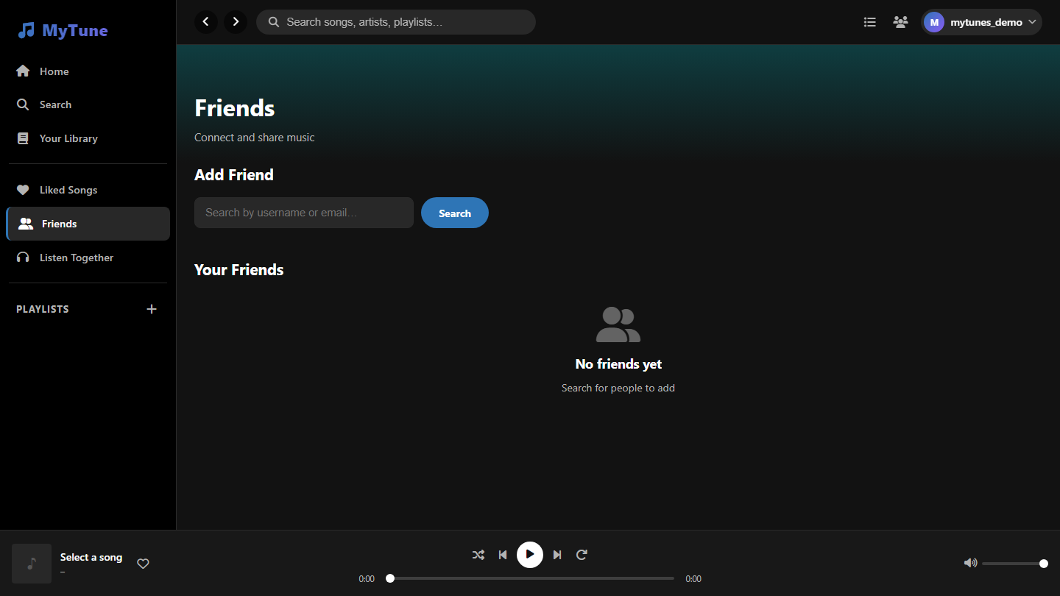
Page 6 – Friends
dashboard.html | Friends section
dashboard.html
How it Works
Search Users
Type a username or email → POST /api/friends/search returns matching accounts.
Send Request
Click 'Add' → POST /api/friends/request. Recipient sees it in Pending Requests.
Accept / Decline
POST /api/friends/accept or /decline. Accepting creates a mutual Friendship document.
Friends List
Shows all confirmed friends. Active friends display the song they are currently listening to.
Real-time Activity
Right panel updates live via Socket.io 'user-listening' events – see friends' current track.
Remove Friend
Three-dot menu → Remove Friend. Both users' lists are updated immediately.

Slide 10
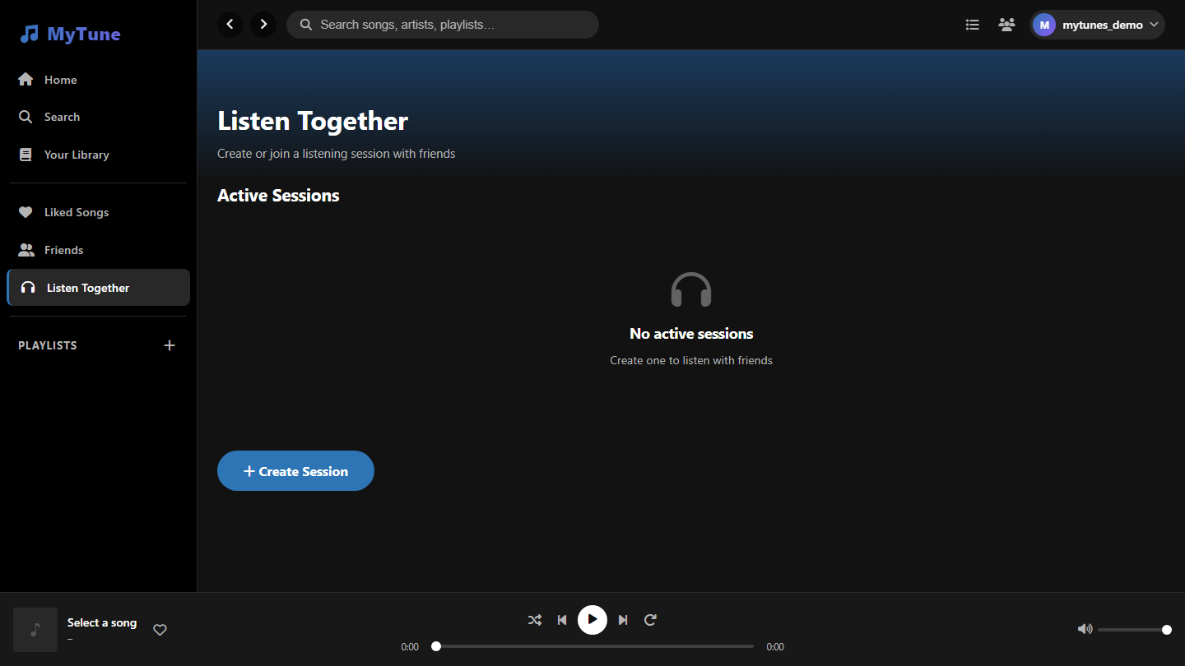
Page 7 – Listen Together
dashboard.html | Listen Together section
dashboard.html
How it Works
Create a Session
Host names the session, sets visibility (Public / Friends / Private). Server returns a unique code.
Join by Code
Others enter the 6-character code in the Join modal → POST /api/sessions/join.
Socket.io Sync
All members join a Socket.io room. Play, Pause, Seek, Skip events broadcast to everyone.
Host Control
Only the session host can change the song or seek. All participants follow the host's state.
Live Member List
Panel shows who is in the session, updated in real time as members join or leave.
Leave Session
Any member can leave. If the host leaves, the session ends for all participants.

Slide 11
Page 8 – User Profile
dashboard.html | Profile section
dashboard.html
How it Works
Profile Hero
Shows avatar initials, display name, total plays, playlist count, and friend count.
Edit Profile
Modal lets user update Display Name, Bio, and profile picture. PATCH /api/users/profile.
Top Tracks
Lists the user's most-played songs from PlayHistory, sorted by play count descending.
Public Playlists
Playlists marked as 'Public' are shown here. Other users can view and play them.
Stats Panel
Plays, playlists, and friends counts pulled from GET /api/users/me and aggregated history.
Settings
Preferences include Dark Mode toggle, AutoPlay, and Language – stored in user document.

Slide 12
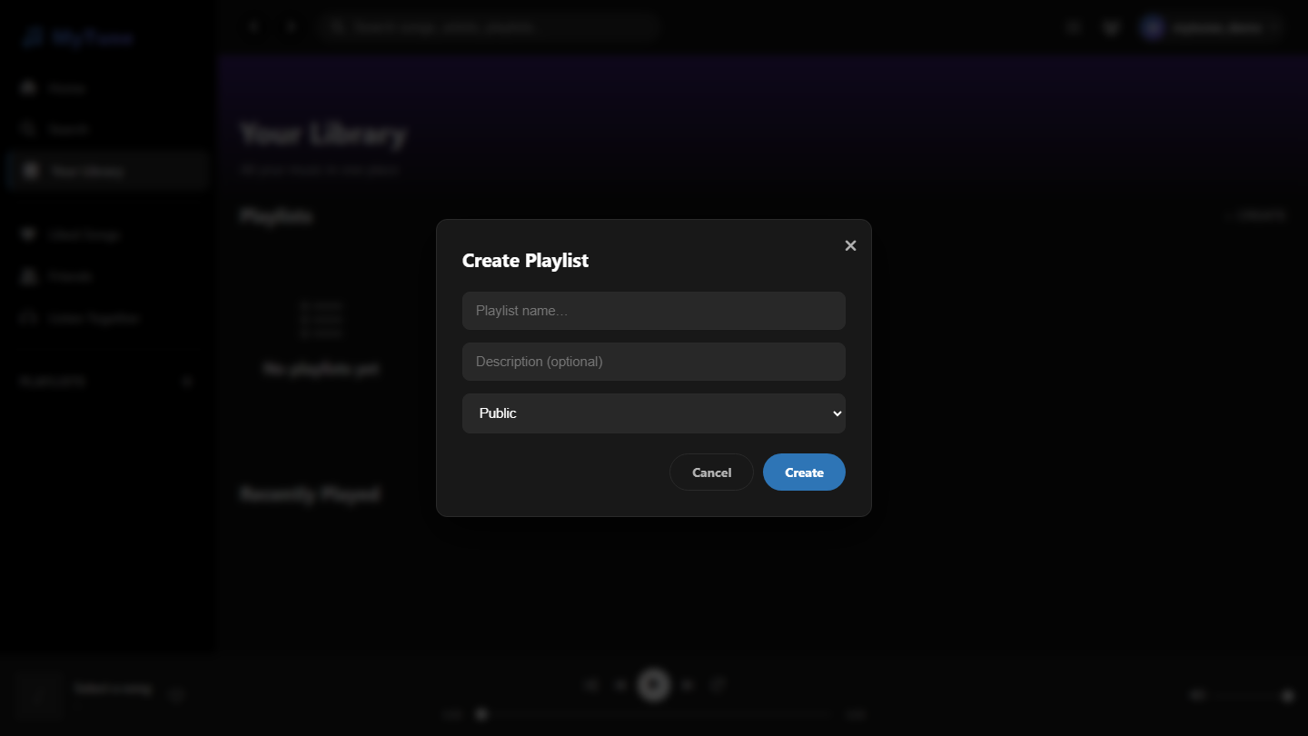
Feature – Create Playlist Modal
Modal overlay triggered from Library or Home page
Modal overlay triggered from Library or Home page
How it Works
Playlist Name
Required field. Validated both client-side and server-side before saving.
Description
Optional text describing the playlist. Stored in the Playlist MongoDB document.
Visibility Options
Public – anyone can see it. Friends Only – only friends. Private – only the owner.
Create Button
POST /api/playlists → Creates new Playlist document, adds it to sidebar and Library instantly.
Cancel / Close
Dismisses modal without creating. Keyboard Escape also closes the overlay.
Instant Refresh
On successful creation the playlists grid and sidebar update without a full page reload.

Slide 13
System Architecture
Full-stack overview – how all layers connect
FRONTEND
REST API
REAL-TIME
DATABASE
HTML · CSS · JS Vanilla SPA • index.html • dashboard.html • playlist.html
Node.js + Express • /api/auth • /api/music • /api/playlists • /api/friends • /api/sessions
Socket.io • Room events: play/pause/seek • Friends activity broadcast
MongoDB + Mongoose ODM • User · Song • Playlist • Friendship • ListeningSession
→
→
→
🔐 Security
🧪 Testing
🚀 Deployment
JWT 24h + 30d Refresh · bcrypt hashing · Protected route middleware
Jest + Supertest · Unit & Integration tests for controllers & routes
Backend: Node.js port 5000 · Frontend: static files via Express/LiveServer

Slide 14
🎵
Thank You
MyTunes – Ad-Free Social Music Streaming Platform
Full-stack web app: Node.js + Express + MongoDB + HTML/CSS/JS
Real-time sync via Socket.io for group listening sessions
Secure JWT auth, bcrypt hashing, refresh tokens
Mood-based discovery, friends system & social features
Automated testing with Jest + Supertest
Department of Computer Science | Academic Year 2024-25

