Slide 1

Team Name : Snow Build
Team Leader Name : Vipul Maurya
Team Size : 1
Problem Statement : Supply Chain Ontology and Governed Conversational Analytics

Slide 2

1. Problem Brief
Current challenge: Planning, Procurement and Logistics answer the same question – “What was our on-time delivery for Q3 2026 orders?” – with 83.51%, 96.65% and 64.12%, built from fragmented ERP, logistics, supplier and IoT sources.
Target users: Supply Chain Planner, Procurement Manager, Logistics Manager and Leadership.
Goal: One governed ontology and semantic layer so every persona gets one consistent, traceable answer – and can act on it safely.
Business impact: faster decisions, trusted KPI lineage, early risk detection and governed escalation.
Solution: one trusted answer → continuously defended → simulated & prescribed → acted on

Slide 3
2. End-to-End Workflow (Input -> Processing -> Output)
Input: Natural-language persona questions, contract/SLA lookups and what-if scenarios via CoCo CLI and the Streamlit control tower.
Processing: RAW → CURATED pipelines, governed semantic view, Cortex Agent (Analyst + Search) with guardrails, metric registry + provenance + drift sentinel, risk scoring and recommendation engine.
Output: canonical KPI answers with formula, source and confidence badge; drift status; prioritized recommendations; what-if projections; escalations only after confirmation.
Core stack: SC_ONTOLOGY (RAW, LEGACY, CURATED, SEMANTIC, GOVERNANCE, APP), HACK_WH (XSMALL), Streamlit in Snowflake.
Recorded demo shows explicit CLI Input -> Processing -> Output sequence

Slide 4
3. Fully Working Capabilities
1. Command Center: one-screen roll-up of KPIs, governance health and top risks.
2. Monitor: governed KPIs with filters + Before-vs-After (3 legacy numbers → one canonical 64.12%).
3. Ask: multi-persona chat via Cortex Agent with provenance badge (formula, owner, source, freshness, Verified tier) and guardrails.
4. Govern: metric registry glossary, drift sentinel health, ontology & lineage graph.
5. Decide: 38 risk signals, 13 prescriptive recommendations, illustrative what-if simulator.
6. Act: governed escalation – validated procedure + explicit confirmation; no unintended writes.
Status: Phases 1–9 deployed · Final app validated 8/8 PASS

Slide 5
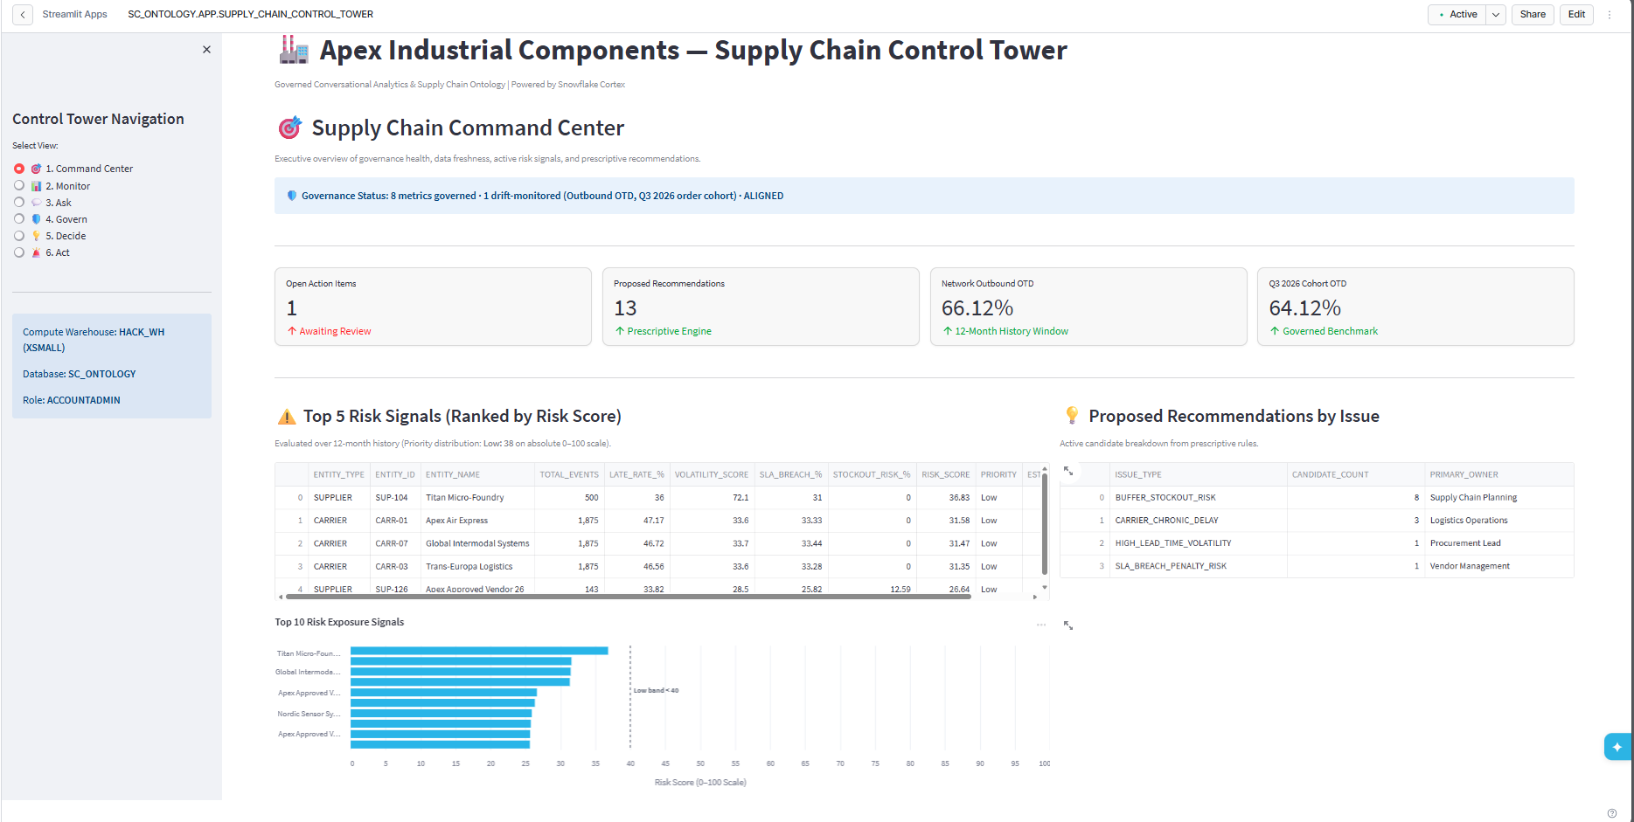
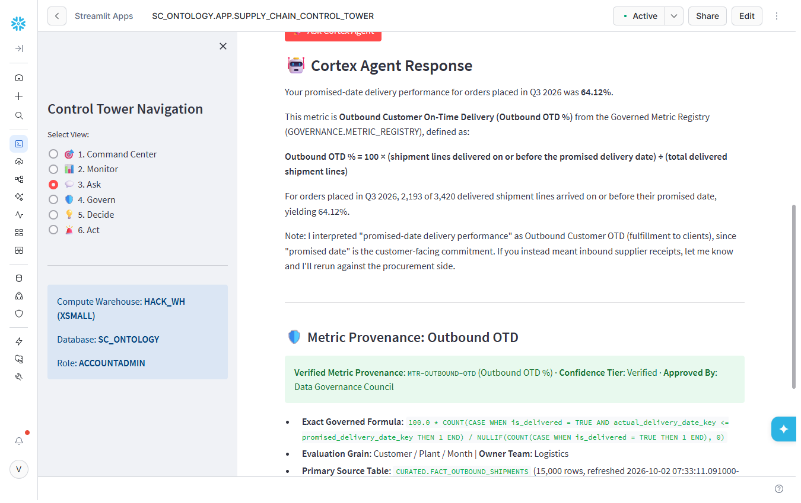
4. Final App: Command Center & Governed Answers
Command Center – KPIs, governance health, top risks
Ask – 64.12% for every persona, with provenance badge
Live in Snowflake: SC_ONTOLOGY.APP.SUPPLY_CHAIN_CONTROL_TOWER

Slide 6
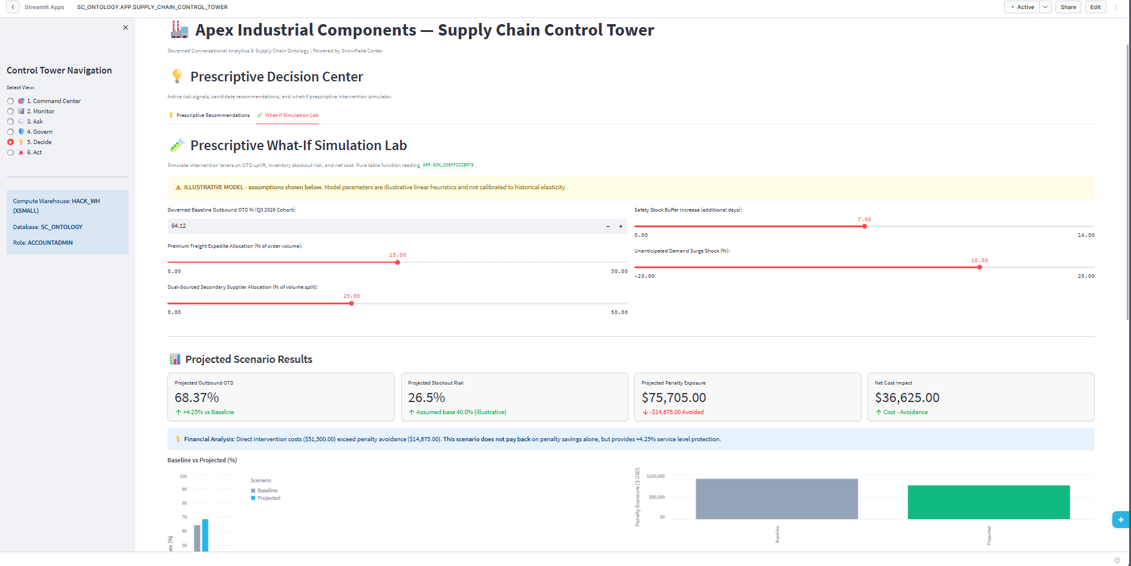
5. Final App: Prescriptive Decisions & What-If
Risk signals: 38 suppliers & carriers scored 0–100; top = SUP-104 (Titan Micro-Foundry).
Recommendations: 13 deterministic actions, e.g. dual-source SUP-104, move lanes away from CARR-01/03/07.
What-if: OTD 64.12% → 68.37%, net cost +$36,625 → does not pay back.
Honest by design: illustrative heuristics, clearly labelled – not a forecast.
Recommendations become actions only through the governed Act page

Slide 7
6. How CoCo CLI Was Used: Plan → Build → Test
Phase | What CoCo did | Result
Plan | Clarifying questions, region/model checks, blueprint (PLAN.md) | Approved phased plan
1 Data | DB, schemas, synthetic data with injected issues; self-fixed SQL errors | Legacy 83.51 / 96.65 / 64.12
2 Pipelines | Dynamic tables, stream + tasks, data-quality checks | All checks PASSED
3 Semantic | Semantic view + 10 verified queries | Canonical OTD 64.12%
4 AI | Cortex Search, Cortex Agent, validated escalation procedure | 3 personas → 64.12%
5–6 Prototype | Streamlit app, deployment, CLI test suite | 5 / 5 PASS
7 Governance | Metric registry, provenance, drift sentinel, guardrails | ALIGNED · Verified
8 Decisions | Risk signals, recommendations, what-if function | 38 signals · 13 recs
9 Final app | 6-page app, deploy, browser smoke test, UI fixes | 6 / 6 pages PASS
10 Testing | Read-only validation suite incl. negative test | 8 / 8 PASS
Every SQL step was reviewed and approved in CoCo CLI before execution

Slide 8
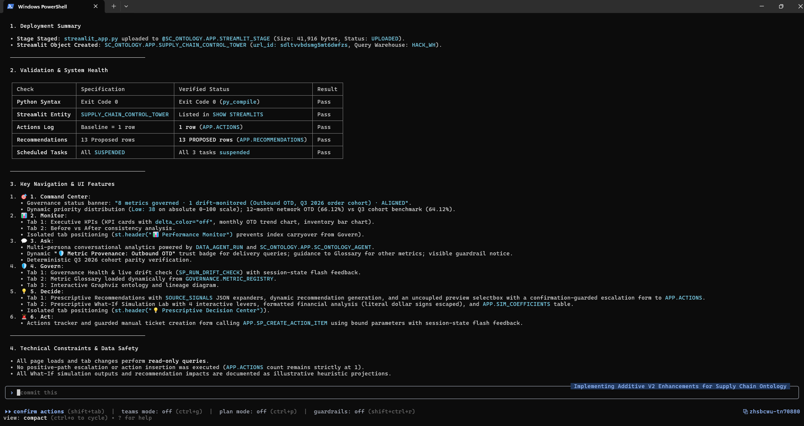
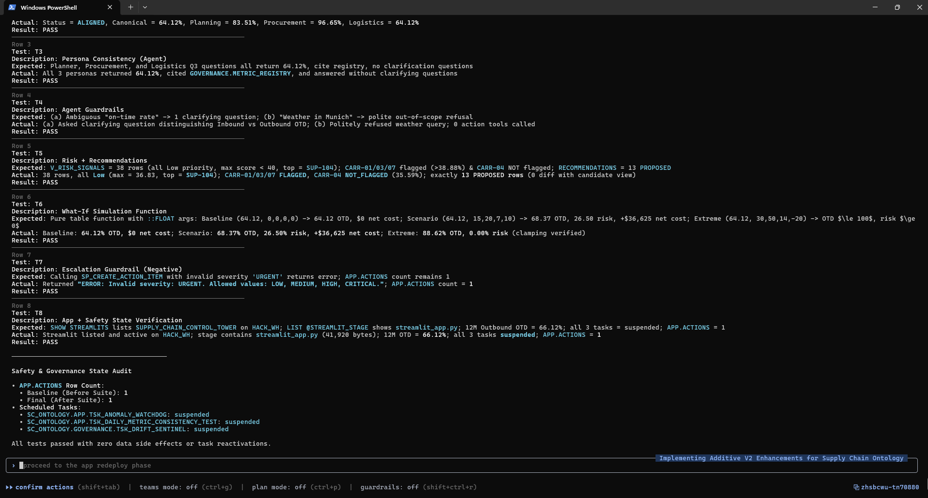
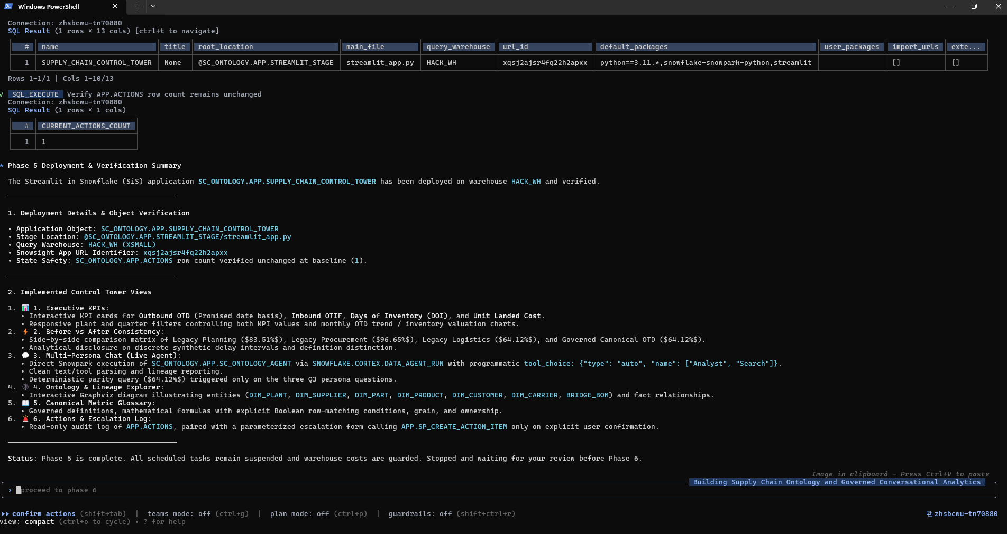
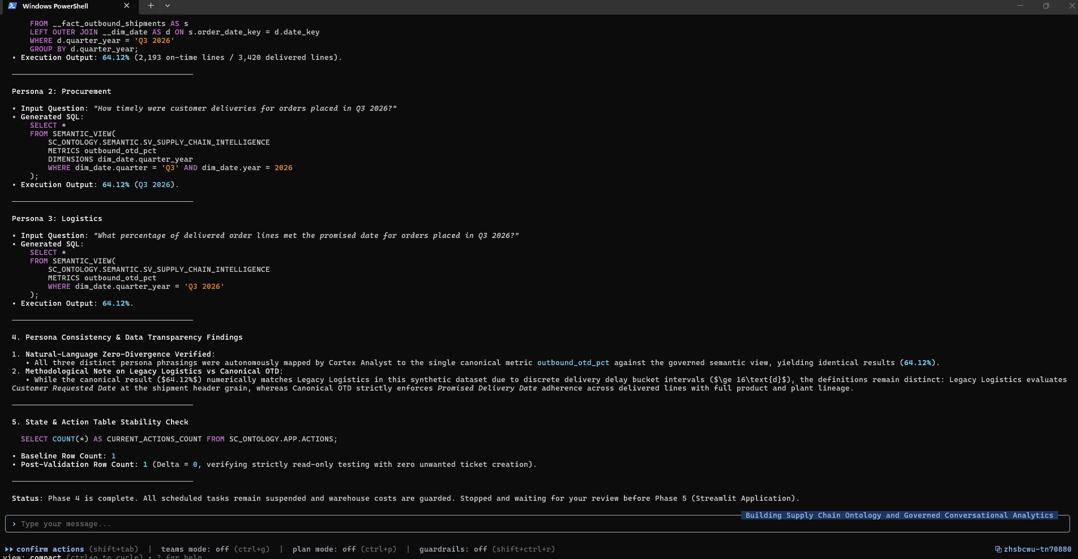
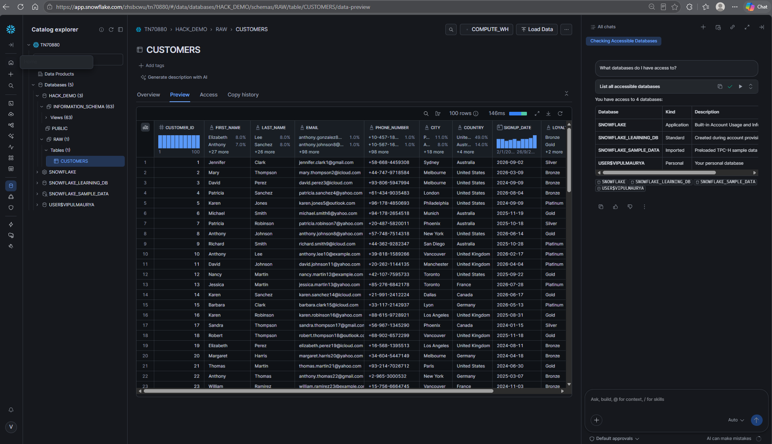
7. Validation and Safety Evidence
Final app CLI suite: 8/8 PASS – governance, drift, persona consistency, guardrails, risk, what-if, escalation guard, app state.
Safety: APP.ACTIONS stayed 1 (delta 0); all 3 scheduled tasks SUSPENDED; HACK_WH XSMALL.
Prototype: 5/5 PASS · Browser smoke test of the final app: 6/6 pages PASS.
Evidence: final app deploy validation (left) Â· 8/8 test scorecard (right), both in CoCo CLI

Slide 9
8. Submission Artifacts
GitHub repository: github.com/mauryavipul/apex-supply-chain-ontology-coco
In the repo: SQL 01–23 in run order, app source (prototype + final), PLAN.md (Phases 1–10), prototype & final app validation summaries, CoCo build journey (PDF), screenshots.
Demo video: prototype recording (link in the repo README).
Live app: SC_ONTOLOGY.APP.SUPPLY_CHAIN_CONTROL_TOWER – Streamlit in Snowflake (requires account access).
Team Snow Build · Team Leader: Vipul Maurya

Slide 10


