Slide 1

Team Name : Snow Build
Team Leader Name : Vipul Maurya
Team Size : 1
Problem Statement : Supply Chain Ontology and Governed Conversational Analytics

Slide 2

1. Problem Brief
Current challenge: Planning, Procurement, and Logistics teams receive different KPI answers from fragmented ERP, logistics, supplier, and IoT sources.
Target users: Supply Chain Planner, Procurement Manager, Logistics Manager, and Leadership.
Goal: Deliver one governed ontology and semantic layer so all personas get one consistent, traceable answer.
Business impact: faster decisions, trusted KPI lineage, and reduced escalation friction.
Prototype focus: governed analytics + conversational insights + operational guardrails

Slide 3
2. End-to-End Workflow (Input -> Processing -> Output)
Input: Natural-language persona questions and contract/SLA lookups via CoCo CLI and Streamlit.
Processing: RAW -> CURATED pipelines, governed semantic view, Cortex Agent (Analyst + Search), validated procedure guardrails.
Output: canonical KPI responses, formula + lineage visibility, and controlled action log behavior.
Core stack: SC_ONTOLOGY (RAW, LEGACY, CURATED, SEMANTIC, APP), HACK_WH (XSMALL), Streamlit in Snowflake.
Recorded demo shows explicit CLI Input -> Processing -> Output sequence

Slide 4
3. Fully Working Capabilities
Capability 1: Governed KPI control tower with plant/quarter filters (OTD, OTIF, DOI, Landed Cost).
Capability 2: Before-vs-After consistency proving canonical metric alignment over legacy divergence.
Capability 3: Multi-persona conversational analytics + Titan Micro-Foundry SLA retrieval via Search.
Capability 4: Actions guardrail blocks unconfirmed writes; no unintended ticket creation.
Phase 6 status: PASSED

Slide 5
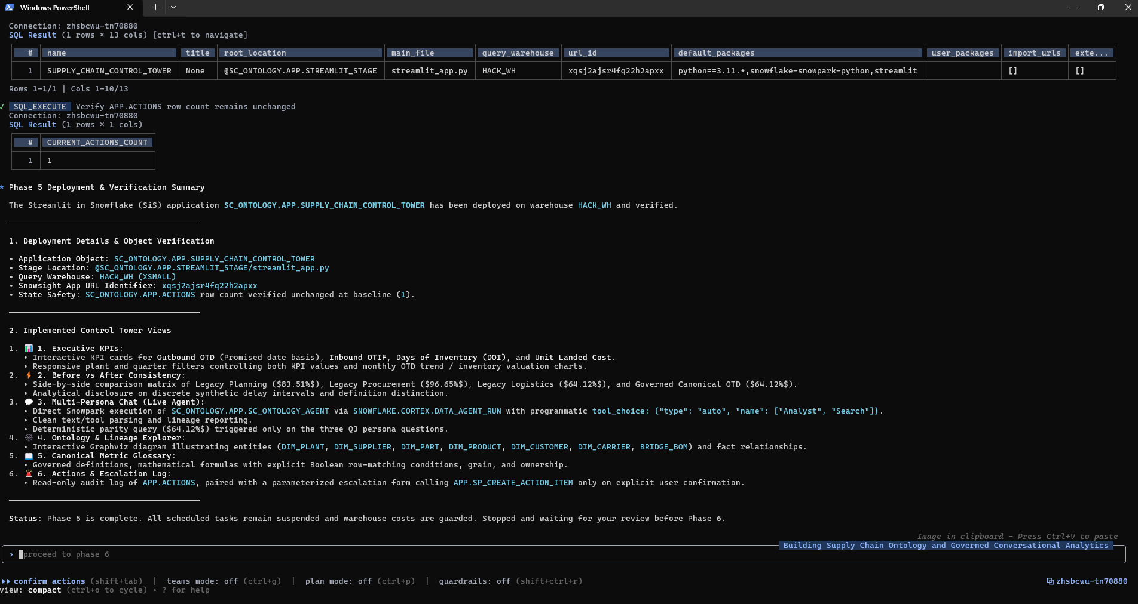
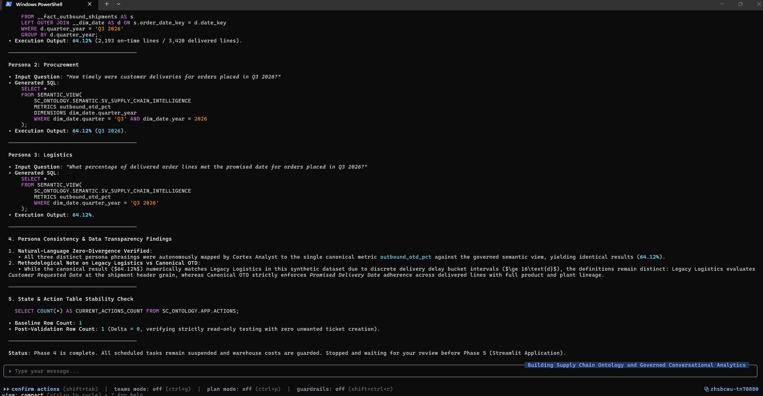
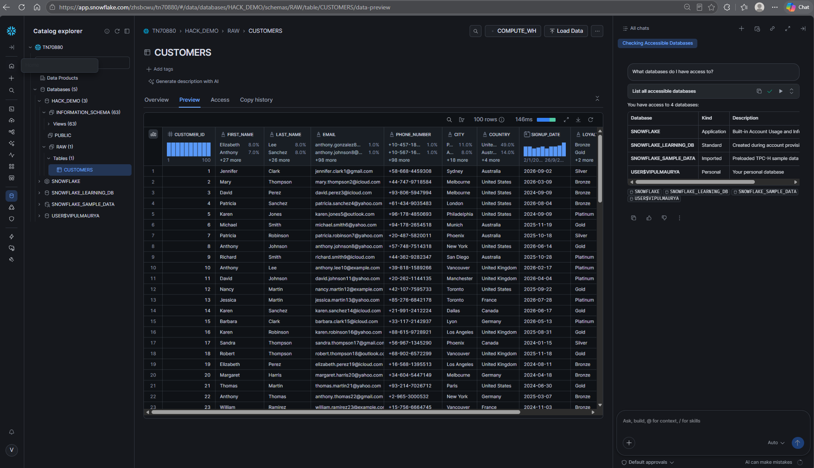
4. Validation and Safety Evidence
APP.ACTIONS stability check: CNT_BEFORE = 1, CNT_AFTER = 1, DELTA = 0.
Ontology, glossary, KPI filters, persona flow, contract search, and actions guard all passed.
Cost control checks: TSK_ANOMALY_WATCHDOG and TSK_DAILY_METRIC_CONSISTENCY_TEST remain SUSPENDED.
Evidence snapshots from build and validation journey

Slide 6

5. Submission Artifacts

