Slide 1
Library management system
BY: mausham kumari
Erp:ru-25-10791
Guided by: mr.santanu kumar sasmal

Slide 2
Introduction
The Library Management System is a software project designed to manage and organize library operations efficiently. It enables users to add, search, issue, and return books while maintaining records of members and transactions. The system reduces manual work, improves accuracy, and saves time by automating daily library activities. It provides an easy-to-use interface and helps librarians manage resources effectively, making library operations faster and more organized.

Slide 3



Slide 4
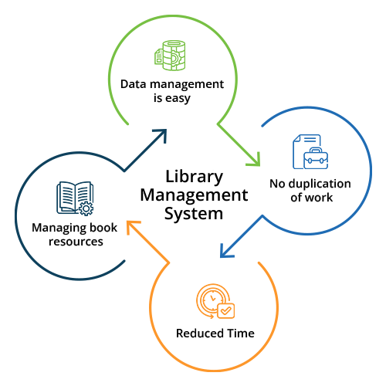

Slide 5

Working of Library Management System
1. Login
The librarian or administrator logs into the system using a valid username and password.
This ensures secure access to library data and features.
2. Dashboard
After login, the dashboard displays an overview of the library.
It shows total books, members, issued books, and due books.
3. Manage Books
Librarians can add new books to the library database.
Existing book records can be updated or deleted.
Users can search for books by title, author, or ISBN.
4. Manage Members
New members can be registered in the system.
Member details such as name, ID, and contact information are stored and managed.

Slide 6



5. Issue Books
Books can be issued to registered members.
The system records the issue date and due date automatically.
6. Return Books
Returned books are updated in the database.
The system marks the book as available for future use.
Fine calculations can be performed for late returns.
7. Reports
The system generates reports on issued books, returned books, and fines.
These reports help in monitoring library activities and maintaining records.
Key Benefits
Reduces manual work and paperwork.
Saves time and improves efficiency.
Provides quick book search functionality.
Maintains accurate records of books and members.
Tracks issued, returned, and overdue books effectively.
Improves overall library management and organization.

Slide 7
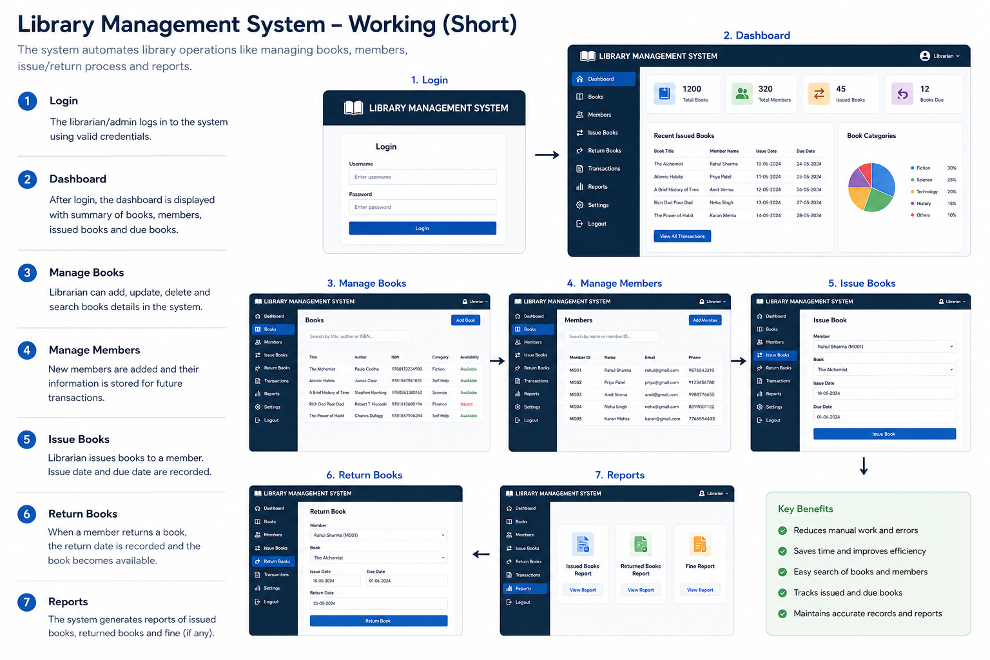

Slide 8
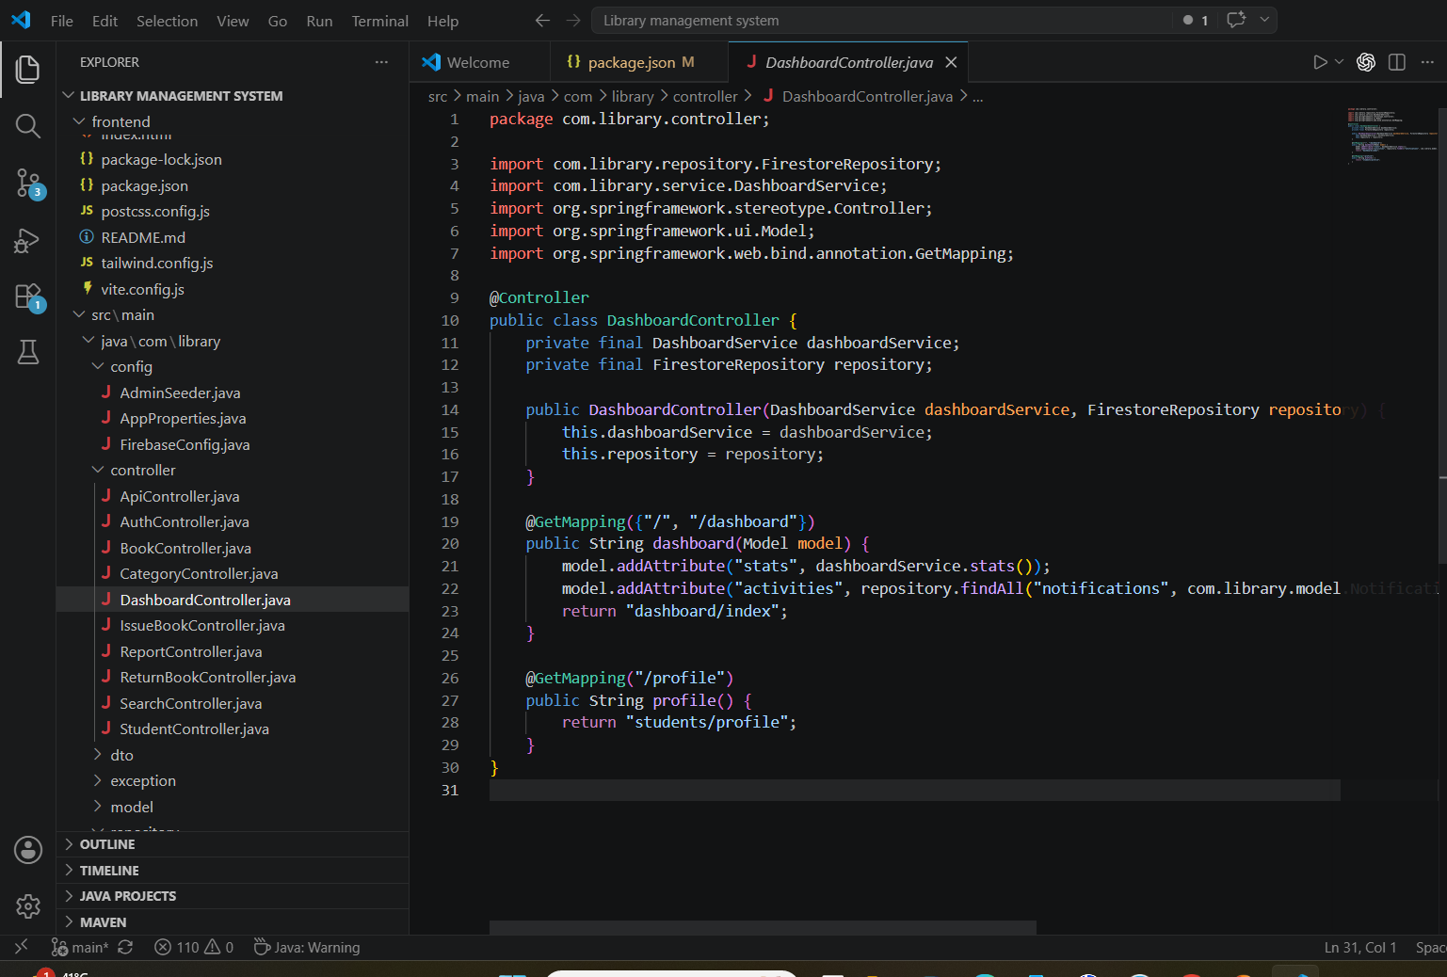

Slide 9

Future scope
Cloud-Based Storage
Library data can be stored on the cloud for better accessibility and security.
Barcode Scanning
Faster book tracking and management using barcode technology.
Advanced Analytics and Reports
Detailed reports and data analysis for better library decision-making.
Multi-Library Integration
Users can search and borrow books from multiple connected libraries.
Enhanced Security Features
Biometric authentication and advanced user access control for secure operations.

Slide 10


