Slide 1



School of Engineering and Technology
INDUSTRY INTRNSHIP -2025 Course Code-CSE404
AICTE Virtual Internship Program 2025
VIRTUAL INTERNSHIP PROGRAM IN Al AND PROMPT ENGINEERING
Name- MAUSHAM KUMAR
Enrollment No-2022BTCSE015
B.Tech - VII
Program Name- Bachelor of Technology

Slide 2
Main Objective of the Internship
To gain practical exposure in applying AI techniques to real-world healthcare problems.
To design and implement an AI-based diagnostic assistant using modern tools (Streamlit, CrewAI, Gemini).
To develop skills in multi-agent systems, LLM integration, and secure data handling.
To learn end-to-end software development, from UI design to deployment.
To contribute towards building a solution that supports remote and underserved healthcare
Program Name- Bachelor of Technology

Slide 3
Company Overview
Educational Technology Startup with 4+ years of experience
30,000+ Learners across India
Live Training + Real Projects + Internships
Google for Education Partner
Listed on AICTE & Internshala
Program Name- Bachelor of Technology

Slide 4
Internship Description
Internship: AI & Prompt Engineering Project: AI Diagnostic Assistant
Duration: 1 Month
Mentor :VaultofCodes
What I Did:
Built a Streamlit app to help doctors in remote areas
Used CrewAI to simulate medical experts (e.g. symptom checker, lab analyst)
Added Google Gemini via LiteLLM for smart diagnosis and advice
Created a simple form for entering patient info (symptoms, vitals, history)
Gave clear diagnosis summaries that can be downloaded
Program Name- Bachelor of Technology

Slide 5
Project Overview
Purpose: Support doctors in remote areas with AI-powered diagnosis
Platform: Easy-to-use web app built using Streamlit
Core Engine: CrewAI agents act like medical specialists (symptoms, vitals, labs, history, diagnosis, advice)
AI Model: Google Gemini via LiteLLM for smart, natural-language diagnosis
Output: Clear diagnosis summaries + downloadable reports
Impact: Helps where expert doctors aren’t available.
Program Name- Bachelor of Technology

Slide 6
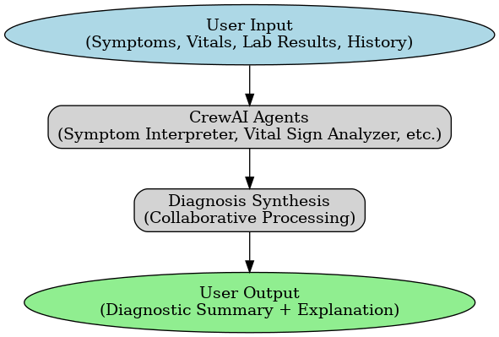
Workflow Overview
Program Name- Bachelor of Technology

Slide 7
Project Features
Intuitive Web Interface built with Streamlit
Multi-Agent Workflow powered by CrewAI for medical data analysis
Natural Language Diagnosis with Google Gemini via LiteLLM
Structured Diagnostic Summary (on-screen & downloadable)
Clear Explanations of diagnostic reasoning
Program Name- Bachelor of Technology

Slide 8
Challenges & Solution
Challenges | Solution
Integrating multiple AI agents and API | Used CrewAI framework to manage agents and integrated Google Gemini via LiteLLM for consistent LLM output.
Handling unstructured patient data | Built input collector and preprocessor agents to clean and standardize data before analysis
Making the tool easy to use for clinicians | Developed an intuitive, single-form Streamlit UI and downloadable summaries
Data privacy & security | Used secure API keys, and planned future authentication features
.
Program Name- Bachelor of Technology

Slide 9
Future Improvement
Upload support for detailed lab reports & medical images
Visualization of diagnosis trends and interactive graphs
User authentication & stronger patient data security
Offline capability or lightweight model for remote use
Multilingual support for global accessibility
Program Name- Bachelor of Technology

Slide 10
Skills Gained
AI-Powered App Development – Building a Streamlit-based diagnostic assistant
Multi-Agent Workflow Design – Using CrewAI to orchestrate specialized agents
Large Language Model Integration – Connecting Google Gemini via LiteLLM
Data Processing & Structuring – Cleaning and normalizing unstructured patient data
User Interface Design – Creating an intuitive, clinician-friendly web form
Testing & Validation – Ensuring accuracy and reliability of diagnostic outputs
Data Privacy & Security Awareness – Handling sensitive medical information responsibly
Program Name- Bachelor of Technology

Slide 11
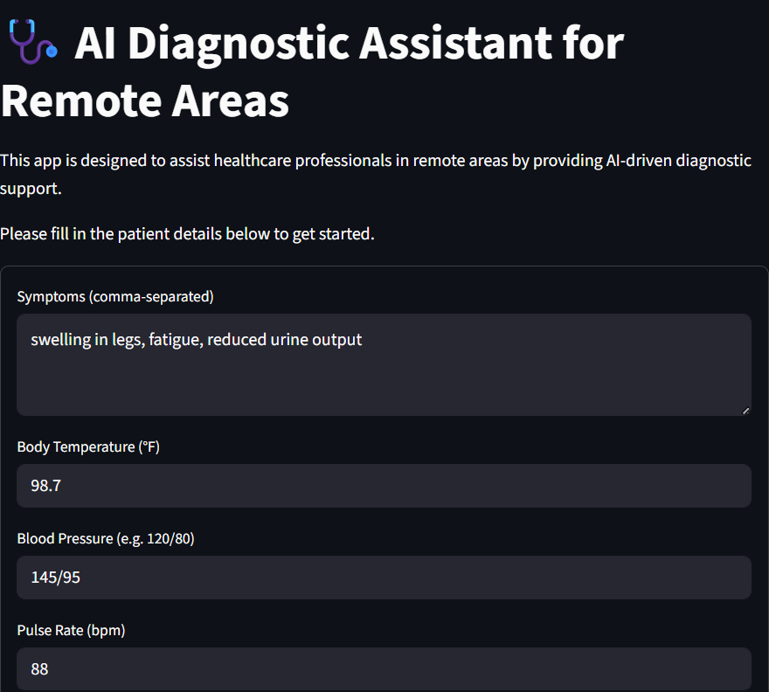
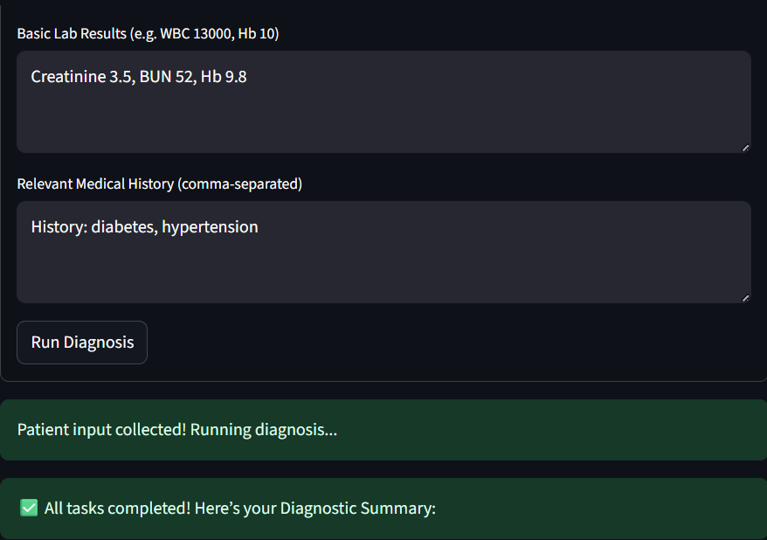
Project Demonstration
Program Name- Bachelor of Technology

Slide 12
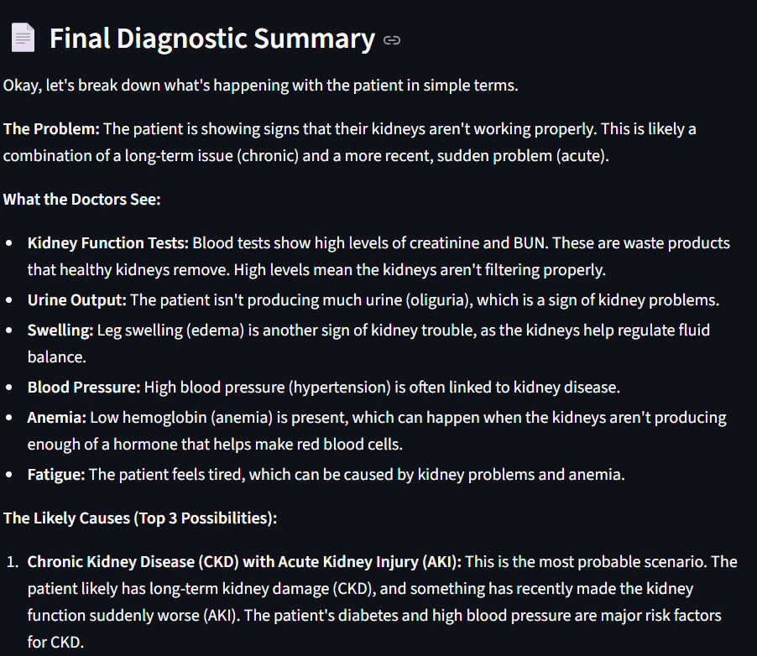
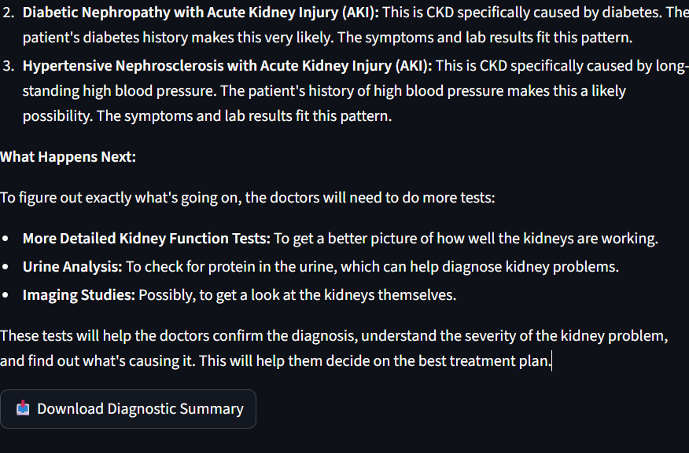
Project Demonstration
Program Name- Bachelor of Technology

Slide 13
Conclusion
Successfully designed and developed an AI-powered diagnostic assistant to support healthcare professionals in remote and underserved areas.
Implemented a multi-agent workflow using CrewAI and integrated Google Gemini for natural-language differential diagnosis.
Deliverd an intuitive Streamlit interface with structured, downloadable diagnostic summaries.
Improved understanding of AI integration, healthcare data handling, and performance optimization.
This project demonstrates how modern AI can bridge gaps in clinical decision support and improve access to quality care.
Program Name- Bachelor of Technology

Slide 14
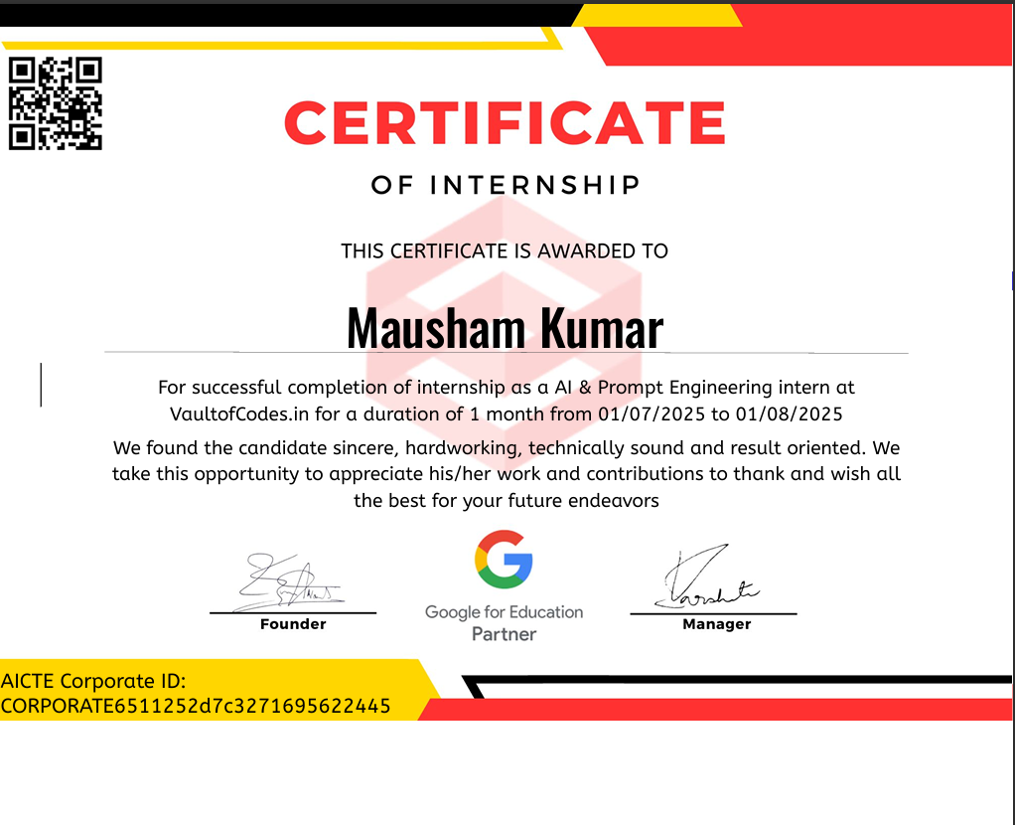
Certificate of Completion
View Full Certificate
Program Name- Bachelor of Technology

Slide 15
Project Links & References
GitHub Repository: https://github.com/maushamkumarray1/ai-diagnostic-assistant
References:-
CrewAI Documentation
LiteLLM GitHub
Google Gemini API / AI Studio
Python Official Documentation
Streamlit Documentation
Program Name- Bachelor of Technology

Slide 16


School of Engineering and Technology
INDUSTRY INTRNSHIP - 2025 Course Code - CSE404
Program Name- Bachelor of Technology

