Slide 1
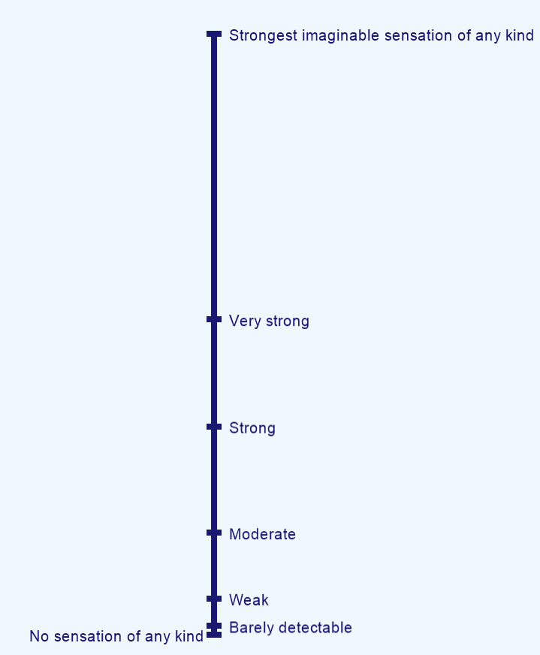
You will asked to rate the intensity of a variety of real and remembered sensations by indicating where they lie on a scale of all possible sensations. The scale contains commonly used terms like “weak” and “strong”. The top of the scale is the strongest sensation of any kind that you can ever imagine experiencing.
To make a rating, move your mouse cursor over the scale and press down on the left-click, but do not release the button. A red triangle will appear on the scale. Move the red triangle to where you want to make your rating, and then release the button to lock in your answer.
Give this a try now by rating something as “moderate”.

Slide 2
When making your ratings, you should use the terms just as you would in daily life. However, do not limit your ratings to the terms themselves. A good strategy is to first decide which term most closely describes the strength of a sensation, and then to fine-tune your rating by choosing between that descriptor and the next most appropriate one. For example, if you think a sensation is just about moderate but a little bit stronger, you should select a rating just above moderate. If you think another sensation is more than just barely detectable but less than weak, you should select a rating at the appropriate place between barely detectable and weak, and so on.
It is important to emphasize that the top of the scale is “strongest imaginable”, which represents the most intense– and therefore, for most people, the most painful—sensation that you can ever imagine experiencing.
Do you have any questions about how to use the scale?

Slide 3
Rate the intensity of the following sensation:

Slide 4
Great! Let’s move on to the next training.
In front of you are 4 small cups.
Starting from the left-most cup and going one at a time, empty the liquid in each cup into your mouth and swish it around for a few seconds. Do not swallow. Spit the contents into the sink, then rinse with a sip from the glass of water (but spit out the rinse too). Continue from left to right until you have tasted all 4 cups. You can throw the empty cups into the trash can.
Which cup’s contents tastes the most like nothing? Click on your answer.
1
2
3
4

Slide 5
Now you will rate the intensity of real taste solutions.
There should be 8 small cups remaining in front of you. Please empty the first cup into your mouth, swish it around for a few seconds, and then spit it into the sink.
Rate the intensity of the taste. After you make your rating, rinse your mouth with a sip from the glass of water (but spit out the rinse too).
1
2
3
4
5
6
7
8
Empty the second cup into your mouth, swish it around for a few seconds, and then spit it into the sink.
Rate the intensity of the taste. After you make your rating, rinse your mouth with a sip from the glass of water (but spit out the rinse too).
2
3
4
5
6
7
8
Empty the third cup into your mouth, swish it around for a few seconds, and then spit it into the sink.
Rate the intensity of the taste. After you make your rating, rinse your mouth with a sip from the glass of water (but spit out the rinse too).
3
4
5
6
7
8
Empty the fourth cup into your mouth, swish it around for a few seconds, and then spit it into the sink.
Rate the intensity of the taste. After you make your rating, rinse your mouth with a sip from the glass of water (but spit out the rinse too).
4
5
6
7
8

Slide 6
Empty the fifth cup into your mouth, swish it around for a few seconds, and then spit it into the sink.
Rate the intensity of the taste. After you make your rating, rinse your mouth with a sip from the glass of water (but spit out the rinse too).
5
6
7
8
Empty the sixth cup into your mouth, swish it around for a few seconds, and then spit it into the sink.
Rate the intensity of the taste. After you make your rating, rinse your mouth with a sip from the glass of water (but spit out the rinse too).
6
7
8
Empty the seventh cup into your mouth, swish it around for a few seconds, and then spit it into the sink.
Rate the intensity of the taste. After you make your rating, rinse your mouth with a sip from the glass of water (but spit out the rinse too).
7
8
Empty the eighth cup into your mouth, swish it around for a few seconds, and then spit it into the sink.
Rate the intensity of the taste. After you make your rating, rinse your mouth with a sip from the glass of water (but spit out the rinse too).
8

Slide 7
Now you be asked to rate how much you like or dislike a variety of sensations by indicating where they lie on a hedonic scale that contains commonly used terms like “moderately” and “very much”. Again, you should use these terms just as you would in daily life, and your ratings are not limited to the locations of the descriptors themselves. For example, if you like a sensation a little less than “very much” you should make your rating at the place below “like very much” that precisely describes how you feel. If for another sensation “dislike extremely” exactly describes how you feel about it, you should make your rating on the line exactly at the descriptor “dislike extremely”, and so on.
It is important to emphasize that the top and the bottom of the scale is the “most liked or disliked sensation imaginable”, which represents the most liked or disliked sensation you can ever imagine experiencing. Finally, if you neither like nor dislike a sensation, you should rate it as neutral in the middle of the scale.
Do you have any questions about how to use the scale?

Slide 8
Please rate how much you like or dislike the sensation:

Slide 9
Add internal state ratings!!!!

