Slide 1
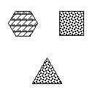
In this experiment, you will perform two different tasks. In the first task, called “Match Shape or Texture”, you see an image such as the one below.
The word in the center specifies whether to match objects based on shape or texture.
Decide if the bottom object matches either object at the top.
PRESS 9 TO CONTINUE
TEXTURE

Slide 2
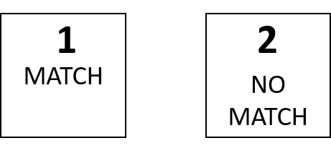
In this example, the word is “Texture”. The texture of the bottom object matches the top-right object.
To indicate that there is a MATCH, press 1.
TEXTURE

Slide 3
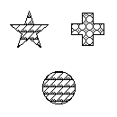
In this example, the word is “Shape”. The shape of the bottom object does not match either object at the top.
To indicate that they DO NOT MATCH, press 2.
SHAPE

Slide 4
Now we will practice “Match Shape or Texture”.
PRESS 9 TO BEGIN PRACTICE

Slide 5
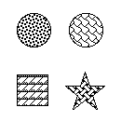
The second task is called “Match Change”. In this task, you will see images like the one below.
PRESS 9 TO CONTINUE
First, decide how the top images change or differ.
In this example, the top images change texture.
PRESS 9 TO CONTINUE

Slide 6
Next, decide if the way the bottom images change matches the way the top images change. In this example, the bottom images also change texture.
Since the way the bottom images change matches the way the top images change, you should respond by pressing 1.

Slide 7
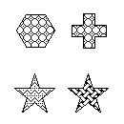
Here is another example.
Again, the first step is to decide how the top images change or differ. In this example, the top images change shape.
PRESS 9 TO CONTINUE

Slide 8
Next, decide if the way the bottom images change matches the way the top images change. In this example, the shape of the bottom two images does not change.
Since the way the bottom images change does not match the way the top images change, you should respond by pressing 2.

Slide 9
Now we will practice “Match Change”.
PRESS 9 TO BEGIN PRACTICE
In the following test, the images will come very quickly. Just try your best to be quick and accurate!
Get ready!
PRESS 9 TO BEGIN TEST

Slide 10
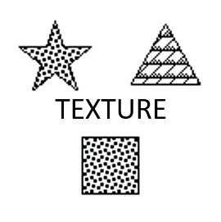
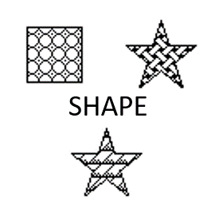
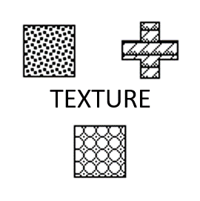
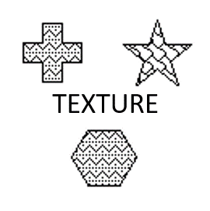
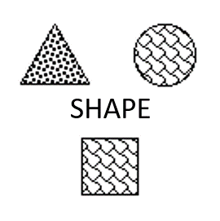
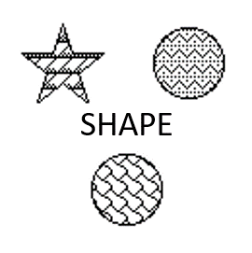

Slide 11
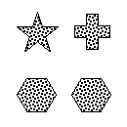
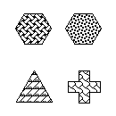
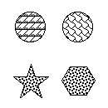
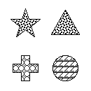
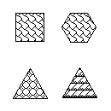
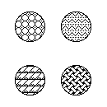

Slide 12
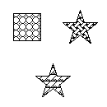
1
2
DIFFERS THE SAME WAY
DOES NOT DIFFER THE SAME WAY
SHAPE
MATCH SHAPE OR TEXTURE
MATCH CHANGE

