Slide 1

Final Project Data Analytics
Effect of gas-extraction on Dutch real estate value and demand
Maurits Siemonsma
Ironhack Data Analytics Bootcamp FTAUG24

Slide 2



Slide 4


Slide 5


Slide 7


Slide 8
Outline
Research objective
Context and key facts
Definitions
Hypotheses formed
Data and techniques used
Findings
Conclusion
Challenges
Suggested improvements

Slide 9
Research objective
Context and key facts
Definitions
Hypotheses formed
Data and techniques used
Findings
Conclusion
Challenges
Suggested improvements
Research Objective
Text

Slide 10
Research objective
Context and key facts
Definitions
Hypotheses formed
Data and techniques used
Findings
Conclusion
Challenges
Suggested improvements
Context and key facts

Slide 11
Context and key facts (cont.)

Slide 12
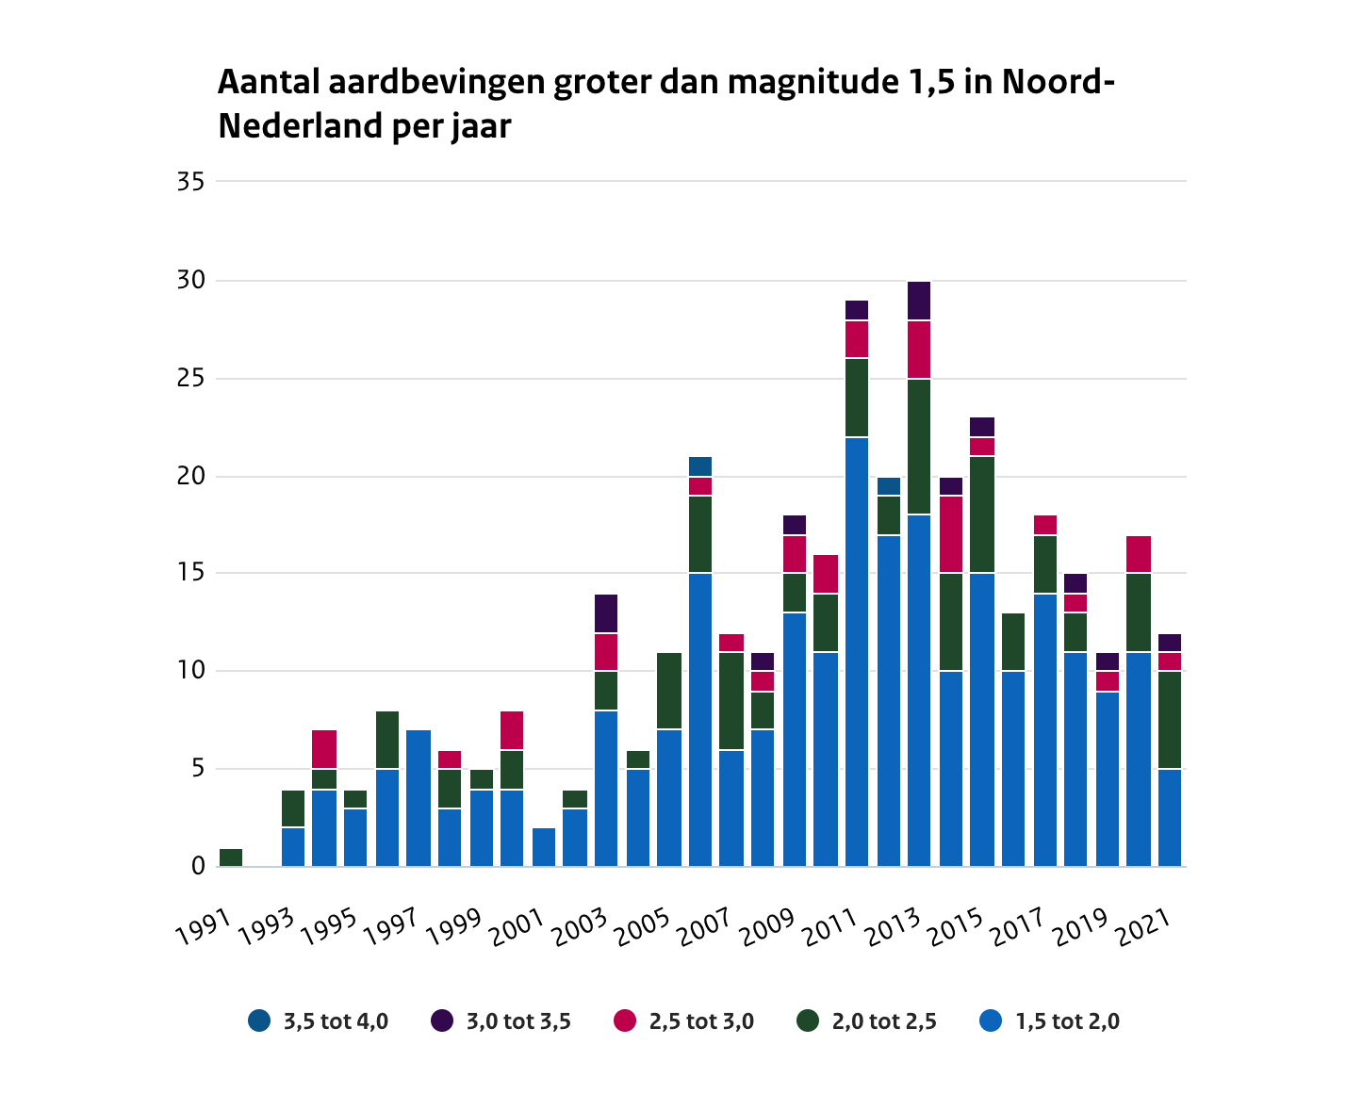
Research objective
Context and key facts
Definitions
Hypotheses formed
Data and techniques used
Findings
Conclusion
Challenges
Suggested improvements
Context and key facts (cont.)
Text

Slide 13
Research objective
Context and key facts
Definitions
Hypotheses formed
Data and techniques used
Findings
Conclusion
Challenges
Suggested improvements
Definitions
Text

Slide 14
Research objective
Context and key facts
Definitions
Hypotheses formed
Data and techniques used
Findings
Conclusion
Challenges
Suggested improvements
Hypotheses formed
H₁: Gas extraction has a negative impact on real estate value
H₂: Areas impacted by gas extraction are more availabe than areas that are not impacted

Slide 15
Research objective
Context and key facts
Definitions
Hypotheses formed
Data and techniques used
Findings
Conclusion
Challenges
Suggested improvements
Data and techniques used
Text

Slide 16
Research objective
Context and key facts
Definitions
Hypotheses formed
Data and techniques used
Findings
Conclusion
Challenges
Suggested improvements
Findings (part 1 - x)
Text

Slide 17
Research objective
Context and key facts
Definitions
Hypotheses formed
Data and techniques used
Findings
Conclusion
Challenges
Suggested improvements
Conclusion
Text

Slide 18
Research objective
Context and key facts
Definitions
Hypotheses formed
Data and techniques used
Findings
Conclusion
Challenges
Suggested improvements
Challenges
Text

Slide 19
Research objective
Context and key facts
Definitions
Hypotheses formed
Data and techniques used
Findings
Conclusion
Challenges
Suggested improvements
Suggested improvements
Text

