Slide 1
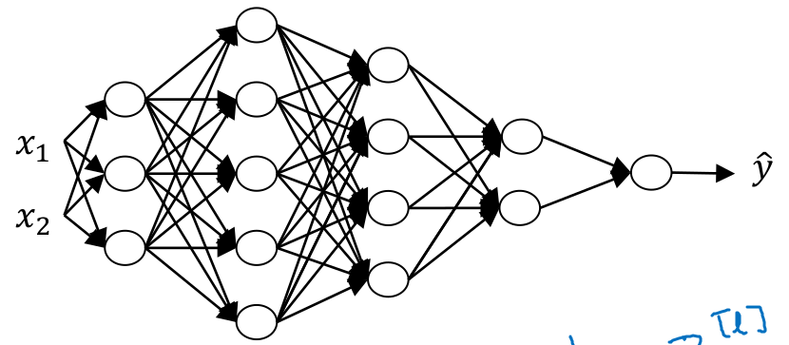
Getting your Matrix Dimensions Right
For one training example
Across all training examples
by broadcasting

Slide 2
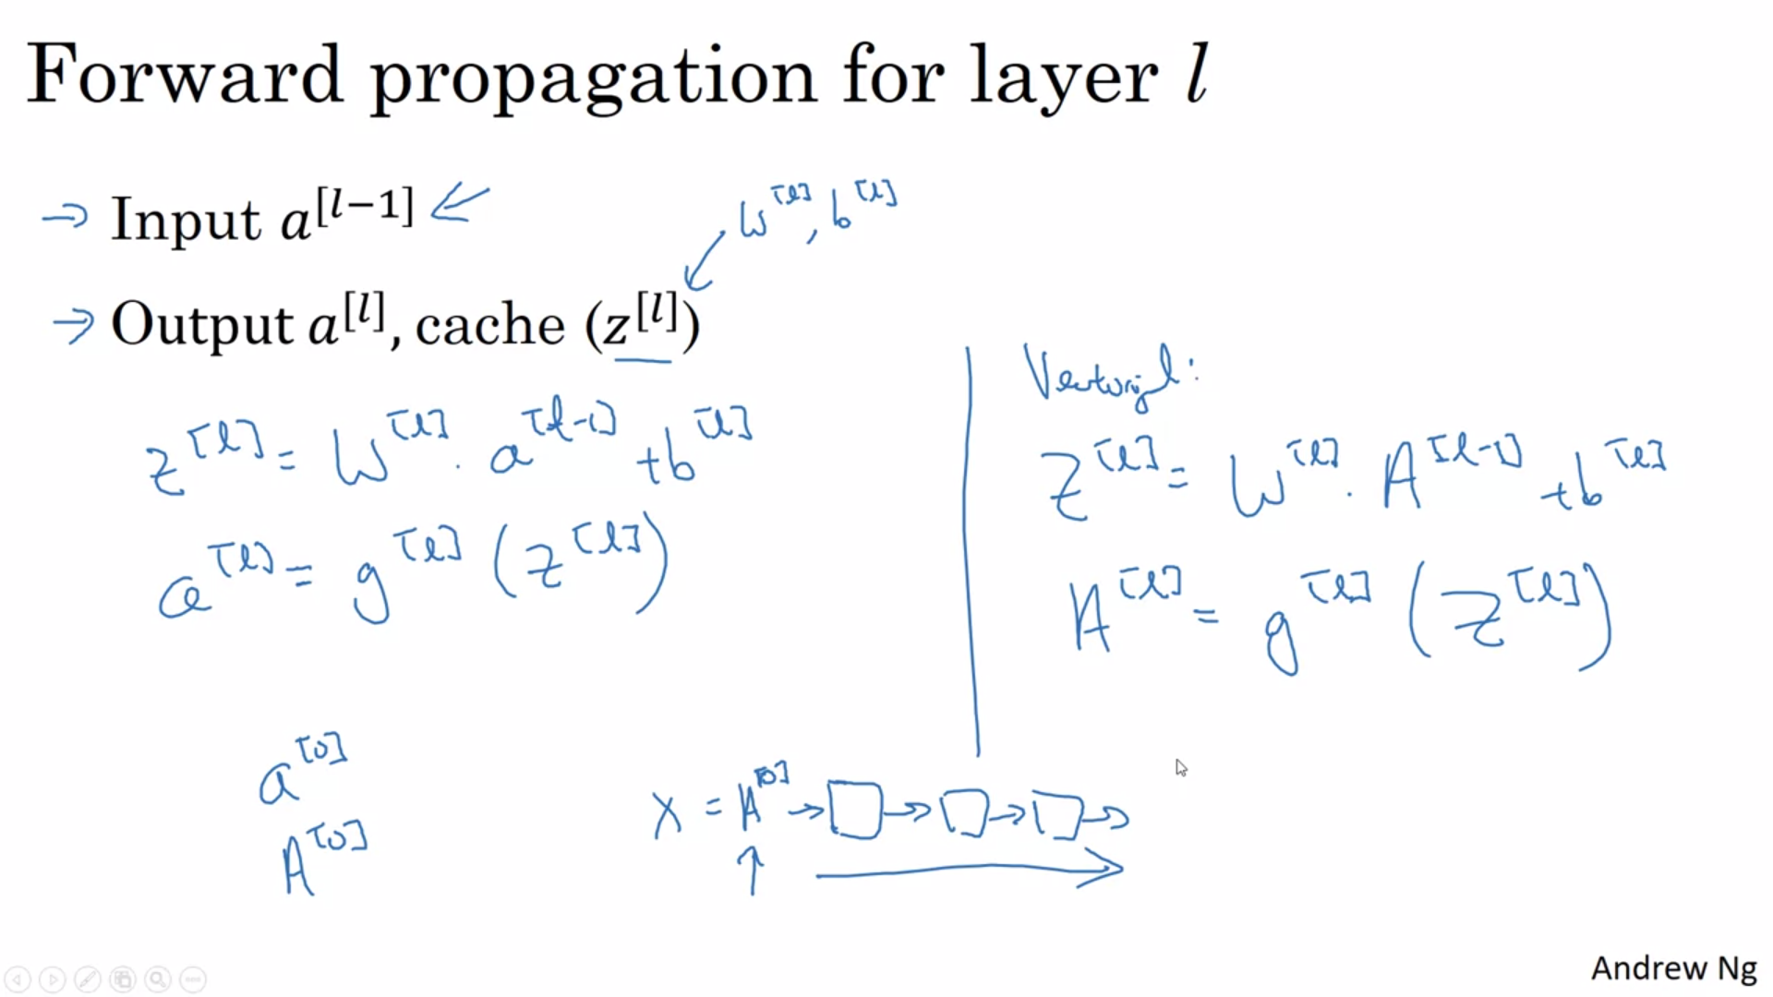
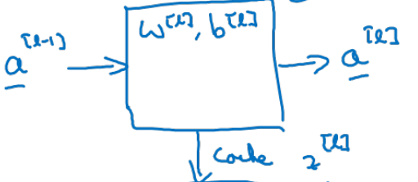

Slide 3
