Slide 1
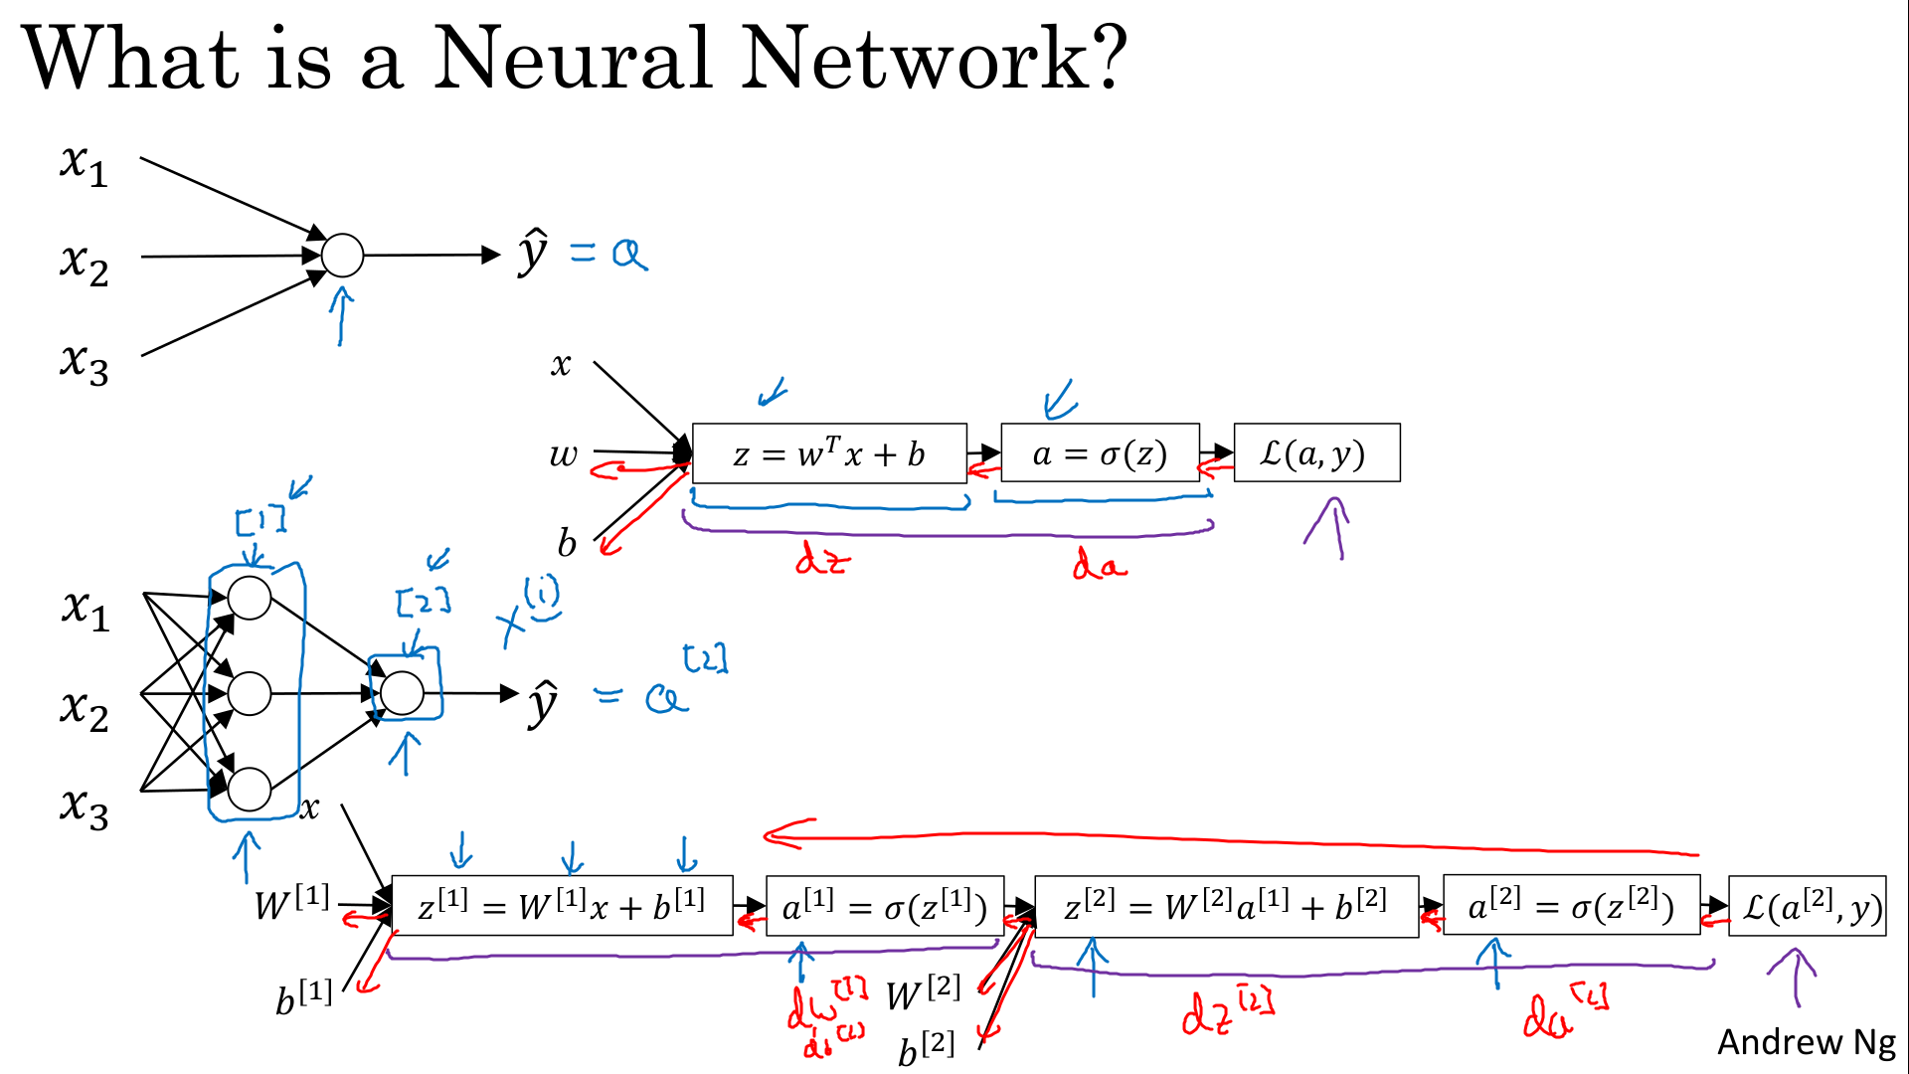
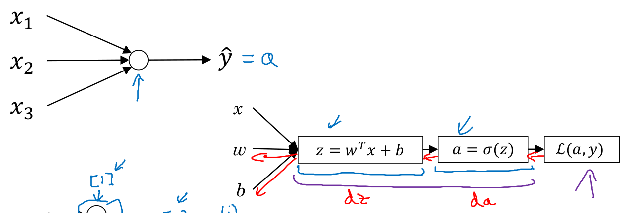
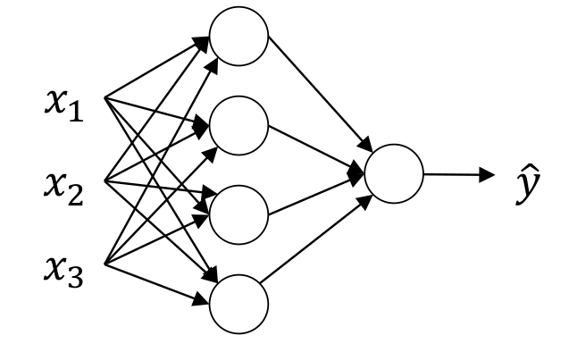
Computation graph (forward) :
compute z (in neuronal)
compute a (in neuronal)
compute loss function
[1]
[1]
[2]

Slide 2

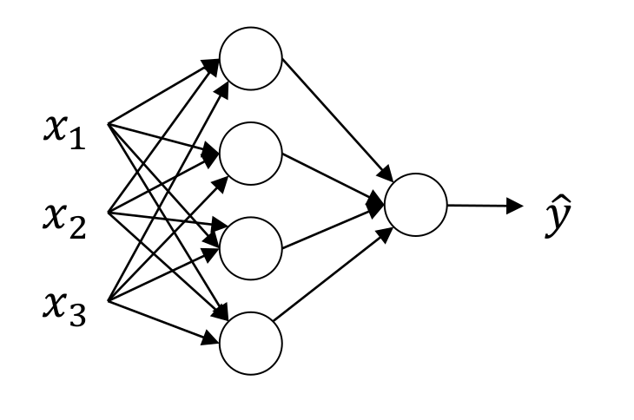
number of features = 3
number of units in layer = 4

Slide 3
(4,1)
(4,3)
(3,1)
(4,1)
(4,1)
(4,1)
(1,1)
(1,4)
(4,1)
(1,1)
(1,1)
(1,1)

Slide 4
(4,1)
(4,3)
(3,1)
(4,1)
(4,1)
(4,1)

Slide 7
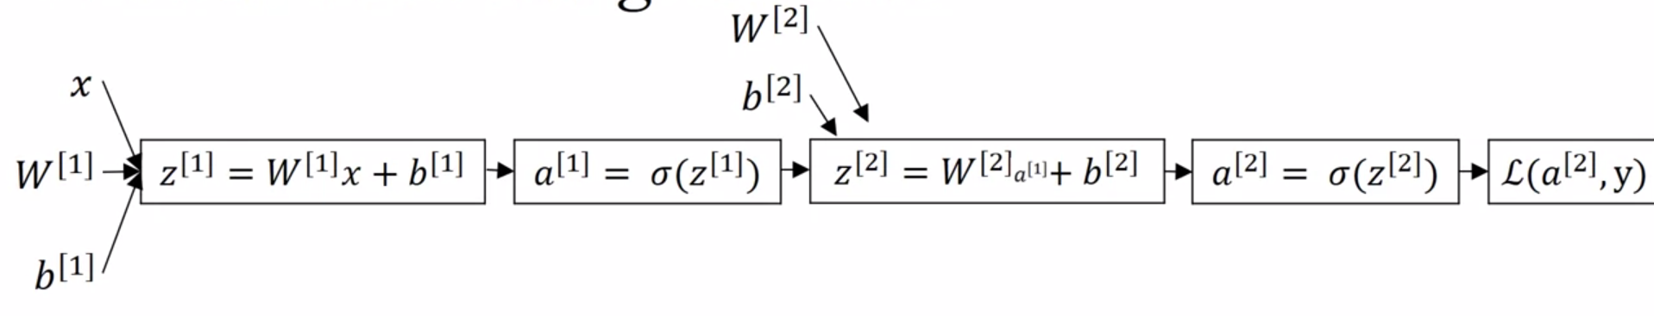
g

Slide 8
g

Slide 9
(1,4)
(1,1)
(4,1)
(4,1)
(4,1)
(1,1)
(4,1)
(4,1)

