Slide 1
Pacific Regional Program Office
Quarterly Program Review (QPR)
  Welcome
  Staffing
    INS/ISS
    Administration
    Project Directors
  Open House Demonstration January
  March Demonstration
  AIIM/KIIM Modeling

Slide 2

















Pacific Regional Program Office
Cdr. Pacific Regional Medical Command
BG Warren A. Todd
Chief, Executive
TMIP
Deputy Cdr. Pacific Regional Medical Command
COL. Thomas Sprague
CBA
Program Office
Directorate
CIO, CINCPAC Surgeon’s Office
LtCdr Tom Moskowitz
CIO and Program Manager
Pacific Regional Program Office
LTC Roger W. LeBlanc
CIO, Tripler Regional Medical Command
MAJ. Frank Rowland
Operations NCO
SSG Mark King
Executive Officer
Lt. Dana Glaser
Executive Asst.
Ms. Pam Divine
Receptionist
Ms. Rosanda Endira
Project
Management
& Staff
Systems Engineer
Mr. John Draude
Contract Manager
Ms. Cathy Dawkins
Health Care Requirements
Mr. Pat Tracy
AKAMAI
Program Director
Mr. Craig Floro
IV&V
Dr. Gene Vasilescu
Contract Execution
Mr. John Harris
Clinical Director
Dr. James Logan
PACMEDNET
Program Director
Mr. Anthony Gelish
Technical Research
Mr. Larry Damewood
Appropriations Analyst
Ms. Julie Thomas-Chun
Clinical Liaison (C3)
Ms. Cynthia Kohuth
Web Master
Mr Angelo Alvarez
Administrative Assistant
Clinical Research
Dr. Victoria Garshnek

Slide 3
















From Alaska to the Coast of Africa--Healthcare for Today and Tomorrow
Pacific Regional Program Office (PRPO)
November 1997, Quarterly Progress Review

Slide 4
Pacific Regional Program Office
Quarterly Progress Review
AKAMAI Telemedicine Project Overview
Hyperspectral Diagnostic Imaging
Clinical Applications
PACS and Teleradiology
Telemedicine Evaluation
C3 Process Improvements
AKAMAI Financials
November 14, 1997

Slide 5
Pacific Regional Program Office
Quarterly Progress Review
Overview of Projects:
  PACS at Elmendorf
  T2P2 progress and collaboration
  Remote Tumor Boards
  Prototype for Hyperspectral Diagnostic Imaging
  Demonstration of RRTTPP
  EVT Preparation
  ATA Abstracts
  Situation Reports
  AIIM / KIIM (Alaska/Korea Information Infrastructure Modeling Project)

Slide 6
Pacific Regional Program Office
Quarterly Progress Review
Overview:
  Office staff expansion
  - Improved intra staff communication
  Team Work
  “What have I done to understand that project ?”

Slide 7
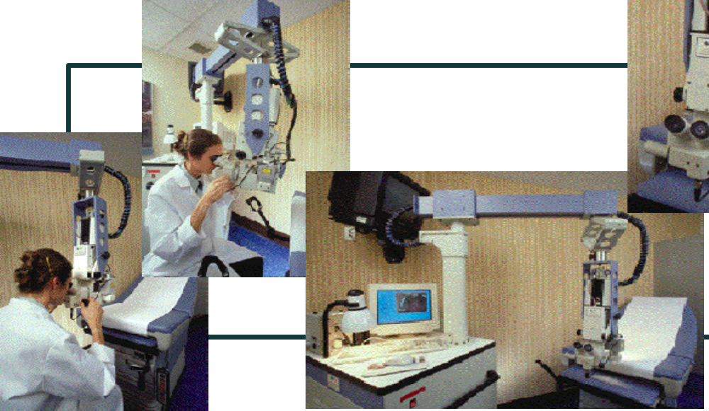
Hyperspectral Diagnostic Imaging

Slide 8
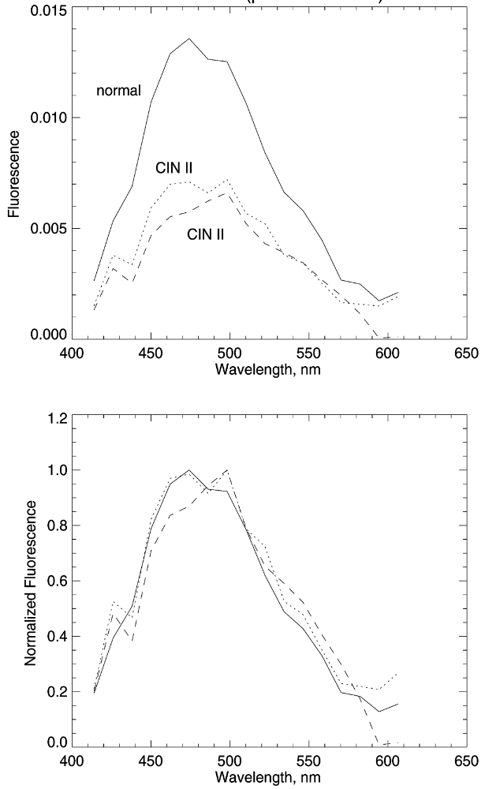
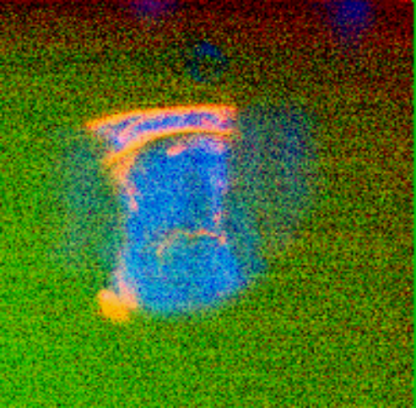
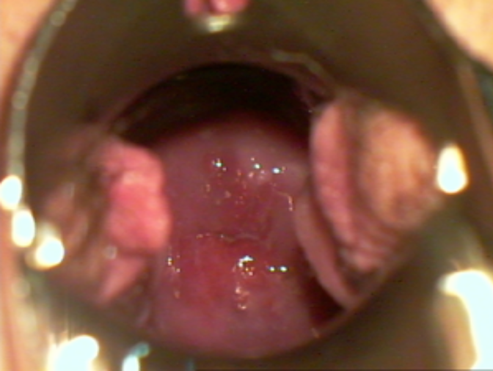
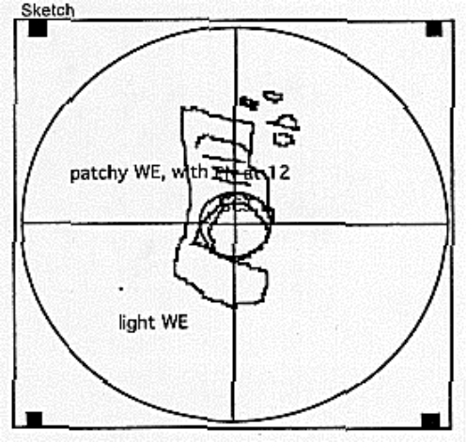
Hyperspectral Diagnostic Imaging

Slide 9
T2P2
Project Objective:
- Develop an integrated Telemedicine consultation telemedicine system to support the AIIM/KIIM modeling effort
Project Status:
- Proof of concept development goal met
- Overall system design complete
- Integration of supporting systems

Slide 10
Issues and Goals
Issues
- Tricare region I relationship
- Increased government functional design input/validation support
Goals for FY 98
- Continued system design beyond prototype
- AIIM/KIIM modeling efforts
- Mature system deployment

Slide 11
Meeting & Conference Update
3-7 Nov. - Design meeting
8-10 Dec. - Functional/Operational Design Review

Slide 12
AIIM/KIIM
Project Objective:
- Participate in the AIIM/KIIM modeling effort
- Successful modeling of a clinical process system
Project Status:
- Validation of equipment requirements
- Integration development effort contract

Slide 13
Issues and Goals
Issues
- Validation of hardware requirements
- Training/installation support at modeling sites
Goals for FY 98
- Successful AIIM/KIIM modeling effort

Slide 14
Meeting & Conference Update
March 1998 Demonstration

Slide 15
Remote Radiation Treatment Planning
Project Objective:
- Develop a treatment planning algorithm to support real-time, online dose calculations for radiation therapy
Project Status
- Development of parallel processing program
- Successful Sept. demonstration

Slide 16
Issues and Goals
Issues
- Contract resolution
Goals for FY 98
- Continued system development
- Clinical trials

Slide 17
Meeting & Conference Update
- September 1997 Demonstration

Slide 18
CD ROM Developement
Project Objective:
-To develop six CD ROM projects
Project Status:
- COE project completion
- Development started on T2P2/Commanders orientations

Slide 19
Issues and Goals
Issues
- Government acceptance testing
Goals for FY 98
- Successful completion of all projects

Slide 20
Speech Pathology
Project Objective:
- To establish the validity of using videoconferencing
for treating patients with voice disorders.
Project Status:
- Preparation for data collection
- Timelines/upcoming events
- Present: Install equipment; test Multi-speech software
Oct 97-Jan 98- Conduct Pilot Study
Jan 98- Dec 98- Conduct Experiment
Oct 98-Feb 99- Analyze data
Feb 99- Apr 99- Write Report

Slide 21
Speech Pathology
- Issues
- Awaiting Audio/Visual installation of Patient
Room and Speech Pathologist Room.

Slide 22
Meeting & Conference Update
Primary Investigator-
- American Speech-Language-Hearing
Association- Boston Nov 20-23, 1997

Slide 23
Video Otoscope
Project Objective:
- Normalization study to determine the accuracy of video otoscopy versus in person physical exam.
Project Status:
- Gathering Data
- Timelines/upcoming events
Jun 97-Dec 97- Conduct experiment
Dec 97-Feb 98- Analyze Data
Feb 98-April 98- Write Report

Slide 24
Issues and Goals
- Issue-
Shortage of manpower to collect data.-
Physician hire for video otoscopy reading.
- Assistance needed-
Hire Dr. Yim or comparable physician for reading images
FY 98 Goals-
Expansion to remote clinics-Audiologist captures digital image, sends to TRMC.
Makalapa- Dennis Sekine Audiologist

Slide 25
Meeting & Conference Update
Primary Investigator-
- American Academy of Otolaryngology
Published Abstract and Poster- Sept 97
- Goal of presenting at ATA in April.

Slide 26
ENT Surgical Suite
Project Objective:
- To establish the validity of using tele-proctoring surgery to treat ENT patients.
Project Status:
- Preparation for data collection
- Timelines/upcoming events
- Present: Trouble shoot fiber/system
Nov 97-Jun 98- Conduct Experiment
Apr 98- Aug 98- Analyze data
Jul 98- Dec 98- Write Report

Slide 27
Issues and Goals
Issues
- Assistance needed to resolve “issues”.
Goals for FY 98
- Expansion to remote clinic-
- Naval Hospital Guam

Slide 28
Meeting & Conference Update
None during last quarter

Slide 29
OB/GYN
Project Objective:
- Proliferate Electronic Patient Record
Project Status
- Operational
- Timelines/upcoming events

Slide 30
Issues and Goals
Issues
- Assistance needed to resolve “issues”.
- Focus of Protocol
- Research Letter from DCI
Goals for FY 98
- Program Execution
- Expansion to remote clinics

Slide 31
DTU (FY97)
Project Objective: Deployable Teleradiology
Project Status:
- Cancelled
- Resources Returned
- PACS Equipment at SCHB Clinic
- $198,351 Carry Over

Slide 32
SCHOFIELD BARRACKS
Project Objective: CR in Schofield Clinic
Project Status:
- FY 97- Kodak CR Loaner
- FY 98- DTU Equipment Installed
- $0.00 Akamai Funds Invested
- MEDCASE Funds Being Expended
-February 1998 Full Implementation

Slide 33
SCHOFIELD BARRACKS
Project Objective: CR in Schofield Clinic
Project Issues:
- CR at PTA - Unpopular
- Kodak vs Fuji CR Run-off
- Network Reliability Problems
- CR Equipment Disposition

Slide 34
Korea Radiology (97)
Project Objective: Update Phase I MDIS
Project Status:
- Update Review Complete
- Installation Plan To Be Developed
- 14 Teleradiology Camps

Slide 35
Korea Radiology (97)
Project Issues:
- Single CHCS System
- Mirror Archiving
- T-1 Network Upgrade

Slide 36
JI Radiology (97)
Project Objective: Install Teleradiology
Project Status: - Incomplete
Issues: - Time
- Communications

Slide 37
Kwajalein Radiology (97)
Project Objective: Install Teleradiology
Project Status: - Incomplete
Issues: - Time
- Communications

Slide 38
Camp Zama Radiology
(97)
Project Objective: Install Teleradiology
Project Status: - Incomplete
Issues: - Time
- Communications
- Credentialling
- CHCS Interface

Slide 39
Pacific Regional Program Office
Quarterly Progress Review
Evaluation Pilot Study
V. Garshnek, Ph.D., Project Manager
November 14, 1997

Slide 40
Evaluation Pilot Study
Project Objectives:
(1) Test a methodology for future telemedicine evaluation in the Pacific;
(2) Evaluate impact of telemedicine insertion into a health care system (Clinical Outcomes, Pt./Prov. Satisfaction, Organizational Impact, Cost-Benefit).

Slide 41
Evaluation Pilot Study
Project Status:
- Phase II -- Experiment Verification Test (EVT)
in progress.
- Consult Manager (CM), Theresa Jones, on board.
- Paper EVT -- 31 Oct. - 5 Dec. (subgroups)
- LF EVT -- 8 Dec. - 22 Dec. (props/T-med clinic)
- HF EVT -- 5 Jan. 98 - 12 Feb. (actual sites)
Issues: Need to identify data fields for database.
Dr. Hassell needs to know who is POC for DB.

Slide 42
Pacific Regional Program Office
Quarterly Progress Review
14 November, 1997

Slide 43
PACMEDNET
Project Objective:
  Phase 1 (FY95):
    CPR
    Telecommunications upgrades to support a regionalized testbed
  Phase 2 (FY96):
    Transportability of the CPR
  Phase 3 (FY97):
    Movement of patient data
    Compliance with the Joint Technical Architecture (JTA)
  Phase 4 (FY98):
    Continue prototyping
      Information interoperability
      Computer-based Patient Record (CPR)
      Support T²P²
    Prototype proof-of-concept modeling (Alaska and Korea)

Slide 44
PACMEDNET
Project Status
  Successful demonstration at August 97 Kernal Blitz
  System Requirements Review (SRR) - 28 Aug 97
    Identified Fixes the March ‘98 Demo
      MPI/MPL
      OBS Communications
      Mini-registration
      Medical Information Carrier (MIC)
      DCE
      Interface Engine
      TCPR +
  Preliminary Design Review (PDR) - 30 Oct 97
    Confirmed March ‘98 Demo functionality and approach

Slide 45
PACMEDNET Schedule
Today
Ph. 2 KB Demo
Ph. 3 Requirements Analysis
SRR
Ph. 3 Preliminary Design
PDR
Ph. 3 Detailed Design
CDR/QPR
Ph. 3 Final Prototyping
Demo
Ph. 4 Requirements Analysis
SRR
Ph. 4 Preliminary Design
PDR
Ph. 4 Detailed Design
CDR
Alaska Prototyping
AIIM
Korea Prototyping
KIIM
Jul 97
Oct 97
Jan 98
Apr 98
Jul 98
Oct 98

Slide 46
PACMEDNET Issues
March Demo
  Integration with T²P²
  Objectification of T²P² and PACMEDNET Data Fields
  DCOM/DCE
AIIM/KIIM
  Security
  Schedule
Financial
  P8 Funding Requires CHCS Approval on all Tasks
  AIIM/KIIM funding requires aggressive collaboration with Akamai
Assistance Needed
  Continued close collaboration with Akamai T²P²

Slide 47
Meeting & Conference Update
Demonstration at Quality of Life Research Symposium
  December 11 at Georgetown
  Hosted by the OASD for Personnel and Readiness
HIMMS
  February 1998
  Collegial PRPO Participation
PRPO Open House
  Date to be determined

Slide 48
Pacific Regional Program Office
Quarterly Progress Review
November 14, 1997
PRPO Security

Slide 49
PRPO Security
Goal:
  Ensure that PRPO programs satisfy DoD security policy
Objectives:
  Guide PRPO programs to successful certification and accreditation
  Define and articulate a secure operational environment for PRPO programs
  Incorporate DoD security requirements into contractor SOWs and life cycle management of PRPO systems
  Infuse leading security technologies into PRPO programs
  Leverage lessons learned from MEDCOM Internet security program

Slide 50
PRPO Security
Project Status:
  Program planning is underway
  Contractor tasks are being finalized
  MEDCOM Internet security is being addressed
Issues:
  Prototype systems have inadequate security mechanisms for deployment
  Significant infrastructure-centric security engineering is required to enable certification of PRPO systems
  Data from sites and program managers is needed for certification and accreditation planning

Slide 51
Meeting & Conference Update
Preparation for HIMMS Conference is Underway
Paper on Internet Firewalls has been accepted for publication
Slides and scripts are being developed
Presenters include:
LTC Roger LeBlanc
MAJ Frank Rowland
Tim DeLoach

