Slide 1
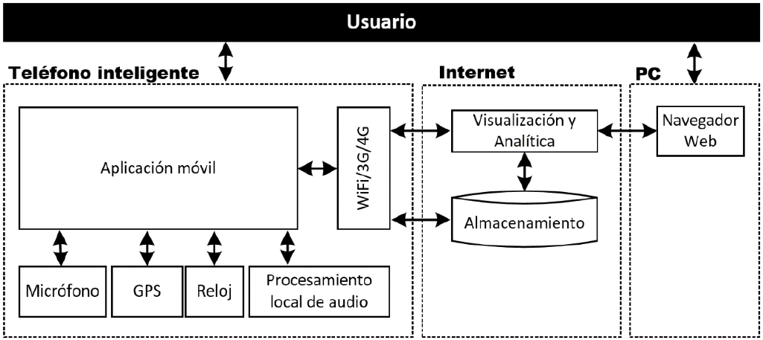
Monitoring and Geolocation of Noise in Urban Environments using the Internet of Things (demo)
System Architecture

Slide 2
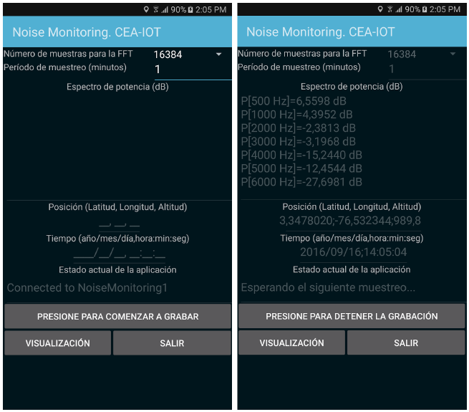
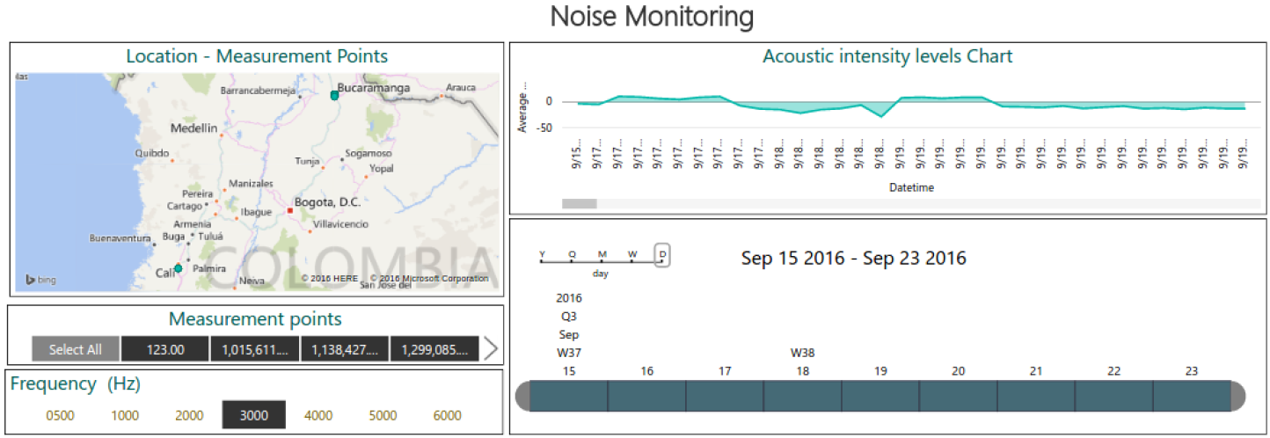
Monitoring and Geolocation of Noise in Urban Environments using the Internet of Things (demo)
User Interface
Visualisation using Power BI

Slide 3
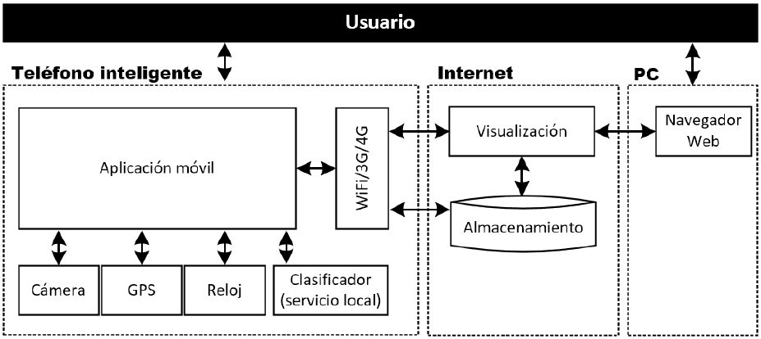
Identification of Nutrient Deficiencies in Oil Palm using the Internet of Things (demo)
System Architecture

Slide 4
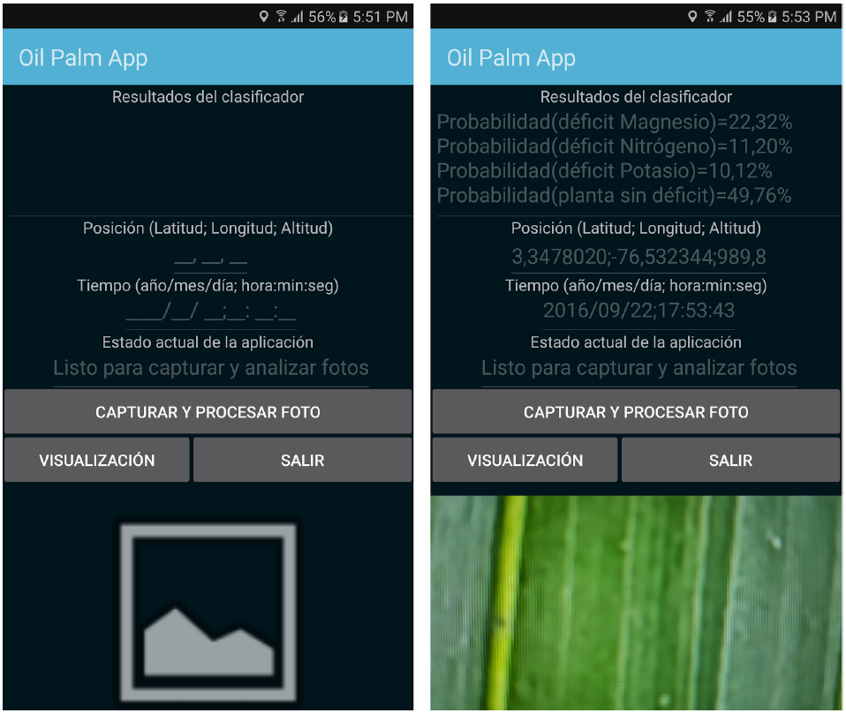
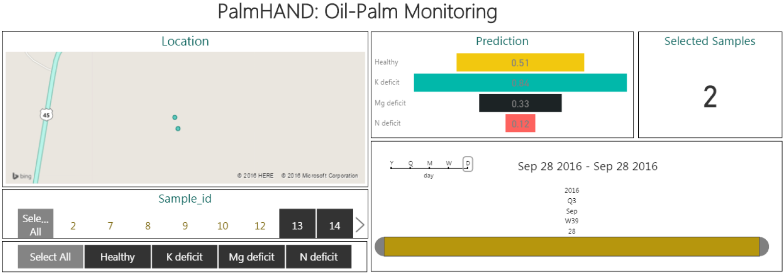
Identification of Nutrient Deficiencies in Oil Palm using the Internet of Things (demo)
User Interface
Visualisation using Power BI

Slide 5











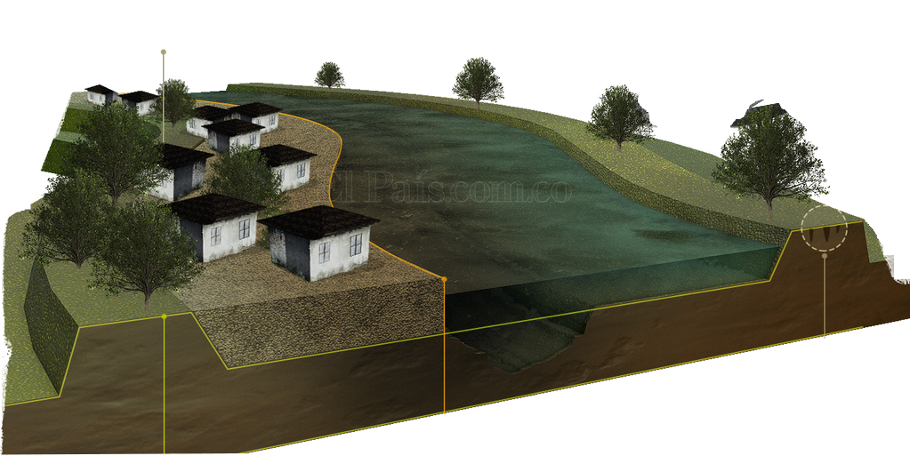



SMAR2C – Sistema de Monitoreo, Alarmas y Reportes del Río Cauca (demo)
BR
B
N_{i}
B
N_{i}
B
B
N_{i}
B
N_{i}
N_{i}
B
N_{i}
S
M
A
R
PANID: 0x5AC1 / CH: 26
Conceptual Model

Slide 6
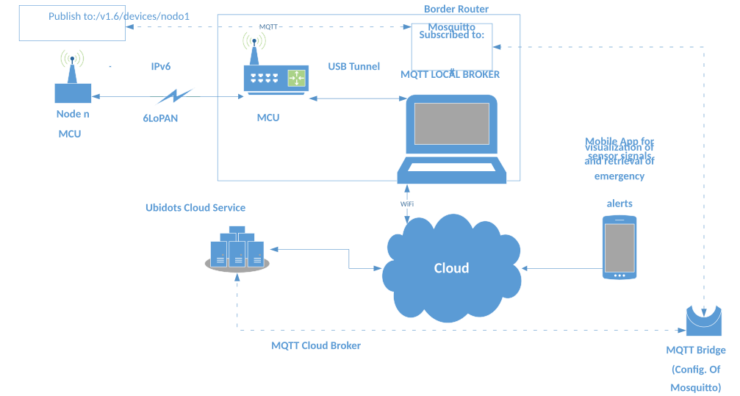
SMAR2C – Sistema de Monitoreo, Alarmas y Reportes del Río Cauca (demo)
System Architecture

Slide 7
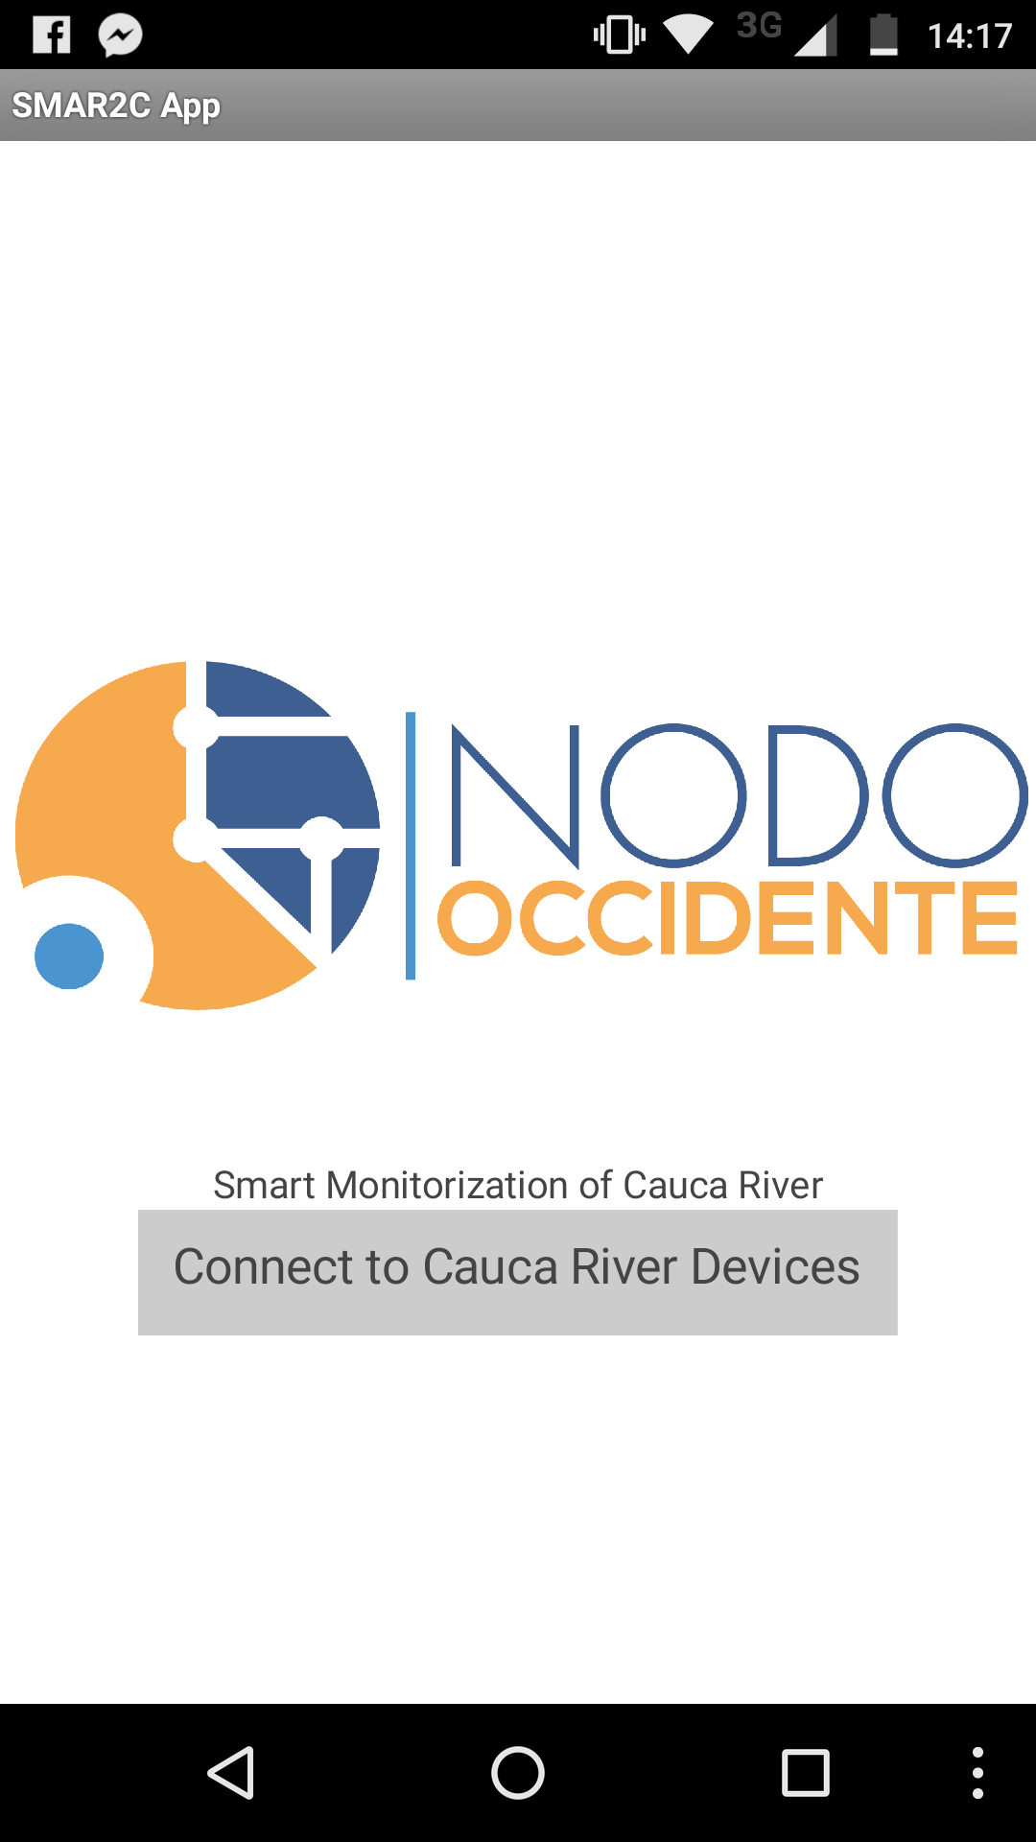
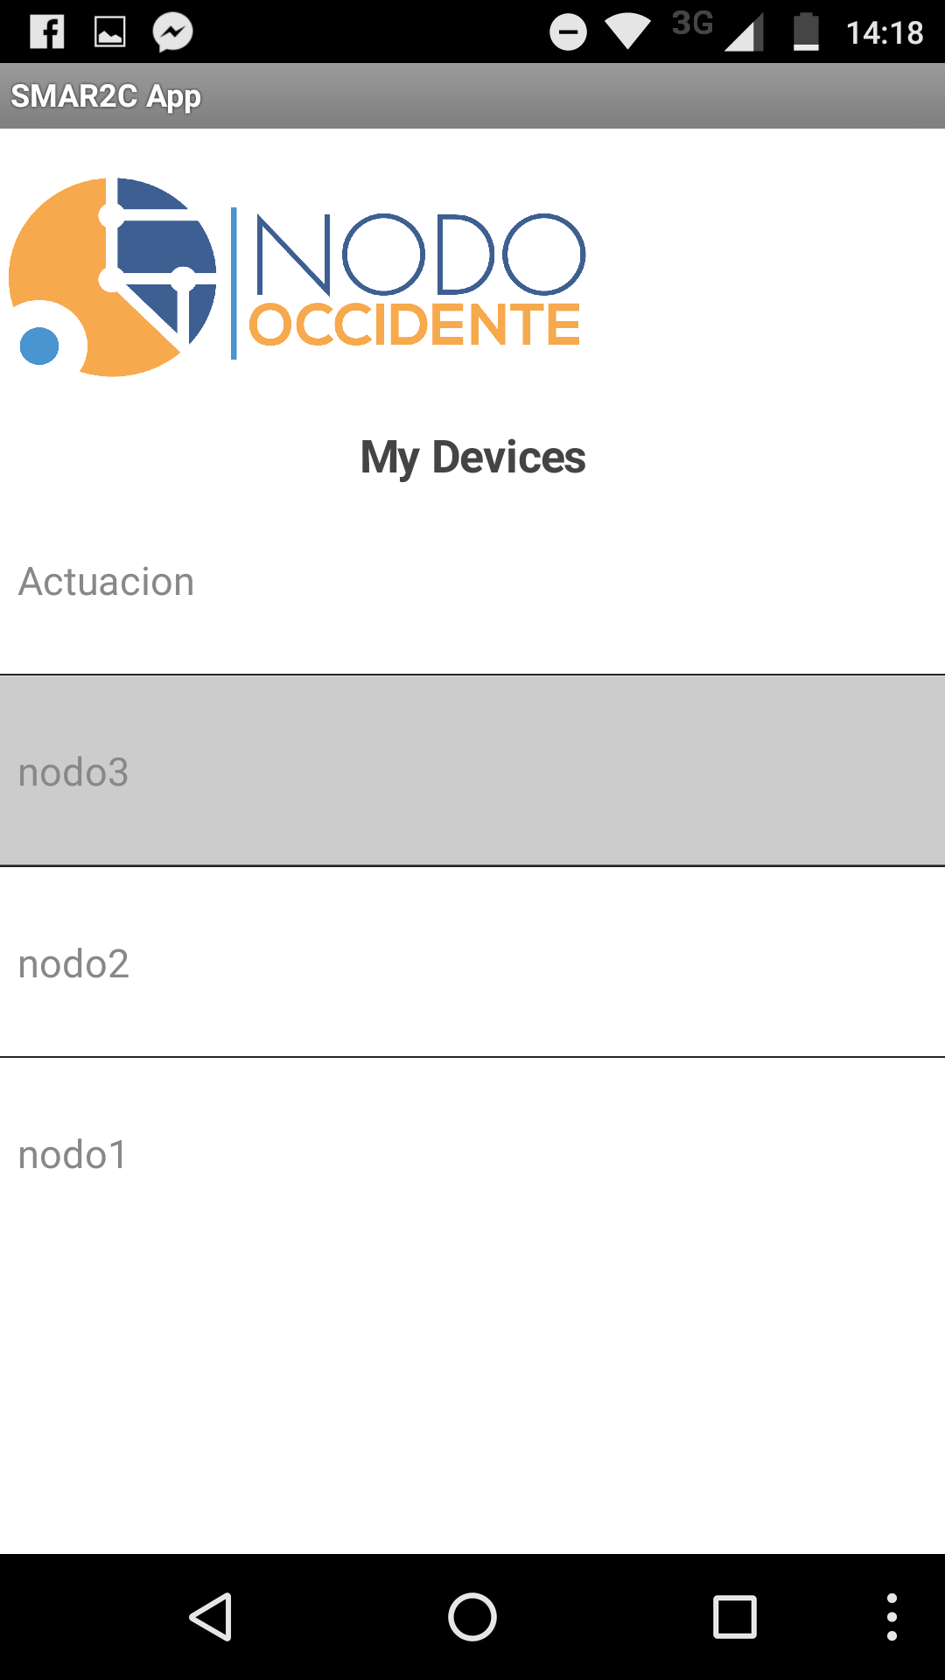
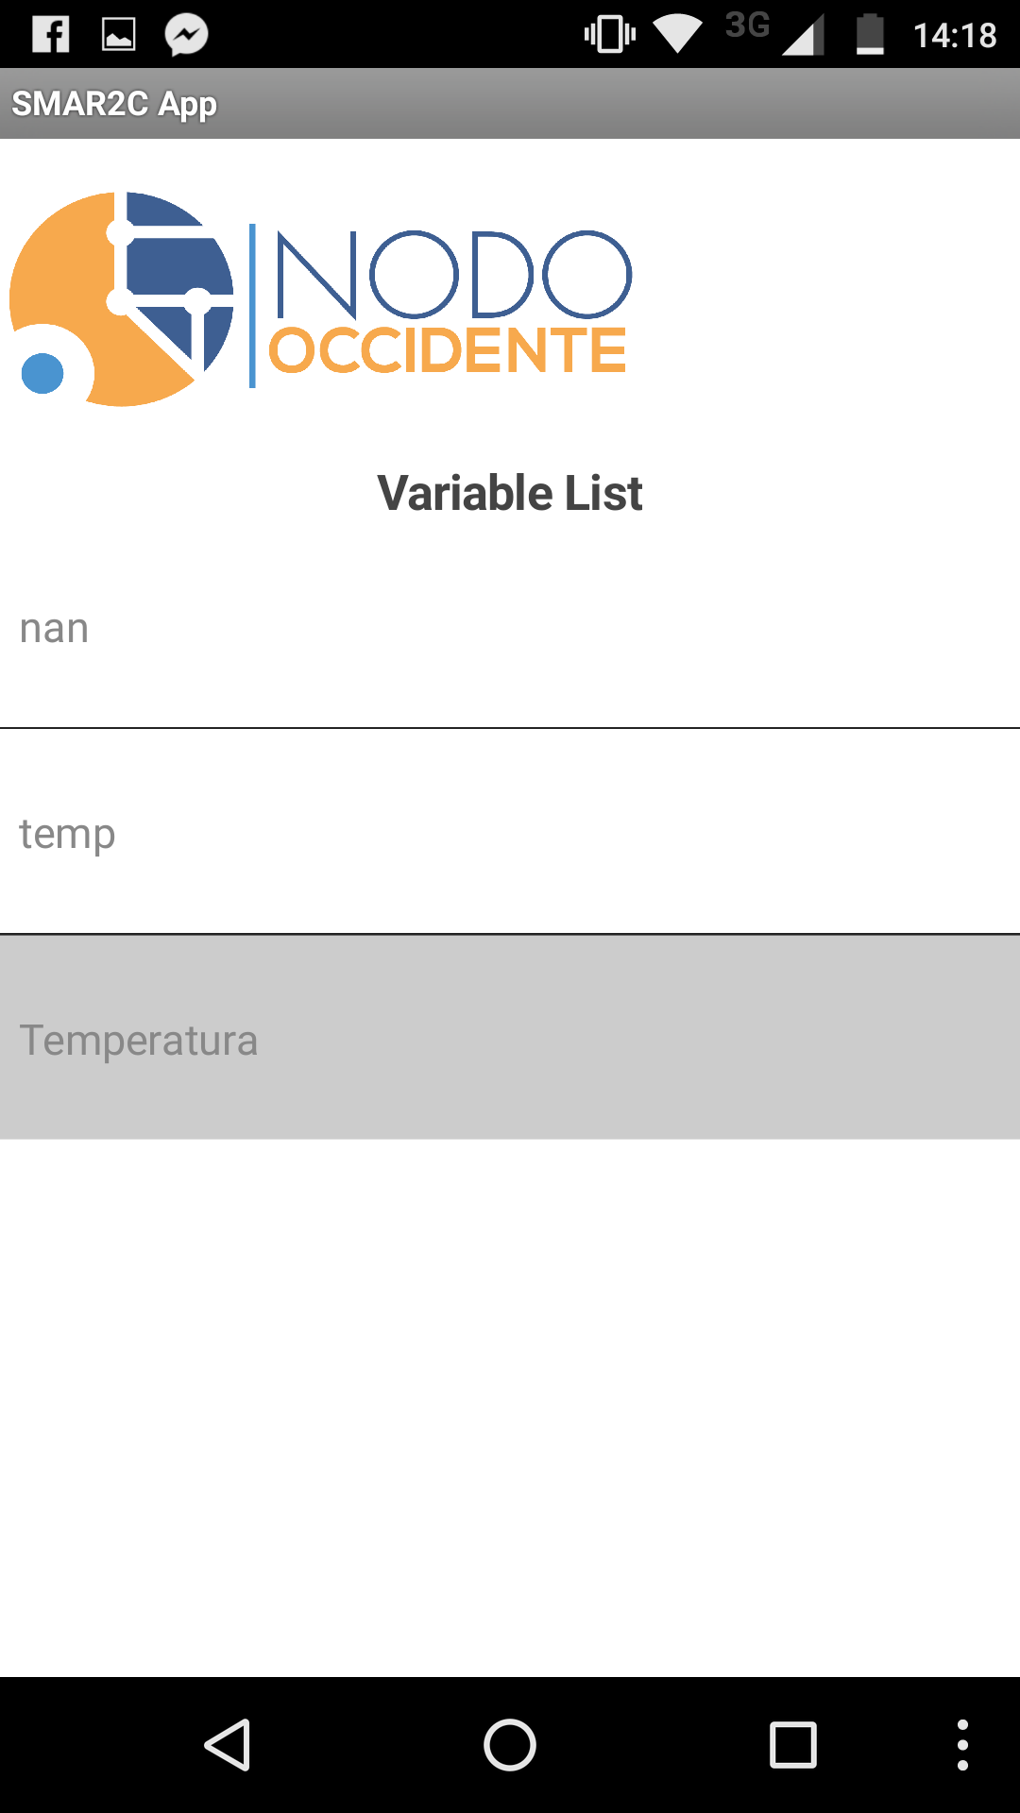
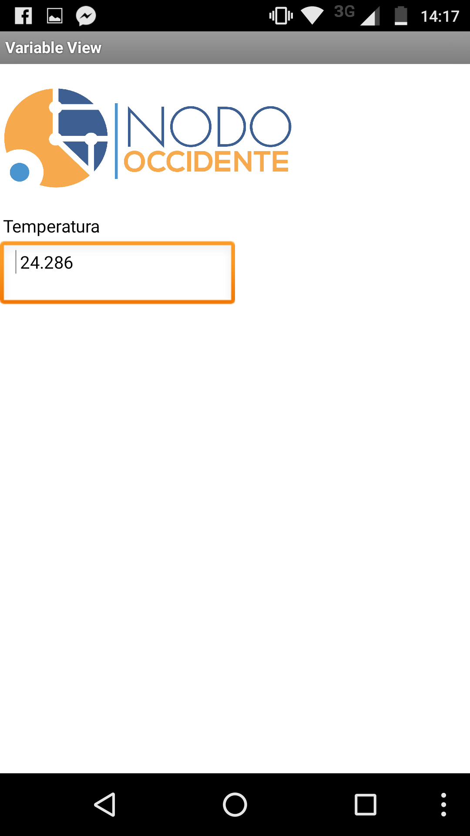
SMAR2C – Sistema de Monitoreo, Alarmas y Reportes del Río Cauca (demo)
User Interface
Visualisation using ubidots

Slide 8
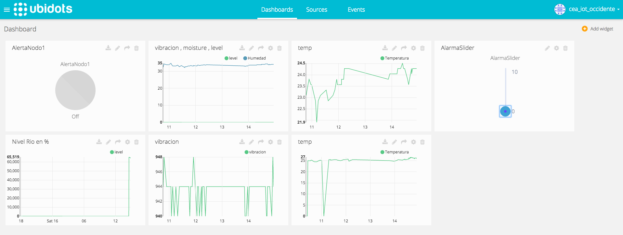
SMAR2C – Sistema de Monitoreo, Alarmas y Reportes del Río Cauca (demo)
Visualisation using ubidots

