Slide 2



CI/CD PIPELINE
TEST
DEPLOY
BUILD
CODE
IMAGE
WEB PAGE
GitHub ACTIONS

Slide 3




User Interface
http Request

Slide 4
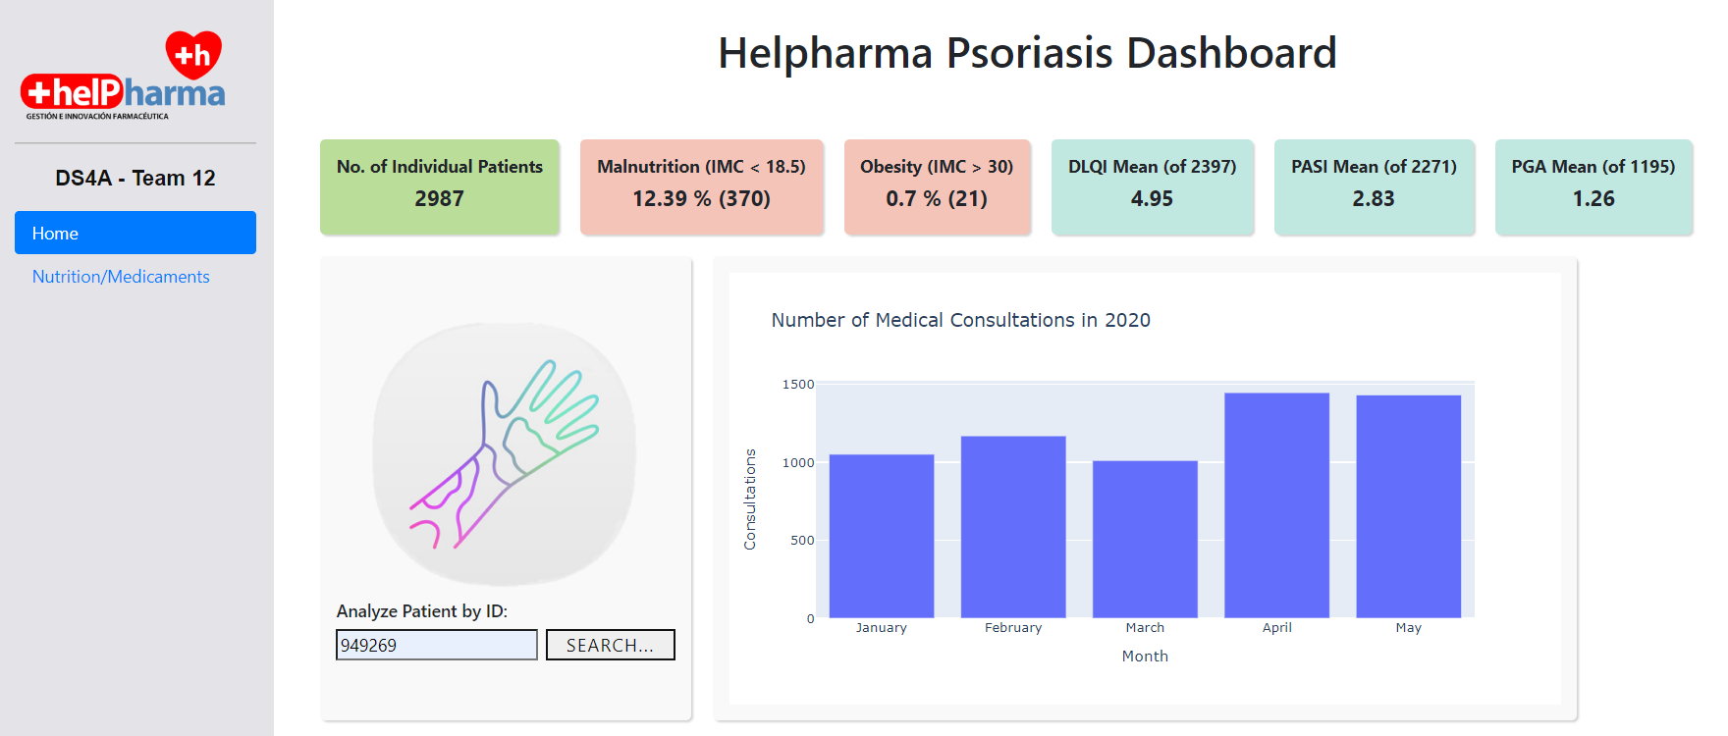


Slide 5
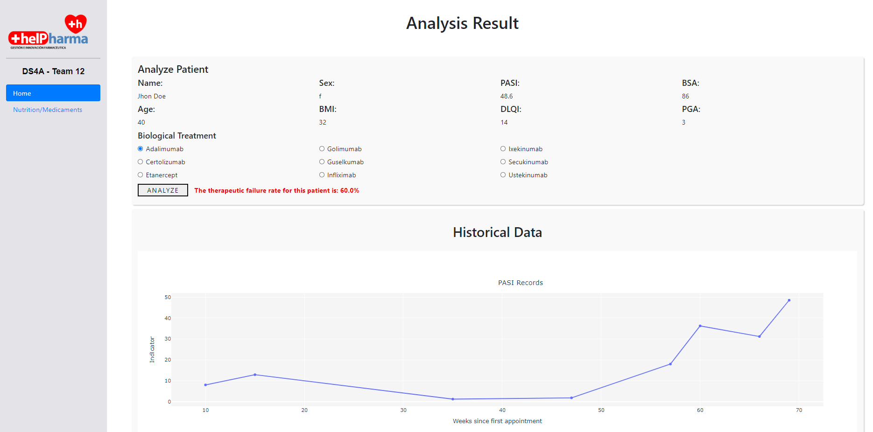
MODEL INPUT
MODEL OUTPUT

