Slide 1
Dataflow analysis

Slide 2
Overview
DFA Example – Reaching Definitions Analysis
Refresh basics of DFA Theory
DFA datatypes in roslyn-analyzers repo
Steps to implement a custom DFA in roslyn-analyzers repo
Walkthrough implementation of Reaching Definitions Analysis
Demo computation of Reaching Definitions

Slide 3
Code Analysis
Code Analysis:
(a) Static program analysis: analysis of computer software that is performed without actually executing the program. In most cases the analysis is performed on some version of the source code or intermediate code.
(b) Dynamic program analysis: analysis performed on an executing program. In most cases the analysis is performed on some form of the object code.

Slide 4
Static analysis
Static analysis can be broadly categorized into:
Flow independent static analysis
Does not depend of the control flow/data flow of the program
Evaluate Static properties of a program
Example: Find All References
Flow dependent static analysis
Depends of the control flow/data flow
Evaluate Dynamic properties of a program at runtime
Examples:
Find All Reaching Assignments:
Reaching assignments for a variable at a given program point are all assignments to that variable that can reach that that point at runtime (i.e. there are no possible intermediate killing assignments)
Null analysis: Can a given variable be null at a given program point?

Slide 5
Data-flow analysis
Data-flow analysis is a technique for gathering information about the possible set of data values calculated at various points in a computer program.

Slide 6
DFA Example - Reaching Definitions

Slide 7
Reaching Definitions
y = 10
x = 3
y = 11
If e
y = 2
x = 1
z = x
x = 2
exit

Slide 8
Reaching Definitions
Every assignment is a definition
d0: y = 10
d1: x = 3
d2: y = 11
If e
d3: y = 2
d4: x = 1
d5: z = x
d6: x = 2
exit

Slide 9
Reaching Definitions
Every assignment is a definition
A definition d reaches a program point p if there exists path from the program point immediately following d to p such that d is not killed (overwritten) along that path.
{ }
d0: y = 10
d1: x = 3
d2: y = 11
If e
{ d0 }
{ d0, d1 }
{ d1, d2 }
d3: y = 2
d4: x = 1
d5: z = x
d6: x = 2
{ d3, d4 }
{ d2, d5, d6 }
{ d2, d3, d4, d5, d6 }
exit

Slide 10
Reaching Definitions
Every assignment is a definition
A definition d reaches a point p if there exists path from the point immediately following d to p such that d is not killed (overwritten) along that path.
Problem statement
For each point in the program, determine which definitions in the program reach that point
A bit vector per program point, vector-length = #defs
d0: y = 10
d1: x = 3
d2: y = 11
If e
d3: y = 2
d4: x = 1
d5: z = x
d6: x = 2
exit

Slide 11
Data-flow algorithm
We assign initial data values to the nodes of the CFG.
We then perform an abstract simulation of the program CFG to analyze how the data is manipulated at various program points.
Abstract execution of nodes of CFG (statements and basic blocks)
Abstract execution of edges of CFG (control flow transfers)

Slide 12
1) Abstract Simulation of Statement
Abstracting the execution of a statement with respect to the problem of interest
For reaching defs, this means computing:
New reaching defs generated by a statement
Reaching defs propagated forward by a statement
Denoted by f_{s} : A transfer function of a statement
For example for a given statement s (d: x = y + z)
out[s] = fs(in[s])
= Gen[s] U (in[s] - Kill[s])
Generated definitions: Gen[s] = {d}
Propagated definitions: in[s] - Kill[s],
Kill[s] = set of all other defs to x in the rest of program

Slide 13
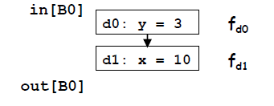
2) Abstract Simulation of Basic block
Abstractly execute the basic block
Transfer function f_{B} of a basic block B:
Composition of transfer functions of statements in B
out[B] = f_{B}(in[B])
= f_{d1}f_{d0}(in[B])
= Gen[d₁] U (Gen[d₀] U (in[B] - Kill[d₀])) - Kill[d₁])
= (Gen[d₁] U (Gen[d₀] - Kill[d₁])) U in[B] - (Kill[d₀] U Kill[d₁])
= Gen[B] U (in[B] - Kill[B])
Gen[B]: locally exposed definitions (available at end of bb)
Kill[B]: set of definitions killed by B

Slide 14
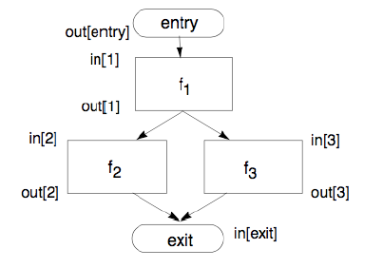
3) Abstract Simulation of Control transfer
Abstracting the execution of jumps between basic blocks
Effect of the edges:
Relates in[B] and out[B] of adjacent blocks.
Single predecessor: Basic block f₁
in[f₁] = out[entry]
Multiple predecessors: Basic block exit
Join node
Meet operator (∧): U for reaching defs problem
in[b] = out[p₁] ^ out[p₂] ^ ... ^ out[p_{n}],
where p_{i} are all predecessors of b
in[exit] = out[f₂] U out[f₃]

Slide 15
Dataflow Analysis schema
For the given program, build a flow graph (nodes = basic blocks, edges = control flow)
Compute a set of equations using:
Transfer function for nodes
Meet operator for edges

Slide 16
Dataflow Analysis schema
Find a solution to the equations
Acyclic graph without loops has a Single pass O(n+e) solution: Application of transfer functions to nodes of CFG in a Topological order.
Cyclic graph with back edges:
Multi iteration fixed point solution

Slide 17
Reaching Definitions: Iterative Algorithm
input: control flow graph CFG = (N, E, Exit)
// Initialization for iterative algorithm
in[Entry] = ∅
For each basic block B
out[B] = ∅
// Iterate till fixed point
while (changes to any out[] occur)
{
for each basic block B
{
in[B] = ∪ (out[p]), for all predecessors p of B
out[B] = fB(in[B]) // out[B]=gen[B]∪(in[B]-kill[B])
}
}

Slide 18
Algorithm properties
Algorithm properties:
Convergence: will the analysis terminate?
Correctness
Speed: how long does it take?
We ensure convergence and correctness by adding constraints to:
Transfer functions
Allowed data values

Slide 19
DFA Theory – Mathematical Framework

Slide 20
The Data-Flow Framework
Formally, data-flow framework is a tuple (F, V, ∧) where
F: Family of transfer functions F: V → V
V: domain of data values (Reaching defs: possible values of reaching def bit vector)
meet operator ∧: V x V → V
Constraints:
V and ∧ : Must define a semi-lattice of finite height
F must be family of monotonic functions

Slide 21
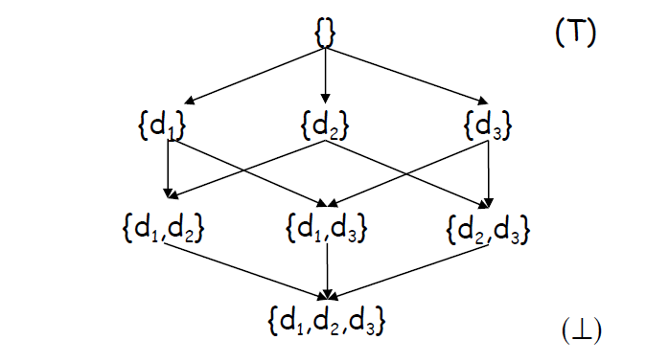
Partial order
A partial order is a mathematical structure (V, ≤) composed of a set V and a binary ordering relation ≤ on V, satisfying the following conditions:
Reflexivity (For all x in V, x ≤ x)
Transitivity (For all x, y, z in V, x ≤ y and y ≤ z ➔ x ≤ z)
Anti-symmetry (For all x, y in V, x ≤ y and y ≤ x ➔ x = y)
(V, ≤) :
V = {x | such that x ⊆ {d₁, d₂, d₃}}
≤ = ⊆ (subset of)

Slide 22
Lattice
A lattice is a type of partial order L = (V, ≤) for which there exists:
Greatest lower bound (common ancestor) for all subsets X of V
Lower bound for any two elements is defined by the meet operator (^)
E.g. there is one lower bound for {d₁} and {d₃}, which is the empty set {}. This is also the greatest lower bound.
Least upper bound (common descendant) for all subsets X of V
Upper bound for any two elements is defined by join operator (v)
E.g. upper bounds for {d₁} and {d₃} are {d₁, d₃} and {d₁, d₂, d₃} and least upper bound is {d₁, d₃}
(V, ≤) :
V = {x | such that x ⊆ {d₁, d₂, d₃}}
≤ = ⊆ (subset of)
^ = ∩ (intersection)
v = U (union)

Slide 23
Lattice
Properties of a lattice:
It has a unique greatest element: top and a unique smallest element bottom.
The height of a lattice is the length of the longest path from top to bottom.
Semi-lattice
Lattice which has only one of the meet or join operator defined
top = {}
bottom = {d₁, d₂, d₃}
h = 3

Slide 24
The Data-Flow Framework
Constraints:
V and ∧ : Must define a semi-lattice of finite height
F must be family of monotonic functions

Slide 25
Transfer functions
A function f on a partial order is monotonic if
For the given partial order (V, ≤), for all x, y in V, if x ≤ y then f(x) ≤ f(y)
Example of non-monotonic function:
If, f’({d₁}) = {d₁, d₃} and f’({d₁, d₃}) = {d₁} then
{d₁} ≤ {d₁, d₃}
f’({d₁, d₃}) ≤ f’({d₁})
i.e. for x ≤ y, we have f(y) ≤ f(x)

Slide 26
Fix point theorem
Fixed point theorem: In a lattice L with finite height, every monotone function f has a unique least fixed point fix(f)
Definition: a value v is a fixed point of a function f if and only if f(v) = v.

Slide 27
Dataflow algorithm revisited
Data-flow analysis works on a control-flow graph and a lattice L.
A variable v_{i} ranging over the values of L is attached to every node program point p of the CFG.
Each v_{i} moves from top to bottom along some path on the lattice until it reaches a fixed point.
Monotonicity of transfer functions ensure that we always move downwards
Algorithm terminates when fixed point is reached for each v_{i}.

Slide 28
DFA Implementation + Demo

